Slide 1



Support for partnering:
"Business Connect Travel Awards"
Belen Rebollo
Knowledge Transfer Manager
European Programmes
Notes:
The abstract pattern can be removed or repositioned if required. Be careful to ‘Send to Back’ so that it does not obscure any important information.

Slide 2


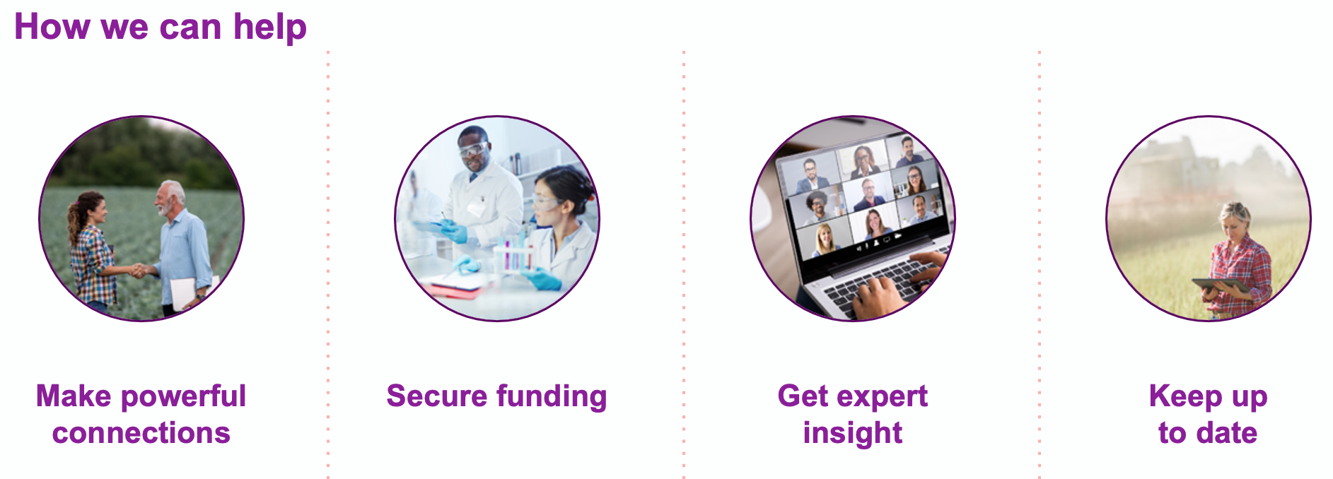
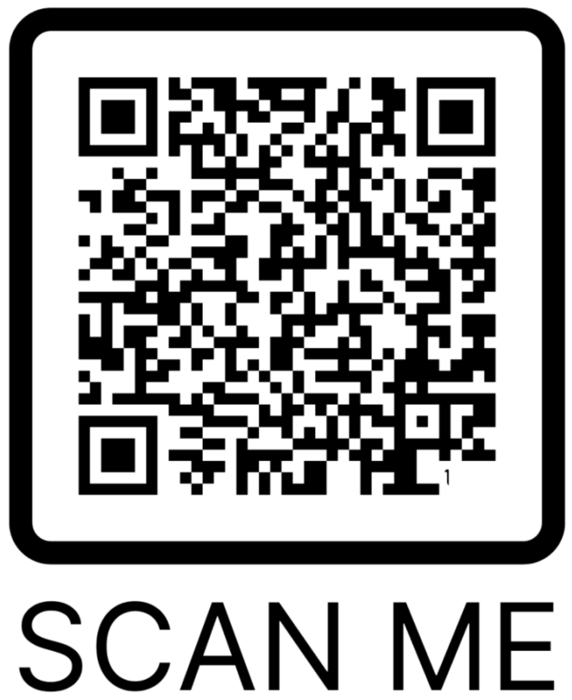

Innovate UK Business Connect
Part of the Innovate UK family.
At innovate UK Business Connect we help you accelerate your innovation. We do this by connecting ideas, people and communities to respond to challenges and drive positive change. We can make introductions to new business partners and funders, help you find collaborators for grants and introduce you to new market opportunities.
Belen Rebollo-Garcia
Innovate UK Business Connect
Belen.rebollo-Garcia@iuk.ktn-uk.org

Slide 3

European Travel Awards
Innovate UK Business Connect “European Travel Awards” support attendance of UK based R&D performing SMEs to specific targeted events for the purpose of increasing engagement with potential partners.
Characteristics:
Application for each specific event gets advertised @ Innovate UK KTN website
A maximum of £700 can be claimed as a contribution towards travel costs incurred for the purpose of attending the specific event. Only 1 representative per SME.
In addition to the funding bespoke pro-active support from IUK teams to progress project idea to application into European Programmes (Eureka & Horizon Europe)
https://iuk.ktn-uk.org/news/travel-support-now-available/

Slide 4

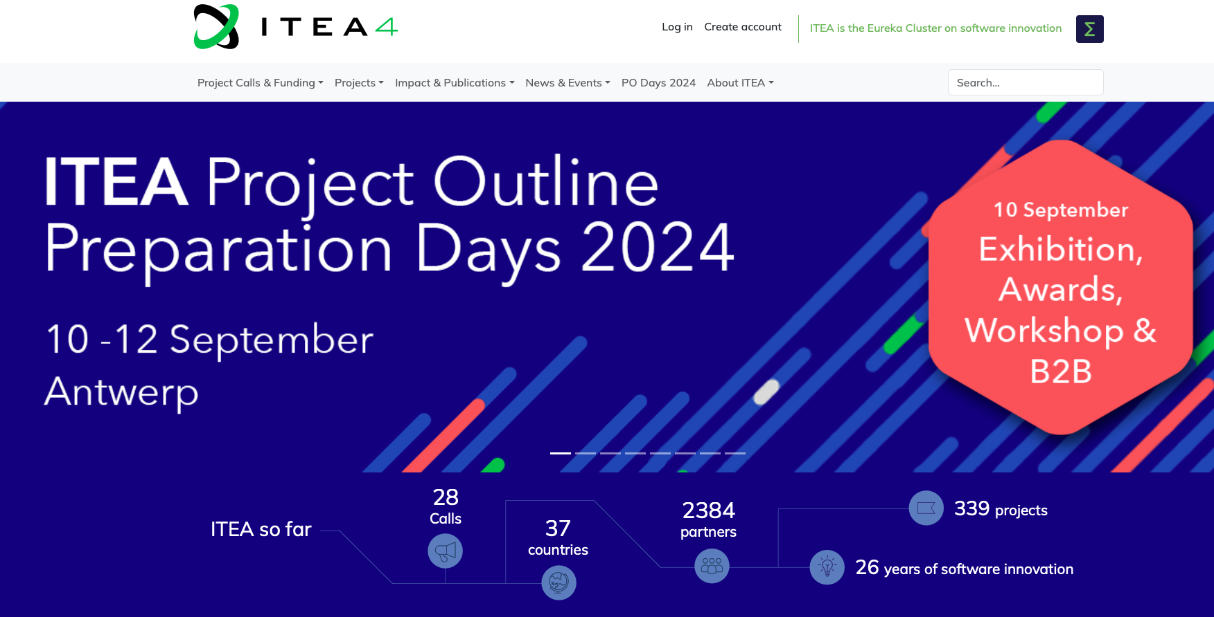
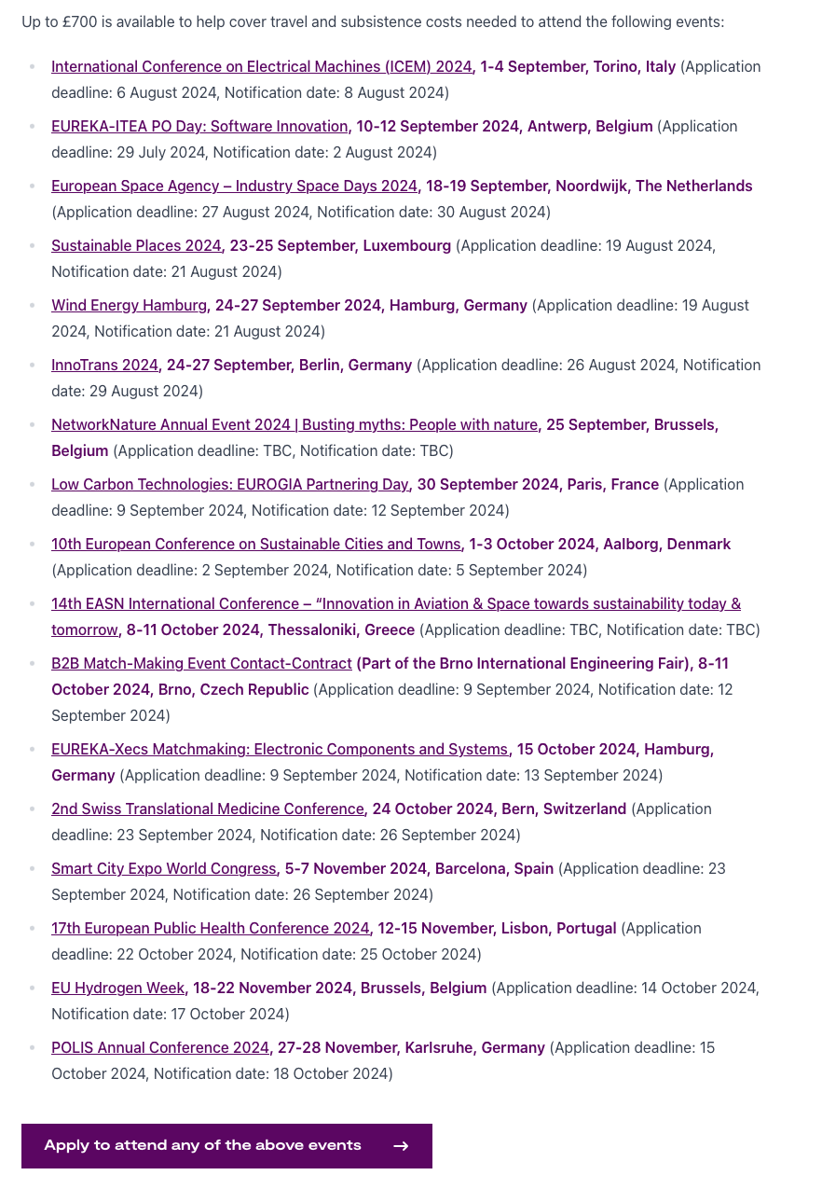





Supporting Partnering on EUREKA
https://iuk.ktn-uk.org/news/travel-support-now-available/

