Slide 1
How to make a successful proposal? Brokerage Tool Autumn Call 2024

Slide 2
What shall a successful proposal target?
The “Basics”:
Targeting the Scope of the CELTIC-NEXT Strategic Roadmap 2021-2025
https://www.celticnext.eu/research-areas/
Technological Innovation
It has to be new, innovative, forward bringing project for the community!
Market relevance and exploitation potential
It must return value for money to the Consortium and to the Funding Countries!
Follow the rules with right mix and balance of participating countries and partners
Create a good consortium (balanced, different countries and company profiles)!
It is not a National Project with “some” links abroad, but a true international balanced cooperation, ideally with no more than 60% and never over 75% of effort and/or budget in one country only.

Slide 3
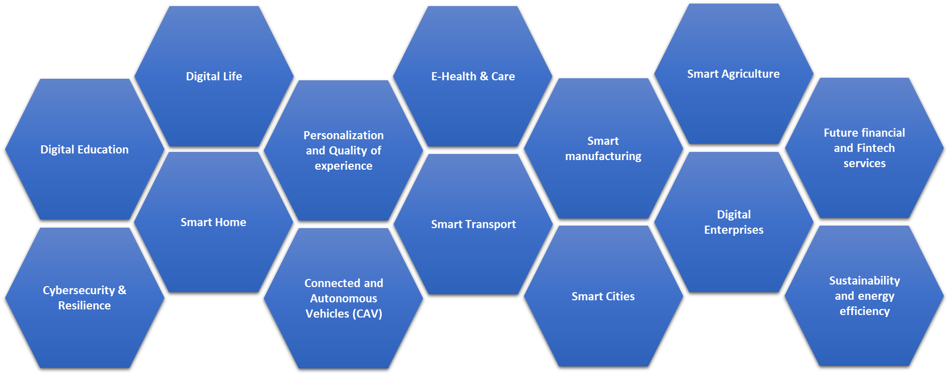
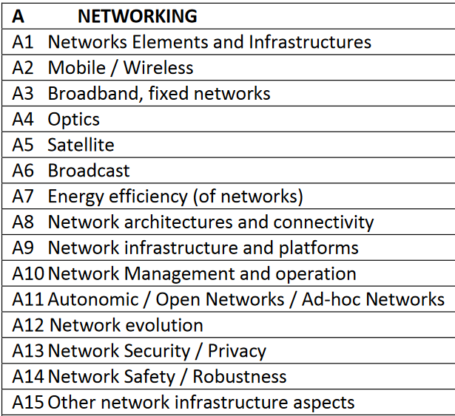
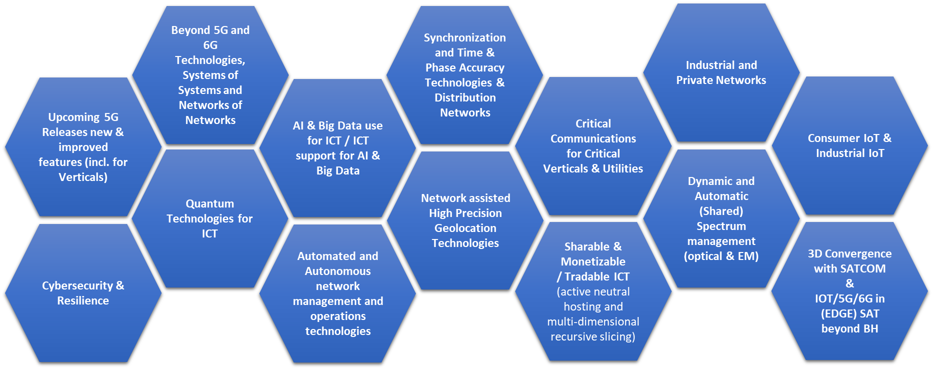
Targeting the Scope of
CELTIC-NEXT Strategic Roadmap 2021-2025
CELTIC-NEXT puts emphasis on Core technologies, Applications and E2E Services
NETWORKING
SERVICES AND APPLICATIONS
FUTURE SERVICE ENABLERS
FUTURE INTERNET / CLOUDS
FUTURE USAGE AREAS AND MULTI-DISCIPLINARY APPROACH
https://www.celticnext.eu/research-areas/
Fields of Application supported
ICT
SUPPORT
DIGITAL
ICT Technologies
CELTIC
CLUSTER
TO
SOCIETY

Slide 4
Technological Innovation
Innovation above the State of the Art (SoA) is a Key Criterion
Rationale for the project: Why is the subject of the proposed project important; which problems will be solved and which results will be generated that are currently not available?
State-of-the-art situation: Describe the current technological situation, the current problems and gaps and indicate the technological improvements that you want to achieve.
Technological innovation and strategic relevance: Strategic relevance and expected impact of your proposal on a per-country perspective. What new businesses will be generated.
50 % of criticism of the Cluster experts during proposal evaluation are related to insufficient description of the SoA

Slide 5
Market relevance and exploitation potential
Market analysis: Technological value chain and added value of the collaboration
Value chain: Right mix of partners in the Consortium
Added value of the cooperation at technology level
Added value of the cooperation at business level
Consortium/partner access to the market
These are Key aspects to motivate Public Authorities to fund your project

Slide 6
Key points 1/2
“Your CELTIC-NEXT project should be successful and beneficial, and it must be managed and controlled properly in order to achieve this”
Give confidence to the Experts and the Public Funders that you will be in control !
“It should be used as a tool to develop your business, if the project scope is aligned with your strategies and future plans. However, it may take some time to reach commercial success.”
Provide a clear outlook on your commercialisation plan, per product/partner and as a whole !

Slide 7
Key points 2/2
“The best practices that help to carry out the project activities properly are based on the commitment of the consortium from the beginning to the end of the project”
Build a strong and committed consortium and show clearly its commitment in the proposal!
“The success of the project relies on three actions: deliverables, dissemination and exploitation of project activities”
Write a good proposal (not only research but also business impact, exploitation plan and dissemination; coordination and WP structure)!
“Be aware that there may be changes in the project (consortium, activities, funding, etc.) that might affect the initial plants (Project Description)”
Provide a well described risk analysis section!

Slide 8
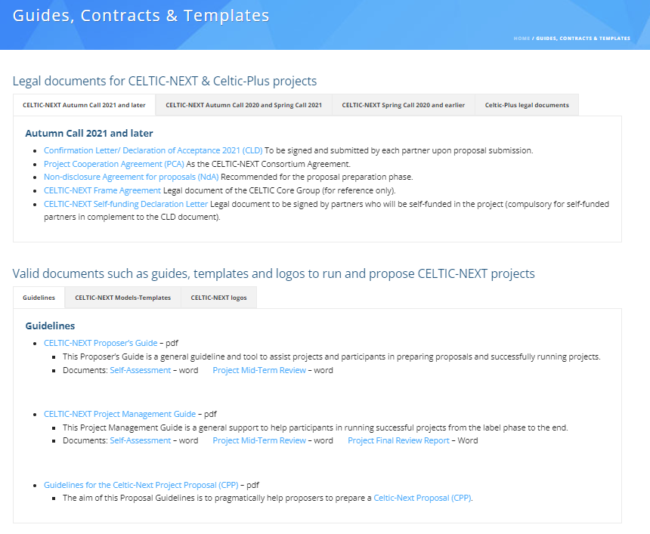
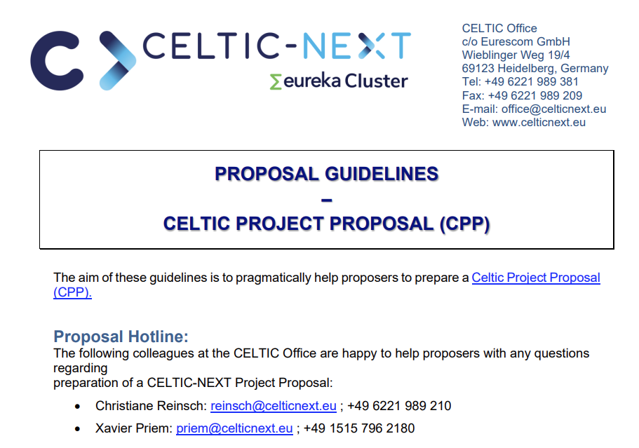
Templates
The “Guides”, “Contracts” and “Forms” to support the writing of your application:
As Proposer you can get a good guidance by reading the Proposal Guildines document via:
https://www.celticnext.eu/guides-contracts-templates/
https://bscw.celticnext.eu/pub/bscw.cgi/d112123/CPP-Proposal-Guidelines%20-%20%202022.pdf

Slide 9
Project Submission
Oct. 21st 2024
Project Evaluation & Labelling
Dec. 2024
Project Start
from Apr. 2025
Call Opening
July. 1st, 2024
CELTIC-NEXT Autumn Call 2024 Timeline
Important: please contact the Public Authorities before Projects submission:
https://www.celticnext.eu/national-public-contacts-funding-schemes/
Receiving their opinion early can avoid mistakes in your proposal, and will improve your chances to get the label by aligning with National Priorities and Schemes
https://www.celticnext.eu/call-information/

Slide 10

A: Submit your proposal
By 21th Oct. 2024*
Register on the Cluster Projects Tool
Fill in the web forms
Download the proposal templates for proposal
Upload your proposal to the Cluster Projects Tool: https://cluster-projects.eurestools.eu
Any innovative ICT subject is eligible, including application to vertical sectors
www.celticnext.eu

Slide 11
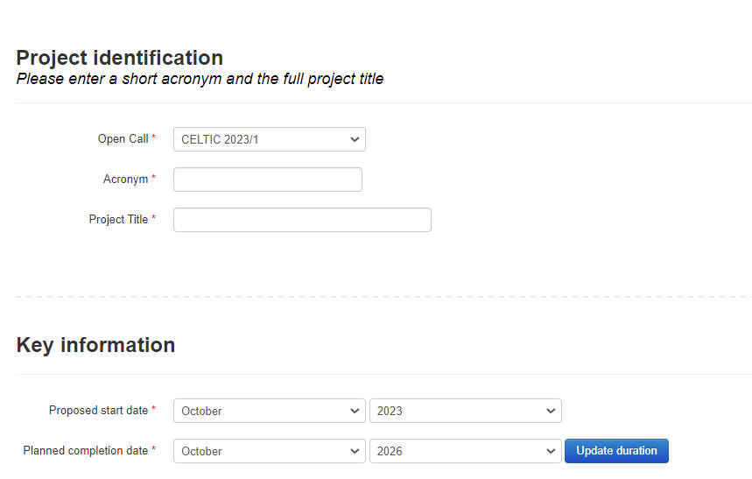
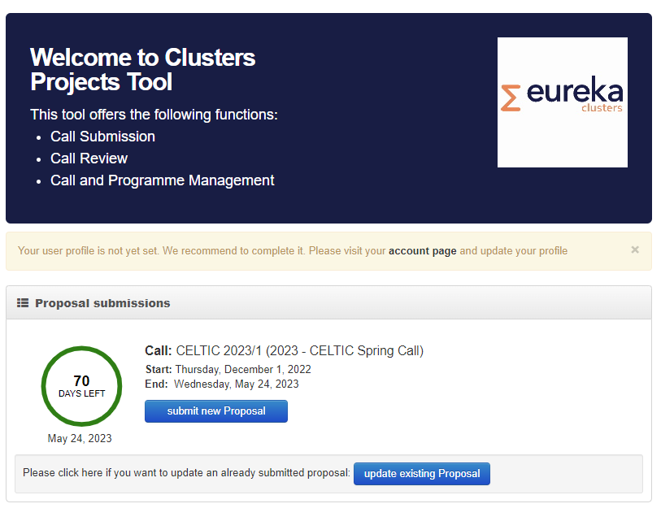

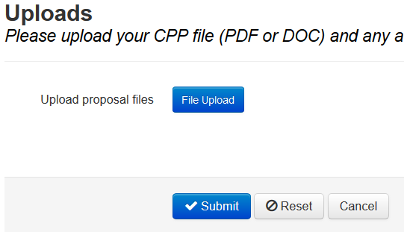
A: The Submission Interface
Register to the Tool:
https://cluster-projects.eurestools.eu/
CPP (Cluster Project Proposal) template available on CELTIC Web

Slide 12
B: Proposal Evaluation
Evaluation by the CELTIC Experts ^{*)}
List of Evaluation Criteria:
1. Excellence and technological innovation
2. Strategic relevance and impact
3. Potentials for exploitation of the results and for future business
4. Quality and efficiency of the implementation of the project proposal
5. Quality of the proposed consortium
Example of a typical outcome of the evaluations of the 3 reviewers
S = Suitable for Labelling
M = Modifications required
N = Not suitable for Labelling
^{*)} Most Experts are from Industry
They provide their Industry Knowhow to the proposals

Slide 13
C: Label Decision
Proposal Submission by proposers (one stage process)
Evaluation by: Industry Experts and Public Authorities
Label Decision: Public Authorities and CELTIC Core Group
Project
Submission
CELTIC Label
Decision
Evaluation by:
Industry Experts
Public Authorities
Time line: 6 weeks in total
Important criteria for labelling decision :
Technical quality
Business relevance
but also national priorities where they exist

Slide 14

B: Start the Project
Starting and running a Labelled project
In EUREKA projects the funding is granted by ministries or Funding Agencies of the participating countries.
Projects can usually start when mandatory partners have green light for funding.
In the last years a success rate for running projects of more than 50 % has been achieved.
When a partner becomes active in a running project he will pay the CELTIC contribution of 1.5% of his budget.
www.celticnext.eu

Slide 15
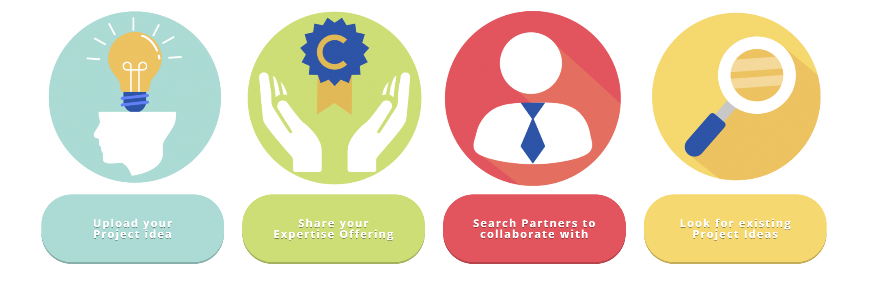
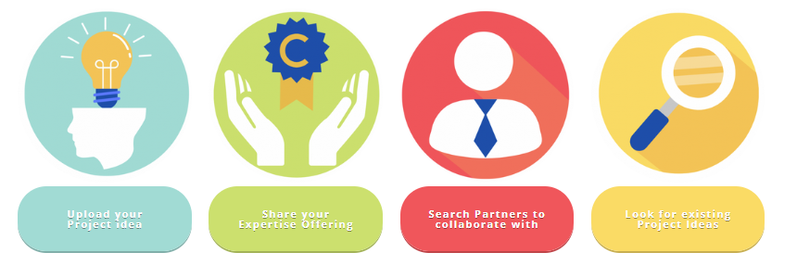
CELTIC Brokerage Tool
Start now and upload your expertise or new project idea
https://www.celticnext.eu/brokerage-tool/

Slide 16
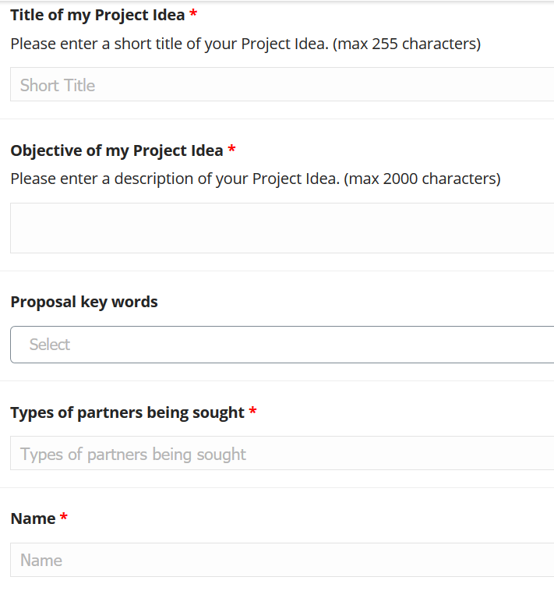
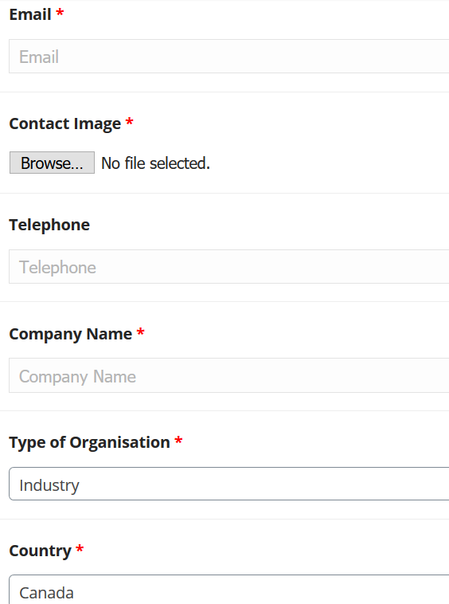
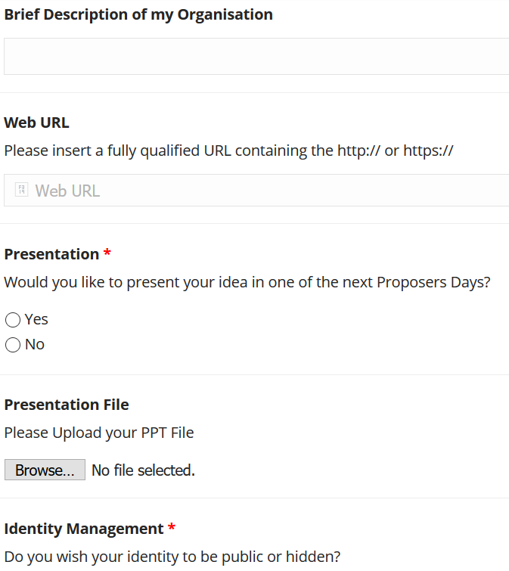
Upload Project Idea

Slide 17
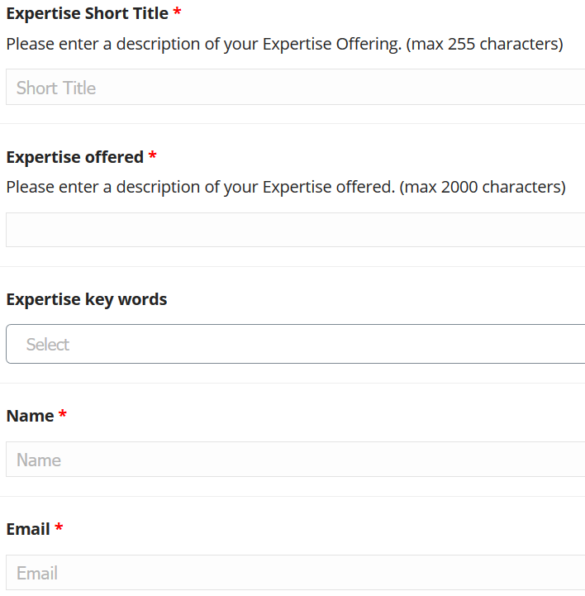
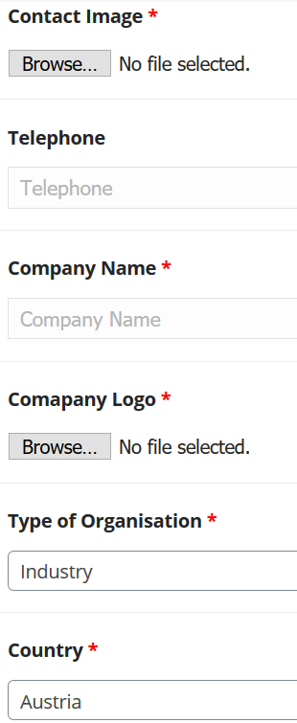
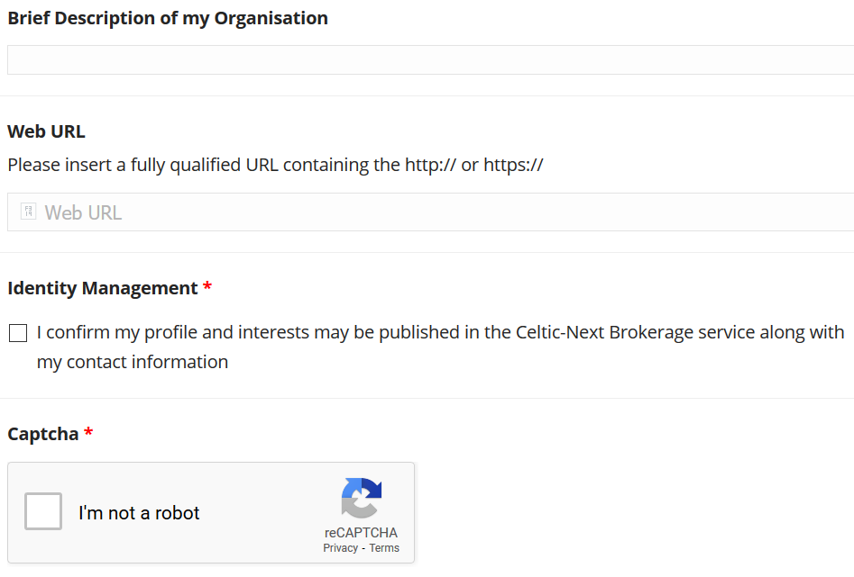
Submit your Expertise

Slide 18
CELTIC Brokerage Tool
The form fields tagged with a * are mandatory.
The “PROPOSAL KEY WORDS” field is implemented using a taxonomy form field class which allows easy update of the key word list, such as renaming, deletion of addition of key words.
The “IDENTITY MANAGEMENT” field determines whether Name, Telephone and Company Name are shown in the Project Idea overview list or search results. The Type of Organisation and Country are always shown. The email address is never shown.
After submission the CELTIC Office will check and publish your Project Idea or your Expertise.

Slide 19
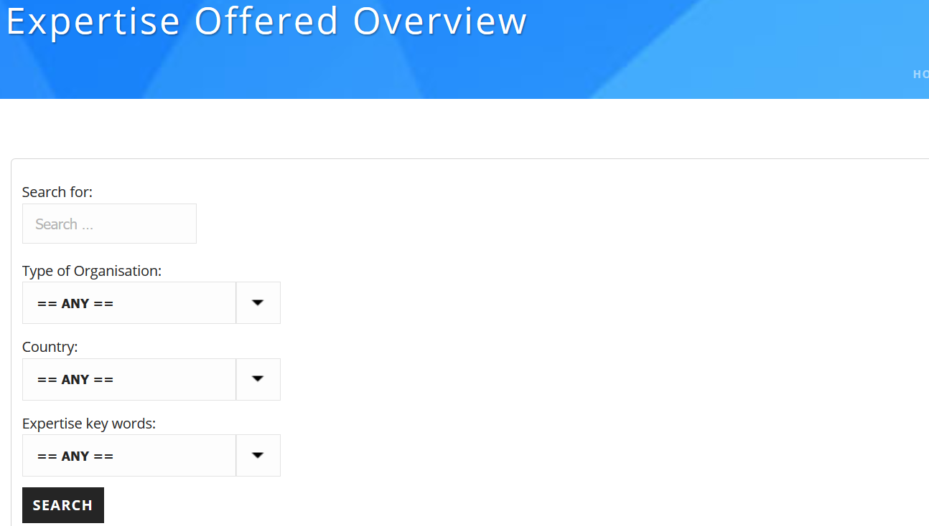
Partner Search

Slide 20
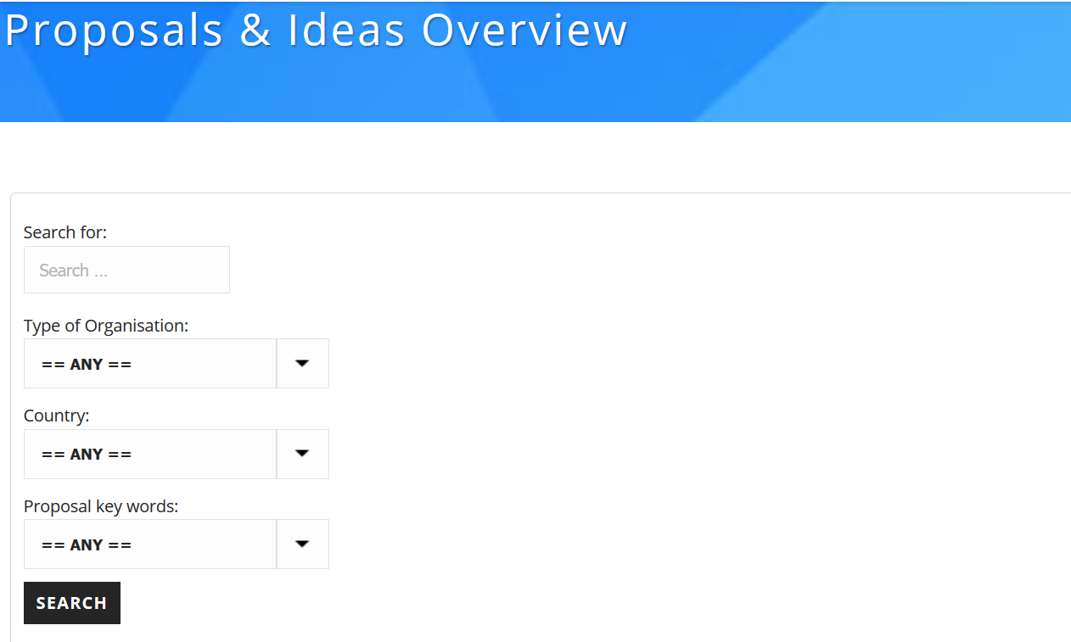
Search Project Ideas

Slide 21
Xavier Priem
CELTIC-NEXT – Director
c/o Eurescom GmbH
Wieblinger Weg 19/4
69123 Heidelberg, Germany
Mobile: +49 1515 796 2180
Fax: +49 6221 989 209
Email: office@celticnext.eu
Web: https://www.celticnext.eu
CELTIC-NEXT is a not for profit organisation hosted by Eurescom GmbH

