Slide 1
Celtic-Plus Proposers Day
20th June 2017, Helsinki
Process control monitoring with
mobile-based technology
Fabiola Vilaseca
University of Girona (SPAIN)
fabiola.vilaseca@udg.edu
MoTECH

Slide 2
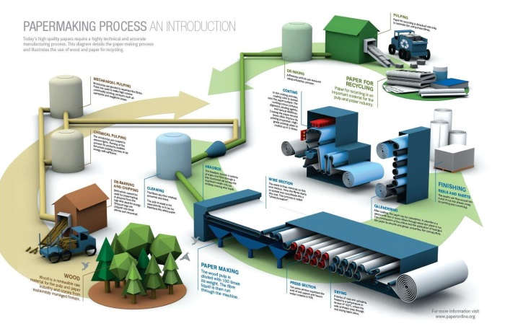
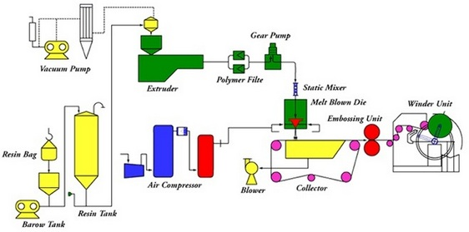
Teaser
What is the main benefit of the idea/proposal?
Get use of mobile technology
What makes the added value?
Facilitate / Improve / Speedy
Why should I participate in the project?
Are you a technological company? Are you a process-based company?
Melt-blow-polymer-processing
http://www.paperonline.org
Fabiola Vilaseca, University of Girona, fabiola.vilaseca@udg.edu

Slide 3
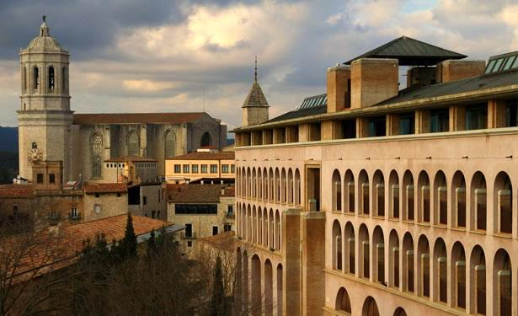


Organisation Profile
The University of Girona (UdG) is heir to the so-called Estudi General which was created in 1446 by Alphonse the Magnanimous
The research group on Advanced Biomaterials and Nanotechnology (BIMATEC) in the Chemical Engineering Department has the mission and vision of generating knowledge and competences on the creation of new functional materials and new technologies for processes.
Fabiola Vilaseca, University of Girona, fabiola.vilaseca@udg.edu

Slide 4
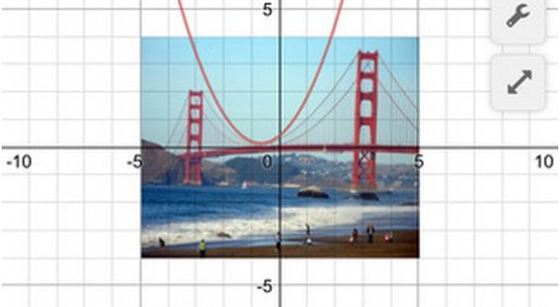
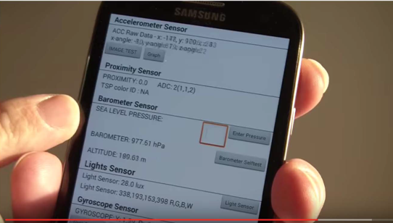
Proposal Introduction (1)
Vision:
Mobile Number Technology (MNT), a disrupting and innovative way to monitor processes at any level.
A better understanding of complicated technological processes trough our visual spatial intelligence.
Motivation:
It can be applied to different and specific industrial processes, to facilitate and improve the
monitoring and assessment of processes.
Digital natives are using mobile technology.
Fabiola Vilaseca, University of Girona, fabiola.vilaseca@udg.edu

Slide 5
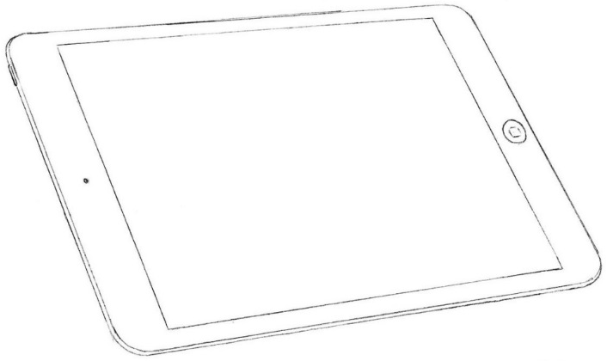
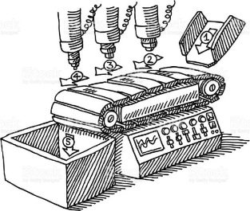

Proposal Introduction (2)
Expected outcome
Facilitate, improve and speed the monitoring of industrial processes
Impacts
Fast control of the inputs and outputs in an industrial process
Schedule
2018. Conversion of the industrial process to mobile technology
2019. Pilot assays
2019. Industrial assays
Control of the industrial process at your fingertips
Fabiola Vilaseca, University of Girona, fabiola.vilaseca@udg.edu

Slide 6



Partners
University of Girona, Spain
University of Jyväskylä, Finland
Polytechnic University of Catalonia, Spain
Nuromedia, Germany
We are looking for industrial partners
Fabiola Vilaseca, University of Girona, fabiola.vilaseca@udg.edu

Slide 7


Contact Info
For more information and for interest to participate please contact:
Fabiola Vilaseca
University of Girona (SPAIN)
fabiola.vilaseca@udg.edu
+34 972 41 9889
Dpt. of Chemical Engineering
17003 Girona (SPAIN)
www.udg.edu
Your
Photo
Fabiola Vilaseca, University of Girona, fabiola.vilaseca@udg.edu

