Slide 1

Celtic-Plus Proposers Day
20th June 2017, Helsinki
Machine learning and big data analytics (for spatial and temporal demand shaping) in wireless communications (5G and beyond)
Dr. SERDAR ÖZEN, HAVELSAN,
Technology and Academy Directorate, Ankara, TURKEY
sozen@havelsan.com.tr

Slide 2
Teaser
The idea:
For heterogenous networks (HetNets): utilize and take advantage of the
  Machine/deep learning and
  Big data analytic tools
that have been developed during the last decade and use them to add
  more cognitive/learning ability in the system,
  well informed user centric decisions/optimizations,
  self evolution/adaptation capability,
and apply them to HetNets for 5G and beyond wireless systems.
If you are an algorithm/SW/system developer for wireless communications, and would like to get ahead by adding value to the existing solutions by using deep learning algorithms/AI/data analytics tools, this project may be a good opportunity.
Dr. Serdar ÖZEN, HAVELSAN, sozen@havelsan.com.tr

Slide 3


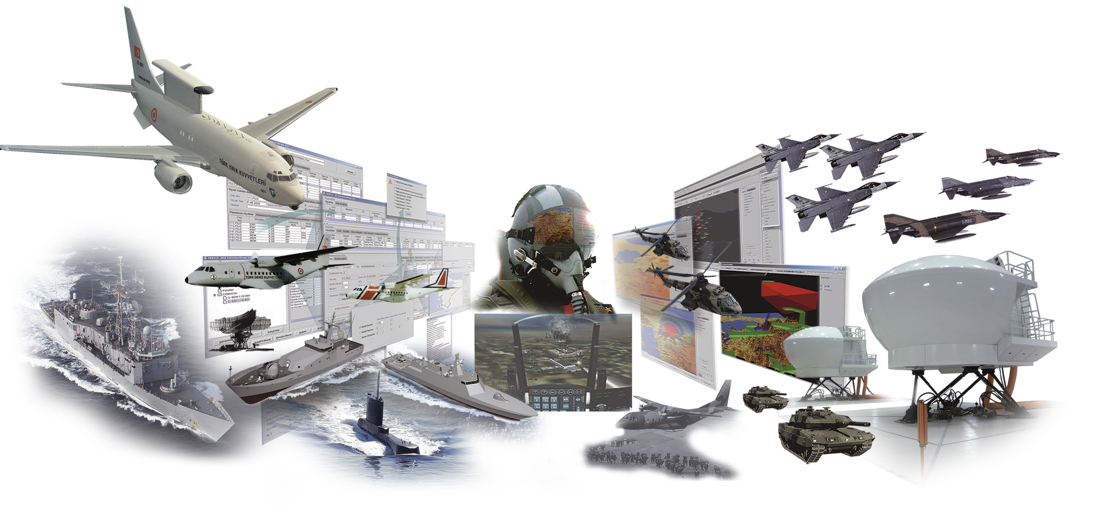

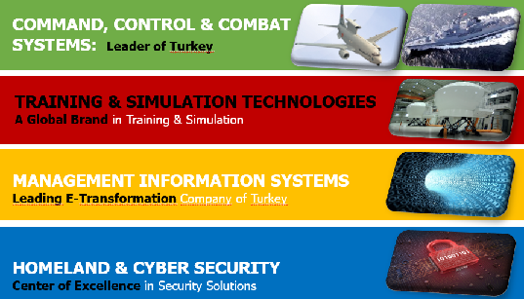
HAVELSAN, Turkey
LEADING INFORMATION TECHNOLOGY, INTELLIGENT SYSTEMS TECHOLOGY DEVELOPER, and
SYSTEMS INTEGRATOR
IN DEFENSE, SECURITY & CIVILIAN TECHNOLOGY MARKETS
TURKISH ARMED
FORCES FOUNDATION
Personnel: ~1380
85% Electrical & Computer Engineers
~40M Euros of R&D Budget
Dr. Serdar ÖZEN, HAVELSAN, sozen@havelsan.com.tr

Slide 4

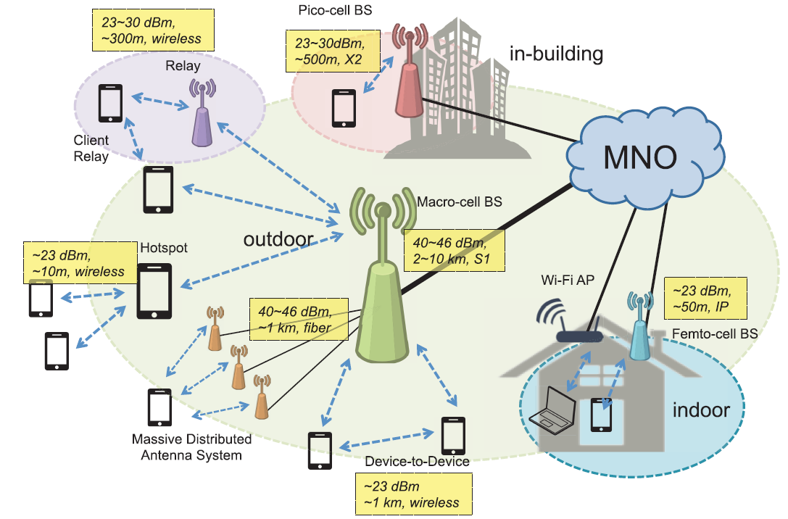
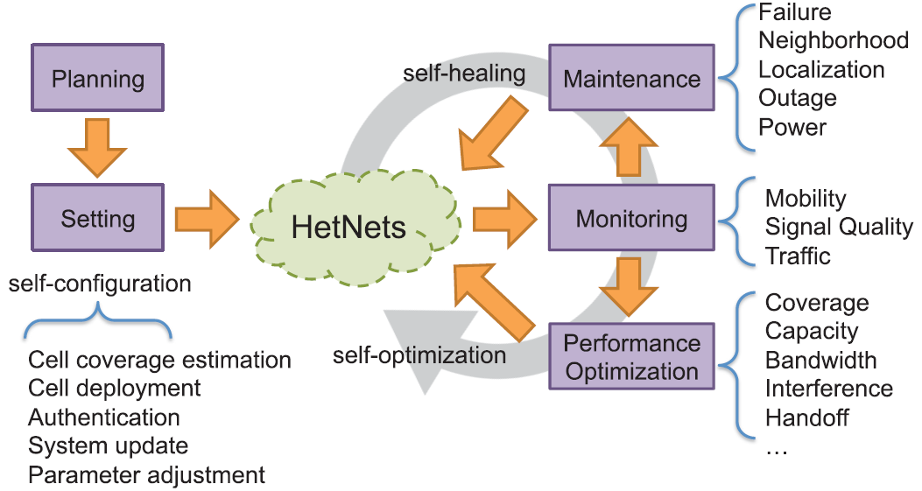
Proposal Introduction (1)
Machine learning and big data analytics for wireless communications (Het-Nets/5G+)
In order to reduce the O/CAPEX of MNO’s,
Machine Learning/AI/Data analytic techniques can
substantially diminish human involvement in HetNets
towards reaching the advanced concepts of
SONs, regarding operational tasks, and optimizing network capacity and coverage, and QoS.
Dr. Serdar ÖZEN, HAVELSAN, sozen@havelsan.com.tr

Slide 5
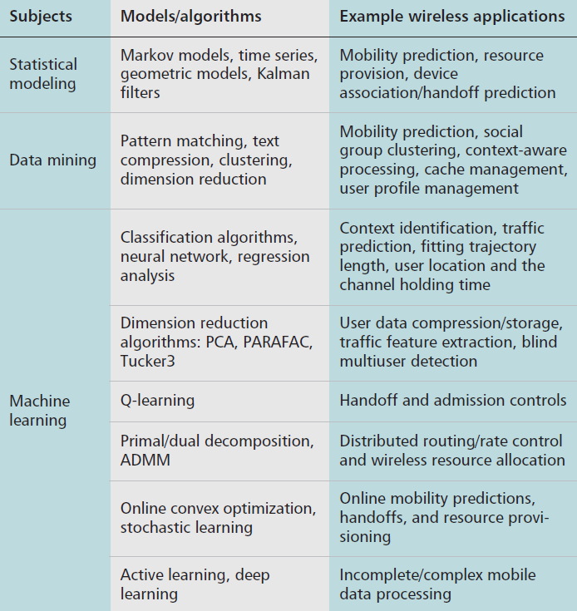
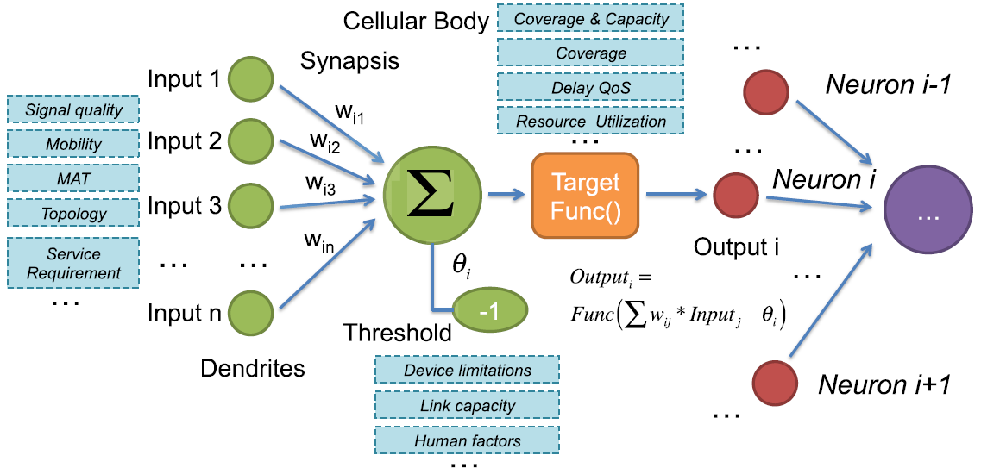
Proposal Introduction (2)
Different scenarios for establishing these learning algorithms for a SON as an SDN concept can be implemented.
30-36 months of Schedule with 6-10 partners (possibly with universty/research lab collaborators as subcontractors/consultants)
Dr. Serdar ÖZEN, HAVELSAN, sozen@havelsan.com.tr

Slide 6
Partners
Currently we are working with Carleton University, Ottawa, Canada.
We need at least 5-6 algorithm and software development partners;
At least 1 mobile network operator, possibly 2.
Here is another Project Proposal Topic to be investigated:
  Drone/UAV/aerial Base Stations and low-altitude/medium-altitude/high-altitude platforms (LAPs/MAPs/HAPs) for Wireless Base Stations to maximize coverage for users with different QoS requirements.
Dr. Serdar ÖZEN, HAVELSAN, sozen@havelsan.com.tr

Slide 7
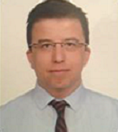
Contact Info
For more information and for interest to participate please contact:
Name and affiliation: Dr. Serdar Özen
E-Mail: sozen@havelsan.com.tr
Telephone: +905323355287
HAVELSAN A.Ş.
Ankara, Turkey
http://www.havelsan.com.tr
Your
Photo
Dr. Serdar ÖZEN, HAVELSAN, sozen@havelsan.com.tr

