Slide 1




Celtic-Plus Proposers Day
20th June 2017, Helsinki
Connected Digital Infrastructure for Optimization, Maintenance and Upgrading of Vehicular Systems
Pasqualina Potena, RISE SICS Västerås pasqualina.potena@ri.se

Slide 2
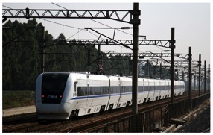
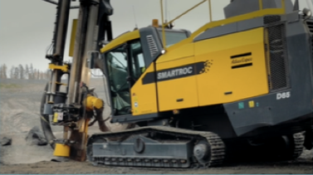
Teaser
Vast amounts of data are generated within technical components in heavy vehicles, with only a limited share used remotely for diagnostics, maintenance and reliability growth.
Examples: electrical train propulsion systems, rock drilling rigs
The partners want to develop a connected digital infrastructure (methods for data sourcing, transmission, storage, safety/security, analysis) with the purpose of optimization, improved commissioning, maintenance, development and upgrading.
Challenges: data volume, data variety, latency, and dependability
Pasqualina Potena, RISE SICS Västerås, pasqualina.potena@ri.se

Slide 3
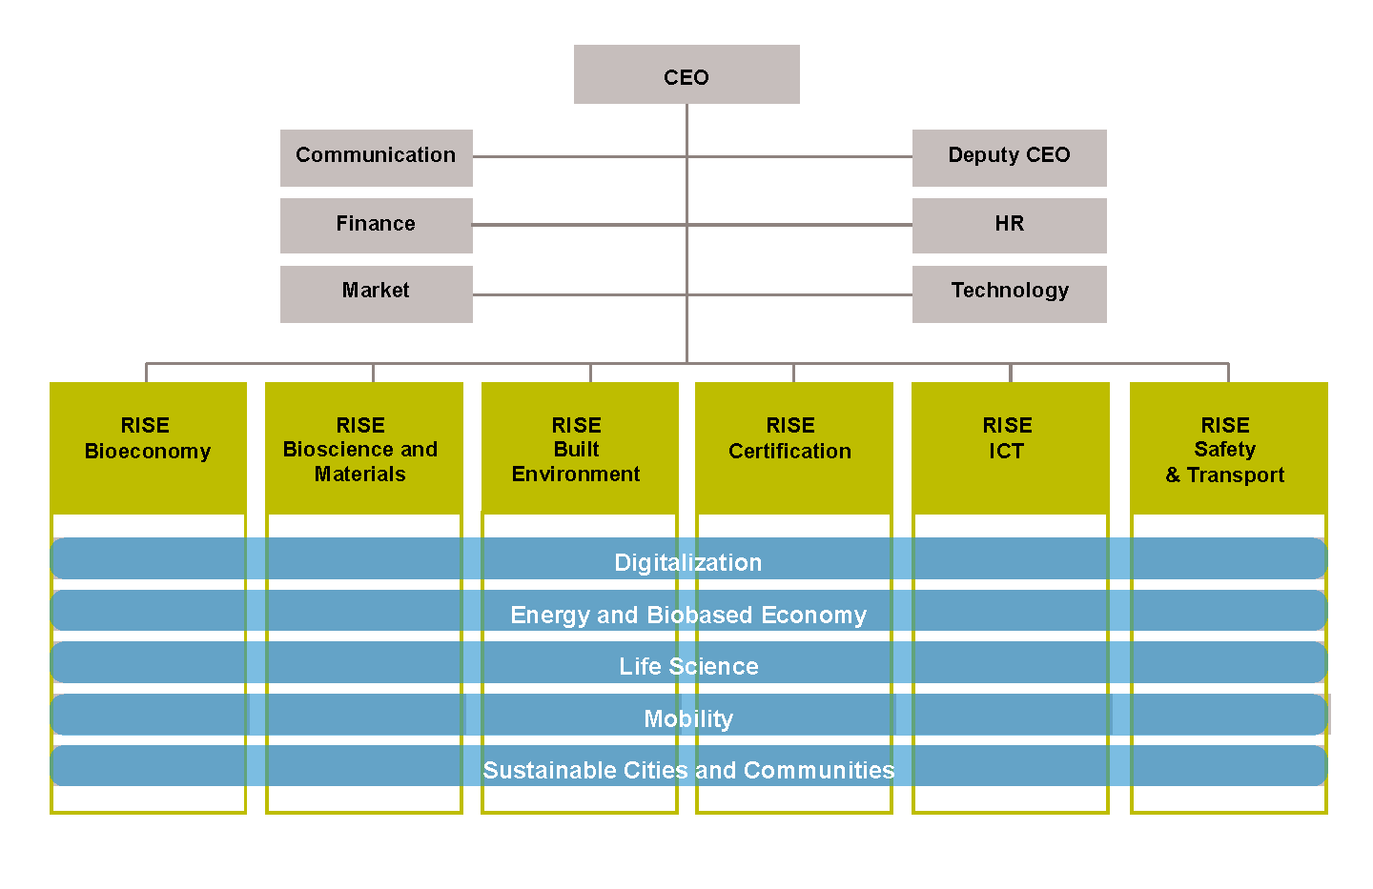
Organisation Profile
RISE Research Institutes of Sweden is fully owned by the Swedish state. RISE 2,200 employees support and promote all manner of innovative processes, and our roughly 100 testbeds and demonstration facilities are instrumental in developing the future-proofing of products, technologies, and services.
RISE is organized as six divisions:
RISE SICS (under the umbrella of the RISE ICT division) is a leading non-profit research institute for applied information and communication technology in Sweden, founded in 1985. It is funded by governmental research programs, industry and the EU. In 2017, RISE SICS had 202 employees (of which 76 have a Ph.D. and 32 are professors). Application areas, such as Internet of Things, Industrial Automation and Maintenance, Automotive and Rail, Telecom, Digital Health, Decision support and business intelligence and Data Centers.
Pasqualina Potena, RISE SICS Västerås, pasqualina.potena@ri.se

Slide 4
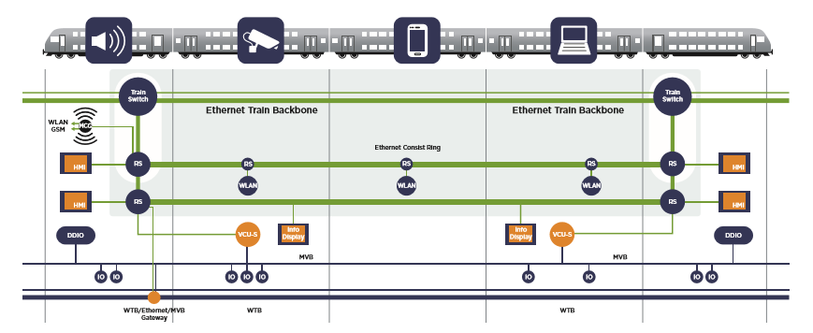
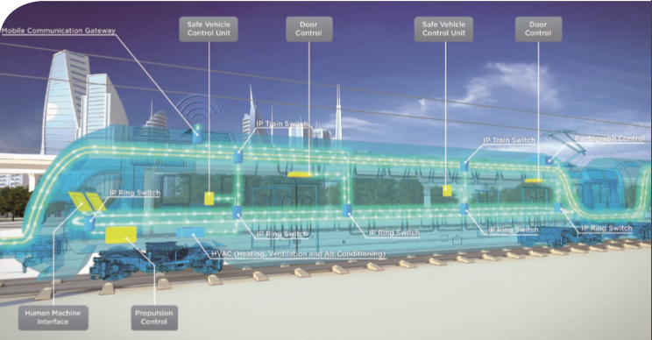
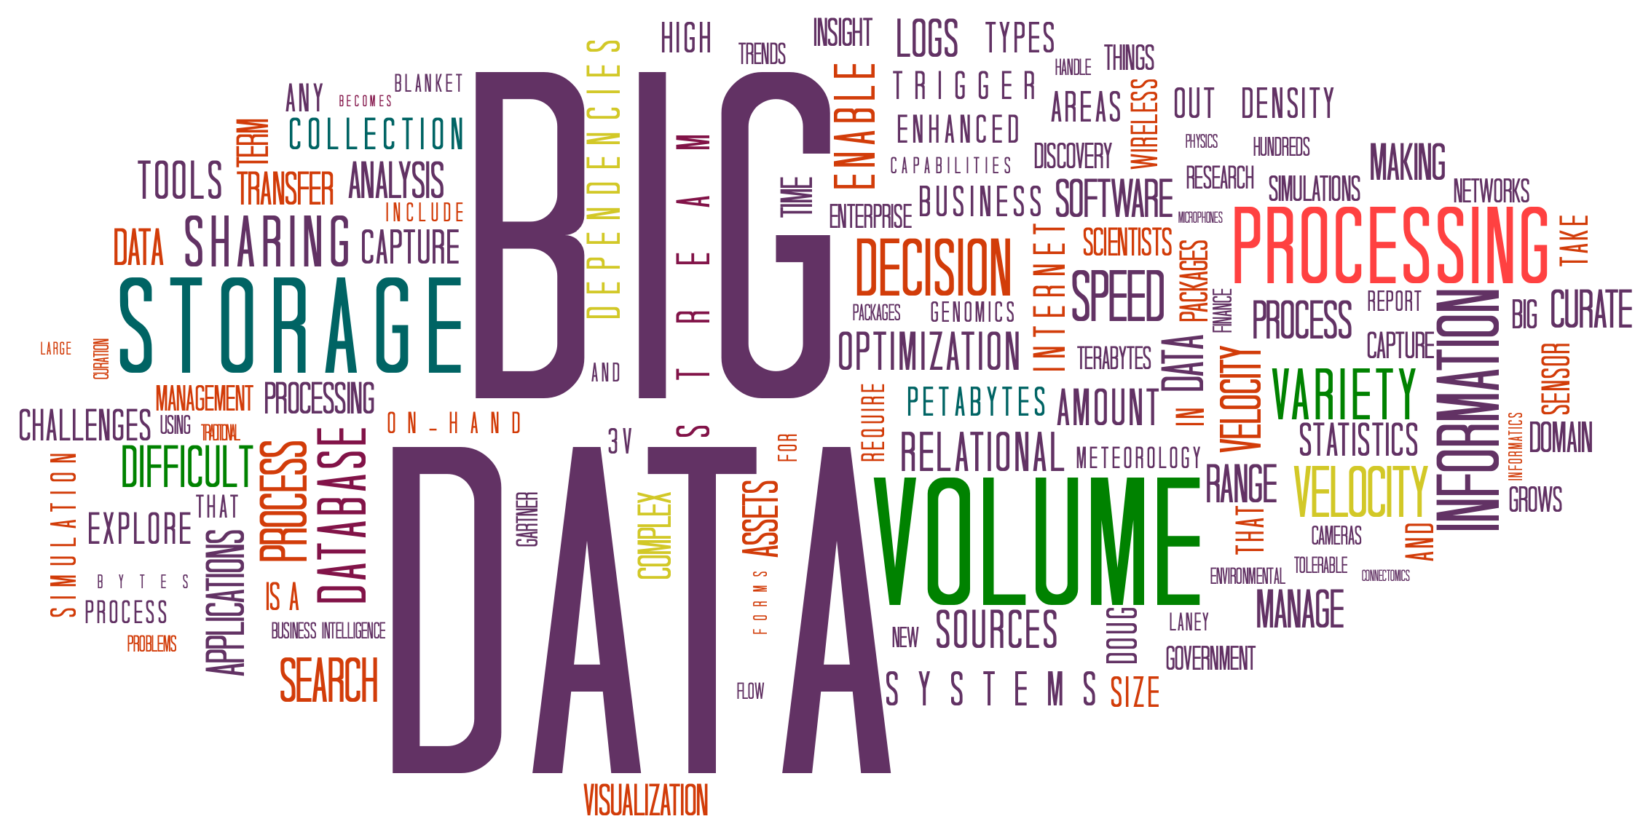
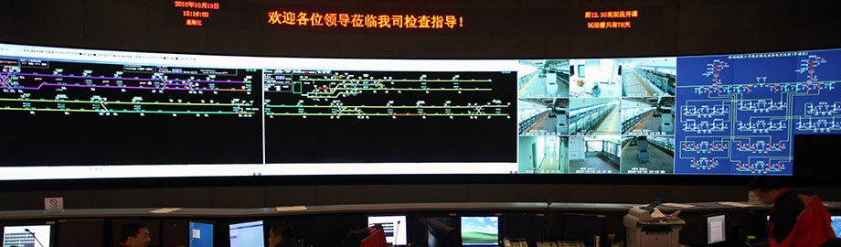
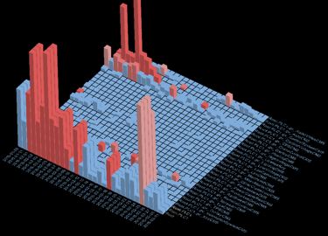
Proposal Introduction (1)
Example from Bombardier
Variety: diagnostic data, propulsion data, event logs, video streams, user content, position, adhesion, electric data,…
Velocity:
Microsecond response time for safety-critical control systems
Optimizations: Online tuning of performance parameters
Re-engineering: Online validation of product performance
Maintenance & Commissioning: Deviation detection & condition-based maintenance
Volume:
Gigabytes
of data per hour
Analyse
Execute
Monitor
Plan
Pasqualina Potena, RISE SICS Västerås, pasqualina.potena@ri.se

Slide 5
Proposal Introduction (2)
Expected Outcomes:
- Safe and secure vehicular communication system
- Big data & data analysis & connected vehicles
- 3G / 4G / 5G interconnected subsystems
- Digital systems for advanced operational diagnostics and condition-based maintenance
- Digital infrastructure between vehicles and stationary equipment for transmission, storage and processing of large data volumes
Impacts:
- Reduced costs for validation, commissioning and maintenance and upgrades of existing fleets
- Reduction of transfer cost and increased transfer speed
- New performance-based services offered to customers
Pasqualina Potena, RISE SICS Västerås, pasqualina.potena@ri.se

Slide 6
Partners
Partners involved:
Bombardier Transportation (large provider
of propulsion and control equipment for trains)
Atlas Copco Rock Drills (large provider of compressors,
vacuum solutions and air treatment systems, construction
and mining equipment, power tools and assembly systems)
RISE SICS Västerås (res. institute)
Mälardalen University
Automation Region (incl. several SME:s)
The railway cluster (incl. several SME:s)
Expertise:
Propulsion, High Voltage System, Auxiliary System and TCMS (train control and monitoring system)
Diagnostics & fleet maintenance, optimization, machine learning, A.I.
Quality Assurance, testing, verification and validation
Looking for partners/consortia in:
Telecom, network and communication
Vehicular systems, Transportation
Cloud platforms, big data, analytics
Pasqualina Potena, RISE SICS Västerås, pasqualina.potena@ri.se

Slide 7
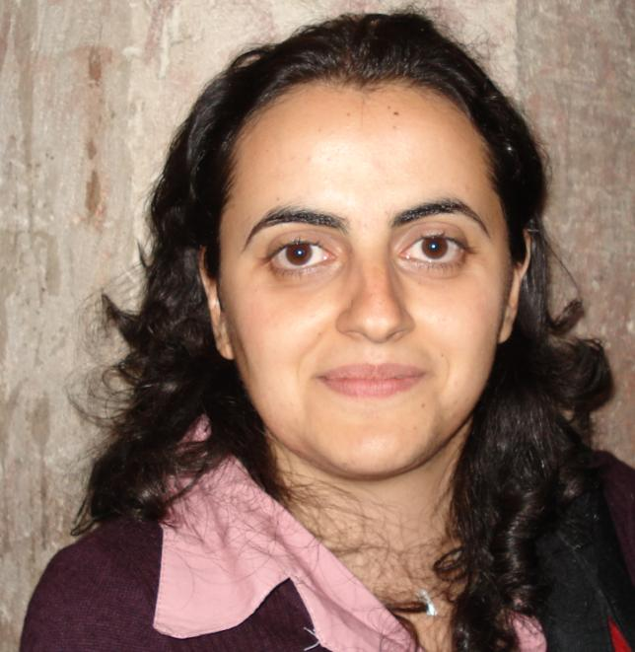
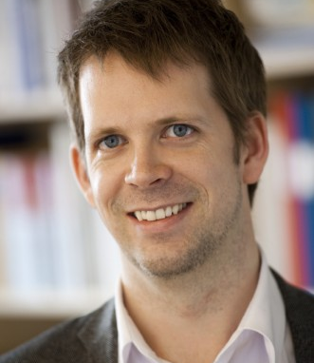
Contact Info
For more information and for interest to participate please contact:
Pasqualina Potena
RISE SICS Västerås
+46 725 103725
pasqualina.potena@ri.se
Kopparbergsvägen 10
SE-722 13 Västerås, Sweden
Markus Bohlin
RISE SICS Västerås
markus.bohlin@ri.se
+46 70 787 66 08
Kopparbergsvägen 10
SE-722 13 Västerås, Sweden
Pasqualina Potena, RISE SICS Västerås, pasqualina.potena@ri.se

