Slide 1


Celtic-Plus Event
Project Ideas and Networking
20th June, Helsinki
Internet of DevOps (IoD)
Frédéric Loiret, KTH
loiret@kth.se
Sigrid Eldh, Ericsson sigrid.eldh@ericsson.com

Slide 2
Evolution of Software Development
1 slide:
What is the main benefit of the idea/proposal?
What makes the added value?
Why should I participate in the project?
Long iterations (e.g., releases every 18 months)
Point-to-point integration
Shorter iterations (e.g., every 6 months)
Enhanced people cooperation
Very short iterations (e.g., every weeks, or even days!)
Continuous Deployment
Big Data Analytics
Optimizing the value stream
Federated Environments
Frédéric Loiret, KTH & Sigrid Eldh, Ericsson

Slide 3
Lifecycle Reality at Ericsson
1 slide:
Very short info about the profile of your organisation
Very large number of tools & legacy!
Picture from Mats Berglund, Ericsson
Frédéric Loiret, KTH & Sigrid Eldh, Ericsson

Slide 4
Towards the Internet of DevOps
1 slide:
Short info what the idea/proposal is about
(vision, motivation, content)
Digital Enterprise: Relying on Internet for connecting DevOps assets throughout the development & operational product lifecycle
Integration solutions “as a Service”
Frédéric Loiret, KTH & Sigrid Eldh, Ericsson

Slide 5
Expected Outcomes
• Support agile development incl. continuous integration using many tools across distributed development teams
• Continuous end-to-end feedback to the developers from analysis/testing/simulation activities
• Scale up test automation processes with very large engineering data sets
• Monitor and analyze data produced throughout the whole development lifecycle
^{• Handle legacy tools}
• Data visibility tailored for different stakeholders in the value chain
e.g., for developers, testing experts, product managers and decision-makers
^{• Security issues}
1 slide:
Short info on expected outcome, impacts, schedule
→ Potential kick-off date: Spring 2018
Frédéric Loiret, KTH & Sigrid Eldh, Ericsson

Slide 6
Partners
1 slide:
Existing consortium, involved countries.
Expertise, profiles and types of partners you are looking for.
Turkey
  Ericsson Turkey (telecom)
  TurkCell (telecom)
  Enforma (SME)
  Istanbul Technical University (univ)
France?
  Orange-Labs? (telecom)
  Airbus? (aerospace)
Sweden
  Ericsson (telecom)
  SAAB (aerospace)
  Data Frame (SME)
  KTH (univ)
Germany
  T-Systems (telecom)
  AEB (SME)
  CQSE (SME)
  Univ. Stuttgart (univ)
  Bosch?
We are looking for:
Large companies (telecom and beyond)
(Cloud-based) Solution Providers & Integrators
Frédéric Loiret, KTH & Sigrid Eldh, Ericsson

Slide 7
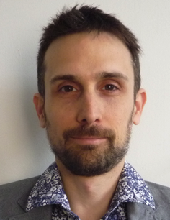
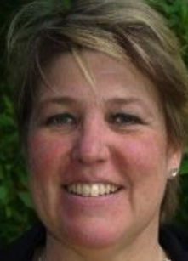
Contact Info
For more information and for interest to participate please contact:
Dr. Frédéric Loiret, KTH
loiret@kth.se
+46734618601
Stockholm, Sweden
www.scanx.org/loiret
Dr. Sigrid Eldh, Ericsson
sigrid.eldh@ericsson.com
Stockholm, Sweden
Frédéric Loiret, KTH & Sigrid Eldh, Ericsson

