Slide 1
Celtic-Plus Event
Project Ideas and Networking
20th of June, Helsinki
Health^5G
Anna Sachinopoulou
VTT Technical Research Centre of Finland Ltd

Slide 2
Vision
We envision a health monitoring system with heterogeneous networks by having various wireless radio technologies, protocol designs, standards, and semantics. Such a system should satisfy application requirements in terms of connectivity, reliability, timeliness and throughput.
Name, affiliation & e-mail of presenter

Slide 3
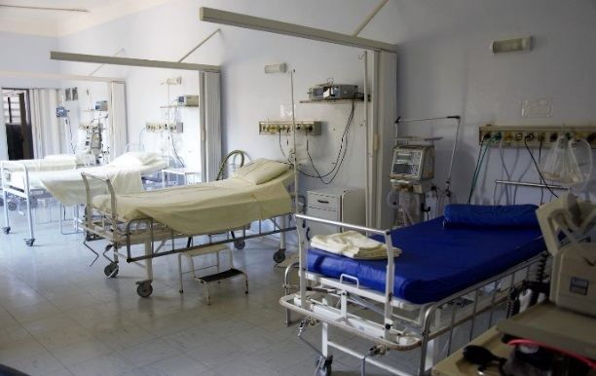

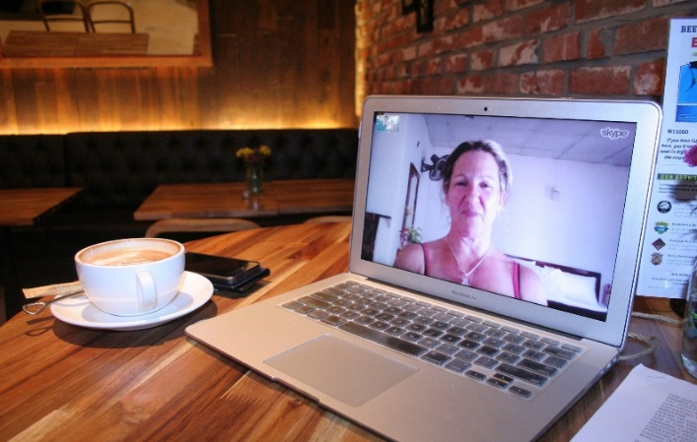

Medical information platforms and messaging
eHealth applications
Data management for health solutions
Medical and eHealth devices
5G
Security and privacy
Network and cloud technologies
and devices

Slide 4
Approach
Identify and refine novel use cases of eHealth that take advantage of 5G capabilities
Define requirements and system architecture for 5G-enabled eHealth services based on the use cases
Study and develop 5G enablers for the use cases
Develop novel eHealth applications and solutions
Tackle interoperability in terms of hardware and software to enable healthcare within 5G
Validate the solutions in real 5G test networks and using eHealth IoT devices equipped with various radios and standard protocols
Disseminate, contribute to standardisation and exploit the results
Selected use cases and requirements
Impact of 5G on the use cases
Solution development and validation
Dissemination and exploitation of the results
Name, affiliation & e-mail of presenter

Slide 5
Turkey
  ENFORMA BİLİŞİM A.Ş. (CC)
  Memorial Healthcare Group
  Acıbadem University - Medical Engineering
  Turkcell
France
  STMicro
Germany
  MCS Data labs
  DAI Labor, Technische Universität Berlin (CC)
  Highstreet technologies GmbH
  Fraunhofer IIS
Ukraine
  National Technical University of Ukraine “Igor Sikorsky Kyiv Polytechnic Institute” (CC)
Sweden
  Mälardalen University (CC)
  CNET
  RISE/SICS, Alten and Tele2
Finland
  Nokia Bell Labs , Mobile Networks and Technologies
  VTT Technical Research Centre of Finland Ltd (CC)
  Åbo Akademi University
Spain
  Universitat Autònoma de Barcelona
  Experis IT
  Pulso
  Quobis
Hungary
  BundlesLab Ltd. (CC)
Korea
  KOOKMIN University(CC)
  HUFS
Belgium
  IMEC (CC)
Israel
  LiveU

Slide 6
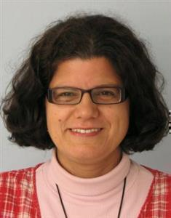
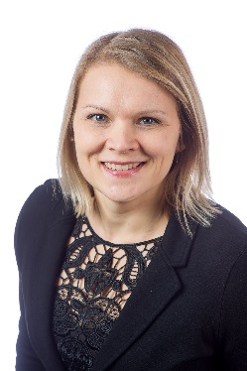

Contact Info
For more information and for interest to participate please contact:
Anna Sachinopoulou
Research Scientist
Digital Transformation, VTT
anna.sachinopoulou@vtt.fi
+358 20 722 2462
Kaitoväylä 1, P.O.Box 1100
FIN-90571 OULU, FINLAND
Milla Immonen
Senior Scientist, Project Manager
Smart Health, VTT
milla.immonen@vtt.fi
+358 20 722 2168
Kaitoväylä 1, P.O.Box 1100
FIN-90571 OULU, FINLAND
Name, affiliation & e-mail of presenter

