Slide 1

Celtic-Plus Proposers Day 20th June 2017, Helsinki
Resilient & Scalable Slicing over Multiple Domains
Prof. Tarik Taleb
Aalto University, Finland
Tarik.taleb@aalto.fi

Slide 2



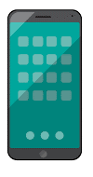



Teaser
Ensuring SURVIVABILITY & RESILIENCE of NW slices running over different environments including the ones which are not under control of network provider
Advancing the SCALABILITY of network slicing by leveraging federation over multiple admin/technology domains
Scalable & Reliable 5G Network Slicing Choreography
Federated slice 1
Slice A,1
Slice B,1
Federated slice 2
Slice A,2
Slice B,2
Slice C,2
Provider
Domain A
Provider
Domain B
Provider
Domain C
Prof. Tarik Taleb, Aalto Univ., Tarik.taleb@aalto.fi
Notes:
1 slide: What is the main benefit of the idea/proposal? What makes the added value? Why should I participate in the project?

Slide 3
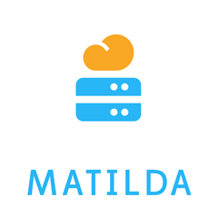





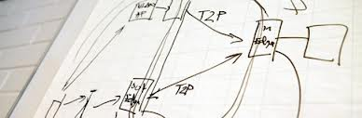

Organisation Profile
Example Projects
Aalto University, Espoo, Finland
Department of Communications and Networks (Comnet)
Personnel: ~115 (15 Professors)
Budget: 60% external funding
H2020, Celtic-Plus, TEKES, Academy of Finland etc.
Prof. Tarik Taleb, Aalto Univ., Tarik.taleb@aalto.fi
Notes:
1 slide:
Very short info about the profile of your organisation

Slide 4
Proposal Introduction (1)
Vision: Realization of a highly resilient and scalable network slicing architecture for enabling end-to-end 5G-based services across multiple technical and administrative domains.
Motivation:
Explosion of 5G verticals with varying requirements in terms of both network and computationational resources, performance, resilience and service
A significant number of verticals demanding 5G-based mission-critical applications with ultra-reliability support (e.g., autonomous cars, industrial control, remote surgery, public safety services, etc.)
Content: Advanced federation strategies for scalable network slicing over heterogeneous admin/technology domains, unified reliability framework, field trials and verification with verticals
Prof. Tarik Taleb, Aalto Univ., tarik.taleb@aalto.fi
Notes:
1 slide: Short info what the idea/proposal is about (vision, motivation, content)

Slide 5
Proposal Introduction (2)
Expected outcome: High-scalable slice choreography plane for offering vertical-tailored multi-domain slices “as-a-Service” with enhanced survivability/resilience support
Impacts:
Both incremental and disruptive business models
Remarkable benefits for Telco operators, Service providers, and mobile subscribers
Contribution to standards and 5G industry alliances
Schedule: Two years (from early 2018 to early/mid 2020)
Prof. Tarik Taleb, Aalto Univ., tarik.taleb@aalto.fi
Notes:
1 slide: Short info on expected outcome, impacts, schedule

Slide 6
Partners
Current consortium
Finland:
Aalto University
Nokia
Norway:
Telenor
France:
Orange
Eurecom
INRIA
Partner Search
Verticals
SMEs
Mobile operators
IaaS/PaaS/SaaS providers
Prof. Tarik Taleb, Aalto Univ., tarik.taleb@aalto.fi
Notes:
1 slide: Existing consortium, involved countries. Expertise, profiles and types of partners you are looking for.

Slide 7
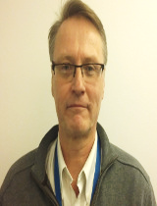
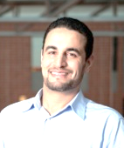
Contact Info
For more information and for interest to participate please contact:
Hannu Flinck, Nokia Bell Labs
E-Mail: hannu.flinck@nokia-bell-labs.com
Tarik Taleb, Aalto University
E-Mail: Tarik.taleb@aalto.fi
Tel: +358-50-435-2325
http://mosaic-lab.org/
Prof. Tarik Taleb, Aalto Univ., tarik.taleb@aalto.fi

