Slide 1

Celtic-Plus Proposers Day 20th June 2017, Helsinki
Privacy preserving Interoperability
Souheil Bcheri
sosso@eurodocs.net
<Your Logo>

Slide 2
Organisation Profile
We are a next generation, Swedish IT Company developing smart, innovative and useful digital solutions that assure Internet users of their anonymity through state of the art privacy and identity protection.
Our business concept is to combine secure, user-friendly and cost-effective solutions together with powerful security mechanics toward a package where users can feel confident in their online personal integrity.
Souheil Bcheri, Eurodocs AB, sosso@eurodocs.net

Slide 3



Past & Current EU Projects
ABC4Trust project addressed the federation and interchangeability of technologies that support trustworthy yet privacy-preserving Attribute-based Credentials (ABC) where a holder may reveal the minimal information required by the application, without giving away full identity information.
Federated Identity Management System (FIDES) project defined a technical blueprint for a federated and interoperable identity management platform, compliant with the current regulations, such as eIDAS, Data Protection and the most relevant national legislations
Green Awareness in Action (GAIA ) will create an innovative ICT ecosystem (including web-based, mobile, social and IoT sensing elements) tailored specifically for school environments, taking into account both the users and buildings to motivate citizens’ behavioral change to achieve greater energy efficiency.
Souheil Bcheri, Eurodocs AB, sosso@eurodocs.net

Slide 4
Proposal Introduction
Problem with the current system regarding the exchange of identifiable, private information related to individuals:
Situation is hampered by technological issues, security concerns, legal conditions, and privacy aspects.
All issues present obstacles put in place by the government to protect its citizens.
This has effectively stopped the flow of information between public agencies and produced a confused, inefficient system.
Businesses are also bound by this complex system when trying to better serve their customers or within their dealings with the respective government agencies.
Souheil Bcheri, Eurodocs AB, sosso@eurodocs.net

Slide 5
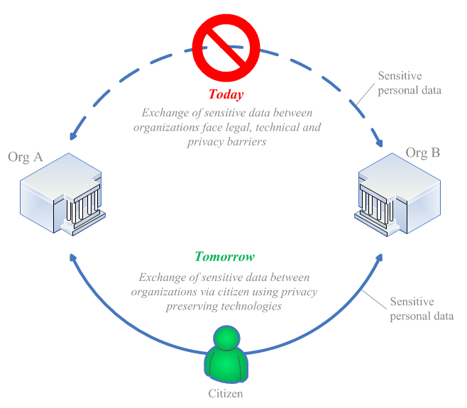
Proposal Introduction
1 slide:
Short info what the idea/proposal is about (vision, motivation, content)
Souheil Bcheri, Eurodocs AB, sosso@eurodocs.net

Slide 6
Proposal Introduction
Our proposed solution regarding the exchange of identifiable, private information related to individuals:
Introduce a system where the individual or owner of the data themselves have control over the information that is intended to be shared between entities, both public and private.
Create a functioning test system of both public and private authorities along with sample users to demonstrate how entities can more efficiently exchange digitized personally identifiable data in a secure and privacy preserving manner.
Satisfy the technological/security and legal/privacy issues that currently impede the system today by forcing data owners to contact or physically go to the respective entities to get the information and share it with another entity.
Streamline the efforts of the entities when serving their citizens/customers.
Souheil Bcheri, Eurodocs AB, sosso@eurodocs.net

Slide 7
Partners
What we are looking for in Partners…
Research Issues to be addressed
Designing the cryptographic protocols
Deciding between the server- or client-based protocols
Analyzing the efficiency of the solutions
Analyzing the security/privacy guarantees
Studying the balance between privacy vs. utility
Engineering Issues to be addressed
Data providers
Designing the access control mechanism
Database design and maintenance
Software development
Interoperability
Provide cloud and maintain the cloud environment
Souheil Bcheri, Eurodocs AB, sosso@eurodocs.net

Slide 8
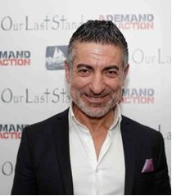

Contact Info
For more information or expression of interest to participate with us, please contact:
Souheil Bcheri – Eurodocs
sosso@eurodocs.net
+46 70 - 602 42 42
Box 1073, 164 25 Kista, Sweden
www.eurodocs.se
Your
Photo
Souheil Bcheri, Eurodocs AB, sosso@eurodocs.net

