Slide 1
Celtic-Plus Event 22 September 2016, Istanbul
IoIST:
Data Analytics Platform for IoT Sensor Data
Dr. İsmail UZUN, INOSENS
İsmail.uzun@inosens.com.tr

Slide 2
Teaser
What is the main benefit of the proposal?
IoIST allows industries to analyze IoT data for Prediction and Anomaly Detection
What brings the added value?
Cloud-based, generic IoT platform will help industries to start using IoT reliably and securely
Why should you participate in my proposal?
Convergence of IoT ecosystem with Industries

Slide 3
INOSENS
INOSENS
Founded in 2014
Expert on Data Analytics, Machine Learning
Expert on Product Development Cycles
Founder has 30+ EUREKA/TEYDEB projects experience

Slide 4
SYM
SYM Software
Founded in 2006
3 experts on Distributed Systems, Big Data Analytics, Machine Learning
3 EUREKA projects
1 in EURIPIDES² (ADORAS)

Slide 5
Proposal Introduction (1)
IoIST is a cloud based Data Analytics Platform for Predictive Maintenance Applications using IoT Sensor Data
Vision
To create global data analytics platform for IoT
Motivation
Our motivation is to solve infrastructure management problem, to ease developing predictive maintenance applications on IoT Sensor Data
Content
Fog Computing, New Standard Definition for IoT I/F and Predictive Maintenance, Anomaly Detection on Sensor Data

Slide 6
Proposal Introduction (2)
Outcome
A Cloud-based Data Analytics Platform for IoT Sensors + New IoT Sensor Data I/F Protocol and Standard will be produced
Impact
To enable industries to jump-start IoT and Predictive Maintenance
Schedule
~30 mo. (Interface Definition, Data Flow, Cloud Platform Dev., Integration, Field Tests, Dissem.)

Slide 7
Partners
Current Status
INOSENS, SYM
Expected Partner Profile:
IoT vendors (SME/Ind)
Sensor Fusion experience (SME/Uni)
Hardware Development/Prototyping (SME)
System Owners/Operators (Defense, Transportation, Energy, etc.) (Ind/Pub)

Slide 8
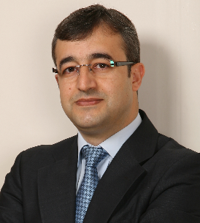
Contact
For more information and for interest to participate please contact:
Dr. İsmail UZUN
INOSENS
ismail.uzun@inosens.com.tr
www.inosens.com.tr

