Slide 1
ITEA
Fostering international software innovation
16 November 2023 | Online
Zeynep Sarılar, ITEA Chairwoman

Slide 2

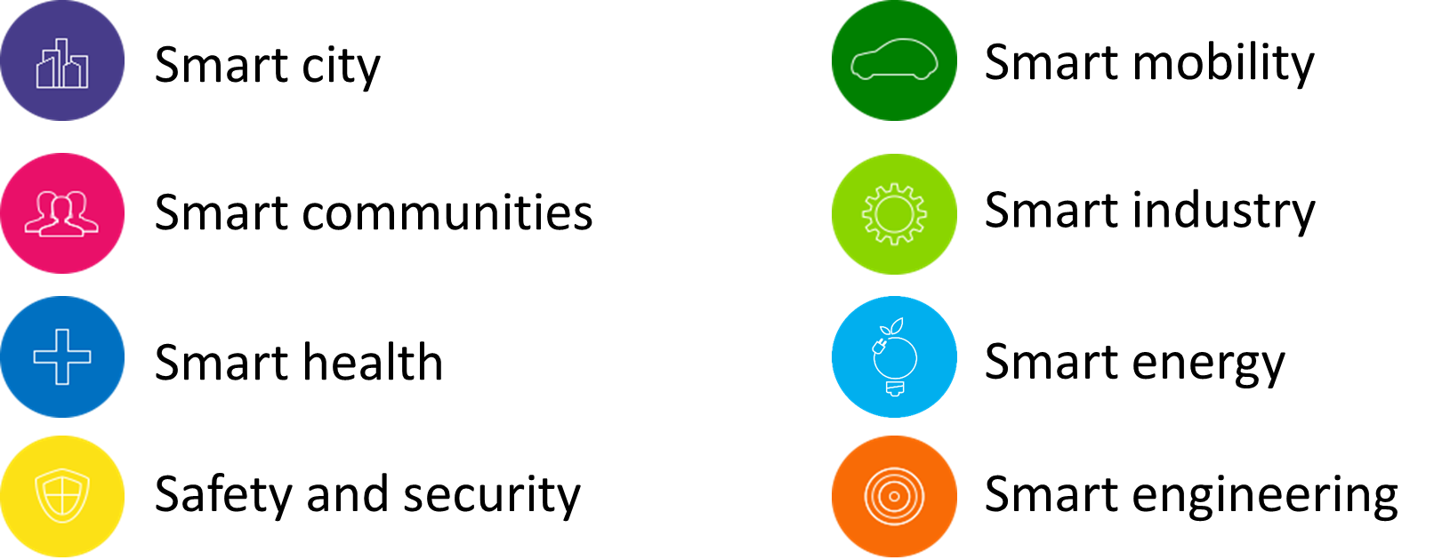
ITEA
The Eureka Cluster on software innovation and digital transition
Since 1998, ITEA is the industry-driven Eureka RD&I programme on software innovation and digital transition. ITEA enables a large international community to collaborate in funded projects that turn innovative ideas into new businesses, jobs, economic growth and benefits for society.

Slide 3



































ITEA governance and main players
Trustful relationship for software innovation
ITEA Board members:
Some of ITEA’s other main (industrial) partners:
ITEA provides a large network of collaboration partners from large industries, SMEs, research institutes and universities.

Slide 4






















Countries supporting ITEA
Austria
Belgium
Canada
Czech
Republic
Denmark
Finland
France
Germany
Hungary
Ireland
Israel
Luxembourg
The
Netherlands
Portugal
Singapore
Slovenia
South Korea
Spain
Sweden
Switzerland
Türkiye
United Kingdom

Slide 5




ITEA facts and figures
ITEA 1
(Call 1-8):
545 unique partners
ITEA 2
(Call 1-8):
972 unique partners
482 SMEs
ITEA 3
(Call 1-7):
438 SMEs
ITEA 4
(Call ‘21-’22):
228 SMEs
837 unique partners
432 unique partners
220 SMEs
Total # PY:
35,116
Total budget:
€3,7 billion
Total # projects: 324
Total # projects:
324
Total # PY:
35,116
Total budget:
€3,7 billion
+ participation in AI Call 2020, AI Call 2021 and Sustainability Call 2022

Slide 6
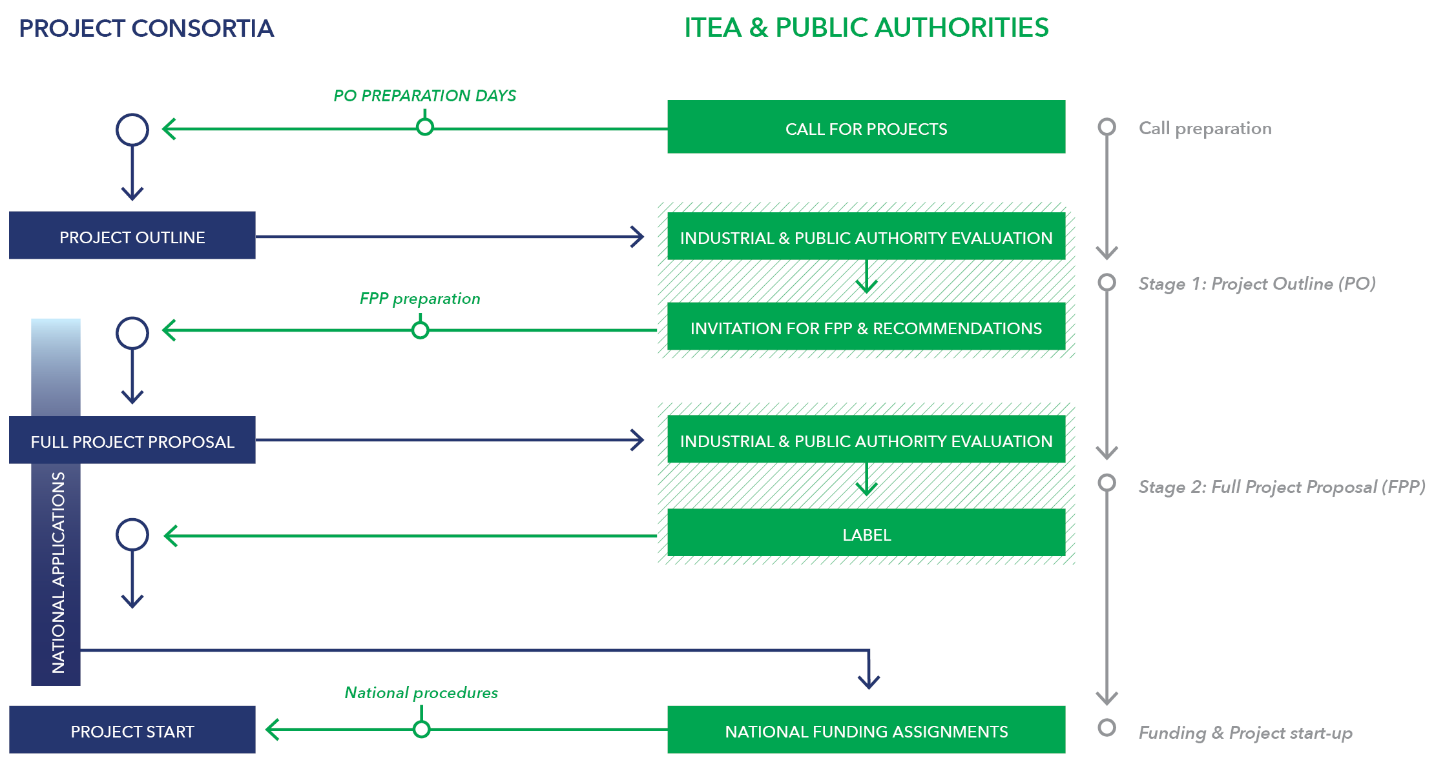
ITEA
Yearly Call process

Slide 7
ITEA – The fast track to software innovation
Core properties of ITEA
ITEA enables the pioneering of the software concepts of tomorrow
ITEA mobilises the right ecosystems
ITEA projects are aligned with end-user demands
ITEA embraces the global dimension of today’s challenges
ITEA is a unique framework delivering standardisation

Slide 8
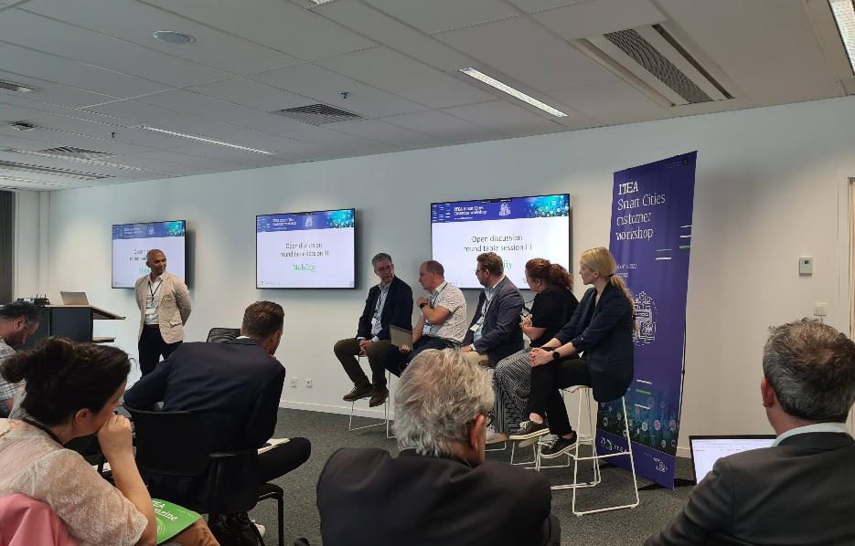
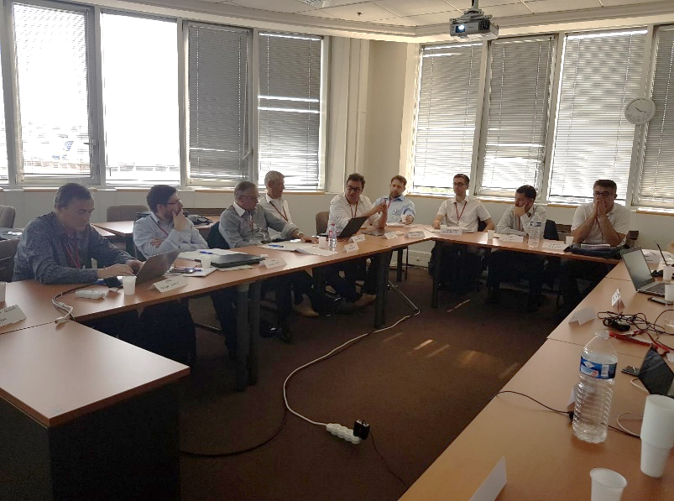


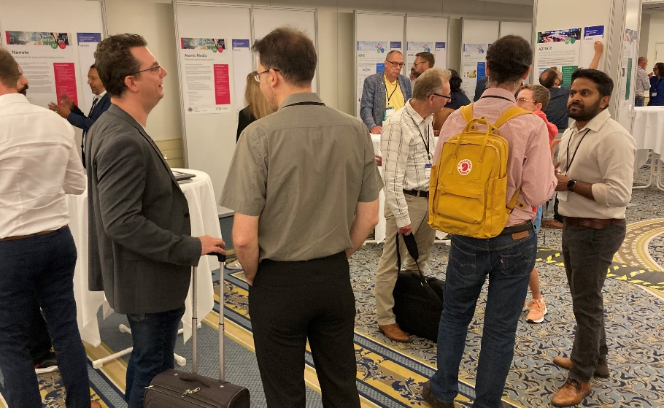
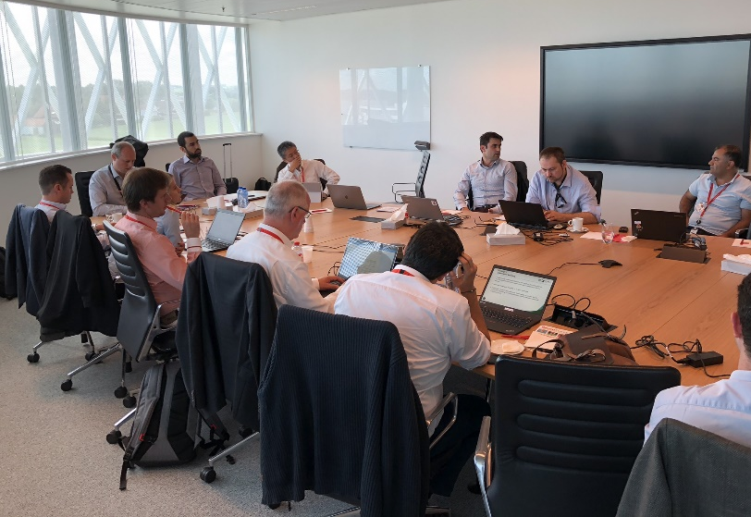
ITEA Yearly events
Creating strong connections and close-to-market solutions
May
ITEA International customer workshop
40-50 participants
Gathering customers and technology providers from the ITEA Community around a dedicated topic
Very interactive workshop to understand the current challenges and brainstorm about possible solutions (as preparation for the PO Days)
June & November
ITEA Advisory Board meetings
Smart City Advisory Board and Cyber Security Advisory Board already established
Creating a dialogue between customers and innovative technology developers to:
  understand the urgent needs
  update customers about latest innovations
  increase chances for exploitation
September
ITEA PO Days - Yearly networking/brokerage event
300+ participants, 15+ countries
Each year 70+ ideas uploaded in project idea tool, 50+ project ideas presented as a poster and 40+ ideas pitches
Focussing on real preparations for project outlines through active brainstorm and workgroup sessions
Throughout the year
National events and webinars
Events organised in collaboration with Public Authorities to inform new-comers about the funding opportunities, processes, support and impact of ITEA.
Thematic webinars
Gathering participants on a dedicated topic to share and discuss case studies, lessons learned, new tools, and innovative strategies to overcome challenges in the domain

Slide 9



Additional ITEA services and support
For projects and Public Authorities
Brokerage/Matchmaking
Online Project idea tool
An NDA-projected environment to share your new ideas, look for project partners and input in preparation of the ITEA PO Days/ITEA Call 2023
Partner search
Almost 10,000 contacts with options to filter, email and invite to project (idea)
Project coaching and monitoring
Project reviews
Three (online and physical) reviews throughout the project lifetime to guide and coach the projects to get the most out of it and stay close to the market
Progress report
Bi-annual written report to keep track of the achievements and exploitable results
Project promotion
Promotional means created by ITEA Office
Project leaflets
Project posters
News items
Magazine articles
Social media posts
Project impact overview and statistics
Impact stream
Overview of short and powerful ITEA impact stories that can be personalised
(e.g. based on country, challenge etc.)
Statistics
Up-to-date and personalised statistics when needed

Slide 10


ITEA Quality
ISO 9001 certified processes

Slide 11
Thank you

