Slide 1

Celtic-Plus Event
Project Ideas and Networking
19st May 2017, Barcelona
Pitch of the Project Proposal
SMARTporter as building block
<Tomáš Trpišovský, IMA s.r.o>
<tomas.trpisovsky@ima.cz>

Slide 2
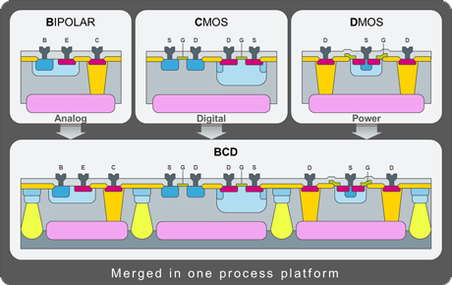
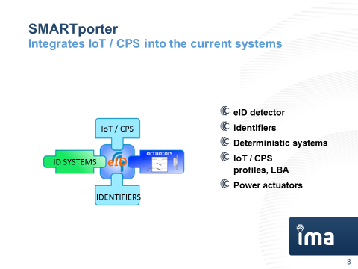
Teaser
Name, affiliation & e-mail of presenter

Slide 3
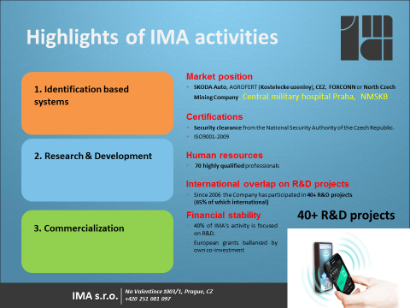
Organisation Profile
IMA s.r.o.
Proactive
SME
Located in
Praha, CZ
www.ima.cz
Name, affiliation & e-mail of presenter

Slide 4
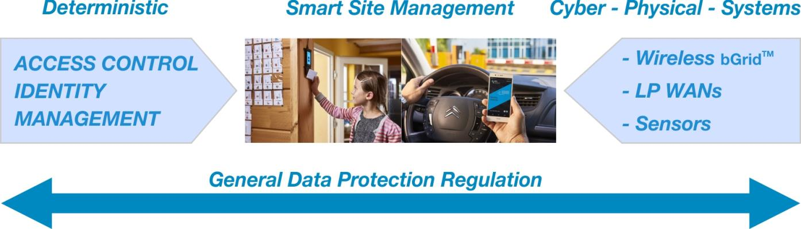


SMARTporter Introduction
Scalable kit / concept to be hosted by…
IoT / Cloud services
Building gateway
HVAC (Energy management, Building automation, Identity mgmt)
Lighting management
ID & Access control
Active lighting actuator

Slide 5
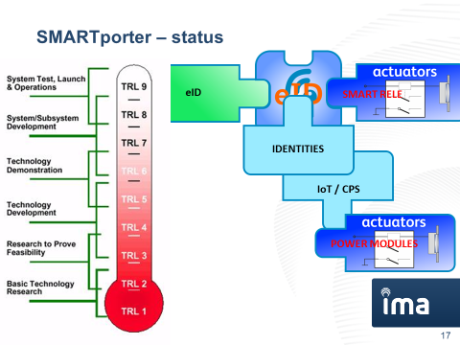
Proposal Introduction (2)
EXPECTED OUTCOMES
Smart building Block for integration to the Security, Access control, IoT & CPS Systems & new business paradigm
IMPACTS
1. Implementation of proximity & actuating services within large (critical) infrastructures.
2. Shared common infrastructures for different applications.
3. Sharing of recent power modules for site physical management.
4. Enabler for asset sharing apps
SCHEDULE 24 months max
Name, affiliation & e-mail of presenter

Slide 6
Partners
CONSORTIUM STATUS
We are offering a Smart building Block for integration to the Security, Access control, IoT & CPS Systems
AVAILABLE KEY PARTNERS
Evalan (NL)
WESTMERE (S)
DFRC (Swiss/Singapore)
LOOKING FOR
Integrators / Enterpreneurs of asset sharing applications
Name, affiliation & e-mail of presenter

Slide 7
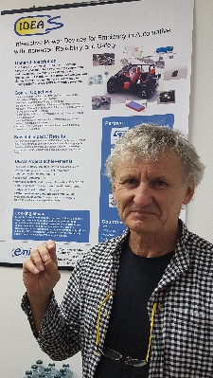
Contact Info
For more information and for interest to participate please contact:
Tomáš Trpišovský, CEO, IMA s.r.o.
tomas.trpisovsky@ima.cz
+420 603 207 900
Na Valentince 1, 150 00 Praha 5, CZ
www.ima.cz
Name, affiliation & e-mail of presenter

