Slide 1

Celtic-Plus Proposers Day
22 September 2016, Istanbul
Privacy Preserving Data Processing
Engin Zeydan, PhD, Türk Telekom Labs
Engin.Zeydan@turktelekom.com.tr

Slide 2
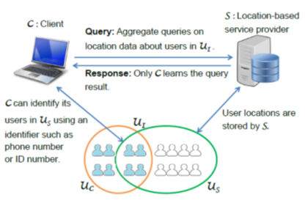
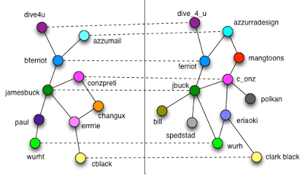
Teaser
Help businesses to better understand their customers via the data they collected through their operations.
Without compromising the privacy and anonymity of the individuals.
Collect, store, process, and share personal data of customers in a privacy-preserving way.
  Solutions for privacy-preserving data publication and sharing.
Engin Zeydan, Türk Telekom Labs, Engin.Zeydan@turktelekom.com.tr

Slide 3




TT in Numbers
175
years of Enterprise
heritage
Turkey’s largest employee
with
34.000
Emloyees İn 81 provinces
38,3 M
Total subscribers
%98
Broadband Infrastructure
service to houses
219.000 km
Fiber Infrastructure
Turkey’s most valuable Telecommunication Brand in 8 Consecutive Years
Over 40.000 KM
Fiber network in
20 countries
8,3 M
Broadband
18 M
GSM subscribers
1,7 M
High Speed Fiber and
Hipernet Subscribers
12,9 M
Fixed Access
Lines
2,0 M
TV and TiviBu Go
Subscribers
Engin Zeydan, Türk Telekom Labs, Engin.Zeydan@turktelekom.com.tr
Selami Çiftçi, R&D Center Manager, selami.ciftci@turktelekom.com.tr

Slide 4
Proposal Introduction (1)
Vision: To enable businesses collect, store, process, and share personal data of their customers in a privacy-preserving way.
Risk: anonymized datasets can be de-anonymized using auxiliary information.
Motivation: Develop privacy-preserving algorithms for businesses to;
    process personal information they collect from own customers,
    query databases of other companies without compromising the privacy concerns of both the companies and their customers.
    Share their data for public good or research purposes.
Tools: cryptographic tools such as homomorphic encryption, secure multi-party computation, private information retrieval, and private set intersection
Engin Zeydan, Türk Telekom Labs, Engin.Zeydan@turktelekom.com.tr

Slide 5
Proposal Introduction (2)
Solutions that provide privacy by design are going to be developed.
Proposed solutions will be applied in several different application areas, including :
    Understanding the whereabouts of current and potential customers (via privacy-preserving location analytics between location-based service providers and businesses),
    Finding similar users based on their location patterns,
    Privacy-preserving graph analysis (e.g., for link prediction).
    Privacy-preserving publishing of call data records (CDR’s) collected by telecom companies.
Expected Impacts:
    Improvement of technologies for data access, processing and analysis.
    Improvements towards creating a secure environment for data access, process and analysis, demonstrated in the use situations that arise in the data experimentation/integration projects.
  Phases:
    Requirements Analysis
    Protocol Development
    Data-Privacy Data-Utility balance issues
    POC/MVP development
    Dissemination & Standardization
Engin Zeydan, Türk Telekom Labs, Engin.Zeydan@turktelekom.com.tr

Slide 6
Partners
Aim is to build a cross-disciplinary consortia to conduct legally and methodologically sound field work.
Will involve legal and ethical institutions/individuals.
    To make sure that our implementations are consistent with EU legislation and with the ethical intuitions of the EU.
Will involve usability experts
    To study how the privacy protection measures can be personalized.
Will involve industrial partners that
    process personal information.
    are willing to share data with other entities.
Engin Zeydan, Türk Telekom Labs, Engin.Zeydan@turktelekom.com.tr

Slide 7


Contact Info
For more information and for interest to participate please contact:
Engin Zeydan, Türk Telekom Labs
Engin.Zeydan@turktelekom.com.tr
+90 (555) 255 26 34
Turk Telekom Technology Center
Saray Mah. Ahmet Tevfik Ileri Cad.
No:5, Umraniye, Istanbul, 34771
www.turktelekom.com.tr
Your
Photo
Engin Zeydan, Türk Telekom Labs, Engin.Zeydan@turktelekom.com.tr

