Slide 1
Celtic-Plus Proposers Day 2016, İstanbul
5G Expert Support System
Basak Gencer Unsalver, Hakan Noyan, Mehmet Simsek
NETAS Telecommunications
bgencer, hnoyan, msimsek@netas.com.tr
<Your Logo>

Slide 2
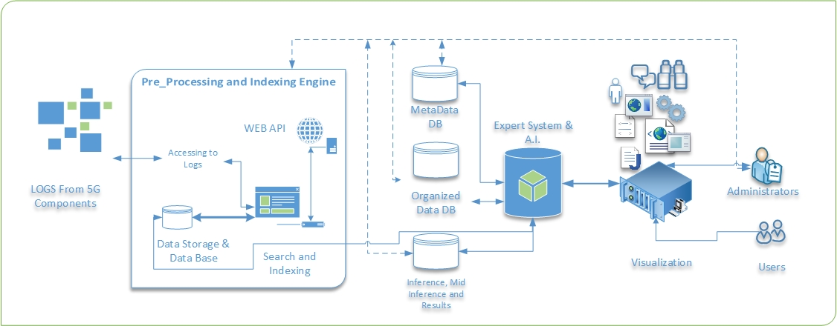
Teaser
Main idea is to build a support system based on an expert system with inference engine learning 5G and future networks and protocol issues from day one.
This system will mimic the mind set of an expert support engineer
This system will offer possible solutions to the problems
This sytem will contribute to the total efficiency of the support organizations
Hakan Noyan, NETAS, hnoyan@netas.com.tr
Notes:
Fixing products as they are in service is expensive
Fix delivery time and maintenance windows periods are most important parameters from support quality perspective.
Each product on the field needs support (as a provider or as an operator)

Slide 3
Organisation Profile
Netaş Telecommunications
Netas provides innovative end-to-end value added systems integration and technology services in the fields of information and communications technologies (ICT).
Its customers range from telco providers to public and private enterprises in domestic and international markets.
Netas’s constant increase in productivity is based on its next generation competencies around technology skillset and expertise.
The company holds a track-record of 49 years and continues its foray in the field of information technologies, supported by with its experienced, best of breed research and development department.
Netas also plays an important role in the modernization of the Turkish Armed Forces defense communication networks.
Hakan Noyan, NETAS, hnoyan@netas.com.tr

Slide 4
Proposal Introduction (1)
Idea is to support 5G and future networks for each component in an intelligent and cost effective way.
The system will be composed of three main parts:
API’s to access components, databases and logs
Inference engine for expert system
Management and user interface consoles
5G and future network support cost can not be maintainable with the current support organizations and techniques
Hakan Noyan, NETAS, hnoyan@netas.com.tr

Slide 5
Proposal Introduction (2)
Decrease the support costs
Shorten fix delivery times
Shorten maintenance windows frames
Increase support quality
Preserving the experience and knowledge through feeding the inference engine by expert personnel so that the troubleshooting quality is kept available regardless of the human facto
Proactive testing systems can be build on top of this system
This project should start soon and live with and live with 5G to cover all troubleshooting aspects
Hakan Noyan, NETAS, hnoyan@netas.com.tr

Slide 6
Partners
NETAS
Core competency to coordinate this project and actively embed the researches.
Proven relations with mobile operators within the region
Knowledge and expertise on support business
We are looking for partners
With (A.I) expert system and rule based reasoning knowledge (company or university)
Which has search engine knowledge and experinece (company or university)
Hakan Noyan, NETAS, hnoyan@netas.com.tr

Slide 7
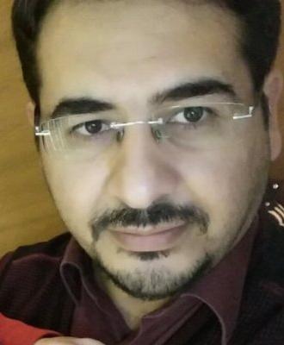
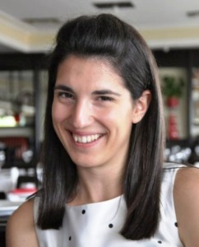
Contacts Info
For more information and for interest to participate please contact:
Mehmet Yoldas SIMSEK
msimsek@netas.com.tr
Hakan NOYAN
hnoyan@netas.com.tr
Basak GENCER UNSALVER
bgencer@netas.com.tr
Hakan Noyan, NETAS, hnoyan@netas.com.tr

