Slide 1
Proposers Day
22 September 2016, Istanbul
Celtic-Plus Success Story
Comosef
(Co-operative Mobility Services of the Future)
Erdem Ergen
erdem.ergen@kocsistem.com.tr

Slide 2
Project Profile
The CoMoSeF project aims to define advanced co-operative mobility use cases, based on user requirements and to produce targeted services for each pilot application to increase traffic safety, traffic fluency and to decrease the amount of accidents and incidents.
Name, affiliation & e-mail of presenter
Notes:
The CoMoSeF project aims to create co-operative mobility solutions, including devices and applications, feasible for large scale deployment that support the objectives of the European Commission’s ITS Action Plan (COM(2008) 886) and national ITS strategies. The project brings existing and emerging sensor units, service platforms and communication technologies and solutions closer to market introduction and will create needed business models that promote and speed that deployment.

Slide 3
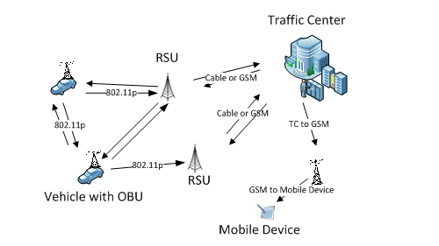



Turkey Pilot and Co-operation
Name, affiliation & e-mail of presenter

Slide 4




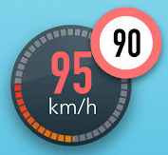

Turkey Scenarios
Intersection collision warning
Privileged vehicle warning
Speed limitaition warning
Speed advise for light controlled intersections
Name, affiliation & e-mail of presenter

Slide 5
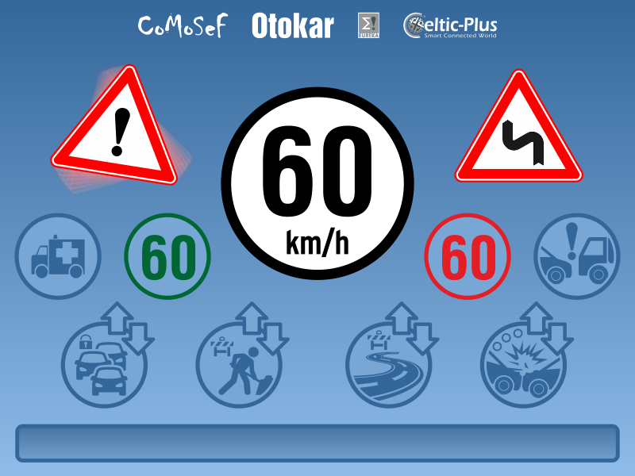
Turkey Scenarios
Name, affiliation & e-mail of presenter

Slide 6





















Turkey Scenarios
Current Speed
Emergency/Public Vehicles
Speed Limitation Warning
Green wave information
Crash Possibility Warning
Distance and other warning information area
Traffic Stream
** Level of traffic stream → Fluent - Concentrated – Intense - Blocked
** Way of Traffic Stream
Road Maintenance Works
Closed or open road with distance
Road Conditions
* Icing
* Flood
* Fire
* Damaged Road
* Closed Road
* Way of event
* Distance from event
Traffic Accident
** Level of accident → Fatal – Injury – Damaged – Fatal & Injury
** Way of Accident
** Distance from accident area

Slide 7
Success Story
Name, affiliation & e-mail of presenter

Slide 8
Contact Info
KoçSistem:
Contact Name: Erdem Ergen
Mail: erdem.ergen@kocsistem.com.tr
Phone: 90 532 230 86 98
Postal: Ünalan Mah. Ayazma Cad. Çamlıca İş Merkezi-B3 Blok Üsküdar 34700 İstanbul
Web site: https://www.kocsistem.com.tr/en/
Otokar:
Contact Name: Serdar Çetin
Mail: scetin@otokar.com.tr
Phone:90 264 229 22 44 / 3511
Postal: Otokar A.Ş. Atatürk Caddesi No:6 54580 Arifiye / Sakarya / Turkey
Web site: www.otokar.com
İsbak:
Contact Name: Halil Ibrahim Onay
Mail: honay@isbak.com.tr
Phone: +90 (532) 457 06 02
Postal: ISBAK A.S Seyrantepe mah. Cendere cad. No: 56 Kagithane Istanbul/Turkey
Web site: http://www.isbak.istanbul
Name, affiliation & e-mail of presenter

