Slide 1
Celtic-Plus Proposers Day 22 September 2016, Istanbul
ViSec Lab Virtual Cyber Security Lab
Uğur Çağal, Hakan Kılınç
hakank@netas.com.tr

Slide 2
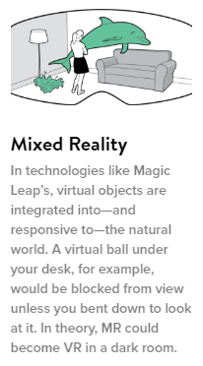
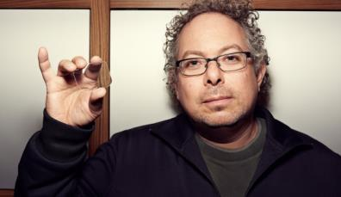
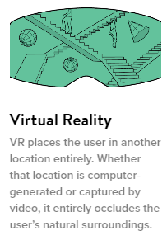
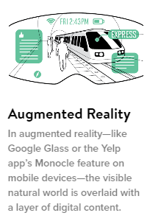
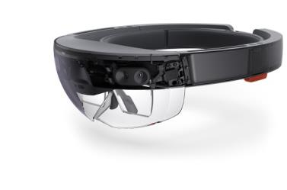
Teaser
Project idea description
Leverage technology to create scalable cyber security training and simulation software with increased learning outcomes and motivation
3 trillion USD global education market
E-learning is expected to more than triple within the next 4 years
2012: $91 billlion industry
2017: $251 billion industry
Hakan KILINÇ, NETAS, hakank@netas.com.tr

Slide 3
Organisation Profile
48 years experience, first and largest private telecom and software development company in Turkey
Develops ICT software solutions for more than 200 global operators
The biggest ICT system integrator company in the region
2200+ employees - 750+ highly qualified R&D engineers (25% with MSc & PhD)
Turkey’s software export champion
65 scientific articles (journal papers, conference precedeings) in three years
First runner-up of ICT sector in Turkey’s patent classification @2013, Over 70 yearly patent applications
R&D 4G Development, IMS, VoIP services, Web applications, HW SW Communications, Cyber Security Products etc.
Hakan KILINÇ, NETAS, hakank@netas.com.tr

Slide 4
Organisation Profile
NOVA Cyber Security Technology Research&Development Centre
Mission: Foster excellence through collaborative effort to delivers products and services that significantly enhances security and continuity of critical ICT systems that serves society and the businesses.
Research Areas
- Architecture for Scalable, Higly Available Network Data Processing with Low Latency
- Big Data Analytics for Network/Applications, Machine Learning and Anomaly
Detection, Behaviour Analysis
- Media Communication Security , End-to-End Security
- IoT/M2M System Architecture and Security
Products and Services
- VoIP & Web Application Firewalls
- VoIP & Web Application Vulnarability Scanning Tools
- Media Security Platform as secure communication infrastructure
- Penetration Test for Enterprises ( Network, VoIP, Web )
Hakan KILINÇ, NETAS, hakank@netas.com.tr

Slide 5
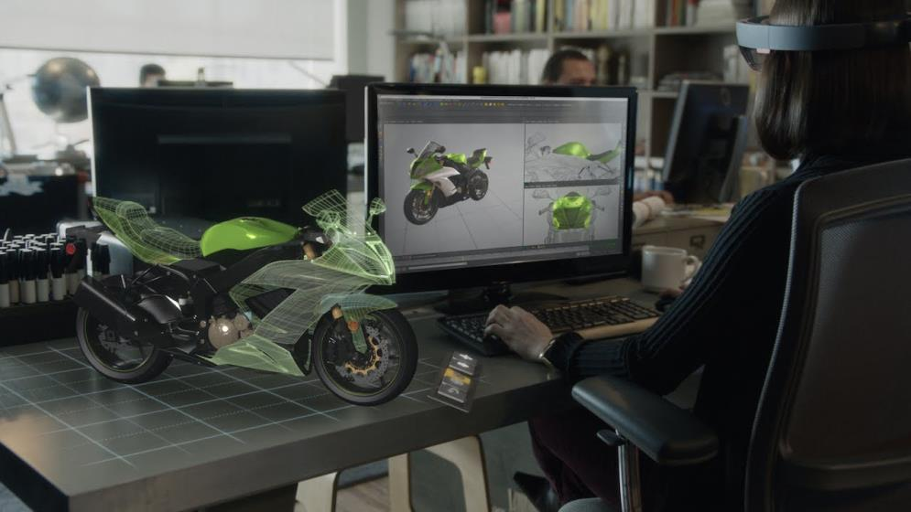
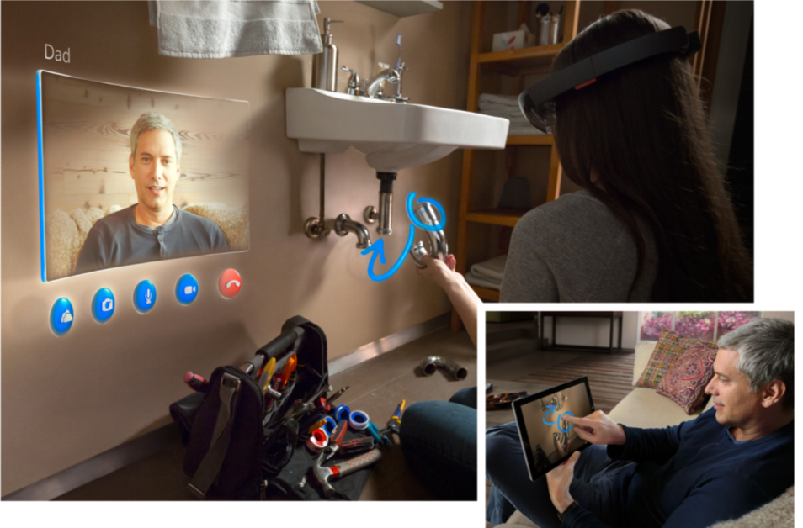
Proposal Introduction
Simulators
Faster Learning (Hays et al. Psychology 4,63-74)
Cost Savings
Funny and interactive content
Engaging realistic scenarios
Innovation
Combination Augmentad Reality & Virtual Reality
Expensive equipment fully simulated
Enhanced Lab Automation Engine
Removing static flat display monitors
Hakan KILINÇ, NETAS, hakank@netas.com.tr

Slide 6
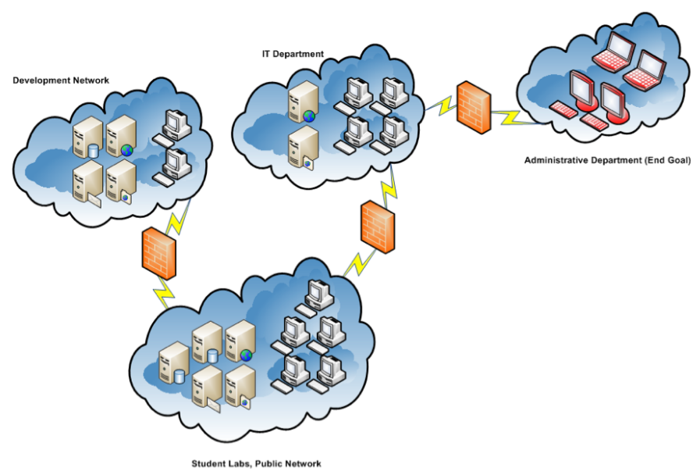
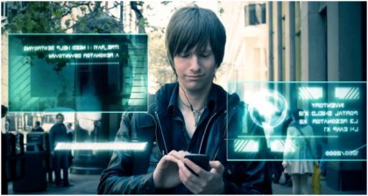
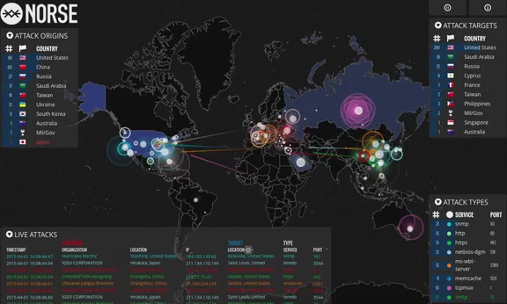
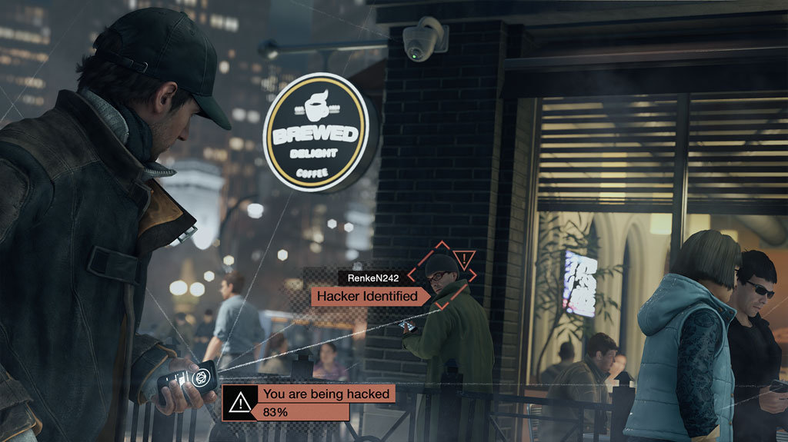
Cyber Security Lab
Malware Analysis
Mobile Security Lab
Forensic
Software Security
Penetration Test
SCADA
VoIP-4G/LTE Security
Security Operation Center
Reverse Engineering
Capture The Flag-CTF Competition
Hakan KILINÇ, NETAS, hakank@netas.com.tr

Slide 7
Partners
Partners involved
Not Yet.
Missing partners / expertise
Massachusetts Unstitute of Technology
University of Exeter
Harvard University
Hakan KILINÇ, NETAS, hakank@netas.com.tr

Slide 8
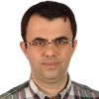
Contact Info
For more information and for interest to participate please contact:
Hakan KILINÇ
hakank@netas.com.tr
+90 (216) 522 25 59
Osmanlı Bulv. No 11 Kurtkoy Pendik Istanbul
www.novacybersecurity.com
Your
Photo
Hakan KILINÇ, NETAS, hakank@netas.com.tr

