Slide 1
Proposers Day 22 September 2016, Istanbul
Celtic-Plus Turkcell Technology
Bülent Kırval (Celtic-Plus Core Group Member)
bulent.kirval@turkcell.com.tr

Slide 2
Turkcell Technology History
Founded in 2007 with a vision of being the leading innovation center in ICT sector
More than 10 years of experience in Turkcell ICT
TTECH Center was put into service
Team of 700+ people with 17 customers in 17 countries
1994-2006
2007
2008
2009
2016
TTECH company formed with 44 engineers
First customers outside Turkcell Group
Our innovation is driven by our customer’s challenges and we are passionate in differentiating our customer’s business.

Slide 3
Competencies
Mobile Marketing
SIM Asset & Services Management
Value Added Services & Enablers
Roaming Solutions
Customer Relationship & Channel Management
Business Intelligence Solutions
Operation & Business Support Systems
OSS
CRM
Mobile Marketing
BSS
BI
SIM
Roaming
VAS
CUSTOM SERVICES
PACKAGED SOLUTIONS
Name, affiliation & e-mail of presenter

Slide 4
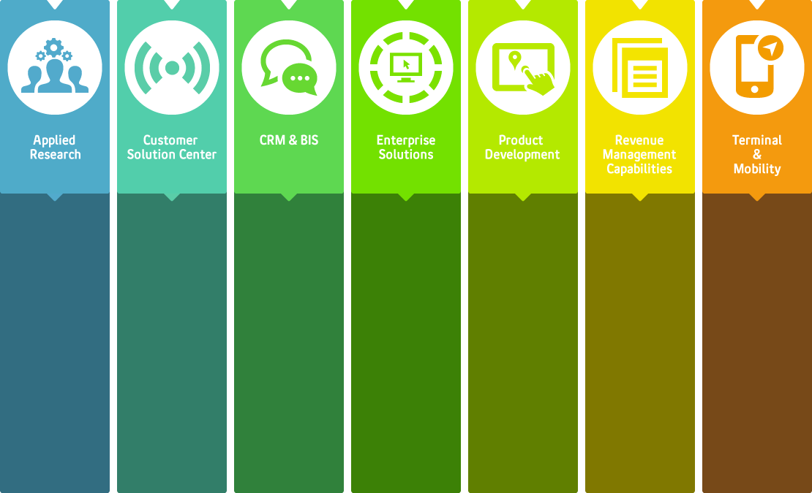
TURKCELL Technology’s Focus Areas
M2M
Embeded Systems
Computational Intelligence
Big Data & Analytics
Open source platforms
Network planning solutions
Process automation software
Enterprise applications
SaaS applications
SIM card technologies
Location-based services
Roaming solutions
VAS
Mobile financial services
CRM applications
Business intelligence applications
Campaign management systems
Charging
Billing
Collection
Mobile marketing
Mobile education
Smart Phone applications
Maxiphones
Cloud computing solutions

Slide 5
Participation in Celtic-Plus Projects
Turkcell Technology is actively participating in Eureka clusters’ management bodies:
CELTIC+
ITEA3
Participation in CELTIC+
Turkcell Technology is a member of the Celtic Board for more than 6 years.
Aim to have a sustainable competitive edge, dominate future trends through collaboration projects.
Participated in 4 completed projects
Homesnet (HBS)
CBDP (Context Based Digital Personality)
Servery
Loop
1 currently on-going project leaded by Turkcell Technology.
UPSC
Name, affiliation & e-mail of presenter

Slide 6
UPSC – Unleash the Power of SIM Project Outcomes
Project Consortium:
Turkcell Technology – Project Leader
Netherlands: Intrinsic-ID B.V, Result XL
Turkey: Turkcell Technology, Kuveyt Türk, SmartSoft, TeknoA
South Korea: CuraySoft
Project Start Date: 01 May 2014
Project End Date: 30 November 2016

Slide 7
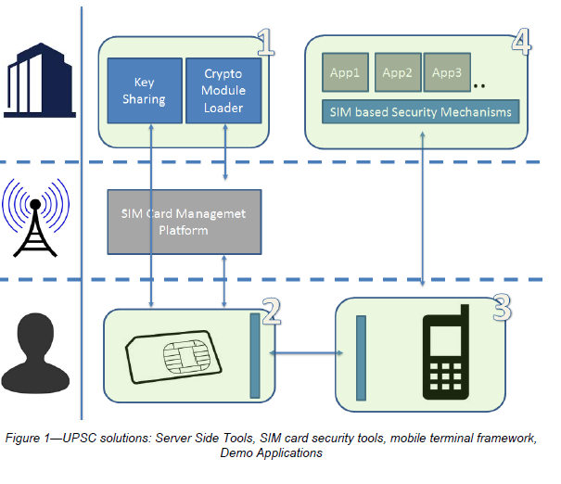
UPSC – Unleash the Power of SIM Project Outcomes
Project Goals:
Implement a software framework that expose the security functions of SIM cards to mobile applications.
Demonstrate mobile applications that utilize this framework.
www.celticplus.eu/project-upsc/

Slide 8
Project Idea: AI in a Nutshell
Title:
An end-to-end quality assurance (QA) platform for software development houses that design, implement, maintain, and frequently release large numbers of inter-connected, mission-critical Web services.
Consortium:
Turkcell Technology, Ericsson, Sabancı University:
Missing partners:
Telecommunications, banking or related fields
Companies works huge data and services with very large system architecture.
Name, affiliation & e-mail of presenter

Slide 9
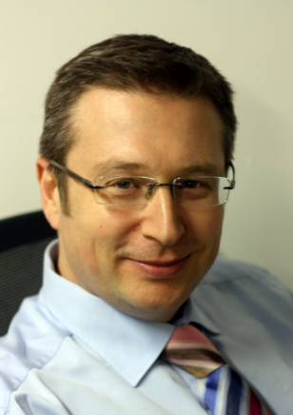
Contact Info
Name and affiliation: Bülent Kırval
(Celtic-Plus Core Group Member)
E-Mail: bulent.kirval@turkcell.com.tr
Telephone: +90 532 2101347
Postal Address: Turkcell Teknoloji A.Ş Aydınevler Mah. İnönü Cad. No:36 Küçükyalı Ofispark C Blok Maltepe / İstanbul
Name, affiliation & e-mail of presenter

