Slide 1
Celtic-Plus Core Group Meeting via WebEx, 14th September 2017

Slide 2
Agenda 1/2
Celtic-Plus Core Group Meeting Wednesday, 14 September 2017, 11:00 – 13:00
11:00 | Welcome Presentation of participants Agreement on the proposed agenda Review action points from previous meeting | Jacques / Peter
11:15 | Celtic-Plus Label renewal (this is the main subject of this CG Meeting all other topics will be done as second priority) Timetable towards prolongation Get support from the PAs for the continuation of Celtic Support from Core Group members Cluster Guidelines | Core Group Members
12:25 | BMBF Meeting Experts discussion on the future form of EUREKA Clusters | Peter
12:30 | Projects and Calls Situation of projects finished, running, starting 4 Proposals received in the Celtic-Plus Spring Calls 2017 Labelling & national evaluations Running projects | Peter

Slide 3
Agenda 2/2
Celtic-Plus Core Group Meeting Wednesday, 14 September 2017, 11:00 – 13:00
12:40 | Inter-Cluster and EUREKA activities Summary of achievements Participation in EUREKA Working Groups To do’s and way ahead | Jacques / Peter
12:45 | Upcoming dates and Meetings Autumn Call ends on October 16th. EUREKA HLR Meeting in Tampere 17th - 19th October SENDATE MTR Event 21st - 23rd November Luxembourg Proposers Day on December 13th | Peter and All
11:50 | Past Events and Meetings Proposers Day at Deutsche Telecom in Berlin in February. Celtic Event in Barcelona on 18th – 19th May Proposers Day in Helsinki on June 20th | Peter and Management Team
12:55 | Any Other Business HIPERMED Next meetings of the Core Group and CELTAC | All

Slide 4
Action points previous meetings
Number | What | Who | Status
01 | MONALIS & MUSCLES: distribute to the Core Group and PA’s a 1 page abstract on what the withdrawing Finish partners contributed to the project. The Core Group and the Public Authorities can help to find new partners. | Celtic Office | Expertise received from Antonio; Mail to Core Group: no reaction Mail to Ayman, no input yet
02 | H-Opto: Turkcell considers to resubmit a Celtic proposal in Turkey | Turkcell | pending
03 | StayIn: Orange double check if Orange Poland withdraws from the project. | Orange | pending
04 | Provide the expertise of rejected partner to Core Group Members helping the projects to find replacement. | Celtic Office | pending
05 | Core Group substitute policy: As a suggestion in the invitation to the next Core Group Meeting. “Participation is required; it is not optional; if you can’t make it you are invited to send a replacement. (Each core group Member could ask internally for a replacement if not available himself for the meeting.) | Celtic Office / Core Group Members | Done: suggestion will be implemented
06 | Decide how much support and contribution to the inter-cluster committee activities Celtic could afford; take a decision before end of 2017 concerning our position for the 2018-2019 inter Cluster spokesperson-ship. | Management team / Celtic Office | pending
07 | The programme for the Helsinki Proposers Day has been finalized. Keynotes on 5G, Industrial Internet and eHealth are confirmed. | Jari | done
08 | Experts for SENDATE MTR: Peter will distribute a short explanation on what kind of experts are required Olivier and Riza help to find the needed experts. | Peter Olivier, Riza | Done; PAs where involved, DGE suggested a reviewer from OVH
09 | On 14th September from 11:00 to 13:00 a Core Group WebEx meeting will be organized. | Celtic Office / Core Group Members | Invitation was sent
10 | Core Group and label meetings planned at SENDATE MTR Event: Label Meeting Monday afternoon Nov. 20th and Core Group Meeting Wednsday Morning Nov. 22nd | Celtic Office / Core Group Members | Meeting Rooms being asked to Orange.

Slide 5
Celtic Label renewal
Timetable towards prolongation
(under the Finnish EUREKA Chair)
The Finnish Chair was asked for a slot in the programme of the EUREKA October meeting to present the plans towards the Celtic Label renewal.
To do:
Work out the presentation for the October meeting.
Open Celtic to the Vertical sectors
Get support from the PAs for the continuation of Celtic.
Get support from the actual Core Group members – Inputs for Industrial Vision Statement and Technology Roadmap to be worked out.
Ask for reactivation of sleeping Core Group Members and accept new Core Group Members.

Slide 6
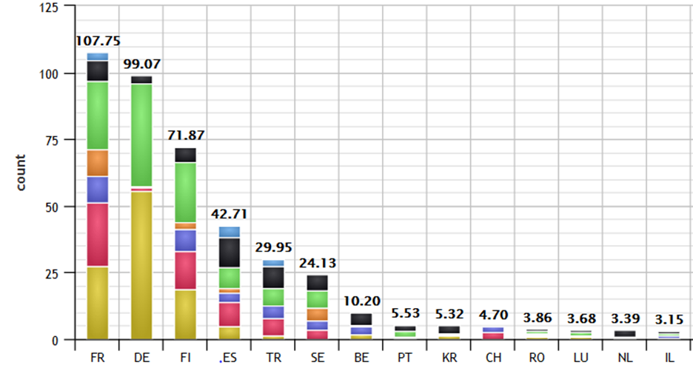
Celtic Label renewal
Get support from the PAs for the continuation of Celtic
We already received an offer from the DE Authorities to get support.
We assume that we can get the following Countries supporting the continuation of Celtic: Germany, France, Finland, Spain, Sweden, Turkey, Belgium, Austria, Portugal, Hungary, Israel, S-Korea, Switzerland, Poland, Romania and Luxembourg.
More tricky are: Netherlands, Italy, UK, Norway, Ireland
If we go again for 1000 M€, this implies that countries would contribute:
For comparison Celtic 2011-2016
2015
2011

Slide 7
Celtic Label renewal
Support from Core Group members
Inputs for Industrial Vision Statement and Technology Roadmap: Work out Index of the document; actualise the actual document on Scope and Research Areas 2016/2017 and fill it with contributions.
Italy (BMBF meeting): the trio Germany, France and Italy is needed (action at EUREKA level). (Italtel): The new Core Group representative Paolo Crosta is very interested to lobby in Rom. He contacted already Telecom Italia and WIND.
UK: takes over the EUREKA Chair in 2018-2019. Find out with our Core Group Member BT, if Celtic Projects will be financed.
Possible new Core Group members:
  Telvent (Spain) possible interest indicated by CDTI
  Bosch (Germany) BMBF meeting on July 06
  Airbus (France or Germany)
  Large SMEs were proposed in earlier meetings

Slide 8
Celtic Label renewal
Ask for reactivation of sleeping Core Group Members
accept new Core Group Members
What to do with inactive Core Group Members?
Minimum Role to be found:
  Contribute to the writing of the technology roadmap.
  Contribute active Reviewers in the Celtic Groupe of Experts
Possible new Core Group members:
Televes (Spain) possible interest indicated by CDTI
Bosch (Germany) BMBF meeting on July 06
Airbus (France or Germany)
Large SMEs were proposed in earlier meetings
Associations such as ERTICO and CLEPA

Slide 9
Celtic Label renewal
Core Group Members Activity (active in Celtic meetings in bold):
ATOS Research, Spain (some review activity of N. da Lama)
British Telecom, UK (regular activity in projects and in GoE)
Deutsche Telekom, Germany
Ericsson, Sweden
Eurescom, Germany
Orange-Labs, France
Gemalto, France
imec, Belgium
INDRA, Spain
Italtel, Italy (regular activity in GoE)
NETAS, Turkey
Nokia, Finland
RAD Data Communications, Israel (participation in WebEx Core Group Meetings)
Siemens Convergence Creators GmbH, Austria (some review activity of M. Zach)
Telefónica I+D, Spain (Partner in Cloudbook)
Telenor, Norway (unsuccessful attempt to participate in SENDATE)
Thales, France
Turkcell, Turkey
Türk Telekom, Turkey

Slide 10
Celtic Label renewal
Celtic E2E approach could be an enabler for Verticals:
Automotive Telecom
Inteligent Mobility
I 4.0,
E-Health
FinTech meets Telecom
Future Media
Smart Farming, Smart Power, Smart Manufacturing, Smart City…
  => Smart Everything

Slide 11

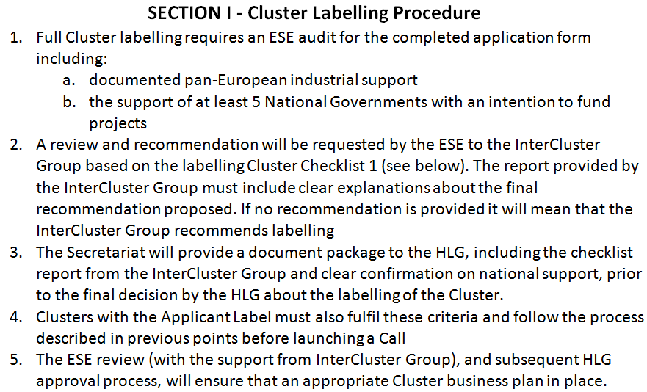
Cluster Guidelines

Slide 12
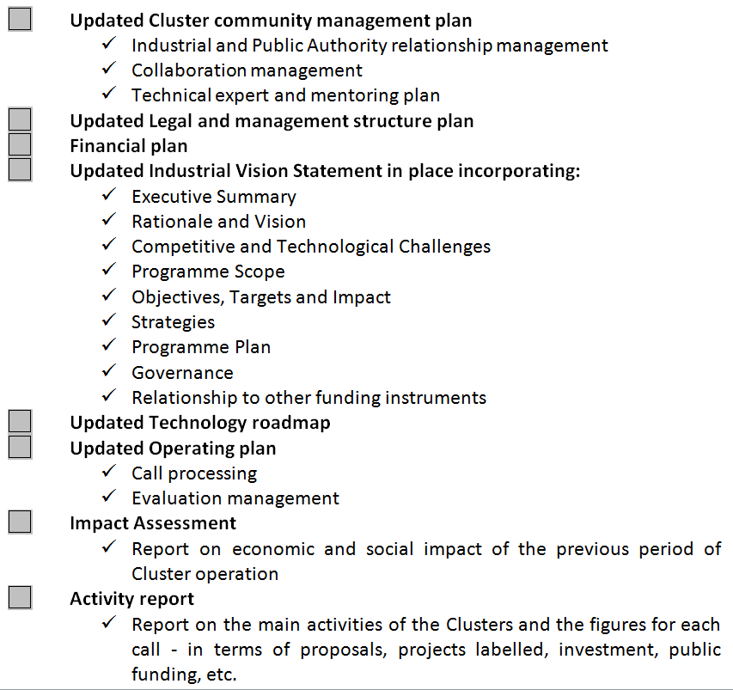
Cluster Guidelines

Slide 13
New Name
The Management Team proposes:
Celtic-NG (Next Generation)
Next generation of Celtic Cluster for NG Networks, Clouds, Services and Verticals.

Slide 14
Celtic Label renewal
Deliverables:
D1 Documents for October 2017 Meeting
D2 Documents for March 2018 Meeting
D3 Label Renewal End of June 2018
Tasks:
T0 Cluster Application Form
T1 Updated Cluster Community Management Plan
T2 Updated Legal and Management Structure Plan
T3 Financial Plan
T4 Updated Industrial Vision Statement
T5 Updated Technology Roadmap
T6 Updated Operating Plan
T7 Impact Assessment
T8 Activity Report

Slide 15
Time table: October HLR
Objective: The strongest possible statement
First Slide Set
12-Sept-2017
Review:
Management team, Selected CG & PA
Fi Chair
Final Slide Set
06-Oct-2017
HLR Meeting
17-19 Oct.

Slide 16
Time table: March HLR
T0: Cluster Application Form
Draft: 20-Sept-2017
Inputs from:
October HLR
T1 – T8
T0: CAF Final
10-Feb-2018
T1, T3, T6?, T7, T8:
Draft: 25-Sept-2017
Management Team + ?
T2: Legal & Management First Draft: 20-Sept-2017
Feed back Core Group + Legal Representatives?
T1, T3, T6?, T7, T8 10-Feb-2018
T4, T5: Vision + Roadmap
First Draft: 20-Sept-2017
T2: L&M Final
10-Feb-2018
Feed back Core Group + PAs
T4, T5: V&R Final
10-Feb-2018
HLR Meeting
6-8 March 2018
Objective: Formal application

Slide 17
Improved Call Process
Jan.
Goal:
Dec.
Feb.
Reduce the hurdle to first feedback
For some Celtic participants the elaboration of a full proposal without prior feed back on the validity of their idea might be considered as too risky.
Proposal: formalise a GoE feedback loop based on abstracts before the call deadline
Abstracts for
feedback
Nov.
March
Autumn Call
Oct.
April
Spring Call
Sept.
Abstracts for
feedback
May
August
June
July

Slide 18
BMBF Meeting on 6th of July
Experts discussion on the future form of EUREKA Clusters
German HLR Mrs Susanne Burger called for this meeting.
Main findings:
The ministry was astonished how bad the EU program and ECSEL were rated by the panel of industry representatives. Typical for this was the statement from Norbert Fabricius from Karlsruhe Institut of Technology: “How desperate must one be to write research proposals with a chance of success of 10 %”.
A strong need for a mayor lobbying action in Italy has be identified and seen as the mayor priority of the moment. Mrs Burger will try to put it on the agenda for the ministerial meeting that will take place in Helsinki. In this context the renewed interest from Paolo Secondo Crosta new Core Group member from Italtel comes exactly at the right moment.
Very interesting is also the proposal the FP9 should focus on questions that are relevant for Europe on a larger scale, and the EUREKA should focus on questions that are of interest of a limited number of member States wanting to progress on a given subject (like this is done in SENDATE).

Slide 19
Celtic-Plus Projects
6 projects will finish in 2017
10 projects with a budget of 77 M€ are in the set-up phase; the big challenge is to get these projects funded.
Up to now 3 projects started in 2017 and the SE participation in SENDATE-Ficus has been decided, 21 projects (including Wins@HI) with a total Budget of 165 M€ are currently running.

Slide 20
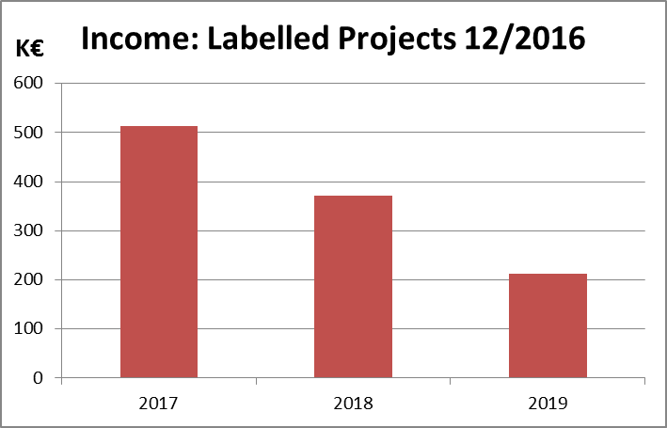
Budget Outlook
Projects
2018
Projects
2017
Projects
2017
In 2017, the time to start projects is becoming longer, even though two projects from 2016 started within 6 months, thanks to the fast funding decision of the coordinating country Sweden.
The figures for 2018 and 2019 will depend on how much time it takes to start projects, and on new proposals submitted in 2017 and 2018.
Faster funding decisions and more proposals are needed.

Slide 21
Starting and running Projects
Finished
Running
Set-Up

Slide 22
Starting projects
Projects Labelled before 2016
  MUSCLES: Project running with IL, LU, PT and TR.
  MONALIS: Project running with ES, PL and PT. IL: Application has been submitted. FI: funding application rejected,
  WINS@HI: The project is running with ES and PT; In RO: is an open call; TR & CA withdrawing (negative funding decision in TR). PCR in Sept.
  STeM: TR: positive but wait other countries decision. PT: Proposal has been submitted, FR: Proposed to nat. call of: Competitiveness Pole?; ES: possible reapplication to CDTI.
  FReeNGES: Cancelled.

Slide 23
Starting projects
Projects from Spring Call 2016
Front-VL: Started last November with SE and AT; ES application to MINETAD in June; HU: can reapply in September result not yet communicated; Reapplication in FI; NO call in October.
H-Opto: Started in December with SE and UK (BT self-funded). ES: application to Innoglobal in June; TR: they are planning to apply for funding; PL: will reapply to call in September with reduce budget.
Cloudbook: ES: Nokia is funded by CDTI; EXPERIS applied (Minetad), Telefónica submitted to CDTI, TR: decision in September, LU: Industry joins (mandatory condition), RO: resubmission in September.
HoT: NL: TNO self-funded and coordinates the project; TR: PCR five new partners: Ericsson, Turkgen, Lostar, Vestel and Koc University. FR: self-funded? figures revised for Orange and Busit. PT: application submitted.
StayIn Cancelled: Orange quits the project, lack of public support from FR and PL; Mail from coordinator on 21st August that the Project is cancelled.

Slide 24
Starting projects
Projects from Autumn Call 2016
IDIMRO: NL: Self funded; TR: Expert evaluation finalized, decision soon.
SARWS: FR: Positive funding decision conditioned to a positive funding decision in BE; #BE: negative funding decision; FI: decision expected this year?; PT: the partners and coordinator failed to submit the proposal at the deadline, coordinator continues his work; ES: two partners joined, in total 9 applications were submitted to Minetad – results in Nov; S-KR: Application rejected, resubmission in March; TR: application to be submitted.
5GMEDE: 4 partner from PT joined the project and the applications were submitted; IL and TR: applications were submitted; FR: contact with DGE estabished.
FlexNet: KR: Positive funding decision; BE, ES, : funding applications were submitted; CA, TR: applications to be submitted.

Slide 25
Starting projects
Projects from Calls in 2017
ENGAGE: ES: application submitted to MINETAD; TR: contact with Tubitak to be established
fiQare: ES, PT and TR: application submitted; IT: withdrawn?
LEAN: ES: 3 partners have applied to MINETAD; FR: two new parents Tales Alenia Space & One Access) contact DGE early September; NL: no information.
Reminder:
Geofencing: was rejected

Slide 26
Labelling & national evaluations
Mismatch between:
Celtic-Plus GoE evaluation and
Evaluation of National funding Bodies
seems to be increasing.
Examples project with high rating of GoE having problems:
SPECMORE
Wins@HI
SARWS
Question: Would it be a good Idea that the GoE Evaluation Reports would be part of the input documents for the national evaluations.

Slide 27
Finished projects
UPSC:
Excellent project results;
Solution to tackle serious barriers like the thread of phishing, virus and sniffer attacks to adopt e-services as banking and transactional electronic services to mobile devices.
Framework to facilitate the access to SIM card, to unleash the SIM to its full potential. A Speedup of about 10 s has been reached for paying transactions in banks.
Notes:
Existing consortium, involved countries.
Expertise, profiles and types of partners you are looking for.

Slide 28
Finished projects
MERCO:
Good project review,
MERCOs provided a novel approach compared to existing videoconferencing systems.
The project achieved good results for creative problem solving via a brainstorming co-operative tool. The project realized a solution for complex-decision making or expert novice transfer.
Notes:
Existing consortium, involved countries.
Expertise, profiles and types of partners you are looking for.

Slide 29
Inter-Cluster and EUREKA activities
• Discussion about Celtic-NG with Finish EUREKA Chair. Next steps:
  Presentaing plans about Celtic-NG at October HLR meeting.
  Preparing document set for formal application in comming March
• Intercluster
  Next Intercluster Meeting on 18th of September.
  Celtic-Plus could take over the Intercluster chairmanship for 2017 – 2018. But this must still be discussed (including in light of the above).

Slide 30
Upcomming Meetings and Dates
Autumn Call for Celtic-Plus Proposals
  Call Deadline October 16
  Review: 17th October – 13th November
  Label Meeting: November 20th
17 - 19 October: EUREKA HLR Meeting in Tampere
22 Nov: Celtic-Plus Core Group Meeting in Paris
21 - 23 November: SENDATE MTR Event in Paris
13th December: Luxembourg Proposers Day
6-8 March 2018 : EUREKA HLR Meeting in Oulu

Slide 31
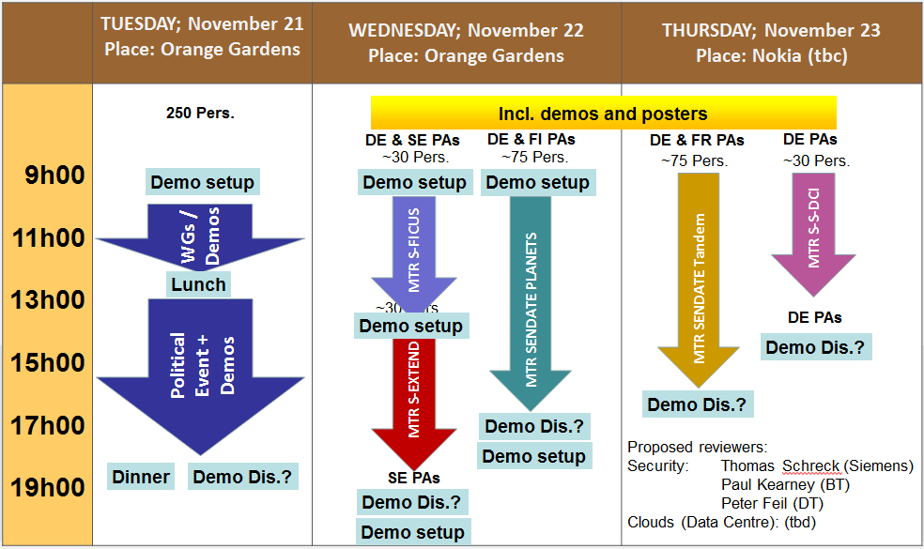

SENDATE MTR Event in Paris

Slide 32


Slide 33

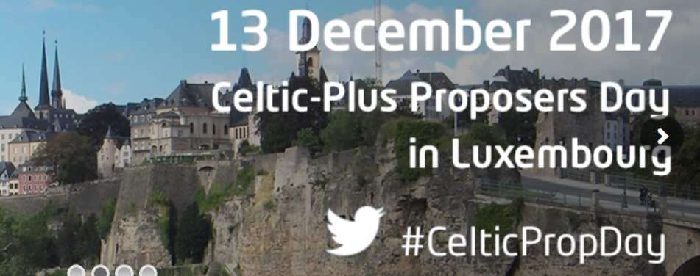

Slide 34
Past Meetings and Dates
Berlin Proposers Day
Celtic-Plus Event in Barcelona
Helsinki Proposers Day

Slide 35

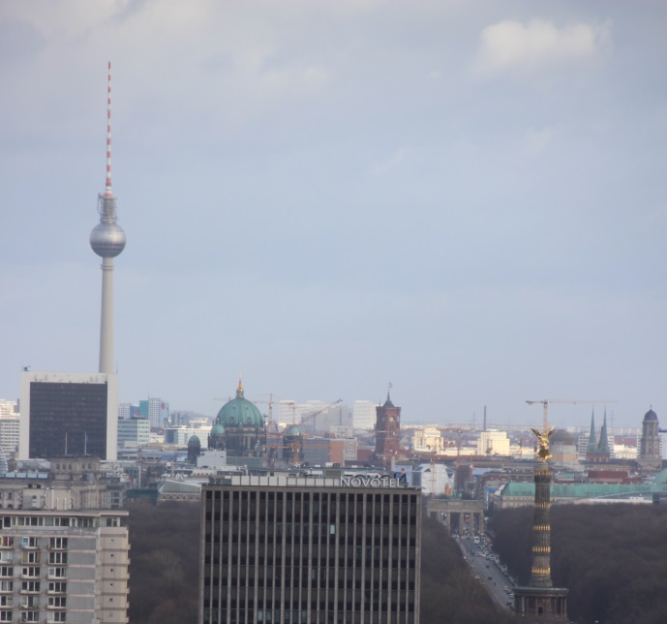
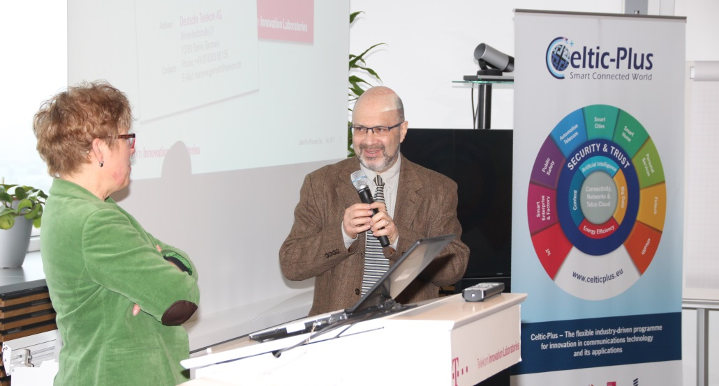
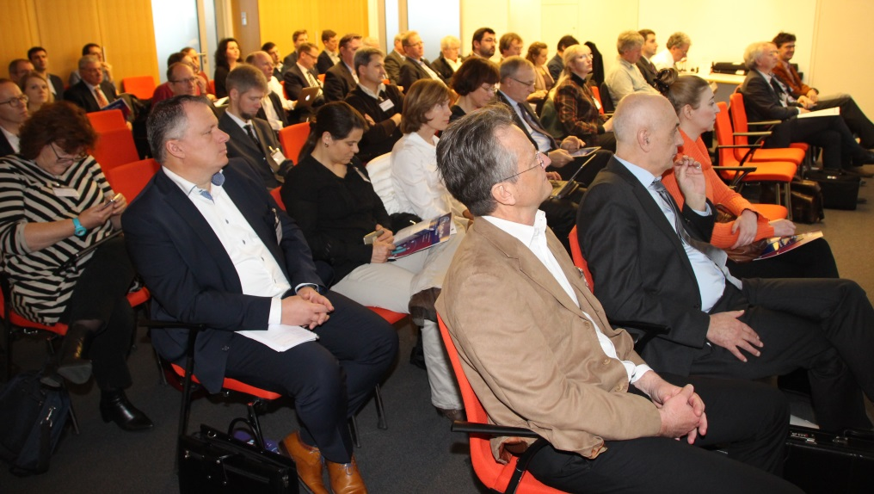
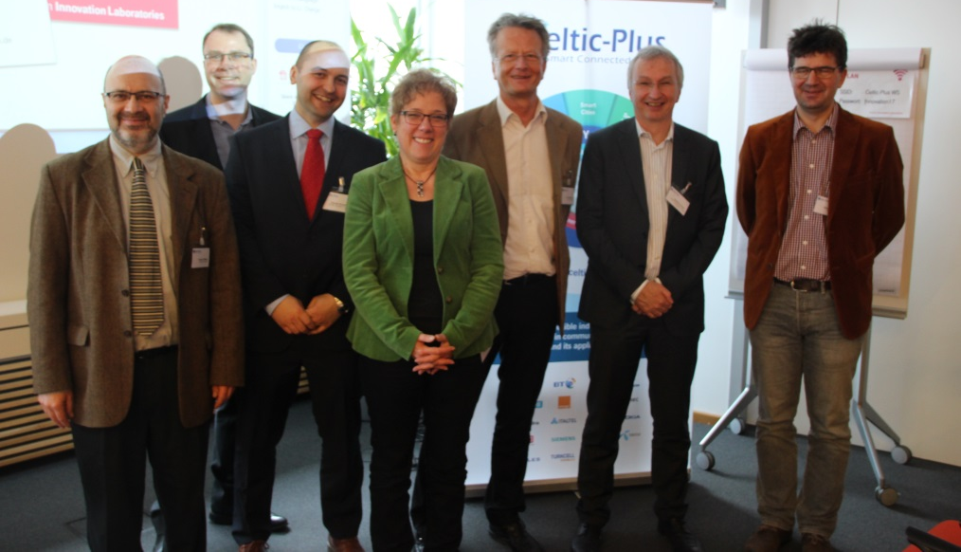
Berlin Proposers Day

Slide 36
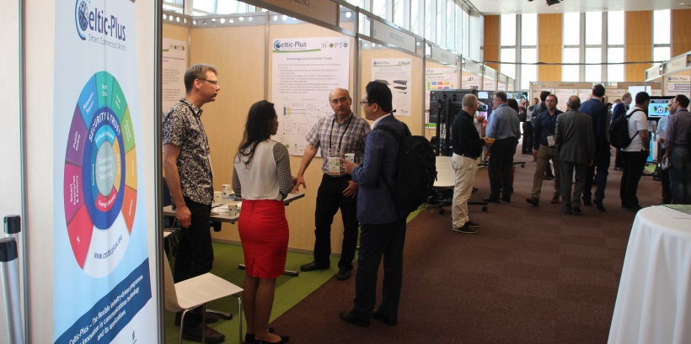

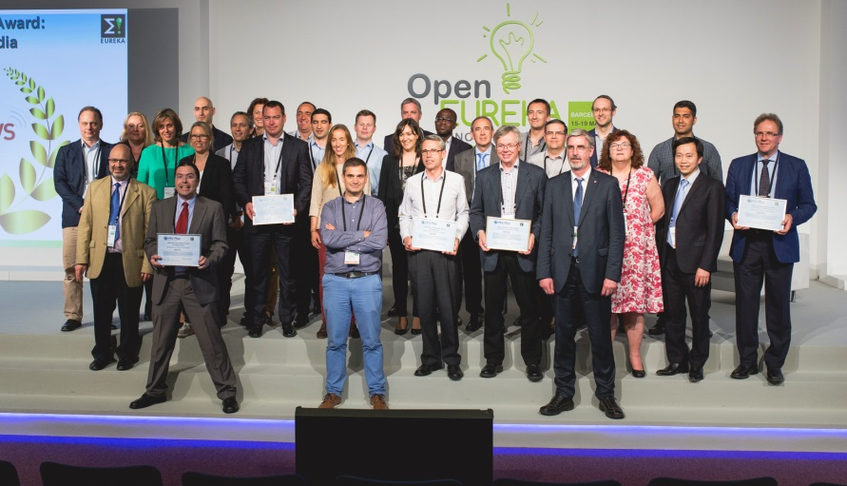
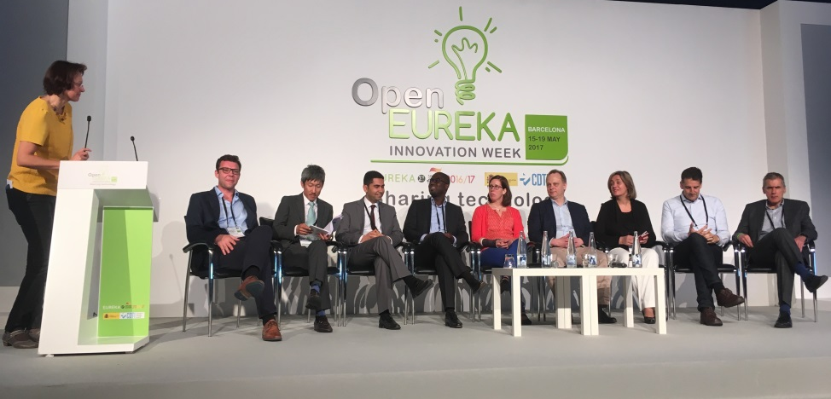
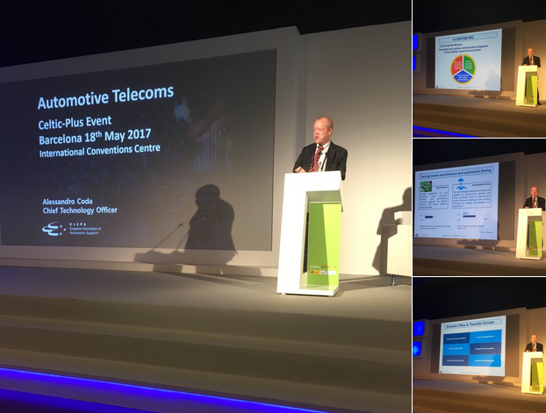
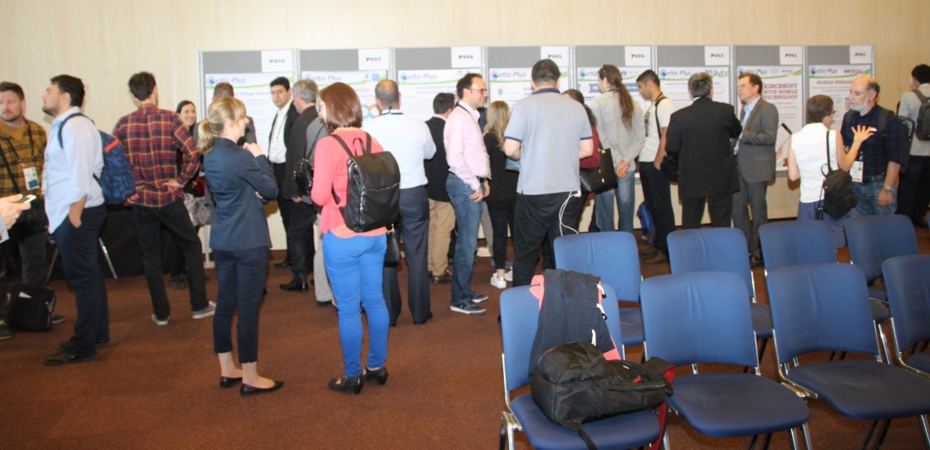
Celtic Event in Barcelona
Projects presented their results in the exhibition
Winners of the Celtic-Plus Awards 2017 and officials from Finland, France, Germany, Spain and Celtic-Plus
Round table on national funding and research topics
Alessandro Coda, Chief Technology Officer of CLEPA, the European Association of Automotive Suppliers
Discussing new proposal ideas at the Celtic-Plus Event 2017

Slide 37

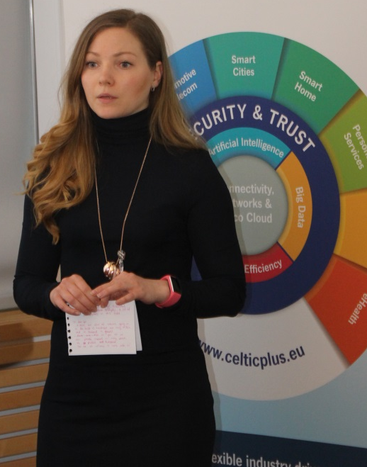
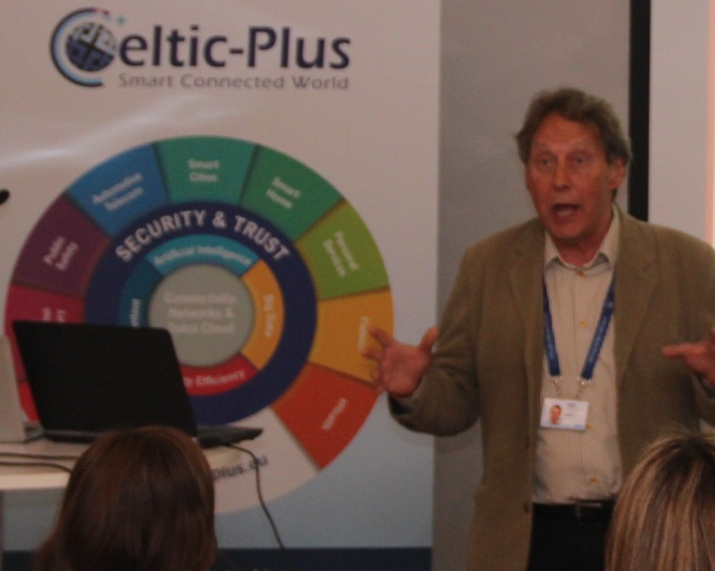
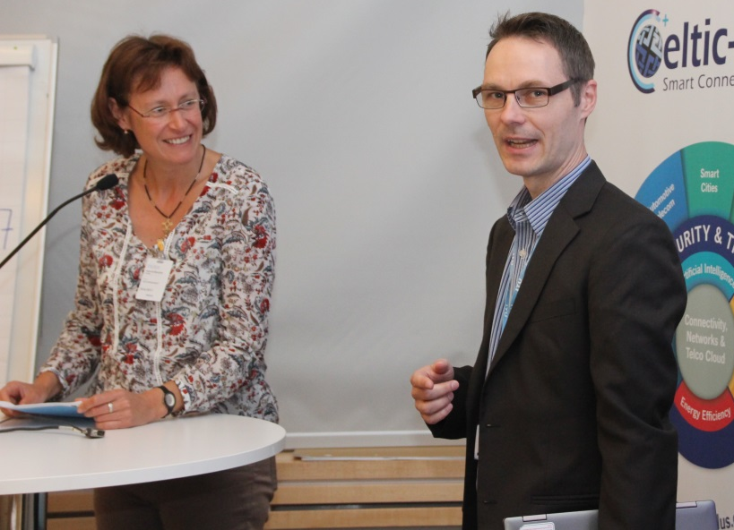
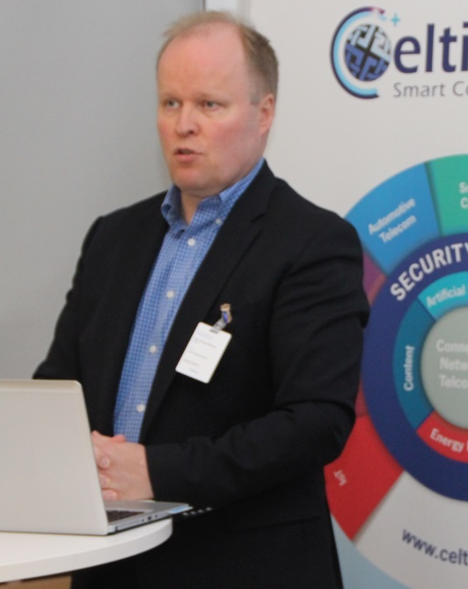
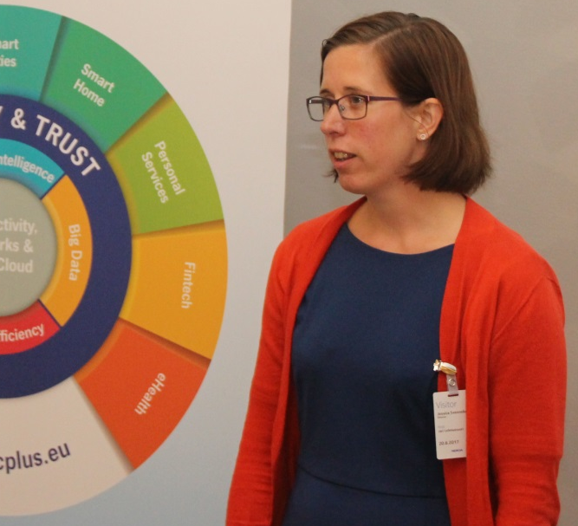
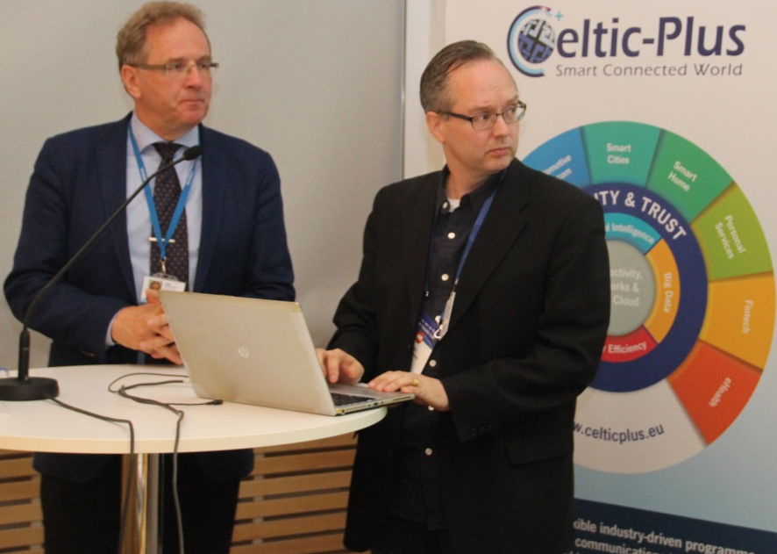
Helsinki Proposers Day
At
Welcome of Mr Reino Tammela, Head of Nokia Espoo and Tampere Technology Centre.
Valerie Blavette (Orange Labs) and Karri Ranta-aho (Nokia Bell Labs) presenting the Roadmap: LTE to 5G
Mari Koskinen from Business-Oulu presenting eHealth a case for 5G.
Kari Komulainen presenting Bits of Health program from Tekes
Jessica Svennebring from Vinnova explains why Celtic Plus is beneficial for Sweden.
Celtic-Plus Vice-Chair Jari Lehmusvuori from Nokia and Mika Klemettinen presenting the 5G Program.

Slide 38
Situation of public Funding
Roundtable on public funding conditions in:
Finland
France
Germany
Spain
Sweden
Turkey…

Slide 39
AOB
HIPERMED aid needed: (Mail from Oscar & Mail to Bertra Maure MINETAD):
The Spanish partners of the HIPERMED project are being reviewed by the Spanish ministry; irregularities are suspected for some partners.
The ministry has invited all the companies to redo the demos that were shown at the Final Review of the project.
Today the Spanish SMEs of the project are experiencing problems at different levels.
We propose to MINETAD to accept the documents from the Final Review that took place in Nancy (France) on December 12, 2013. Present in this review meeting was the main reviewer Mr Martin Zach from Siemens, Mr Geoffroy Hermann from the French DGE, and Peter Herrmann (Celtic).
The Final Review Report indicates that 5 Spanish partners were present in this review. It gives a description about the demos that were shown and that can be correlated with the “expected impact of the Results” that were provided by the Project Coordinator in the Self-Assessment.
The reviewers were very satisfied with the “excellent results” of the project.

Slide 40
Televes
Televes is a leading global company focused in the design, development and manufacture of equipment for distributing telecommunication services in buildings and homes.
The company is headquartered in Santiago de Compostela (Spain), where it keeps its state-of-the-art manufacturing facilities.
Televes is much more than a leading brand. It is the head of a Corporation comprised of strategic technological firms with a commercial presence in more than 90 countries. Televes is formed by more than 20 industrial and services subsidiaries, over 800 employees and holds more than 200 Industrial Property registers.
From antennas to professional analysers and portable meters. From vanguard head-ends, robust amplifiers to complete distribution and switching components. From solutions for unifying multimedia services in the home to cables, connectors and outlets.
Televes is synonymous of a “One-Stop-Shop” solution to deliver the television signal to the digital home environment, with the best technical support for the professional installer in charge of certifying the highest levels of quality signals.
The power of Synergies working for a common sector. Televes is placed amongst the largest three companies of the sector in Europe. A guarantee of quality and compromise.

