Slide 1
Celtic-Plus Event 28-29 April 2016, Stockholm
Pitch of the Project Proposal IoT enabler
Purificación Amaya Trinidad
Sinapse Energía
proyectos2@sinapseenergia.com

Slide 2
Teaser
IoT Enabler
Any devices connection
Operable in existing platforms.
Interconnection with other elements.
Accesories.
Purificación Amaya Trinidad, Sinapse Energía, proyectos2@sinapseenergia.com

Slide 3
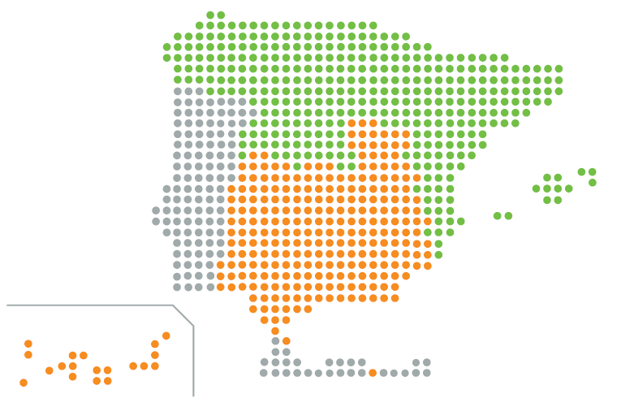
Organisation Profile
Experts in lighting control systems
Provide Telecommunication and Hardware experience for IoT enabler development project.
SME located in Spain
Huesca
and
Cádiz
www.sinapseenergia.com
Purificación Amaya Trinidad, Sinapse Energía, proyectos2@sinapseenergia.com

Slide 4
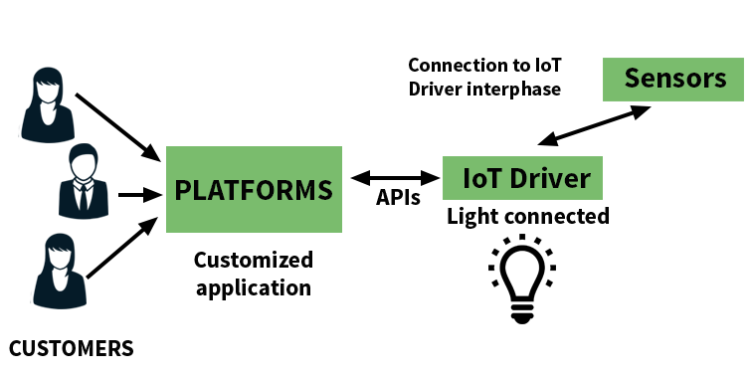
Proposal Introduction
Transforming devices into IoT technology available for Smart Cities.
Easy to integrate, adaptable, scalable, APIs for communication with platforms…
An example: IoT enabler integrated in Driver for LED technology control.
Purificación Amaya Trinidad, Sinapse Energía, proyectos2@sinapseenergia.com

Slide 5
Partners
Experts in software development
Provide Telecommunication and software experience for IoT enabler development project.
Located in Austria,
Graz
www.eluxoon.com
Partners profile we are looking for…
platforms, packaging (product and connections requirements), Business Development consultacies, marketing companies, sensors, portable solar cells…
Purificación Amaya Trinidad, Sinapse Energía, proyectos2@sinapseenergia.com

Slide 6
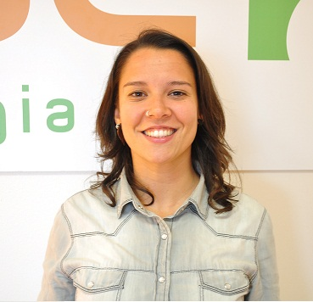
Contact Info
For more information and for interest to participate please contact:
Purificación Amaya Trinidad
proyectos2@sinapseenergia.com
Telephone: +34673103383
Postal Address: Chile street, Parcela I-4. nave A-6, Polígono Industrial Bajo de la Cabezuela, Puerto Real, Cádiz, Spain
www.sinapseenergia.com
Purificación Amaya Trinidad, Sinapse Energía, proyectos2@sinapseenergia.com

