Slide 1
Celtic-Plus Event 28-29 April 2016, Stockholm
InnovaTTion Spain
Carlos Juiz, VP of Turistec for EUREKATOURISM+ , vpeureka@turistec.org
Elena Villa, CEO of Turistec and EUREKATOURISM+ , directora@turistec.org

Slide 2
Teaser
InnovaTTion Spain is the new open networking for Tourism and its Technologies
InnovaTTion Spain is an open marketplace where our ideas and projects come true
You can navigate through the huge network of the platform to find offers that may suit your Innovative needs
InnovaTTion Spain will give visibility to all AEITs (Innovative Business Organizations) adhere in a collaborative environment and interaction..
Elena Villa, directora@turistec.org; Carlos Juiz, cjuiz@uib.es; vpeureka@turistec.org

Slide 3
Organisation Profile
Turistec is an international cluster, dedicated to Information and Сommunication Technologies applied to tourism with the mission:
To generate our partners´ competitiveness by stimulating innovation;
To strengthen ICTs in tourism with the latest specialized products and services, so that companies create better solutions for their customers;
To promote sustainable economic development while we aim to be a point of reference worldwide.
Mainly Turistec contributes to socio-economic development connected to tourism, anywhere in the world. We do this by improving competitiveness in ICT-tourism companies.
Elena Villa, directora@turistec.org; Carlos Juiz, cjuiz@uib.es; vpeureka@turistec.org

Slide 4
Proposal Introduction
The technological platform will give visibility to all AEITs in a collaborative environment and cooperation.
This tool will allow the visibility of companies that are innovating and providing extraordinary value added to the sector, allowing the generation of synergies and increasing business opportunities and promotion.
Elena Villa, directora@turistec.org; Carlos Juiz, cjuiz@uib.es; vpeureka@turistec.org

Slide 5
Partners
InnovaTTion Spain is developed by the University of the Balearic Islands (UIB), Spain.
It is a national project for all AEITs of Spain.
Elena Villa, directora@turistec.org; Carlos Juiz, cjuiz@uib.es; vpeureka@turistec.org

Slide 6
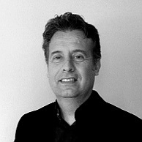
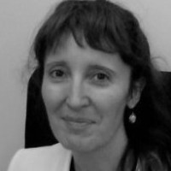
Contact Info
For more information and for interest to participate please contact:
Carlos Juiz,
Vice-President of Turistec for EUREKATOURISM+
cjuiz@uib.es; vpeureka@turistec.org
Elena Villa,
CEO of Turistec and Head of EUREKATOURISM+
directora@turistec.org
+34 971 104 199
http://turistec.org
Elena Villa, directora@turistec.org; Carlos Juiz, cjuiz@uib.es; vpeureka@turistec.org

