Slide 1



CELTIC-NEXT
Proposers Day
26th September 2018, Madrid
Pitch of the Project Proposal
ACZIDENT
Mr. EMILIO MULET
emilio.emulet@accuro.es

Slide 2



MONITORING in cities, “Vulnerable Road Users”
During last 50 years, many significant technological advancements have been observed by the human being, namely in terms of road safety. Indeed, considering that by 2050 about 70% of the world’s population is expected to live in cities, there is a move to revolutionize TRAFIC MONITORING in cities, in our approach to the “Vulnerable Road Users”
www.celticplus.eu ACCURO TECHNOLOGY (SPAIN) - Mr.EMILIO MULET - emilio.emulet@accuro.es

Slide 3

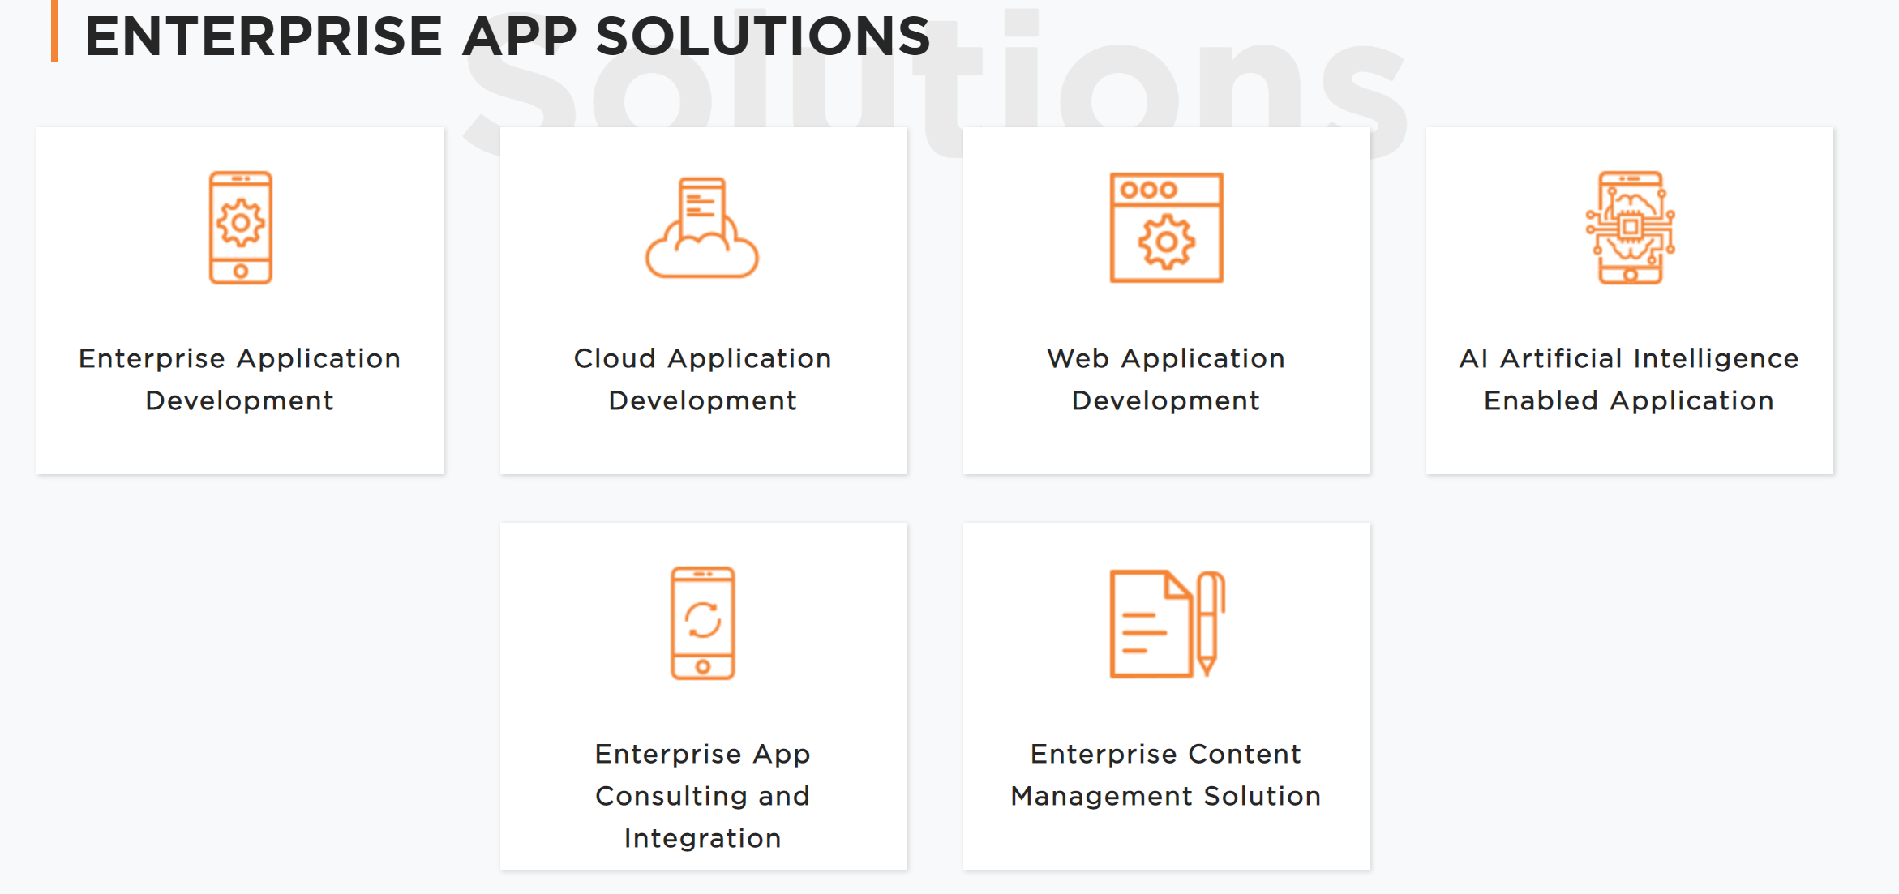
www.celticplus.eu ACCURO TECHNOLOGY (SPAIN) - Mr.EMILIO MULET - emilio.emulet@accuro.es

Slide 4


the creation of awareness for an unpredictable behaviour
Problem is that the focus is on bringing people living in cities to stop being the problem and start being the solution, taking into account the characteristics of the VRUs, along with their physical and emotional state, allowing, for example, the creation of awareness for an unpredictable behaviour. This project idea emerged from the need to strengthen the foundations of Smart Cities and, thus, empower Citizens.
www.celticplus.eu ACCURO TECHNOLOGY (SPAIN) - Mr.EMILIO MULET - emilio.emulet@accuro.es

Slide 5

Smart City’s approach to crowd sensing
The ACZIDENT PROJECT aims to present a proof of concept on a Smart City’s approach to crowd sensing, validating that our concept is feasible and has practical potential.
The goal is to have several methodologies to tag peoples behavioural habits at a particular point of interest for VRUs, such as pedestrian crossings. Such information may be relevant to a number of applications, allowing one to promote greater and better security measures on crossing spots, enhance crowd control and urban planning.
www.celticplus.eu ACCURO TECHNOLOGY (SPAIN) - Mr.EMILIO MULET - emilio.emulet@accuro.es

Slide 6
Partners
WE WELCOME
AUTOMOTIVE OEM (ORIGINAL EQUIPMENT MANUFACTURER)
TIER 1 & TIER 2 SUPPLIERS
TELECOMUNICATION COMPANIES
MOBILE APPS DEVELOPERS
INFORMATION TECHNOLOGY “IT” EXPERTS
SMART CITIES
COMPANIES RELATED WITH “VULNERABLE ROAD USERS”
www.celticplus.eu ACCURO TECHNOLOGY (SPAIN) - Mr.EMILIO MULET - emilio.emulet@accuro.es

Slide 7
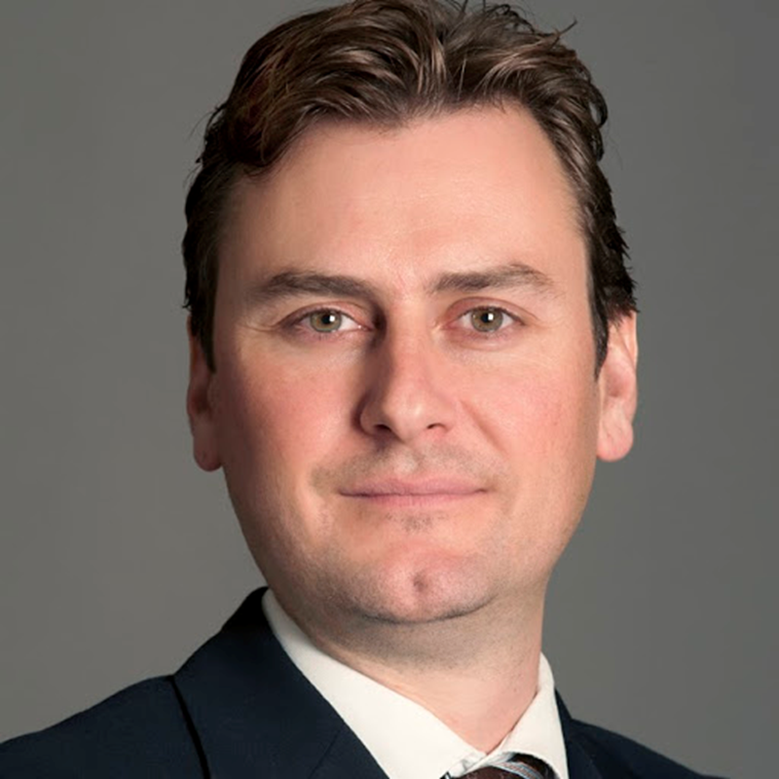
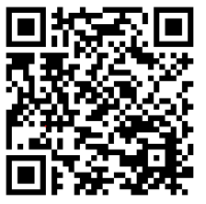
Contact Info
For more information and for interest to participate please contact:
Mr. Emilio Mulet
ACCURO TECHNOLOGY
M - +34653625586
emilio.emulet@accuro.es
                Presentation available via:
                www.tiny.cc/projectidea

Slide 8
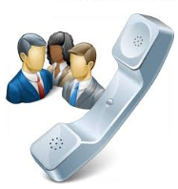
Join the follow-up Telco
3rd of October 10 CET
For PSTN Access, dial +49-6221-905280
After or during the voice prompt,
dial 5-digit conference ID 37447
(using DTMF or softphone keypad)
For International access numbers http://vc.eurescom.eu/international-info.html
For Voip (SIP) Access, dial ac@eurescom.eu.
  For help with Voip (SIP) client setup, http://vc.eurescom.eu/voip-info.html.
www.celticplus.eu office@celticplus.eu

