Slide 1



CELTIC-NEXT
Proposers Day
26th September 2018, Madrid
Pitch of the Project Proposal
Predictive Monitoring Platform for Telcos
Fernando Iglesias & Co. – Project Coordinator
figlesi@gmail.com

Slide 2

Teaser
Goal
LEAD the transition to 5G technology
How
Adapt CURRENT processes, escalating models
Distintive Feature
Guide innovation, REDUCING costs, using existing resources
Join us
PIONER project, seeking support mainly from telcos

Slide 3

Organisation Profile
We believe in our team of consultants,
together we will develop business and will grow with partners
Senior management freelance team
Extensive experience in the IT field
Well connected to key people in the IT industry
Motivated, involved and believer in the project

Slide 4

Proposal Introduction
Implement 5G technology
Develop vertical markets
Optimize existing resources
Predict risks
Monitor real time facts
Adequate business response
Forecast consumers behavioural trends
Minimum operational costs
Enhance business
Integrate Big Data & IA
Make decisions efficient
Increase sells

Slide 5



Partners
Country
Expertise
Name
IT processes development
Turkcell
www.turkcell.com.tr
Finalizing deals with
Service provider
Aurea Telecom
www.aureatelecom.com
Software & hardware development
In conversations with
Project management
Network management
Seeking from more partners currently, ideally from the telco industry: network and performance monitoring, orchestration processes.

Slide 6
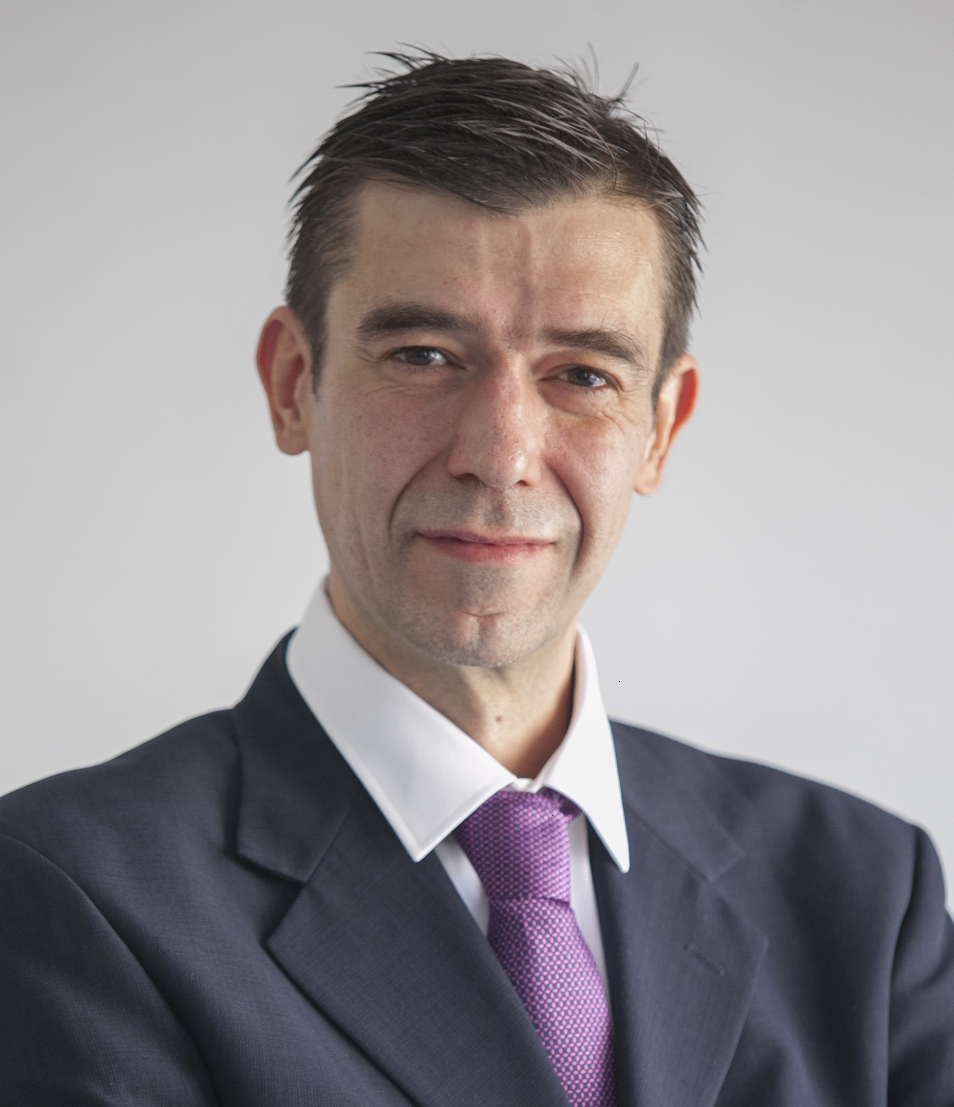


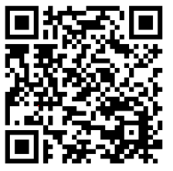
Contact Info
For more information or to participate please contact:
Fernando Iglesias & Co.
Project Coordinator
figlesi@gmail.com
+34 629 811121
Madrid - Spain
                Presentation available at: www.tiny.cc/projectidea

Slide 7

Join the follow-up Telco
4th of October 14 CET
For PSTN Access, dial +49-6221-905280
After or during the voice prompt,
dial 5-digit conference ID 33291
(using DTMF or softphone keypad)
For International access numbers http://vc.eurescom.eu/international-info.html
For Voip (SIP) Access, dial ac@eurescom.eu.
  For help with Voip (SIP) client setup, http://vc.eurescom.eu/voip-info.html.
www.celticplus.eu office@celticplus.eu

