Slide 1

Welcome
CELTIC Online Pitching Session
WebEx, 10th of December 2019
Christiane Reinsch
CELTIC Programme Coordinator
www.celticnext.eu

Slide 2


2003-2018: 16 years of success
SME participation more than 40%
  Increased throughout the years to reach more than 40% in budget
1 B€ invested in innovation
150+ R&D projects
Creation of new businesses and new market
  1045 products commercialised
  16 start-ups created
1000+ PhD and Master Thesis
900 private and public organisations
  large industry players
  small & medium-sized enterprises
  academic/research institutions
Large “flagship projects”
  Opportunity for countries and industry to work together on strategic priorities creating a major impact on European economy

Slide 3




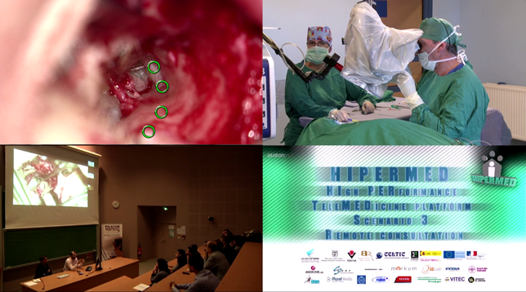
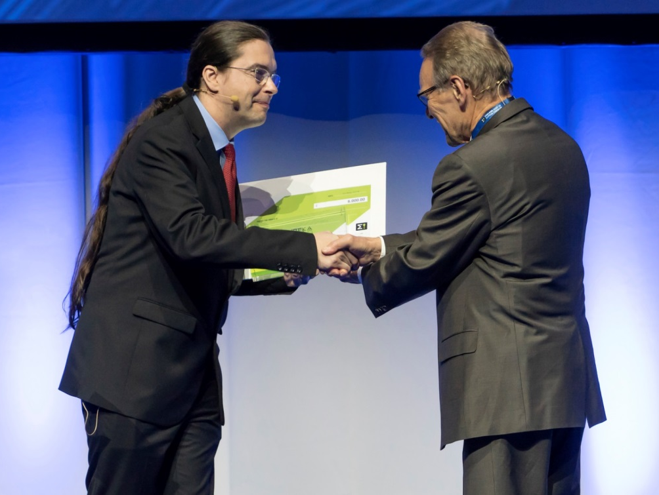



CELTIC impact on competitiveness rewarded by 4 EUREKA Innovation Awards
SME-led
project
HIPERMED
High-Performance Telemedicine Platform
Cost-effective healthcare even in remote areas
Digital
Society
HFCC/G.fast
Hybrid Fiber-Copper connectivity using G.fast
Brings broadband to the home with existing copper cables
More than 10 million premises connected by end of 2020
Network
Automati-
sation
SIGMONA
EUREKA
Global Project of the Year 2019
Customer
Satisfaction
Innovative software-defined network (SDN) concept
in generalized mobile network architectures, which has contributed to the development of 5G networks
NOTTS
Next generation OTT multimedia Services
Guarantees the video content delivery from the customer’s perspective

Slide 4
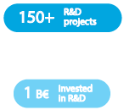
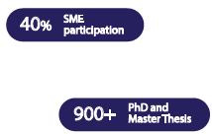

Industry Vision Statement: the CELTIC-NEXT White Paper
CELTIC-NEXT Web Page:
https://www.celticnext.eu
CELTIC-NEXT White Paper: https://www.celticnext.eu/celtic-next/
16 years of success
www.celticnext.eu

Slide 5
Updated Technology Roadmap: CELTIC-NEXT Scope & Research Areas
SERVICES AND APPLICATIONS
B1 Voice Services
B2 Data Services
B3 Multimedia and content Services
B4 Audio/ Video Services (incl. image processing)
B5 Mobile Services
B6 Cloud Services
B7 Security, Privacy related services
B8 IoT related services
B9 Teleworking
B10 Smart City related services and applications
B11 Smart home related services and applications
B12 Smart enterprise / transport related services and applications
B13 Smart traffic / car related services and applications
B14 eHealth related services and applications
B15 eGovernment related services and applications
B16 eLearning / digital school related services and applications
B17 Entertainment services and applications
B18 Gaming services and applications
B19 Location related services (incl. navigation)
B20 Business related services and applications (incl. ePayment)
B21 Societal Improvement
B22 Disaster recovery, safety
B23 Future end-to-end services
B24 Quality related aspects
CELTIC-NEXT Scope & Research Areas:
https://www.celticnext.eu/celtic-next-scope-and-research/
NETWORKING
SERVICES AND APPLICATIONS
FUTURE SERVICE ENABLERS
FUTURE INTERNET / CLOUDS
FUTURE USAGE AREAS AND MULTI-DISCIPLINARY APPROACH

Slide 6

















Organisation
National Authorities
CELTIC Authorities Committee (CELTAC)
Industry
18 CELTIC-NEXT Core Group (CG)
Management Team
Chairperson:
Valérie Blavette, Orange
Vice-Chair:
Jari Lehmusvuori, Nokia
Vice-Chair:
Riza Durucasugil, NETAS
CELTIC Office Director
Peter Herrmann
CELTIC OFFICE
Office admin
support team
Technical IT
support team
Programme
support team
PR & Marketing
support team
Finance
support team

Slide 7
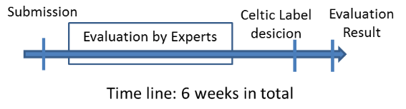
Celtic Label in 6 Weeks
Proposal submission
Evaluation
Label decision
Evaluation Results to the Submitters
In Parallel: Contact your national authorities: https://www.celticnext.eu/public-authorities/
www.celticnext.eu

Slide 8

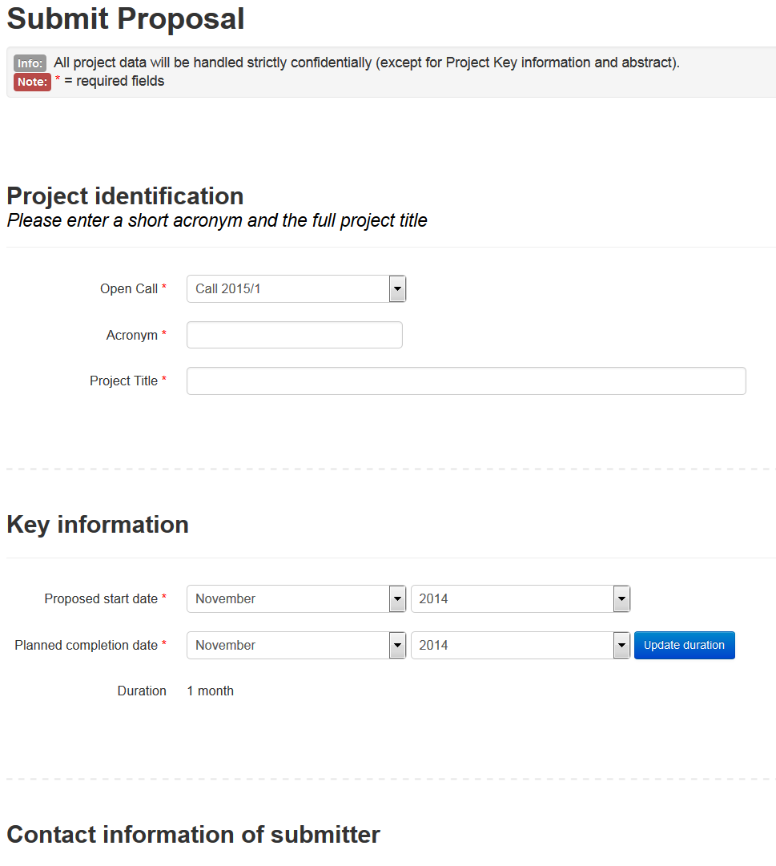
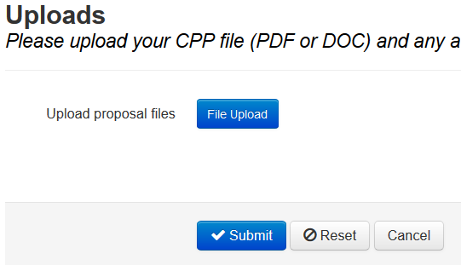
Step 1: Proposal Submission
CPP (CELTIC Project Proposal) template available on CELTIC-NEXT Web

Slide 9
Step 2: Proposal Evaluation
Evaluation by the Group of Experts^{*)} (GoE)
List of Evaluation Criteria:
1. Excellence and technological innovation
2. Strategic relevance and impact
3. Potentials for exploitation of the results and for future business
4. Quality and efficiency of the implementation of the project proposal
5. Quality of the proposed consortium
Example of a typical outcome of GoE Evaluations
S = Suitable for Labelling
M = Modifications required
N = Not suitable for Labelling
^{*)} Most Experts are from the Celtic Core Group Companies

Slide 10
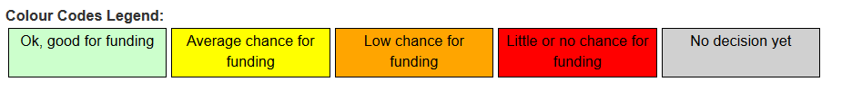
Step 2 Evaluation
2. Evaluation by Public Authorities
Example of a typical outcome of PA Evaluations:
www.celticnext.eu

Slide 11
Step 3: Label Decision
GoE
Evaluation
Results
CELTIC
Core
Group
CELTIC
Label
PAs
The decision on the label of proposals is taken in a common meeting of the Public Authorities and the CELTIC Core Group.
In addition to technical quality and business relevance national priorities can also be a criterion.
www.celticnext.eu

Slide 12

Next Steps
Starting and running a CELTIC project
In EUREKA projects the funding is granted by ministries of the participating countries.
Projects usually start when mandatory partners have green light for funding.
In the last years a success rate for running projects of more than 50 % has been achieved.
When a partner becomes active in a running project he will pay the CELTIC contributions: 1500 €/PY
www.celticnext.eu

Slide 13

Join a Labelled Project
Check Projects Overviews at CELTIC-NEXT website, with status classification of “set-up” or “running”:
https://www.celticnext.eu/running-projects/
In case of interest directly contact the Coordinator
For information on funding contact the Public Authorities
For information on the Programme contact the CELTIC-NEXT Office
www.celticnext.eu

Slide 14
Project Live Cycle
The Celtic-Office supports with tools, templates and advice
Project Preparation
Project Active
Project Idea
Project Proposal
Project Kick-Off
Mid-Term Review
Final Review
Exploitation
of Results
CELTIC-NEXT Label
Cooperation Agreement
Submission to CELTIC-NEXT
Get funding in part. countries

Slide 15
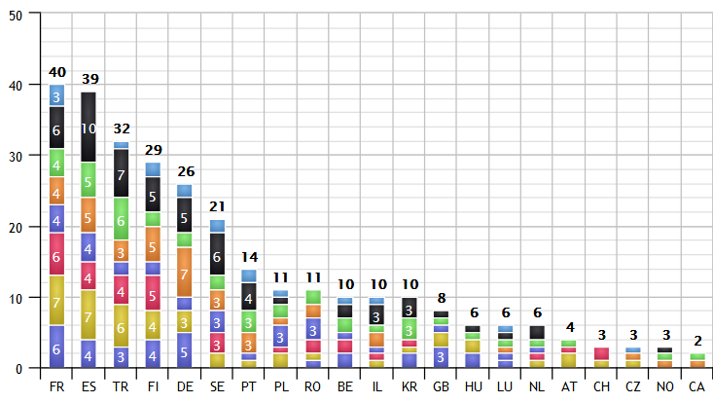

Active Countries in CELTIC
Number of projects
www.celticnext.eu

Slide 16
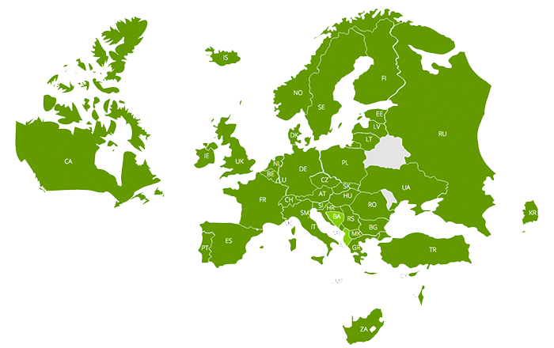
Opportunities to collaborate globally
South Korea
Canada
And in the future
also with other countries
like Japan…
www.celticnext.eu

Slide 17


Next CELTIC Spring Call 2020
Submit your project proposal:
Call open until 30th of March
Preparing and submitting a CELTIC-NEXT project
proposal is easy:
  register on the CELTIC-NEXT Online proposal tool
  fill in the web forms
  upload your proposal
A template for the proposal can be downloaded from our Call information page (“proposal forms and documents”)
Information via https://www.celticnext.eu/call-information/
Autum Call 2019
Open until 14th of October

Slide 18




Contact:
+ 49 6221 989 381
www.celticnext.eu
reinsch@celticnext.eu
https://twitter.com/CelticNext
https://www.youtube.com/user/CelticplusVideos
https://www.linkedin.com/groups/12181580/

