Slide 1


Slide 2
Vinnova is tasked with promoting sustainable growth by funding needs-driven research and development of effective innovation systems.

Slide 3

Our view on EUREKA clusters
EUREKA Clusters is an important part of our ambition to further internationalize Swedish industry, in particular SMEs.
International collaboration projects that focus on the needs of industry with a clear a commercial potential for participating companies.

Slide 4

Our view on EUREKA clusters
Projects financed within the call shall contribute to societal benefit and sustainable growth in Sweden and increased competitiveness for Swedish business and industry.
Expected long term outcome are, for example, new products, new business opportunities, new competence, and standardization that are relevant to the competitiveness and competence of Swedish companies.

Slide 5
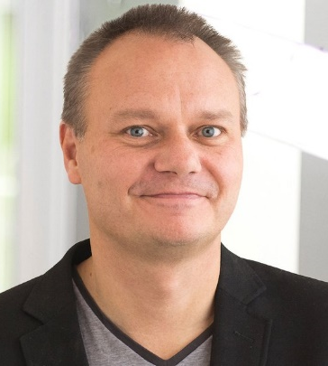
The EUREKA cluster projects provide us with inputs and personal networks in large and small European companies that are difficult or impossible to achieve otherwise.
The projects also contribute to our product development being able to sync with the needs and opportunities that exist and with the industry standards that are being developed.
In addition, our participation in these projects means that our credibility as a supplier increases.
Kenneth Bodin,
CEO and founder of Algoryx Simulation AB in Umeå, Sweden

Slide 6

Funding outlook & national priorities
Since 2016 we have increased our budget for EUREKA Clusters by 150% and in 2020 the budget is around €9 million
Vinnova – five priority areas
Other considerations in our evaluation
  Gender aspects are considered
  More focus on sustainability and UN Sustainable Development Goals in the evaluation of EUREKA Clusters in the coming years

Slide 7
Eligibility criteria
The Swedish consortium should be industry-driven with a good balance between large companies, SMEs and academia/research institutes.
The effort from the participating companies must be at least 60% of the Swedish consortium's total work effort. At least one Swedish SME must participate in the project.
Swedish SMEs must, at the time of the national application, show that they:
  Have an annual net turnover of at least 1 million SEK according to the latest annual report
  Have a minimum of three full time employees

Slide 8

Funding rates
Maximum 50% from Vinnova to Swedish SMEs
Maximum 30% from Vinnova to large companies
Up to 100% from Vinnova to universities and research institutes
The maximum funding from Vinnova is 50% of total budget of the eligible costs for all the participating Swedish organisations.

Slide 9
Cluster application process
Specific for Sweden
IDENTIFY
Extended Abstract
PPD
APPLY & IntervieW
Choose an open call
Extended abstract is submitted to Vinnova before 10th of February
Project Proposal Document is sent to cluster
National application is sent to Vinnova and interview with SE partners
1
2
3
4
5
6
7
8
FORM
Evaluation
EVALUATION
DECISION
Build consortium during networking days and matchmaking events
Vinnova evaluates the abstract
The cluster and Vinnova evaluates the application.
Approved project gets a EUREKA Label
Vinnova decide to fund or not to fund SE partners

Slide 10
National contact details CELTIC-NEXT
Sanja Šain-Strömberg
sanja.sain-stromberg@vinnova.se
+46 8 473 31 13
Jessica Svennebring
jessica.svennebring@vinnova.se
+46 8 473 31 34
Website for more information:
https://www.vinnova.se/m/eureka/kluster

