Slide 1


CELTIC-NEXT
Online Proposers Day
10th December 2019, via WebEx
Best Practices from Project idea to Project End
Pekka Eloranta, Sitowise Oy
pekka.eloranta@sitowise.com

Slide 2


Teaser
Your CELTIC –project can be successful and beneficial, if the project is managed and controlled properly.
It can be used as a tool to develop your business, if the project scope is in line with your strategies and future plans. However, it may take some time to reach commercial success.
In a good project the activities are carried out properly, the consortium is committed to the work and respects the dad-lines.
Naturally active dissemination and exploitation activities are important.
Be also aware that there may be changes in the project consortium and are ready to make changes in your plans (the Project Description).
Keep the Celtic Office aware of the process and possible changes needed.
www.celticnext.eu Best Practices, Pekka Eloranta, Sitowise, pekka.eloranta@sitowise.com

Slide 3
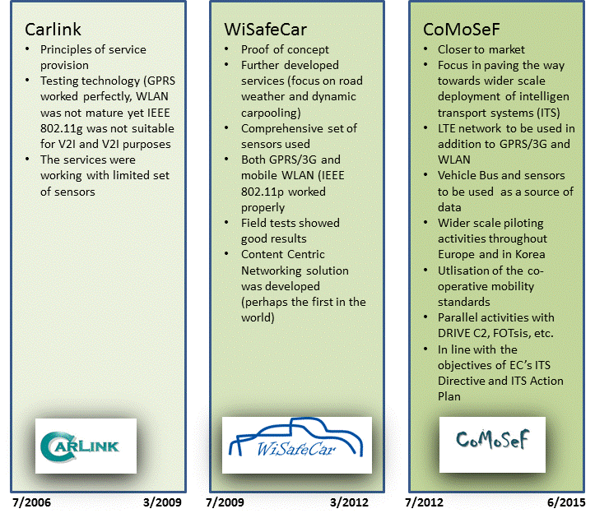

My Celtic History
www.celticnext.eu Best Practices, Pekka Eloranta, Sitowise, pekka.eloranta@sitowise.com

Slide 4
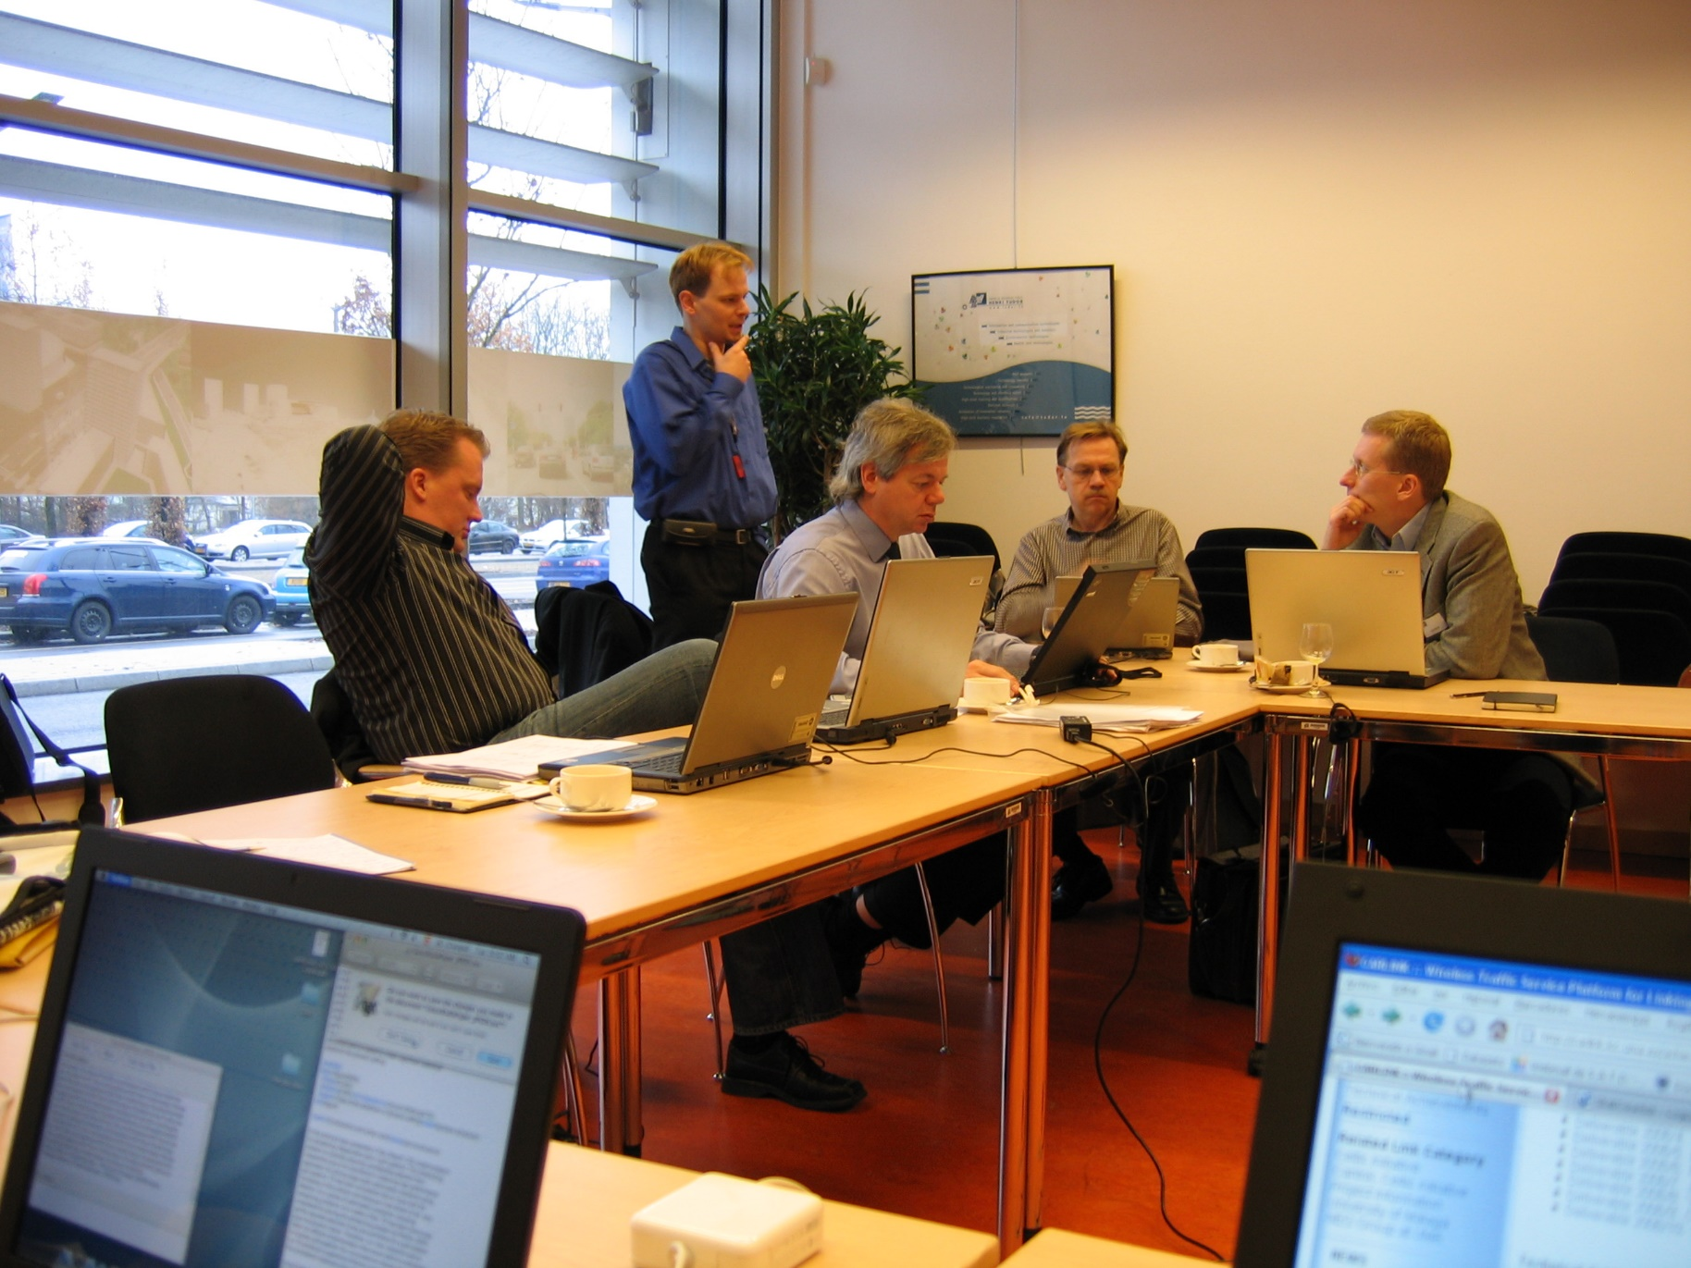

My Celtic History
Technology
Tests –
Finnish partner
www.celticnext.eu Best Practices, Pekka Eloranta, Sitowise, pekka.eloranta@sitowise.com

Slide 5
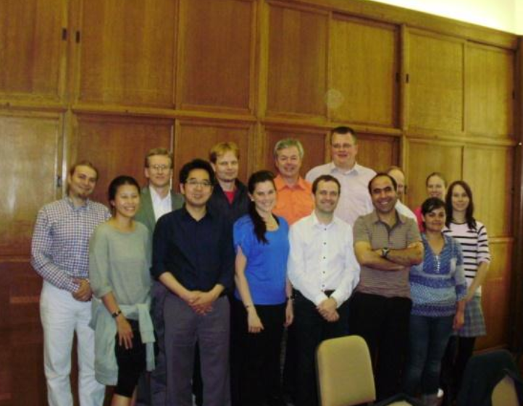
My Celtic History
Proof of
Concept –
Coordinator
www.celticnext.eu Best Practices, Pekka Eloranta, Sitowise, pekka.eloranta@sitowise.com

Slide 6
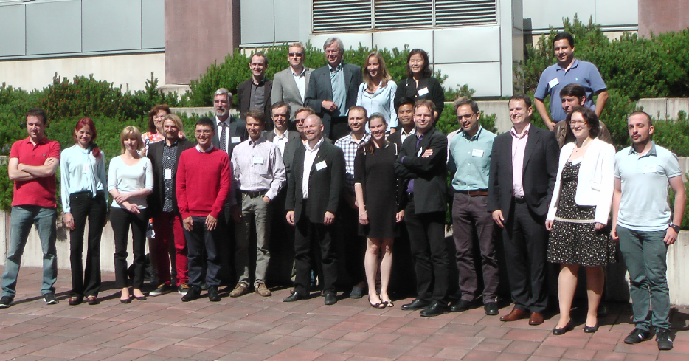

My Celtic History
Deployment –
Coordinator
www.celticnext.eu Best Practices, Pekka Eloranta, Sitowise, pekka.eloranta@sitowise.com

Slide 7
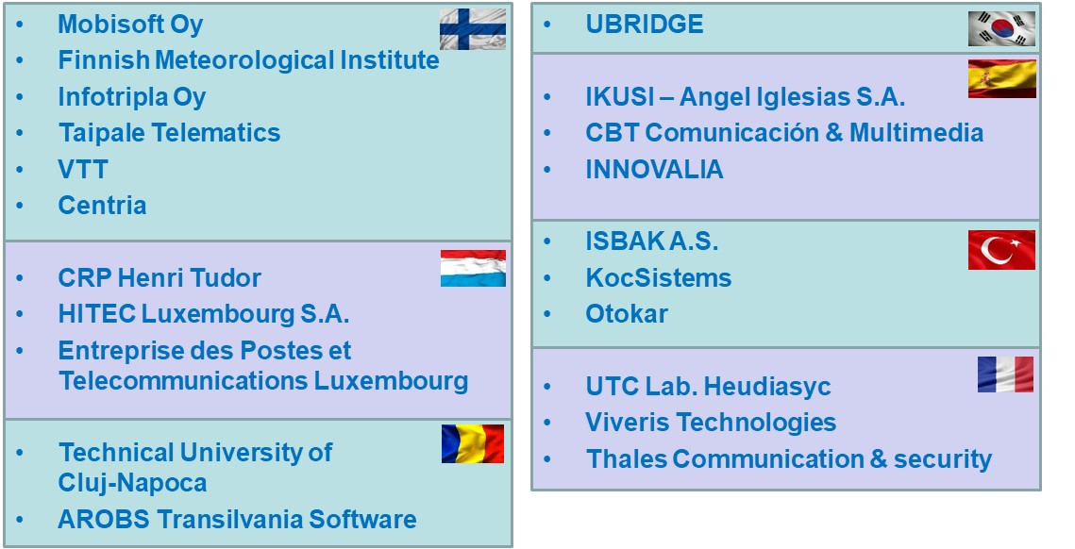
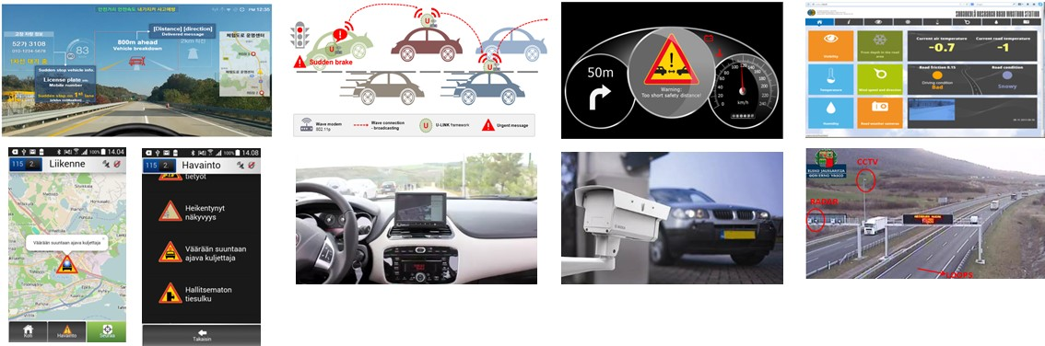
CoMoSeF
9 M€, 94 Person years
7 countries, 21 partners, 11 pilots
23 new products, 23 product improvements
1 new company planned
15 new employees
1 patent
11 scientific publications
59 conference papers, presentations and posters
3 Ph.D Thesis, 2 Masters Thesis, 2 Bachelor’s Thesis
But also numerous Project Change Requests.
www.celticnext.eu Best Practices, Pekka Eloranta, Sitowise, pekka.eloranta@sitowise.com

Slide 8



CoMoSeF PROs & CONs
PROs
Results were in line with the European level and national strategies.
Solutions, services & technologies developed were in line with results and suggestions by the main standardization bodies.
Project tested the latest standards for instance related to the use and contents of DATEX2, hybrid communication & conformance test specification for Decentralized Environmental Notification Messages.
Developed pilots covered in practice all the systems and services included in the European Commissions and C-ITS Platfrom’s “Day One Use Cases”
Pilot feedback from the end users and authorities was very encouraging and the profile of the project is high.
Several pilots reached a higher maturity level than planned and some were ready for introduction and commercialization.
Results of the project had very much publicity and positive feedback.
Automotive industry was involved in the project.
Consortium worked very well together and all the partners expressed their interest to continue co-operation.
Decision to have separate administrative and technical co-ordinators was a good decision and made the work easier.
Co-operation with Celtic Plus was very good and it is important to emphasize that, when challenges are discussed and questions asked from Celtic Plus, as soon as they may appear, the project work will be much easier.
The project received Celtic-Plus Innovation Award.
CONs
Continuously changing situation at the early stages of the project required quite a lot of administrative and technical coordination activities.
National funding decisions did not come at the same time and therefore a lot of re-planning and changes were needed to make the project run smoothly.
Funding approval process in different countries is completely independent, both in the form of decision results and decision process timing. Some kind of synchronization and harmonization would clearly benefit and ease the projects and the related administration.
Funding-% varies from country to country, but it is an issue that may be difficult to change. On the other hand the national funding authorities could emphasize the funding rules and percentages. Situations where funding applications are made and approved and then the partner withdraws because of having lower funding-% than expected, should not happen.
Withdrawal of some partners caused some challenges. Therefore some of the technical work needed to be re-planned. However the project managed to do this smoothly and there were no major problems to fulfill all the obligations and promises.
www.celticnext.eu Best Practices, Pekka Eloranta, Sitowise, pekka.eloranta@sitowise.com

Slide 9
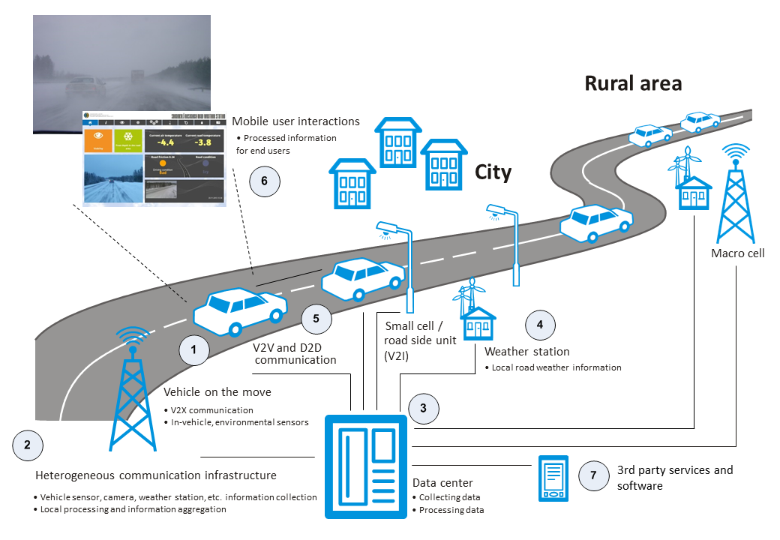

5G-Safe-Plus
5G-SAFE-Plus supports wide-scale implementation of advanced road weather & road maintenance services with 5G networking capabilities and service enablers.
5G-SAFE-Plus will produce innovations on 5G-based vehicular connectivity, distributed data processing, and novel road weather & safety services that benefit connected and automated vehicles, road operators and 3rd party organizations.
Industrial & academic collaboration in identifying novel road safety use cases and services enabled by 5G.
Status:
  Finland – positive funding decision received
  Sweden – negotiations going on
  Portugal - negotiations going on
  Romania - negotiations going on
  UK - negotiations going on
  Canada - negotiations going on
  Germany, Turkey & Israel – interested but no funding
www.celticnext.eu Best Practices, Your Name, affiliation & e-mail of presenter

Slide 10

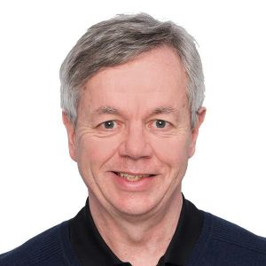
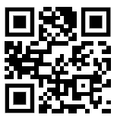
Contact Info
For more information and for interest to participate please contact:
Pekka Eloranta
pekka.eloranta@sitowise.com
+358 40 505 1818
Åkerlundinkatu 11 A
33100 Tampere, Finland
www.sitowise.com
                Presentation available via:
Your
Photo

