Slide 1


Project Idea
Pitching Session
Christiane Reinsch, CELTIC Programme Coordinator
reinsch@celticnext.eu

Slide 2
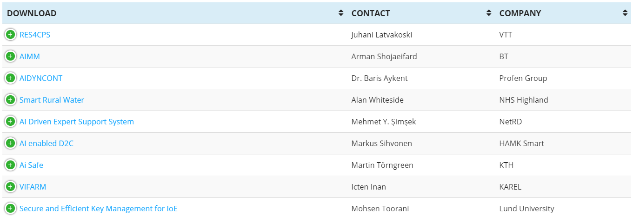
Pitch Overview

Slide 3


Find the pitches Online
tiny.cc/projectidea
www.celticnext.eu office@celticnext.eu

Slide 4


CELTIC-NEXT is…
The flexible industry-driven programme for innovation in communications technology and its applications
open to any organization willing to contribute to industry-driven ICT research and innovation collaborative projects
organising regular project calls
(next Call open until: 14 October 2019)
a Cluster for collaborative projects that is financed through public and private funding
900 private and public organisations:
  large industry players
  small & medium-sized enterprises
  academic/research institutions
www.celticnext.eu office@celticnext.eu

Slide 5




Next Call for Proposals
https://www.celticnext.eu/call-information/
@CelticNext
#CelticPropDay

Slide 6

Next Proposers Day
https://www.celticnext.eu/latest-event/
@CelticNext
#CelticPropDay

Slide 7




Contact:
+ 49 6221 989 210
www.celticnext.eu
Reinsch@celticnext.eu
https://twitter.com/CELTICNEXT
https://www.youtube.com/user/CelticnextVideos
https://www.linkedin.com/groups/3875389

