Slide 1
Celtic-Plus Proposers Day, 22 September 2016, CDTI, Istanbul
IDIMRO
Intelligent Dynamic Integrated Maintenance Repair & Overhaul
Planning and Optimization Platform
Nejdet Pamuk | Managing Director / CEO
' +31 (0) 6 23472564 | @ nxp@icrontech,com | http://www.icrontech.com

Slide 2
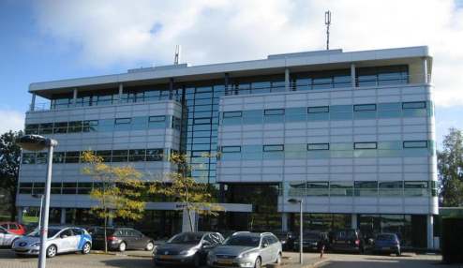
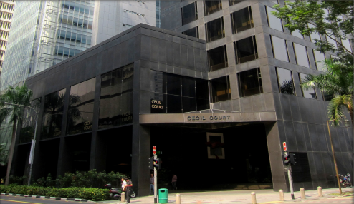
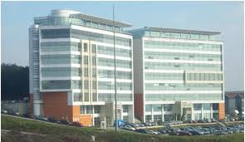
ICRON Technologies
Leading developer of
advanced planning, scheduling and optimization solutions
20+ years of experience
70+ customers, 200+ implementations
Innovation culture
Cultivation of business focus with academic depth
Amsterdam
Headquarters
Singapore
A-PAC center
Istanbul

Slide 3
Our Passion
Provide
integrated and intelligent platform for
strategic, tactical and operational planning
Improve
speed, flexibility and quality of
decision making
Guarantee
Return on investment through
end-to-end visibility and optimization
on supply-chain

Slide 4
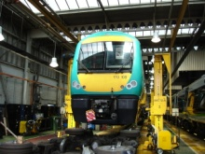
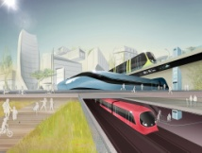
IDIMRO for – Aviation, PTM and Utilities
ICRON Maintenance Planning
Train maintenance
Workshop maintenance
ICRON Infra Planning:
Railway maintenance
Tooling
Material planning
Strategic Planning
Fleet planning
Network analysis
Investment planning
Operations Planning
Manpower, materials & operations
Time schedule planning

Slide 5
What is IDIMRO?
It’s an Supply Chain Management Planning, Scheduling and Optimization
project including embedded ERP, Mobile and Execution functions
for
Maintenance Repair and Overhaul companies
(Aviation, Public transportation and Utilities) which is:
Named: IDIMRO
Intelligent Dynamic Integrated Maintenance Repair And Overhaul

Slide 6
Benefits of IDIMRO
Direct savings:
Lower maintenance costs
Optimized workforce requirements
7-10% Reduction on the number of spare vehicles required
Reduction on out-of-service durations of vehicles
15-30% reduction in material inventory levels
30-40% improvement in efficiency
Improvement in meeting the SLA requirements
Other benefits
Customer service improvement
Clear overview of the maintenance plan
Integrated interactive planning platform for multiple divisions/departments
More stable maintenance environment due to ‘less surprises’

Slide 7
IDIMRO System Components
ERP System
Strategic Planning – Capacity Planning
Maintenance Planning:
Manual and automated planning and optimization
Multi-user environment
GIS (integration)
INFRA Planning:
Manual and automated planning and optimization
Multi-user environment
GIS (integration)
Mobile & WEB Analytic and reporting
Google/Map Integration
Analytics and Reporting
Workforce Planning:
– Shift planning
– People Qualification & Assignment
Notes:
Formatı düzelt

Slide 8
Consortium & Role of the Partners
Partner | Country | Contribution to the Project
Model Business Solutions | Turkey | Model will analyze, design and develop MRO module integrated with all related modules in Model ERP system. For Maintenance and Repair operations Model ERP will be integrated with Human Resources system.
Korgun Software | Turkey | Korgun will develop mobile and web interfaces for MRO planning
Istanbul Technical University | Turkey | ITU will support the project to improve the quality of the project and ensure its success in terms of process, output and the outcomes.
ICRON Technologies | Netherlands | ICRON TUR will be responsible for development of MRO planning and optimization processes of Model ERP and Human Resources system.
ICS IT - Logistic System | Germany | Use case partner.
We are looking for partners for the following subjects:
Use case partners for airplane, public transportation maintenance
Technology partners for system integration and Human Resources system

Slide 9
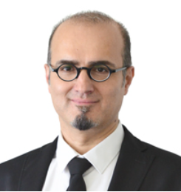
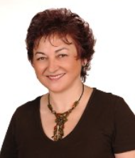
Contact Info
For more information and for interest to participate please contact:
Nejdet Pamuk, Managing Director / CEO
nxp@icrontech.com
+31623472564
Burg. Stramanweg 108-N
1101AA Amsterdam / Netherlands http://www.icrontech.com/
Gülgün Kayakutlu, Assoc. Prof. Dr.
gkayakutlu@gmail.com
+90212 2931300 (2665)
Istanbul Technical University
Maçka 34367 İstanbul / Turkey
http://www.isl.itu.edu.tr/

