Slide 1
Proposers Day 22 September 2016, Istanbul
Celtic-Plus NETAŞ
Core Group Member
Gönül KAMALI
VP, VoIP MM Technologies R&D
gonul@netas.com.tr
www.netas.com.tr

Slide 2
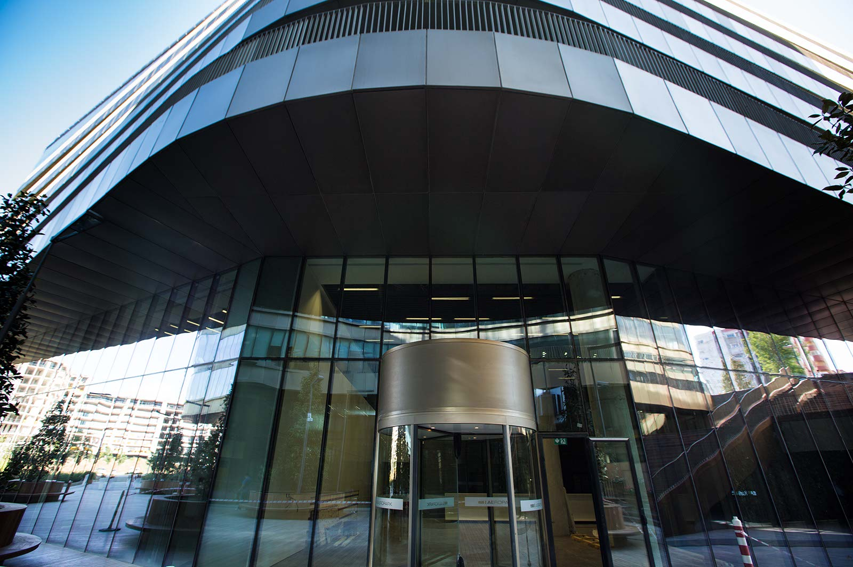
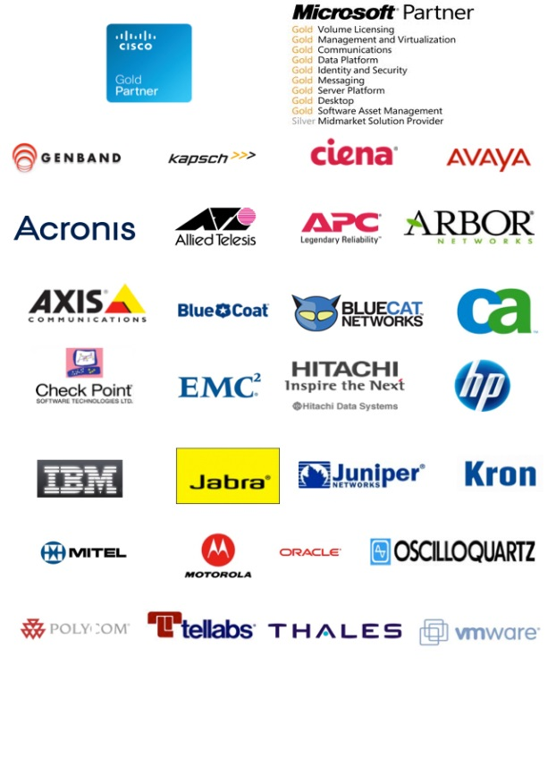
Short Company Presentation
NETAŞ
Turkey’s fastest growing ICT company
Turkey’s #1 converged Systems Integrator also serving the Region
1,500+ customers including Turkey’s 500
Strategic Business Partners
Cisco, Microsoft, Genband, Kapsch, Tellabs, Ciena, Avaya, Motorola, Oracle, HP
Premises
Head Office: Kurtköy-İSTANBUL
İstanbul: Ümraniye, Eyüp, Orhanlı
Ankara
İzmir
Kazakistan
Algeria
Bangladesh
Public
Turkish Armed Forces Foundation
Name, affiliation & e-mail of presenter

Slide 3
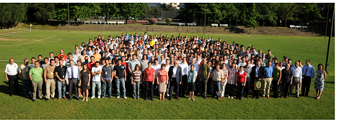
Who We Are?
48 years experience, first and largest private telecom R&D in Turkey
Develops ICT software solutions for more than 200 global operator
An R&D Center announced by government and supported by Turkish incentive programs
2007 Turkey SW Export Champion
2008 Turkey SW Export Champion
2009 Turkey SW Export first runner-up
2010 Turkey SW Export Champion
2015 Turkey SW Export Champion
Turkey’s software export champion (30 M$ / yr software export)
800+ highly qualified R&D engineers
Electronic Computer and Telecom Engineers
25% with MSc & PhD
2200+ employees
Strong relations with more than 25 main Turkish Universities
8 collaborative projects with METU, Bosphorus, ITU and Özyeğin
Over 20 thesis projects completed at 10 universities with mentoring
Scientific Articles
13 in 2013, 3 Journal paper & 10 conference preceedings
17 in 2014, 2 Journal paper & 15 conference preceedings
35 in 2015, 8 Journal paper & 27 conference preceedings
First runner-up of ICT sector in Turkey’s patent classification @2013
Over 70 yearly patent applications

Slide 4
Netaş R&D
INTERNATIONAL
ICT
DEFENSE
CYBER SECURITY
One of 10 strongest VoIP Multimedia R&D firms with 40+ years experience
,
Custom solutions for ICT sector needs
Local products for the units in the defense and public sectors
Cyber Security products:
VoIP security
Web security
Media security

Slide 5
Netas Future Strategy
Premium Solution Provider in the Digital Urban Life
Urban areas are getting
More populous
More digital
Urban life & ICT are in a positive feedback loop
Netas is the reliable & competent solution provider, chartering the transformation in the Region
4G LTE
Big Data
IoT
Security
Government &
Public Entities
Education
Banks
Retail stores
Smart Life Centers, Buildings, etc.
New infrastructure
Own 4G LTE products & solutions
Managing the volume
Data Centers, SDN & NFV partner for large projects
Connecting all devices
Own IoT products & solutions for the new network
New solutions for cyber threats and secure communications
Own security products & solutions
Governing people in the cities
Transformation of courts & penitentiaries
Disaster & Emergency Mgmt Ops. Centers, ..
Educating crowds for digital age
Technology partner of countrywide infrastructure transformation
‘Bank of the Future’
Mobile Banking
ATMs & Virtual Teller Machines
Consolidating online & offline
Venue Management
Managing crowds in buildings & centers
Solutions from smart homes and offices to large public areas such as stadiums, shopping malls etc.

Slide 6
Involvements in Celtic Plus Activities
Labelled Proposals
Safety Management in Coal Mines (WINS@HI)
Partners: Masaryk Univ. , GiTy, VUB, Tech. Uni Liberec (Czech Rep.), BAU, ITU, BOUN, Korgun, Nesta,
Netaş Role: Leader,Underground Communication, IoT
Virtuose (Virtualized Video Services)
Partners: VTT, Vestel, Koç University
Netaş Role: Integration/Demonstrations leader, SDN, Video streaming
Secure Transactions and e-Medical Care: STeM
Partners: Airbus DS, Gemalto, Turk Telekom, Bogazici Univ, Argela, IdeaTeknoloji,
Netaş Role: Service-Oriented Smart IoT
Utilization of NFV to support IoT services in heterogeneous networks and clouds (UNITed)
Partners: VTT, Turkcell and Özyeğin University
Netaş Role: Emergency Management with IoT, SDN-NFV-Virtualization

Slide 7
H2020 & ITEA3 Submissions
ITEA3 Submissions
APPSTACLE, Digital Backbone, Ewatch, Safe Rescu
Horizon2020 Submissions (Total 9)
TEMPEST Project – Disaster Resilience (Coordinator),
Collection and management of INternet Forensic evidence material with Investigative support and respect for Privacy (CINFIP)
Reputation Based Trust Services (ReBaT) – Cybersecurity
DICE-IoT Proposal
HYLIOT Proposal
Zen-Auto Test Proposal
ENERGETIC Proposal
Network for Sustainable Mobile Clouds
UpWeb
Alcatel-Lucent, Atos, Erarge, Italtel, Tecnalia, University of Gent, Legind, Univ. Dundee, CEA, Guardia Civil, Hamburg Univ., Uni. Bremen, Univ. Col.London, Cork. Inst. Tech, Cork Port Auth, TuTech Inno, IBM Ireland, W3C, Aalto Univ., Simula, Fraunhofer, Technical University of Vienna, Ikerlan, Thales Services, Univ Surrey, Silicon, Evolio, Eticas,

Slide 8
Contribution to Celtic Plus Vision with
Power of 40+ years ICT & Telecommunications R&D Background
R&D of NA VoIP&Multimedia Market Leader – GenBAND
Innovative, Talented Researcher Pool
Variety of Lab Facilities
Strong University Relations

Slide 9
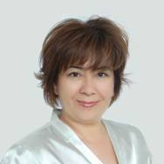
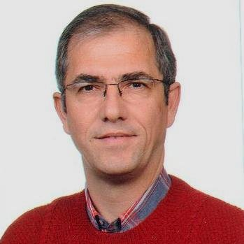
Contact Info
Gönül Kamalı
VP, VoIP MM Technologies R&D
gonul@netas.com.tr
www.netas.com.tr
Rıza Durucasugil
Director, Innovation and R&D Strategies
rizad@netas.com.tr
www.netas.com.tr
Name, affiliation & e-mail of presenter

Slide 10
Turkish SI Market Outlook
THANK YOU

Slide 11
Some of our Innovative R&D Projects

Slide 12
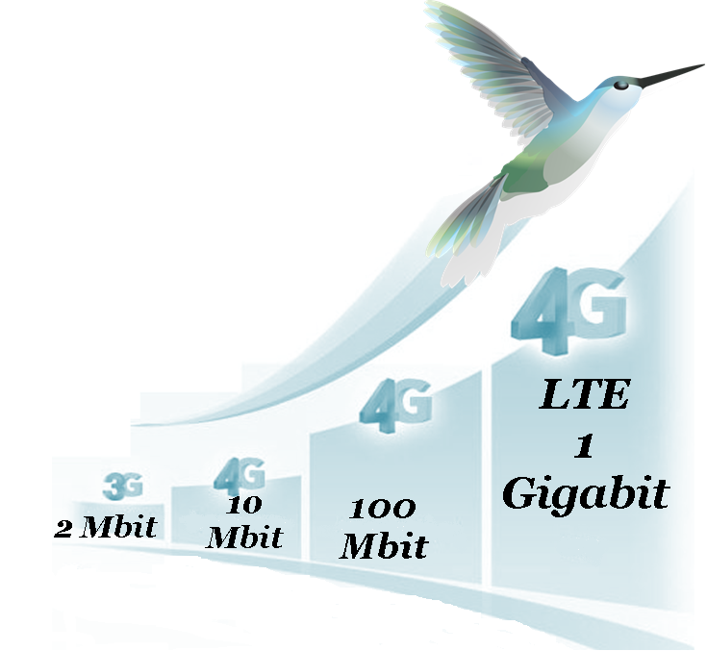
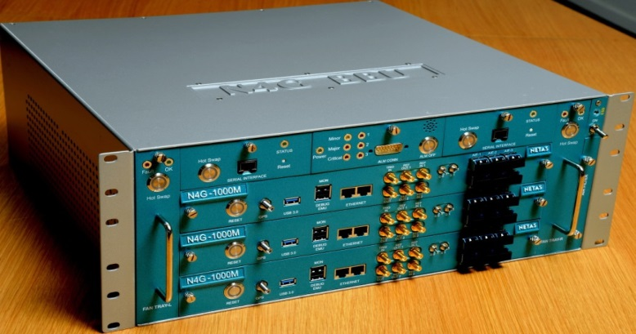
4G – LTE Advanced
Base Station (ULAK) Project
Cooperation of Netaş, Aselsan and Argela
Netaş: Baseband hardware, L1/L2/L3 level softwares, OAM and networking software
Maximum of 1,5 Gbps bitrate (downlink)
Innovative vision
First wide band base station design in Turkey
All hardware and software are developed in Netaş from scratch
Developing a product in state of the art LTE-Advanced standard
Development of receiver algorithms that are not yet standardized

Slide 13
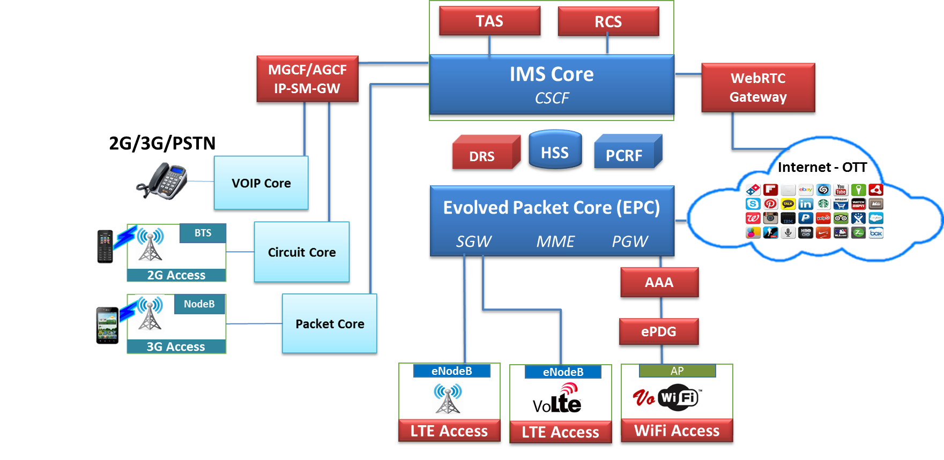
First 4G R&D Lab in Turkey
DRA/DRS
Central Traffic Management
Network Traffic Routing
Congestion Management
Reporting
RCS
Voice & Video Calling
Off-net messaging
RCS features:
File sharing
Location sharing
Group chat
AAA
Authentication
Authorization
Accounting
eNodeB
First national 4G LTE-Advanced base station
Main access technology for 4G and beyond
Macrocells and small cells
ePDG
User Authentication & Authorization (through AAA)
Tunneling and QoS mapping
Routing of downlink packets
VoLTE
Voice & Video Calling
Service Parity
Handover Scenarios
VoWifi
Native Telephony:
SMS/MMS
Voice calls
Coverage Advantage
Roaming Advantage
Service Parity

Slide 14
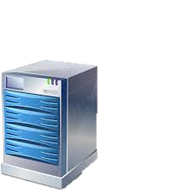
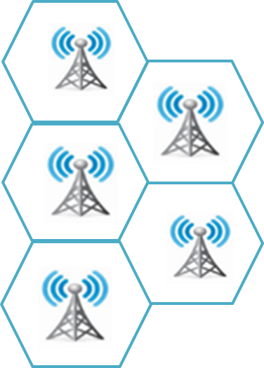
5G Project: Mobile Edge Computing: MEC
Centralized Content Servers & Cloud Services
IOT/M2M Services
Augmented Reality
Content/DNS Caching
Video Analysis
QoS/QoE and content optimization
Cyber Security
Restful APIs
EPC
IP Transport
(Backhaul and backbone)
MEC Server
Big Data
INTERNET
Enterprise & OTT Services
Proximity to data source
Local procesing of data
E2E low latency data transmission
Providing low latency in realtime/time critical applications
Access to realtime radio network information
Location based applications and services
Location Awareness
Core traffic optimization for M2M/IOT applications
Management of traffic and QoS/QoE

Slide 15
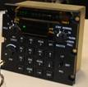
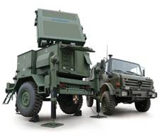
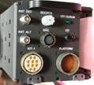
Ship Communication Solutions- Switching and control units for all sea comm. platforms of TSK (Turkish Army), custom project for TSK and compatible with latest technologies
TASMUS – First national tactical field communication system with latest technologies
Friend-Enemy Recognition (IFF) – First national IFF system in Turkey
APCO-25 Wireless Keying Systems – Largest Public Safety and Emergency Communication system
GNSS receiver – Satellite based
Global Positioning System Receiver
Defence R&D Projects
UKB (Remote Command Unit)
F4/2020 Air Fighter
RESPONDER
Encrypted Questioning
HSR (Air Defence Radar)
Encrypted Response
QUESTIONING

Slide 16
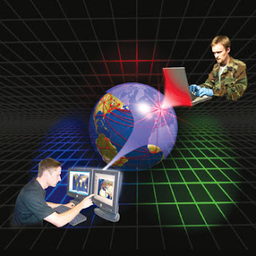
Cyber Security
VoIP communication solutions become widespread due to cost, operational advantages and rich services
Security is of at most importance due to nature of open system architecture of VoIP technology
World Telecommunication Fraud cost: 46,3 billion $- 2013*
Cost due to attack on VoIP networks: 3,62 billion $ - 2013*
Turkey has 4th rank in Europe and 5th rank in
world among most attacked countries
Analyzing and detecting the weaknesses of systems and applying critical precautions
Media and service security come forward as security applications
R&D Investments
VoIP Security Device design
Voice over IP security in Smart Phones
Media Security Project with disposable keys
VoIP Security
Web Application Security
Notes:
4G kablosuz geniş bant iletişim teknolojisi sayesinde VoIP haberleşme çok daha yaygınlaşacak ve güvenlik ön plana çıkacaktır.
CFSA

Slide 17
Cyber Security Product Family
Our new national and international ready R&D product – Cyber Security Product Family:
`VoIP/Web Analyze Tools` detects weakness of the system
`Security Firewall`,
`Media Security Platform`
`Machine to machine communication platform and security’ in oneM2M standard
Innovative vision
First national and international VoIP SIP Security family with distinguished features
First international attack detection and prevention system with expert system, rich weakness-detection tools and methods considering critical call parameters

Slide 18
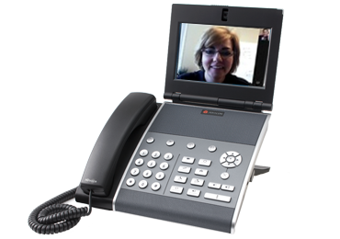
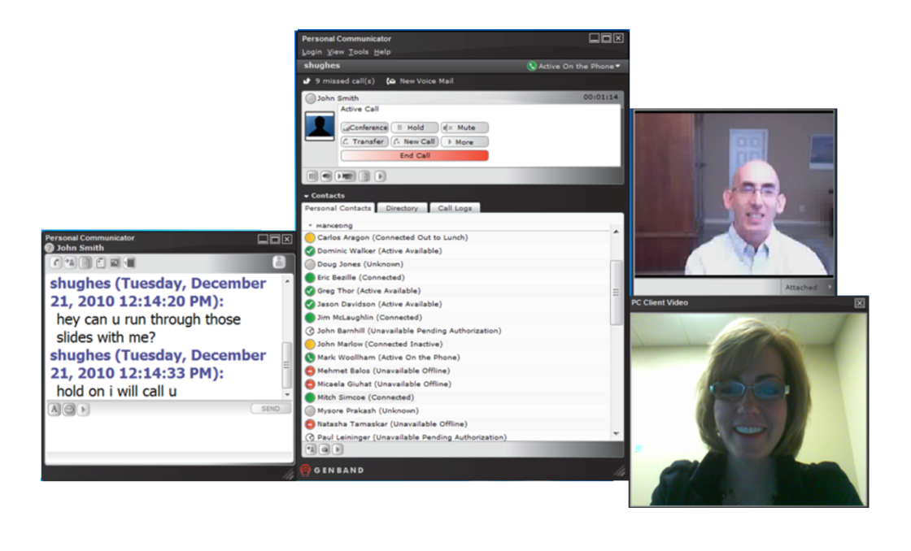
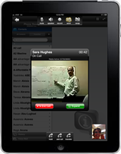
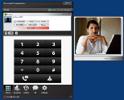
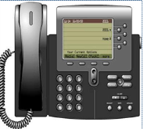
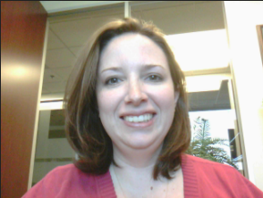
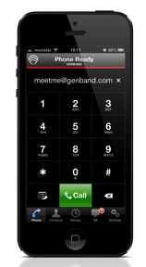
WebRTC Gateway
Project
WebRTC Gateway that provides communication between Internet Browsers and legacy TDM networks
Servers in the project: Application, Media Broker, Transcoder, STUN/TURN, Call Server
Innovative vision:
The first national WebRTC product and one of the pioneers in the world
Collaboration of many different technologies and protocols
Provides opportunity for new product development that support itself as a platform, thereby starting new R&D projects and potential of employment
Unified
Communications
Browser
IP
PBX
Video
SIP
REST APIs
Internet
Mesajlaşma
Gateway
PSTN
Internet

Slide 19
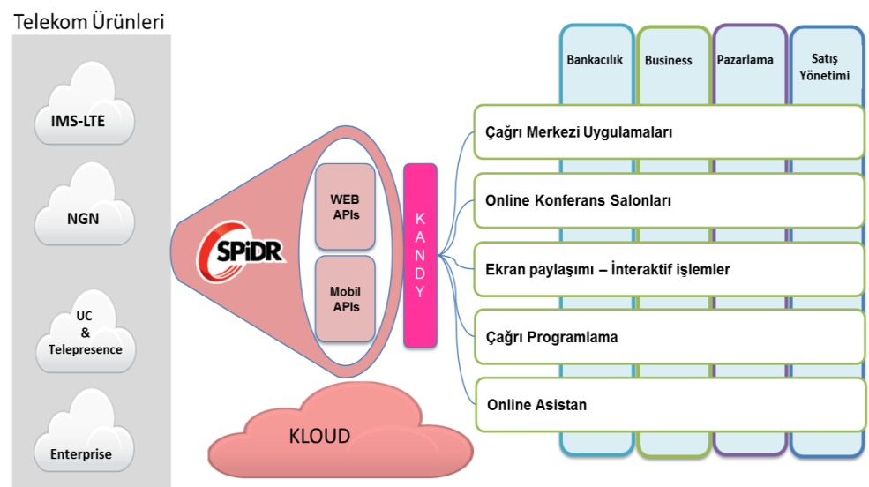
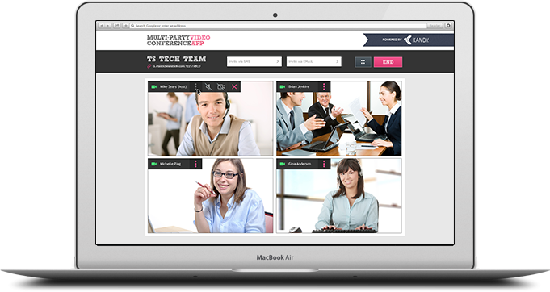
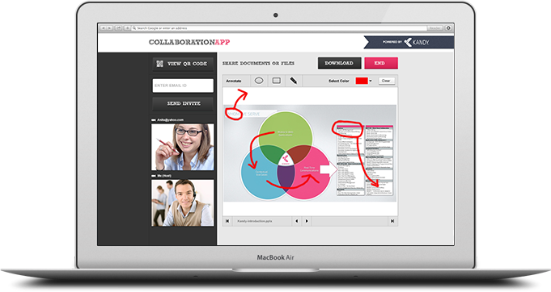
Kandy – Innovative Services for Efficiency
Simple, innovative services over Web without the need of telephones, addional application installation or setup.
Use cases:
Call center applications
Online video conference rooms
Screen sharing – interactive operations
Call programming
Online assistant
Y
Innovative vision:
The first national and one of the pioneer Smart Office unified communication solutions
Benefitting from many advantages of cloud computing by deployment of current application servers on Amazon cloud

Slide 20
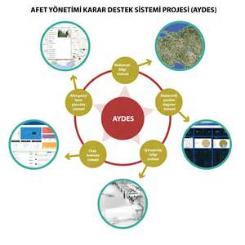
Disaster and Emergency Management based on Sustainable Geographical Information System
Before, during and after disaster:
Preparation and cost reduction – Applying Spatial Information System and Geographical Information (location and feature data) Technologies
Intervention – Information management during disaster and management of attributes
Enhancement – Ranking risk factors before incidents and enhancements afterwards
AFAD AYDES (Disaster Help/Support) Project
Innovative vision:
A complex solution that covers operations all over Turkey in case of disaster
Partnership in AB H2020 project consortiums to apply our know-how

Slide 21
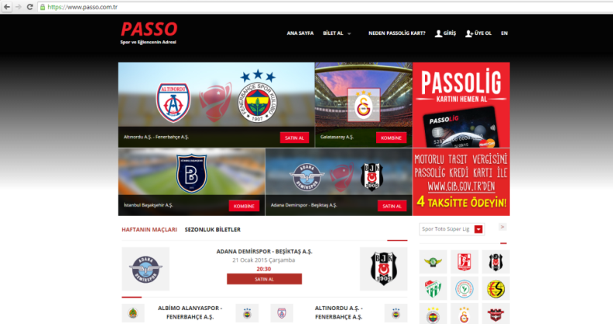
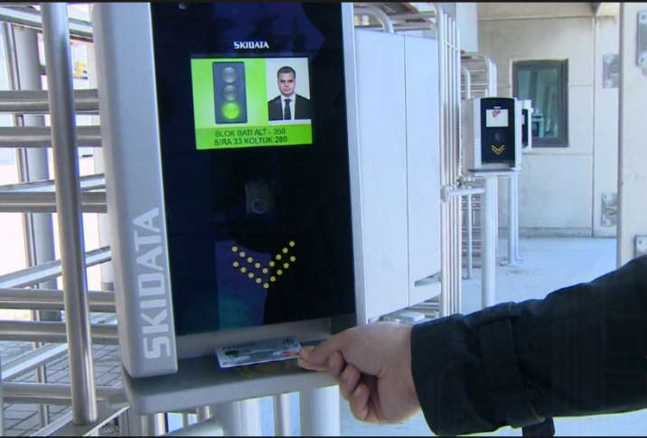
Software System that reaches the users via Web portal and box offices’ entrances of sports clubs by E-ticket applications
Prevent banned people to attend football matches using “Blacklist” control
“Access Control” and “Security” system development
TFF E-ticket Project
Innovative vision:
First national, fully integration stadium control system including security, entrance permissions and ID control that is expected to spread over all stadiums nationwide

Slide 22
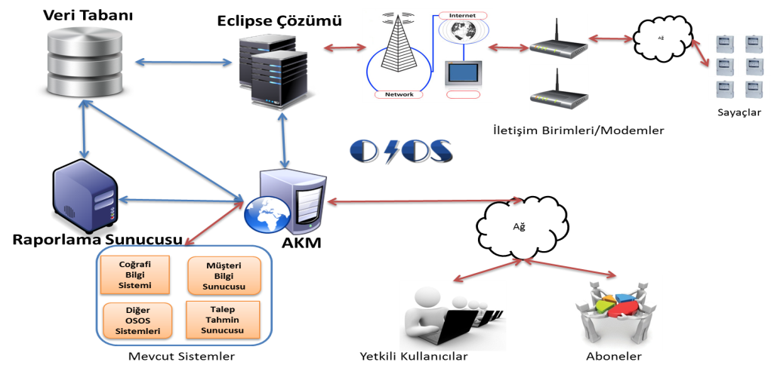
Automatic Meter Reading System (OSOS)
A currently working system designed for AYDEM company where the aim is Energy Efficiency which is a hot research topic
A part of smart cities concept as a result of EPDK regulations
Innovative vision:
First big sized energy project in Netaş
An application of M2M technology
A very important step for companies’ future M2M projects

Slide 23
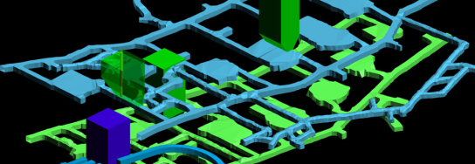
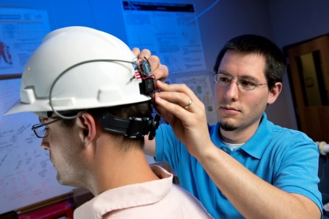
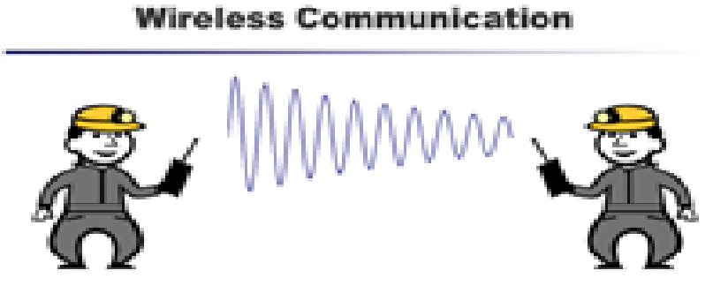
Real-time detection of mine accident risks to prevent accidents
Emergency management system that uses wearable sensor networks for communication
Detecting location of mineworkers after an accident, obtaining their health conditions, and lead resque operation
IoT : Mine Accident Prevention and
Mineworkers Tracking System
Innovative vision:
First IoT project applied to Mine in Turkey
Wearable sensor network application
Underground wireless communication
Warning systems with sophisticated algorithms

Slide 24
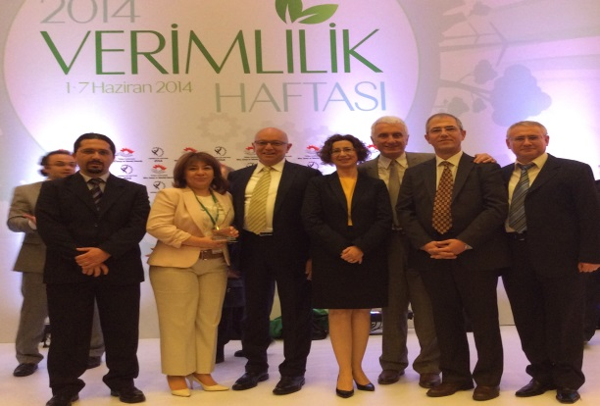
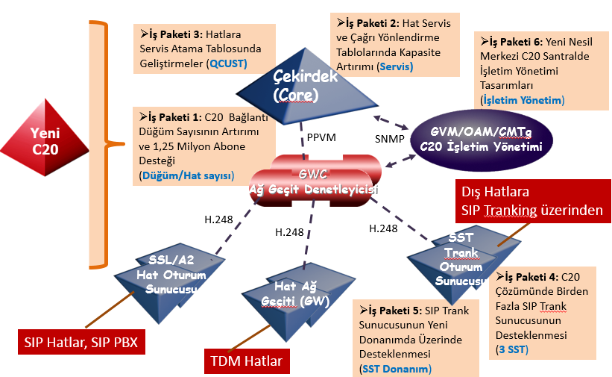
High Capacity New Generation Central Switch Design
High capacity, new generation central switch design for C20 in VoIP network, with supporting new technologies thus providing advantages on cost, management and rich services
Netaş won the efficiency award by Science, Industry and Technology Ministry with “High Capacity New Generation Central Switch Design” project
Innovative vision:
Architectural design for preservation of performance while increasing C20 capacity
Increasing capacity with the new digilator architecture, twice (1,25 million) in line, tripling in SST trunk
Integration with high technology hardware

Slide 25
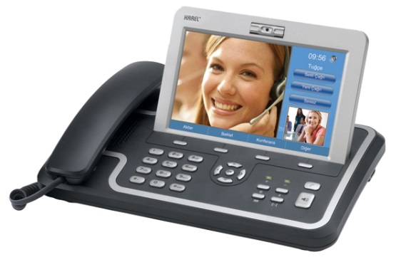
National IP-phone Prototype: The contract with Algeria Ministry of Defence:
VoIP desktop phone prototype design by collaboration of Netaş ve Algerian R&D teams
Office and Laboratuary establishment by Netaş in Algeria city for telecommunication hardware design and production
Algerian engineers’ training by Netas eng.
IP-phone Prototype Development
Innovative vision:
First national VoIP phone prototype in Netaş
First integrated Ethernet and SHDSL interface desing in the world
First R&D based technology transfer project

Slide 26
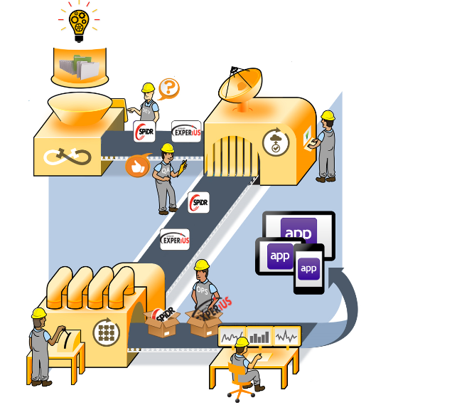
Project provides performance enhancement by end-to-end system proof steps
CONTINUOUS INTEGRATION: Easy detection of differences between releases, continuosly merging newly changes to already packaged loads
RELEASE AUTOMATION: Automatic operational and performance tests
APPLICATION MANAGEMENT: Tracking changes in application
INFRASTRUCTURE AUTOMATION: Automatic and fast system setup
End-to-End, Fast and Quality Continuous Software Delivery - Continuous Integration
CONTINOUS
INTEGRATI ON
RELEASE
AUTOMATION
Innovative vision
Fast and reliable software releases
Customer Satisfaction
Enhanced efficiency:
Efficiency in test efforts
Efficiency in release updates
INFRASTRUCTURE
AUTOMATION
APPLICATION
MANAGEMENT

Slide 27
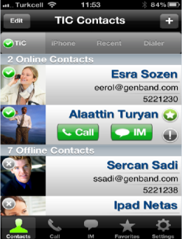
Developments for Telecom Corporations
Developments for Corporations- THY Luggage Tracking ve TFF E-ticket Projects, Reporting and Integration Tools for Call centers and solutions for Finance sector
e-Government –KKTC e-Population System
Telecom Operators – Loupe Project, Unified Device Management (UDM), Adaptive SMS Distribution Application (ADA), Display environment for added-value services and Mobile Terminal Test Service
Netaş Client Family – Multimedia mobile/tablet/internet client applications for on line messaging and comm. that support Turkish language, SIP and value-added application server: TiC -Turkcell BİP
GSM-R – Adaptation of GSM-R standard - used in railway communications - to IP technologies
Innovative vision
Custom, innovative and value-added software solutions for national and International Telecom corporations and enterprises

