Slide 1



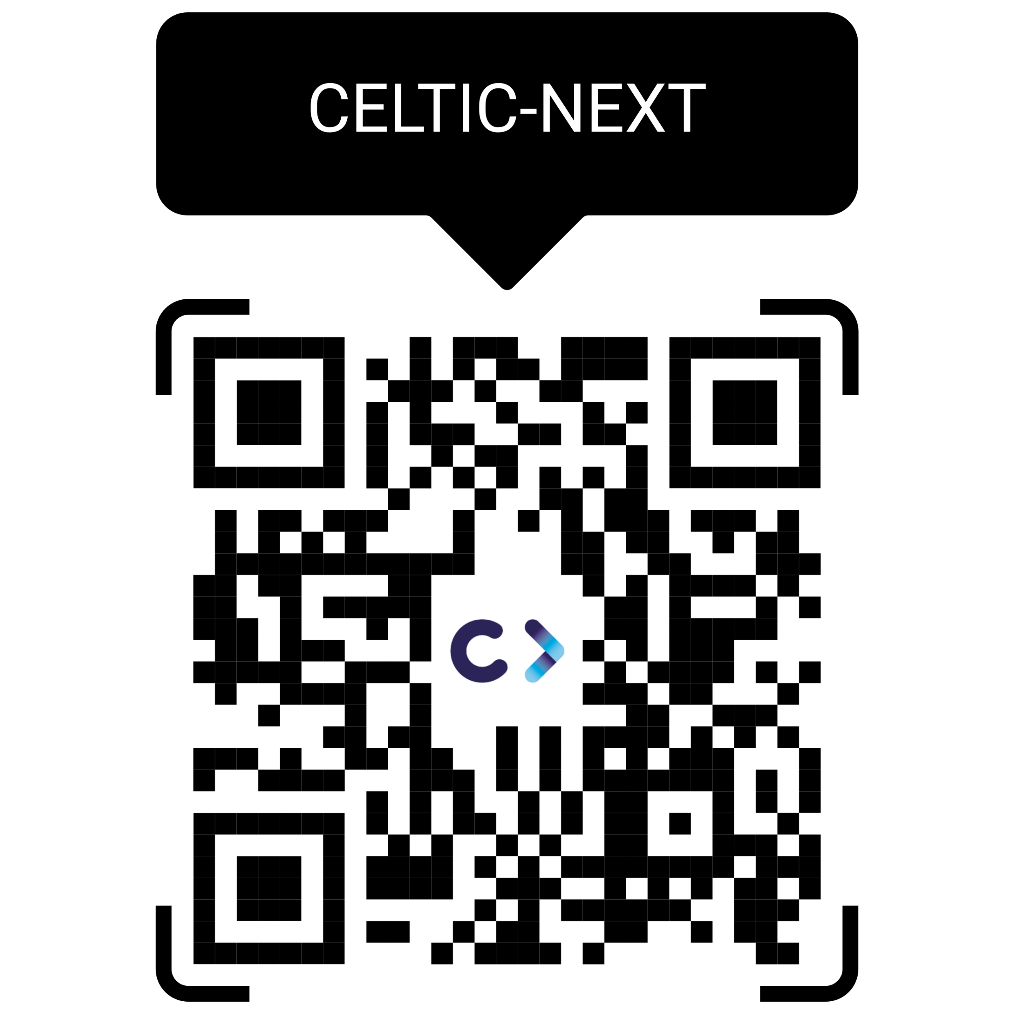
‘European Space-enabled Connectivity
Solutions for the Car of the Future’
Session 4:
Advancing innovation for automotive: Support mechanisms
CELTIC-NEXT
Support mechanism
Xavier Priem, CELTIC-NEXT Director
7th Nov 2023
www.celticnext.eu

Slide 2


Who is CELTIC-NEXT?
CELTIC-NEXT is the world industry-driven ECP* ICT** not for profit cluster involving major ICT** industry players, service providers, many SMEs, and research institutions & academia to enable a secured, trusted, and sustainable digital society.
*Eureka Clusters Program, launched on 17/6/2021, CELTIC-NEXT was launched earlier in 2003
*Eureka Clusters Program, launched on 17/6/2021
** Information & Communications Technologies
*** Research, Development & Innovation

Slide 3



CELTIC-NEXT in the European innovation landscape
EUREKA
National
European Community Programmes
Innovation
Programmes
following
European
Strategy
Trans-National Programmes
following
National Priorities
Develop &
Maintain
Critical Mass & Differentiation

Slide 4






CELTIC-NEXT offers…
Opportunities to fund transnational RD&I consortia
Access to the best companies and knowledge institutes
Projects initiated by industry in line with national priorities
Global and trusted cooperation in the communities
Support of experts with an industrial viewpoint
  “Are you looking to collaborate on an international and industry-driven RD&I project that covers a whole value chain?”
Notes:
Clusters offer/value – why participating in Clusters

Slide 5
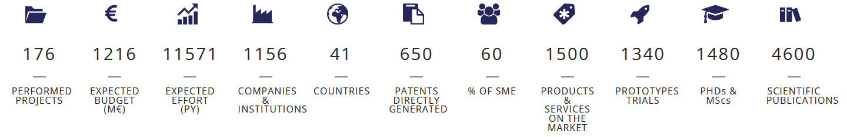

Who is CELTIC-NEXT?
Since its launch in 2003, CELTIC has achieved:
CELTIC-NEXT is open to all entities willing to align their business targets with their national public priorities, by running common RD&I*** projects to advance the development and uptake of advanced ICT solutions, thus accelerating their own Time-To-Market.
*Eureka Clusters Program, launched on 17/6/2021
** Information & Communications Technologies
*** Research, Development & Innovation
https://www.celticnext.eu/

Slide 6
The mission of CELTIC-NEXT is to:
  Foster our Eureka collaborative RD&I program for the ICT community
  Accelerate the deployment and uptake of advanced ICT services
  Employ the new network concepts of 5G and beyond, and lead to the innovation ownership and implementation of 6G in Eureka countries
Because It is crucial to consolidate the position of :
  Eurekan manufacturers and service providers
  Eurekan countries sovereignty
The strong ambition of CELTIC-NEXT is, therefore, to:
  Assist Eurekan National Authorities, Eurekan Industry, and Eurekan Societies
  Make them access to societal benefits, competitive advantages, commercial returns of being at the forefront of the new digital era for the society-
Who is CELTIC-NEXT?
-
CELTIC-NEXT Mission & Vision
Notes:
NEW

Slide 7




What CELTIC-NEXT does ...
CELTIC-NEXT manages an international Quality Label that enables international consortia to apply more successfully to National Funding schemes and assemble them to fund international cooperative innovation.
CELTIC Bottom-up calls
CELTIC Flagship projects & open calls
EUREKA ECP Joint Calls

Slide 8
















CELTIC’s Community
CELTIC Core Group
CELTIC’s Community builds its Mission, Vision & Roadmap
with over 1150 community members across 41 countries (Europe & beyond)
Many Verticals incl. Automotive Sector
https://www.celticnext.eu/celtic-next-organisation/

Slide 9
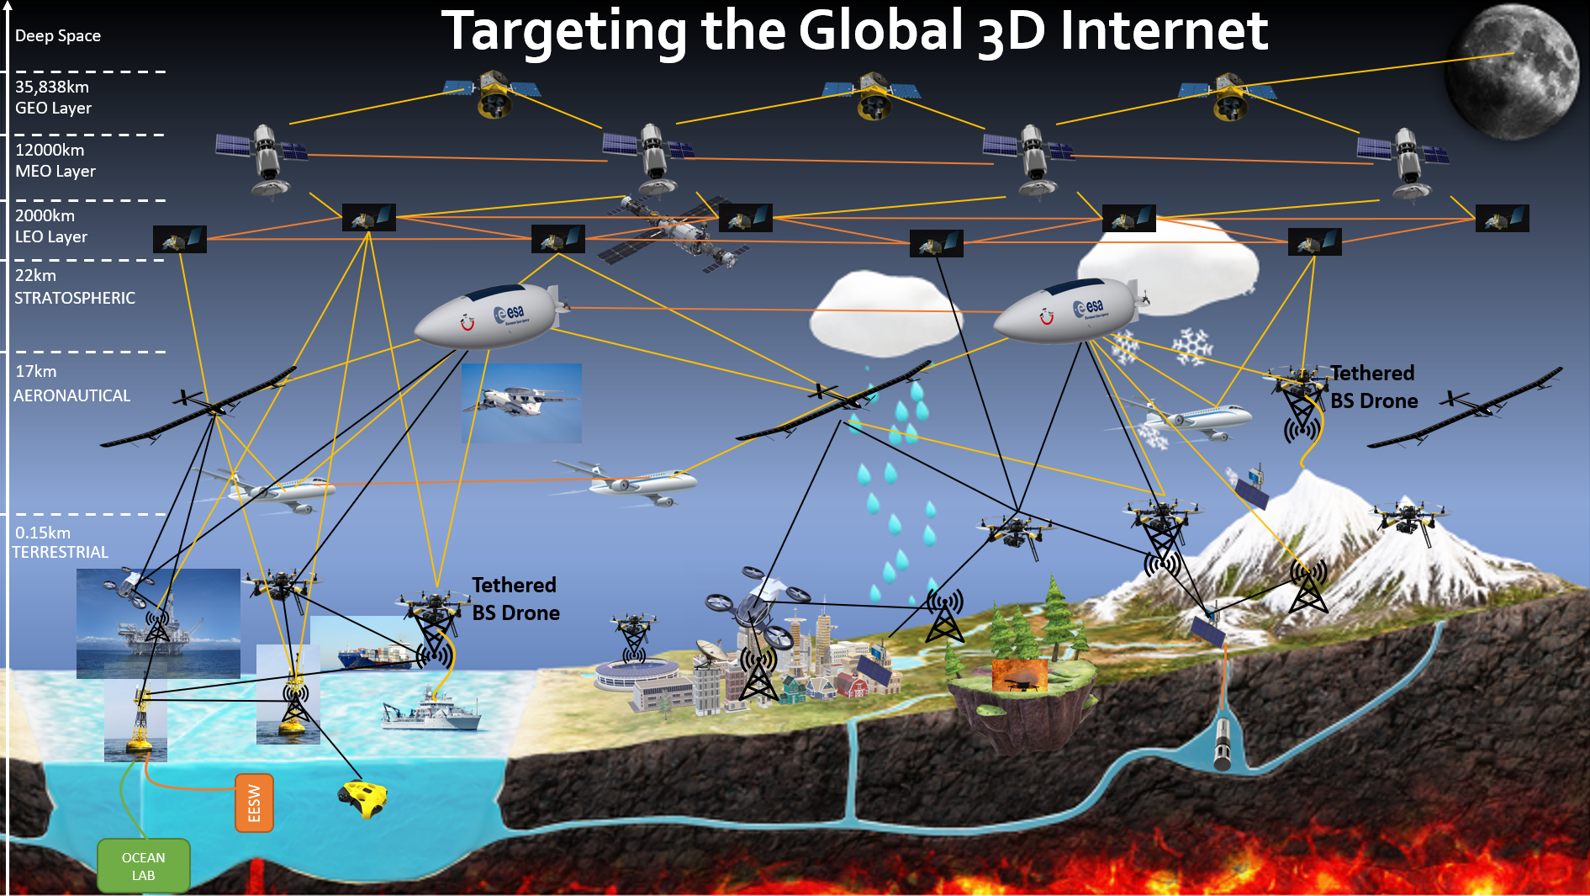




Slide 10

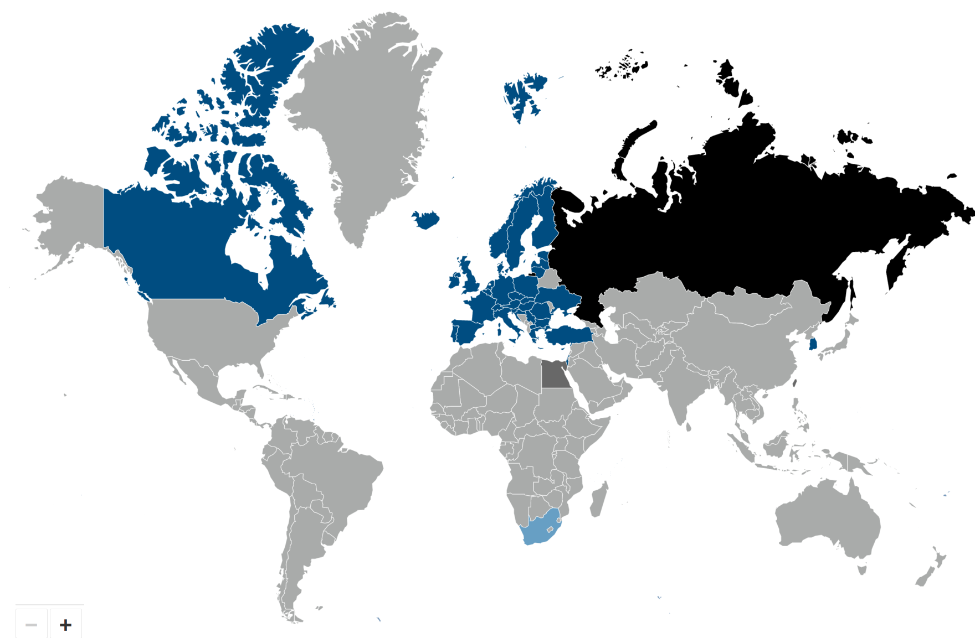

CELTIC-NEXT’s DNA
FOR YOUR SUCCESS
Bottom-up
  Proposers are free to define their project proposal according to their own research interests
By participating, you will get
Expectable benefits for you
Your opportunities are
The award of an Globally Recognised Label
Professional coaching and mentoring
Easy access for SMEs
Access to SMEs for Large industry & vice-versa
Access to partners from more than 45 countries
Access to national funding (while having international co-innovation)
Transnational RD&I cooperation
Boosting your competitiveness
Accelerating your growth
Shortening time to market
Accessing new markets
Increasing your international visibility
Exposing your know-how to the eco-system
Receiving guidance, coaching and monitoring of your project by the CELTIC Office,
flexible project coaching process where you can adapt your project plan, consortium and other aspects, in agile way, using CELTIC’s Project Change Requests
Immerge yourself into a rich ecosystem covering the technology and business whole value chains (Large Industry, SMEs, Startups, RTOs, Academia, end-users)
Build RD&I consortia during brokerage and other events
Lead or be part of an industry lead project
Create and foster collaborative innovation
Stimulate disruptive and/or sustainable ideas
Run and manage your collaborative project with the Office’s support
Adapt to internal and external circumstances
Generate high economic impact
Grow and collaborate beyond borders
Deliver high social and economic impacts
Support U.N. SDGs
Close to the market
  So far projects have led to more than 1500 new or improved products and services
High Success Rate
  High-quality proposals have a good
  chance of receiving funding.
  Average success rate 60 %
Flexibility
  Project focus can be adjusted to new technological developments in the field

Slide 11





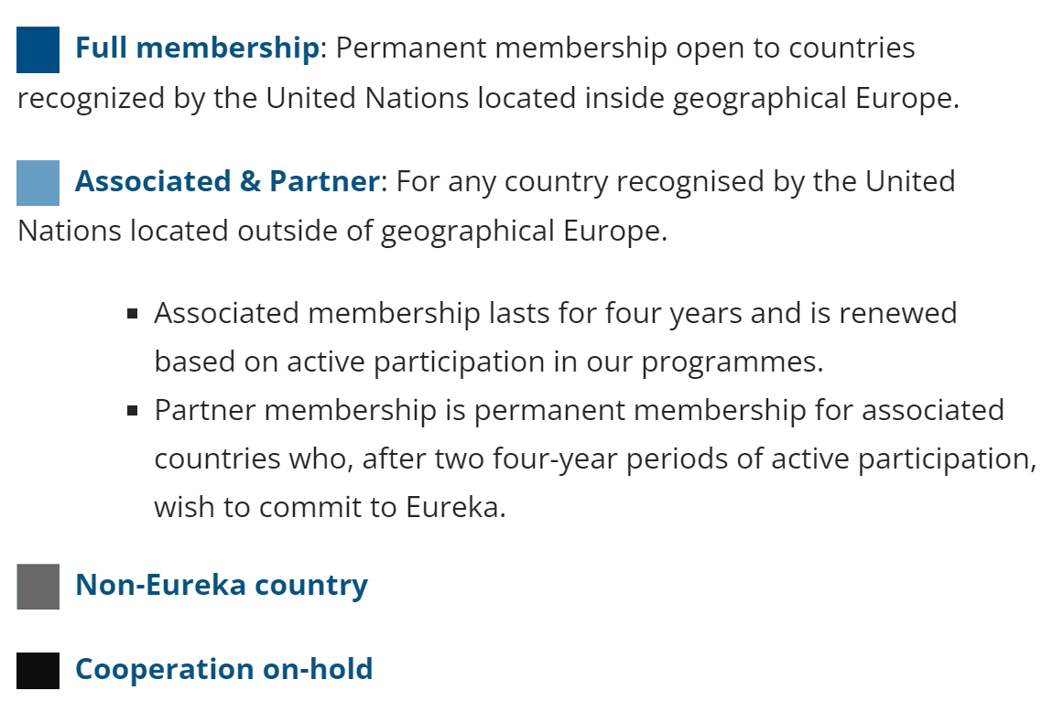

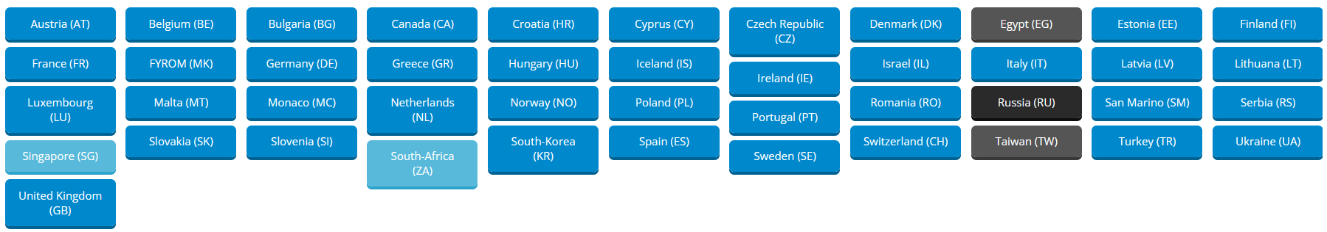
Opportunities to collaborate globally
Europe (large)
UK
Canada
South-Korea
South-Africa
Singapore
And more countries to come, like Chile...
https://www.celticnext.eu/national-public-contacts-funding-schemes/

Slide 12
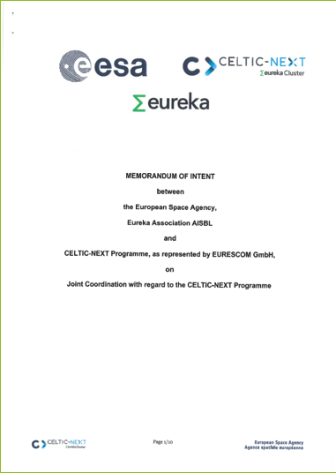
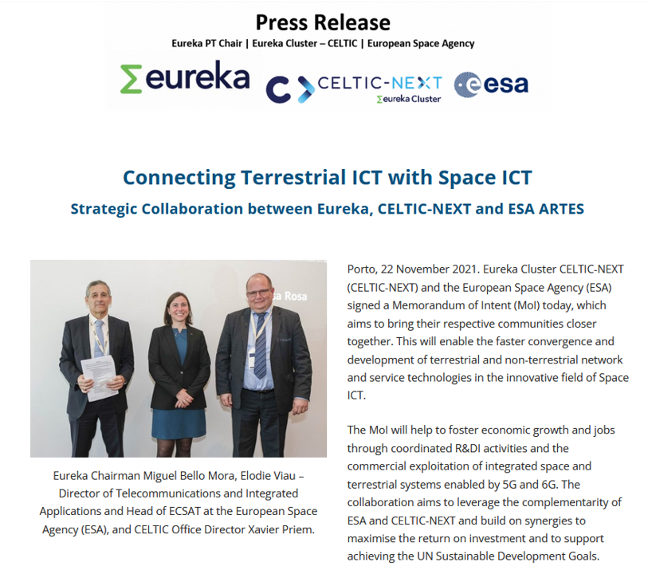
CELTIC-NEXT COLLABORATIVE PROGRAMMES
CELTIC-NEXT in the European Funding Landscape
EUREKA-CELTIC &
European Space Agency MoI Signed (Nov. 2021)
______
EUREKA-CELTIC &
6G-IA SNS
MoU Signed (Apr. 2022)
Knowledge exchange &
SRIAs cross-contributions
Leveraging funding schemes across TRLs & topics
Calls timing alignment
Easier pipelining of proposals
From Research to Market
(TRL , early adopters, testbeds...)
Offering innovative entities the full panel between top-down programs and bottom-up spaces for their collaborative projects

Slide 13
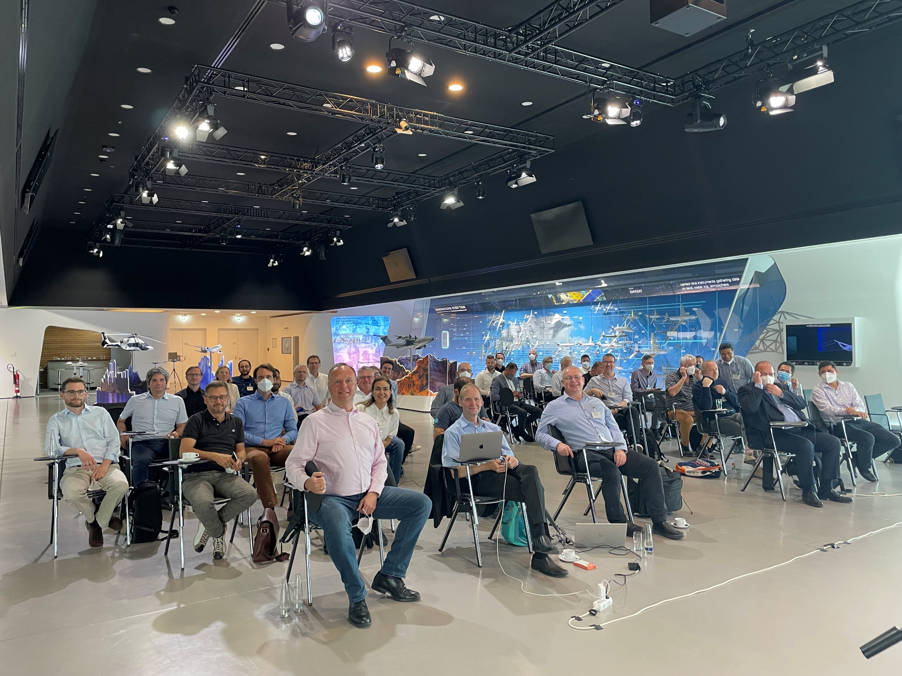
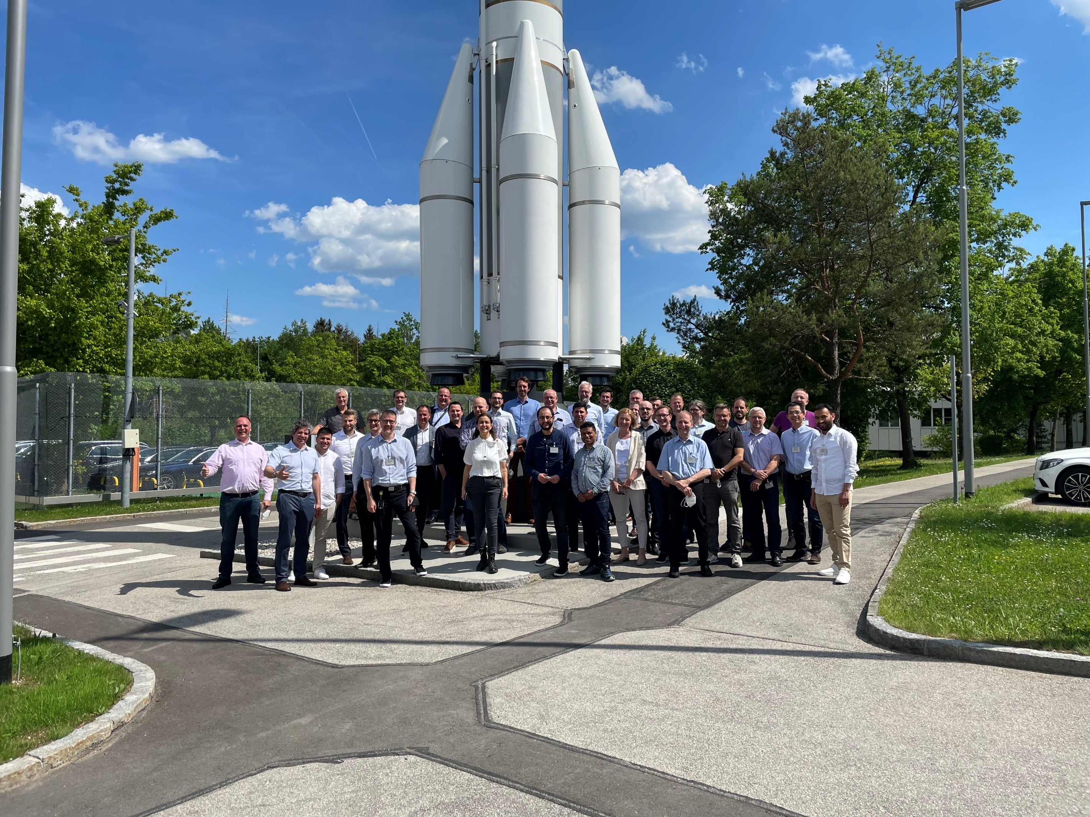
6G-SKY as seed for SPACE-ICT Flagship programme
Mid-Term Review to be held on 10 Nov 2023
Pictures from kick-off

Slide 14
CELTIC-ESA JOINT COLLABORATIVE PROGRAMME
Both organisations have expressed their interest in cooperating in the field of funding R&D&I projects related to the “Space ICT” domain, including the convergence between terrestrial and non-terrestrial networks of the future.
This cooperation does NOT replace their respective funding programmes and instruments, but leverages on them as well as on identified synergies in terms of topics of interest or strategic goals for their communities.
CELTIC-NEXT
&
ESA MoI

Slide 15

Rationale (1/3)
CELTIC-ESA JOINT COLLABORATIVE PROGRAMME
Space ICT has become a high attention subject for the Industry and the Governments:
  New entrants are currently disrupting the sector, with LEOs and HAPS
  New needs and usages have been revealed due to the pandemics impact on several sectors of the Economy and population groups
  3GPP has now opened wider doors for the inclusion of SatCom beside the traditional backhauling role
Space ICT remains a complex field with specifics in terms of operational conditions for R&D&I as well as field deployment:
  The barrier to entry for new or small players is very high.
  The inherent inaccessibility after launch in case of outage or upgrade poses challenges not existing to terrestrial network players

Slide 16

Rationale (2/3)
CELTIC-ESA JOINT COLLABORATIVE PROGRAMME
ESA ARTES owns several funding instruments:
  Open Calls, ITT, PPP...
  From 100% funding (studies or contracted development) to match-funding schemes with levels depending on Projects targeted TRLs
EUREKA CELTIC-NEXT manages an international Quality Label that enables international consortia to apply more successfully to National Funding schemes (mostly match-funding):
  CELTIC Bottom-up calls
  CELTIC Flagship Calls
  EUREKA ECP Joint Calls

Slide 17
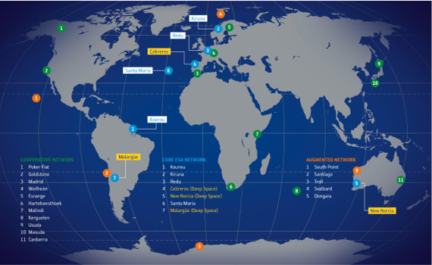

Rationale (3/3)
CELTIC-ESA JOINT COLLABORATIVE PROGRAMME
Both organisations
cover a large geography, with some countries in common, and some not
represent communities, with some members in common, and many not
see high complementarity and incentive in joining forces to leverage on the association of their respective assets, forces, and communities
Celtic-Next Eureka Cluster major European telecommunications vendors and operators
Source : The European Space Agency, Network Map, 2021

Slide 18
Coordination on Specific Themes
CELTIC-ESA JOINT COLLABORATIVE PROGRAMME
These themes include but are not limited to:
  multi-layered Space ICT and Flying Objects Convergence
  design and development of systems, subsystems and technology
  networks and services conformance and interoperability tests
  viable business ecosystem models
  convergence and integration of terrestrial and non-terrestrial networks
  frequency spectrum sharing between satellite networks and other satellite/terrestrial networks
  network timing and synchronisation technologies
  edge cloud computing
  data driven (AI enabled) management
  data curation technologies
  digital twins

Slide 19
Joint actions
CELTIC-ESA JOINT COLLABORATIVE PROGRAMME
Road mapping
Joint cross-communities Technology and Strategy Advisory Boards?
Exchange on Call dates and processes to anticipate best conditions for calls and participants
Knowledge Network creation and animation
Joint Working Groups on specific topics across funded projects
Joint Webinars / Workshops
Testbeds & Trials Platforms (R&D, Integration, Launch) promotion / provision?
Mutual Calls advertisement and bringing communities to jointly apply

Slide 20
CELTIC-ESA JOINT COLLABORATIVE PROGRAMME
EUREKA CELTIC-NEXT PROGRAMME
(Bottom-ups, Flagships, ...)
Step 1
(Σ CELTIC)
Studies
(topics generation & early exploration)
Step 5
(EUREKA)
Transfer / Industrialisation / Commercialisation
Step 2
(ESA ARTES+Σ CELTIC)
Joint Consultations &
Road mapping
Step 3
(ESA ARTES+Σ CELTIC)
Aligned Calls
(funding synch)
One or 2 streams
Step 4
(ESA ARTES+Σ CELTIC)
Joint Projects & // Projects
(R&D)
JOINT
COLLABORATIVE
PROGRAMME
ESA ARTES PROGRAMME
(Open Calls, ITT, PPP, ...)
Step 1
(ESA ARTES)
Studies
(topics generation & early exploration)
Step 5
(ESA ARTES 4.0)
Transfer / Industrialisation / Commercialisation
JOINT COLLABORATIVE PROGRAMME ( Alignment, Working Groups, Exploitation... ) / Topics: Hybrid SD-SATs, TN/NTN Convergence, Dynamic Spectrum Management...

Slide 21
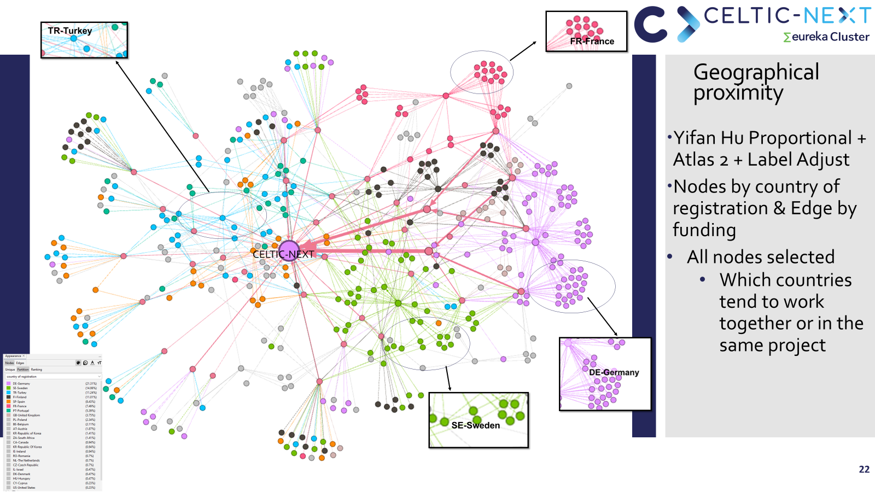
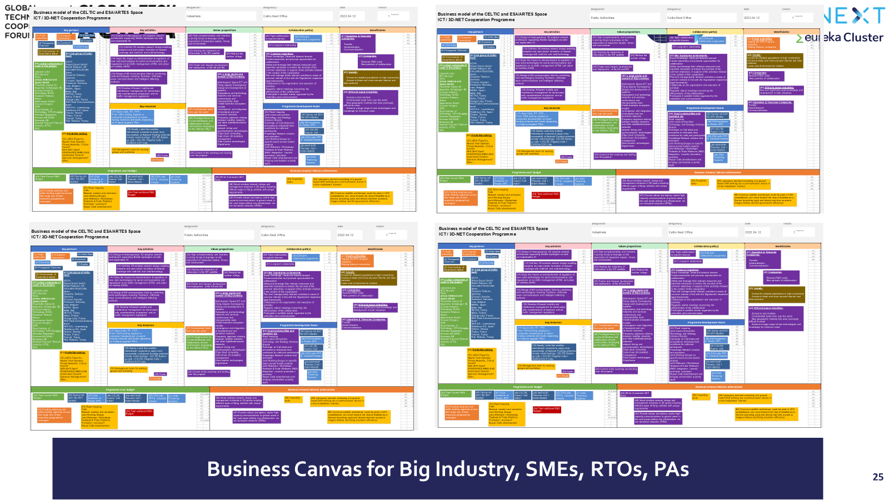
CELTIC & ESA Communities analysis with Gephi
First collaborative tools developments between CELTIC & ESA
TN & NTN Convergence Cooperative R&D Business Canvas

Slide 22
Join the in preparation TN-NTN Convergence Flagship (3D-NET)
(Vertical sub-projects, transversal thematic working groups...) !!!
Conclusion
What CELTIC-NEXT can offer:
A well-established industry-led collaboration space where projects benefit from the offered bottom-up approach allowing them to research and develop their own innovation targets.
An existing inter-governmental legal collaborative framework (EUREKA) where Countries decide for themselves with whom they collaborate and co-finance joint innovation.
If wished from proposers, support to collaboration outside of Europe (Eureka Network of Countries), still completely under your control.
Lean & agile processes and tools to manage inter-platforms cooperation calls for projects.
Simple tools for projects management and monitoring.

Slide 23

MANY THANKS FOR YOUR ATTENTION.
Xavier Priem
CELTIC-NEXT – Director
c/o Eurescom GmbH
Wieblinger Weg 19/4
69123 Heidelberg, Germany
Mobile: +49 1515 796 2180
Fax: +49 6221 989 209
Email: office@celticnext.eu
Web: https://www.celticnext.eu
CELTIC-NEXT is a not for profit organisation hosted by Eurescom GmbH
CelticNextEurekaCluster
@CelticNext
CELTIC-NEXT Video Channel

