Slide 1

Celtic-Plus Proposers Day
23 November 2016, Leuven
ICT, Telecommunication, Banking,…
Artificial intelligence Service Management Platform
Burak Barış Bürkan
burak.burkan@turkcell.com.tr

Slide 2

Problem Statement
The average of a telecommunication operator has 20K services.
Challenges:
Rapid Development
Keeping Services Up & Running
Platform Management Problems
Burak Barış Bürkan, burak.burkan@turkcell.com.tr

Slide 3

Teaser
AI in a Nutshell
An end-to-end quality assurance (QA) platform for software development houses that design, implement, maintain, and frequently release large numbers of inter-connected, mission-critical Web services.
Burak Barış Bürkan, burak.burkan@turkcell.com.tr

Slide 4
High Level Design
Repository Layer
D
E
P
L
O
Y
M
E
N
T
L
A
Y
E
R
System Controller Layer
Production
Service Layer
Development Enviroment
Test Enviroment
Preprod
Test Enviroment
Stable
Test Layer
Burak Barış Bürkan, burak.burkan@turkcell.com.tr

Slide 5
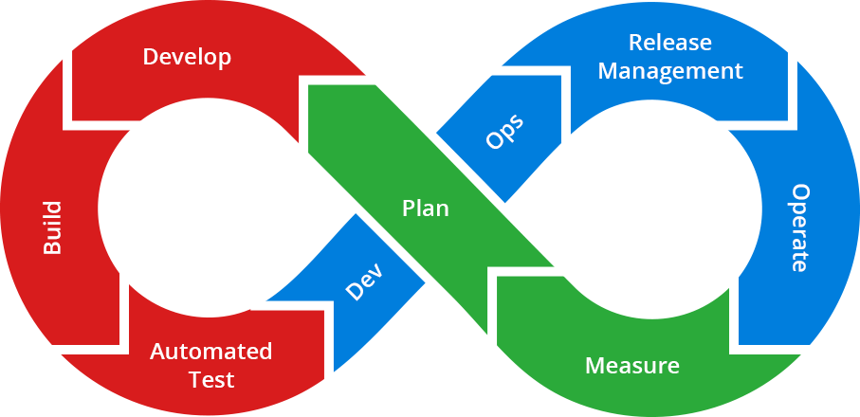
Target
The proposed AI differs from existing approaches in that it is an end-to-end solution that
  Continuous integration and DevOps
  Improve software quality both development and operational environments
  Make development life easier
  Control Production system
Burak Barış Bürkan, burak.burkan@turkcell.com.tr

Slide 6

Gain
Offered Innovation
Business relevance
Exploitation of the results

Slide 7



Current Consortium
Leading mobile operator in Turkey with 35M subscribers
Active partner of 5G activities of NGMN (Next Generation Mobile Networks)
Non-profit private university
Scientific development on an international scale
95% of faculty members have PhD from top-tier US universities
Technology Transfer Officestrongly linked to academic disiplines and incubation center.
World leader in providing telecom equipment, software and services to enable transformation through mobility
Largest holder of standard-essential patents for mobile communication
Burak Barış Bürkan, burak.burkan@turkcell.com.tr

Slide 8

Expertise in Search
  Data Analytics
  Test Automation
  Learning Engine
  Algorithm Analysis
  System Tracking
  Performance Improvement
  Fault Managemenet
  Log Management
  DevOps
Burak Barış Bürkan, burak.burkan@turkcell.com.tr

Slide 9
Contact Info
Burak Barış Bürkan
burak.burkan@turkcell.com.tr
+90 532 210 1424
Özgün Algin
ozgun.algin@turkcell.com.tr
+90 533 210 8463
Burak Barış Bürkan, burak.burkan@turkcell.com.tr

