Slide 1
Proposers Day 23 November 2016, Leuven
Celtic-Plus Success Story MediaMAP+
Steny SOLITUDE
CEO
Perfect Memory
steny.solitude@perfect-memory.com

Slide 2







Slide 3
Basic concepts of the MediaMap dynamic
The creation of Audiovisual media from ‘Intention’ to ‘Publication’
Native semantic networks
Interoperability within the organisation
Interoperability between organisations
Gracefull migration from “Flat Models” to “Semantic Model” & vice versa

Slide 4
MediaMap+ Project Implementation of the interoperability of the production chain!
Objectives : make the media production chain:
Interoperable
Efficient
Seamless
Z
Zemantic

Slide 5
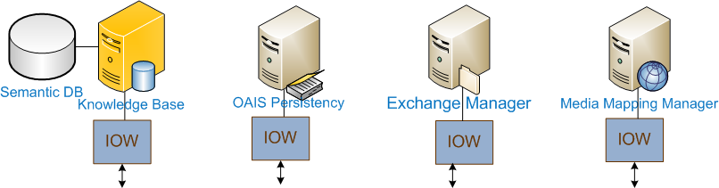
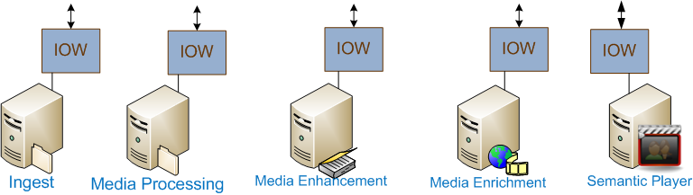
Semantic middleware

Slide 6
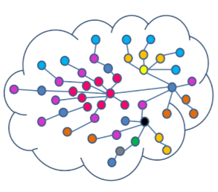
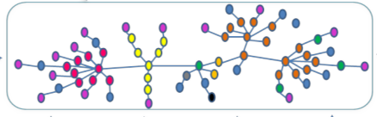
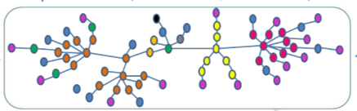
Agility & Scalability
Collect & integration of Data Flows
Reconciling data sources is a key and 1st of content personalization. It allows to consolidate assets
It consists in :
Project Data in an Evolving & Interoperable Data Structure (understandable by all),
Single access point for exploitation of the Semantic DataLake.
Set Company Business Rules
Common Knowledge (Linked Open Data)
Public Community
Customer Adpated Metamodel
Group
Customer Model
Unit
Steny SOLITUDE, Perfect Memory & steny.solitude@perfect-memory.com

Slide 7
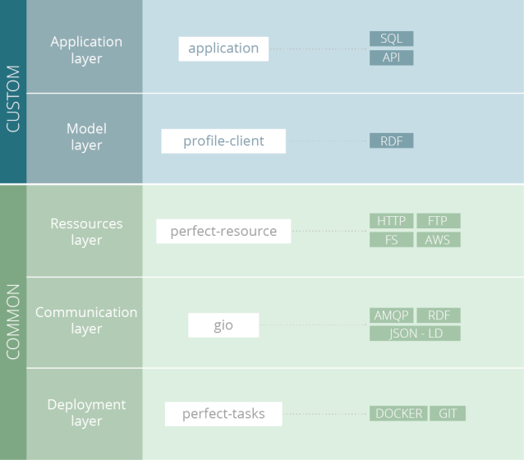
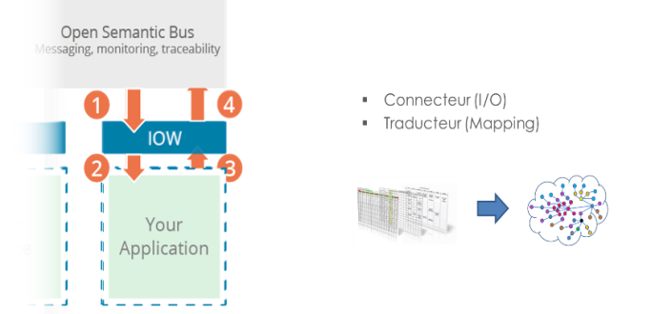
Agility & Scalability
Collect & integration of Data Flows
PMSC 2 Main Roles :
Connector : connect application to Middleware to allow exchanges
Translator : Interoperable exchanges between PM Platform Semantic Language and application Language
5 layers of an PMSC :
Interoperable Window
Steny SOLITUDE, Perfect Memory & steny.solitude@perfect-memory.com

Slide 8
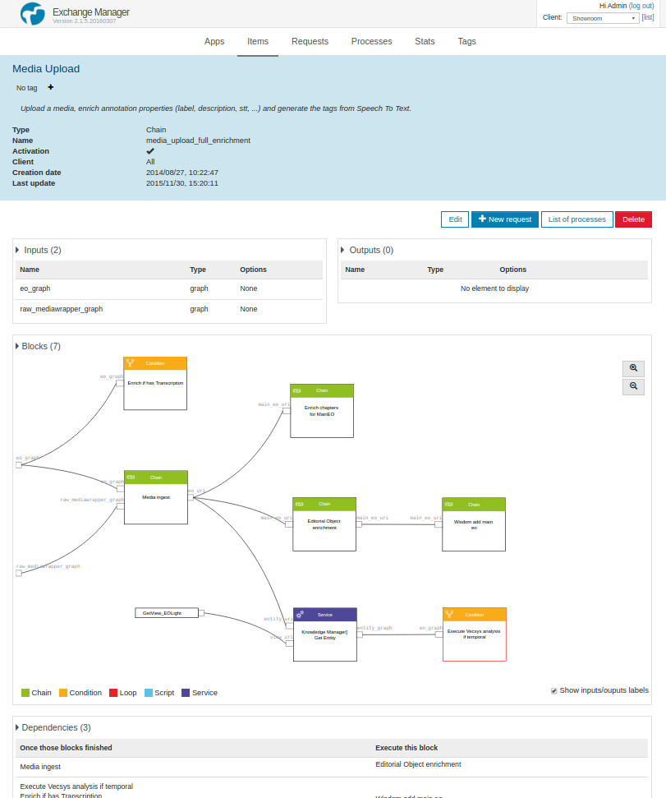
Agility & Scalability
Connect Business Data & IT Process
Exchange Manager Interface
Workflow configuration to better manage indexation of Data pour to improve quality and quantity of usable information.
Perfect Memory micro-services platform are driven by a workflow engine that secure Flexibility and Scalability in what treatment to apply to content
Platform comes with a set of pre-configured Workflows
Steny SOLITUDE, Perfect Memory & steny.solitude@perfect-memory.com

Slide 9
Efficiency
An Information Oriented Architecture
We do Reconcile data sources in order to capitalize on Information independently from where they are and description.
1 Single Access Point for Users
1 Data Model
Spaghetti Infrastructure
Treatment Modules
(>50)
Steny SOLITUDE, Perfect Memory & steny.solitude@perfect-memory.com

Slide 10


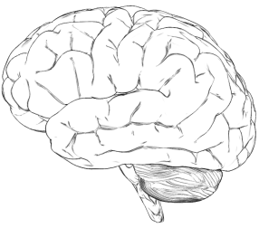
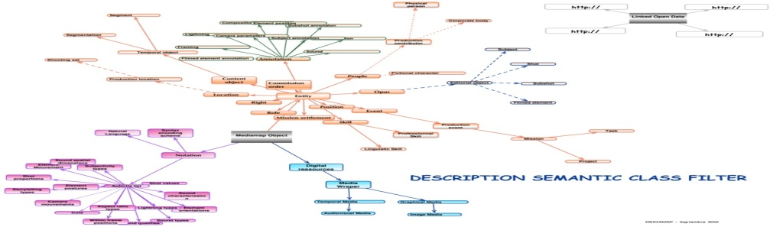
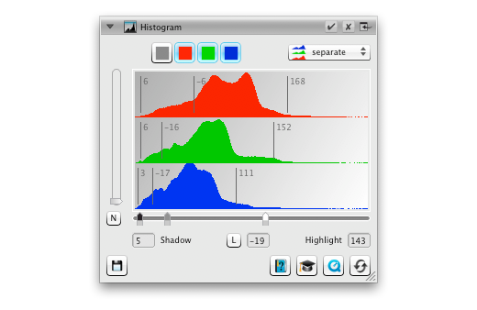

Bring the media to a semantic level
Data
Info
Knowledge
2 persons, face to face, smiling and laughing
EBUCore
Samuel L. Jackson rdf:type Person
Leonardo DiCaprio rdf:type Person
Thumbnail from Django unchained
Quentin Tarantino behind the camera
Data
Info
Semantic system
Knowledge

Slide 11
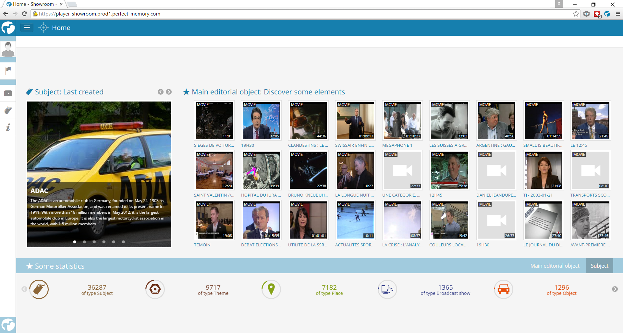
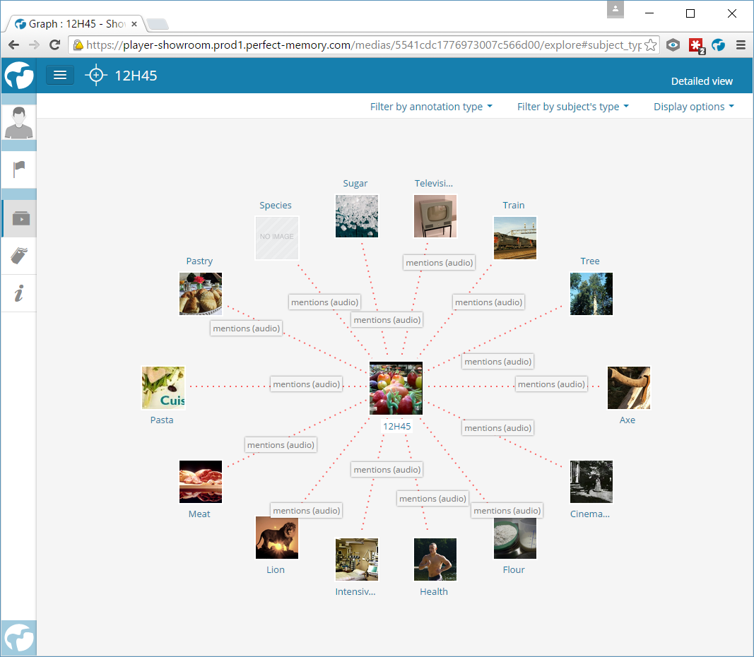
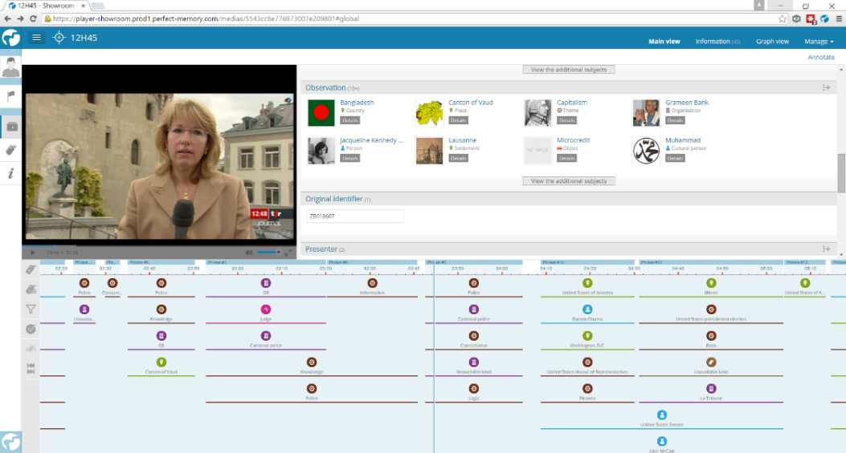
Augment and improve users experience

Slide 12
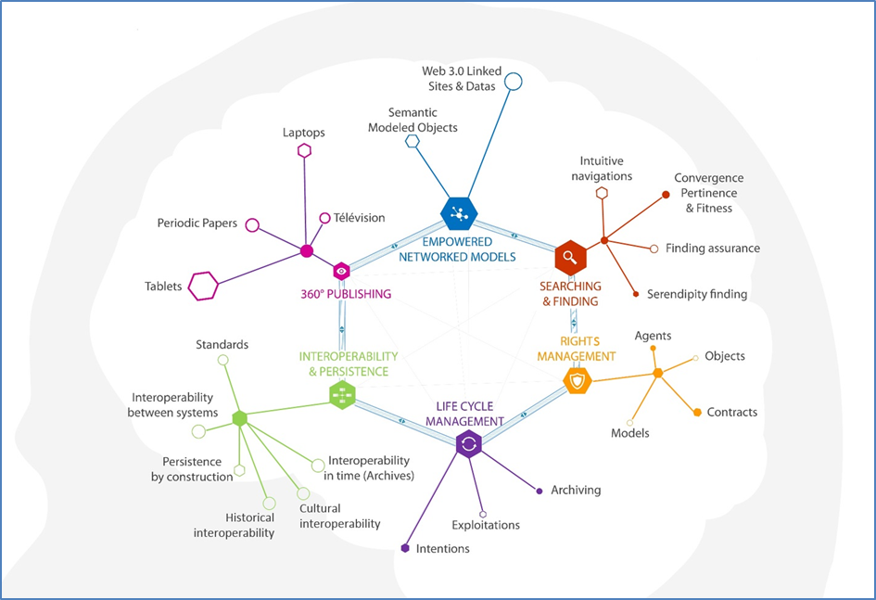
WaaB : Web as a Brain
MediaMap+ articulates a networked computer system that gives orders translated into processes and enables computers to interact in a particular environment. This network mobilizes all resources required by the editorial to materialize rich content destined for consumption! The architecture of such a network is done partly or largely on inputs (ontologies) but the reasoning or inference may influence construction.
Steny SOLITUDE, Perfect Memory & steny.solitude@perfect-memory.com

Slide 13

A New Product
A Unique Approach of the Business Needs
We connect A.I. branches
Semantic is used as statistic categories
Factual
knowledge
SEmantic
HEURISTIC
KNOWLEDGE
STATISTIC
Semantic Middleware & DAM
Semantic processing of the data
Statistic processing of the data
[Grammar, Structuring, Reasoning]
[Data mining, Machine Learning, Deep Learning]
FACT
RULE
Statistics are structured into new knowledge
DISCOVER
HYPOTHESIS
OBSERVATION
13
Accurate Meaningful & Actionable Data
Steny SOLITUDE, Perfect Memory & steny.solitude@perfect-memory.com
13
Pitch Deck - Confidential - © Perfect Memory

Slide 14




Raffiné
The Semantic middleware & DAM that disrupts DAM, ECM and MDM
Data Sources
Process and Enrich
Exploit
Vidéo
PM Semantic Connectors- Ingest & Normalize
PM Semantic Connectors- - Export & Monetize
IMPORT
CONTENT
PROCESSING
ENRICHMENT
STORAGE
Product Catalog
...
...
CRM / ERP
Named
Entity Recognition
...
Business Applications
...
...
Speech To Text
Graph
Marketplace
Sound
MAM
Recommendation
Engine
Controlled
Annotation
Hadoop
Database
Segmentation
Classiﬁcation
NoSQL
Data Visualization
Text
Oﬃce Document
Transcoding
Video Analysis
SQL
Semantic Search
Export
Sensor Data
Semantic Services
Social Média
Semantic Enrichment
Server Logs
Call detail records
Ontology
Perfect Memory
Optional Module
Steny SOLITUDE, Perfect Memory & steny.solitude@perfect-memory.com

Slide 15
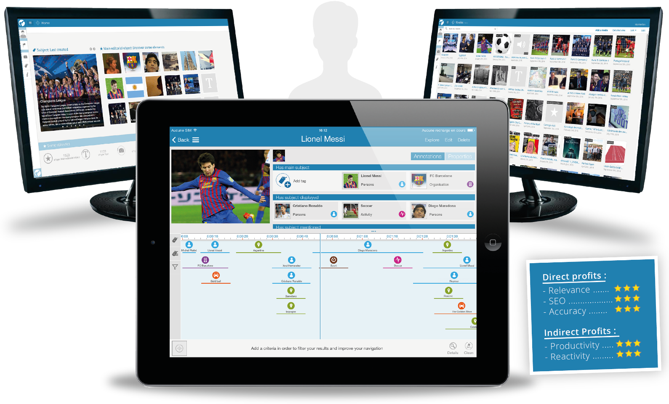





Increase the revenue of catalogs owners with a user-centric description of products and an improved accessibility and quality of reference listings
11/23/2016
© Perfect Memory 2015
15

Slide 16
Opportunity & Impacts
Allow Any Data To Be Processed, Reused, And Monetized By Business
Accelerate
products & services time-to-market
Distribute
to consumer a richer and more accurate information
Improve innovation identification & referencing
Steny SOLITUDE, Perfect Memory & steny.solitude@perfect-memory.com

Slide 17
Opportunity & Impacts
Lack of Sales Efficiency
Lack of Operational Efficiency
+Data
ux Quality Decreasing
Steny SOLITUDE, Perfect Memory & steny.solitude@perfect-memory.com

Slide 18
Organizational Silos & No Common Repository & Lack Of Data Update
Opportunity & Impacts
11%
of data are cross-BU
73%
of data remain unused
22%
of data become obsolete
after 90 days
Steny SOLITUDE, Perfect Memory & steny.solitude@perfect-memory.com

Slide 19





Opportunity & Impacts
ROI
30% improved accuracy on recommendations.
15% price increase for advertising.
Use Generated Content
Catalog
Entertainment
Media
Asset
Social Data
Value Provided
Enrich brand content.
Increases customers intimacy.
Customer
Inventory
ROI
35% reduction in customer acquisition cost.
Marketing
R&D
Advertiser
Customer
Sales
Value Provided
Delete silos of business data.
Automate data update and exposure.
Product
Inventory
Steny SOLITUDE, Perfect Memory & steny.solitude@perfect-memory.com

Slide 20
Opportunity & Impacts
Speed up access to any content being managed & exploited
(internal, external, corporate and UGC)
Dedicated LOB tools to simply exploit content
Strengthen and deepen reference listings
Improved front-end capabilities & performances (Recommendation Engine, Portal, …)
Steny SOLITUDE, Perfect Memory & steny.solitude@perfect-memory.com

Slide 21
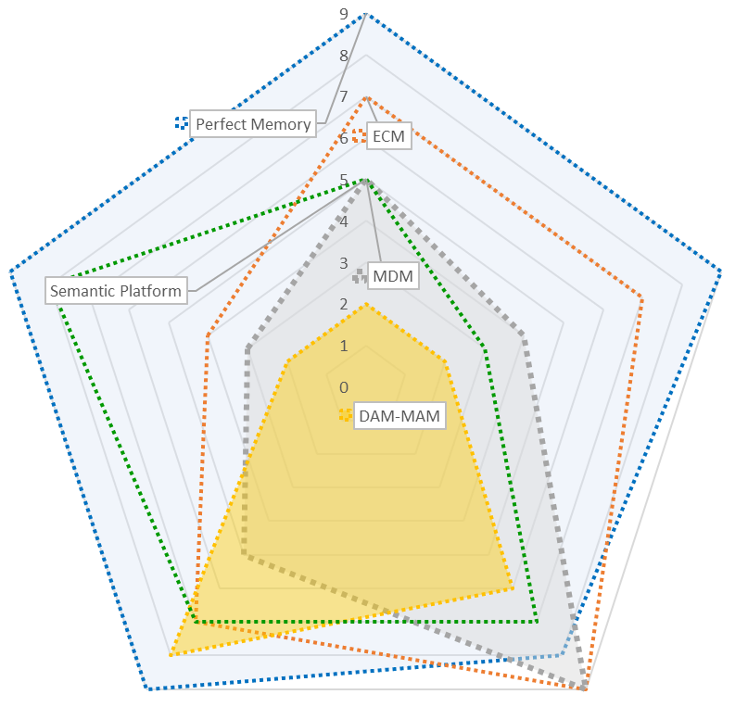




















Merging ECM, DAM and MDM
Number of data sources
ECM
Infra & Model agility
Data sources
Master Data Management
Enterprise Content Management
Semantic Platform
MDM
DAM-MAM
Semantic Platform
Digital Asset Management
Types of documents
Scalability
Steny SOLITUDE, Perfect Memory & steny.solitude@perfect-memory.com
Notes:
YM: Changé le titre: Market Landscape, pas Perfect Memory Landscape

Slide 22
















References
Confidential
Steny SOLITUDE, Perfect Memory & steny.solitude@perfect-memory.com

Slide 23
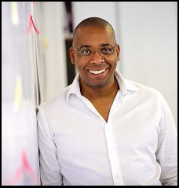

Contact Info
Steny SOLITUDE
steny.solitude@perfect-memory.com
+33 661 763 493
Perfect Memory
33b boulevard Berthelot
63400 Chamalières
France
www.perfect-memory.com
@perfect__memory http://youtube.com/+PerfectMemoryChamalieres
Steny SOLITUDE, Perfect Memory & steny.solitude@perfect-memory.com

