Slide 1
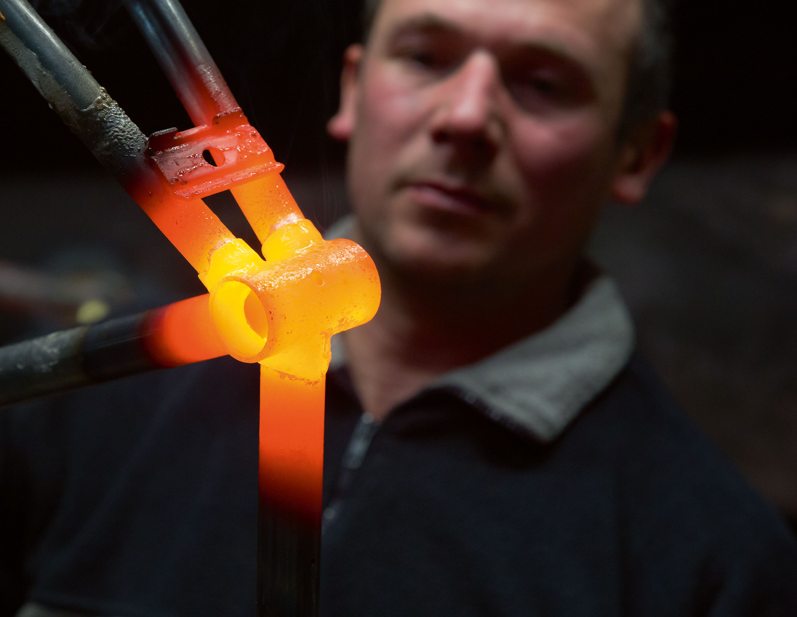

Innovation Financing
Industrial R&D subsidies
Danny Van Steenkiste
dvs@vlaio.be
http://www.vlaio.be/
Presentation for the EUREKA Cluster CELTIC+, November 23, 2016

Slide 2

FLANDERS INNOVATION AND ENTREPRENEURSHIP (VLAIO)
Merger between formerly IWT and Agency for Entrepreneurship
We help companies with the startup of their activities, the growth and continuity of their business, but also with the search for the right location, information on permits, financing, investments in innovation and ecological technologies, and other topics.
In short, we confidentially guide entrepreneurs throughout the government landscape.
Budget in 2015 : 510 M€ total VLAIO budget, 175 M€ for industrial R&D projects
Applications in 2015: 500 Industrial R&D projects

Slide 3
Programme for:
Industrial basic research or development
Objective:
  Financial support for R&D projects tackling a technical and/or scientific problem.
  Essential criteria for evaluation are:
    the project quality
    the valorisation potential in Flanders.
For whom:
  Any company, SME or multinational, with exploitation in Flanders.
  Cooperation with other companies and/or research partners is possible.

Slide 4
Industrial basic research or development
Submission:
  Any day of the year
Duration:
  Max. 3 year
Budget:
  Min. 100.000 EUR
  Funding Max. 3 Mio EUR
Basic Support (% budget):
  50% subsidy for industrial basic research
  25% for industrial development

Slide 5
Subsidies
50% Support
Industrial basic research
25% Support
Industrial development
10%: Medium sized companies
20%: Small companies
10%: Substantial collaboration with an SME, or any company in the EU

Slide 6
Our cost model:
Based on payroll costs
(human resources and real salary costs)
per FTE: 20,000 € Indirect costs
Lump sum
per FTE: max 20,000 € Direct costs
No details needed
Can be verified at the end of the project
Subcontracting cost
1 large Direct cost

Slide 7
Evaluation
Phase I: Eligibility
Phase II: Evaluation
(written evaluation by 3 external reviewers and IWT)
Phase III: Agreement
Meeting with IWT advisors
Submission of additional data
Agreement
Eligibility
Decision of Board of Directors
12 working days
75 days

Slide 8
Special program for SMEs
Innovation Projects
Objective:
  Financial support for the realisation of innovation (i.e. new or improved product, process, service or concept). Development and implementation of (non-)technological knowledge is essential. The innovation is new for the company and will have a clear impact on the company’s activities.
For whom:
  SMEs with exploitation in Flanders.
  Cooperation with other companies or research partners is possible.

Slide 9
Innovation Projects
Submission:
  Any day of the year
  Max. 2 innovation projects per SME per year
Duration:
  Max. 2 year
Funding (% budget ) in EUREKA context:
  45% for ME
  55% for SE
  Max 250,000 €

Slide 10
Danny Van Steenkiste ▪ Advisor ▪ EUREKA Regional Representative
Tel : +32 2 432 42 17
Mail: dvs@vlaio.be ▪ http://www.vlaio.be
FLANDERS INNOVATION AND ENTREPRENEURSHIP
Department of European & International Collaboration
Koning Albert II-laan 35 box 12 ▪ 1030 Brussels ▪ Belgium

Slide 11
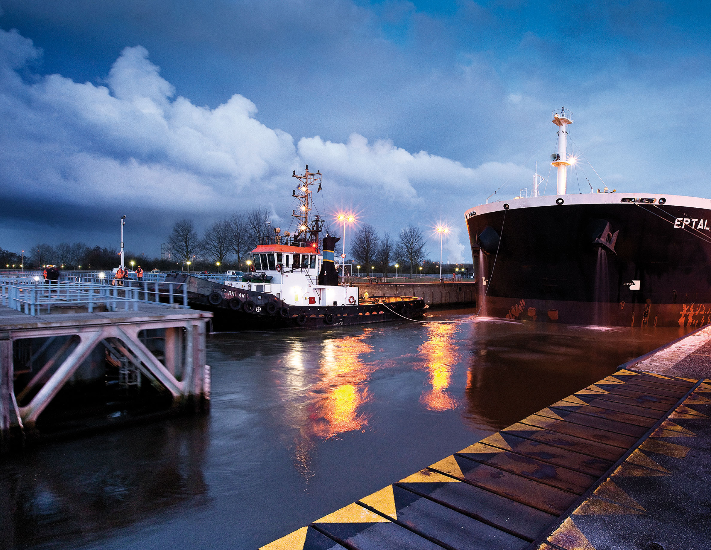
Tank you for your attention,
Any questions ?

