Slide 1

Pitch Summaries of Celtic-Plus Proposers Day in Stockholm, 29 April 2016
https://www.celticplus.eu/project-ideas-from-proposers-days/
#CelticPropDay

Slide 2
Proposal Ideas Overview
1 | Quality Management in Ubiquitous Telecommunication (QaMUT) | Janne Seppänen (Toni Maki) | VTT | Finland
2 | Thermal Resonance for Heat Transfer Enhancement | Jae Won Kim, | Sun Moon University | S-Korea
3 | Invisible Wealth | Matthias Svahn | HHS | Sweden
4 | Wherever, Indoor/Outdoor Location Service | Kukyeon HWANG (Director) | AscenKorea | S-Korea
5 | IoT Device Connectivity Platform | John Lebeau => Dr. Paul Slaby | Teslonix | Canada
6 | The Smart Sensor & Semiconductor NVM Switch | Yun-sik LEE | UNIST(Ulsan National Institute of Science and Technlogy) | S-Korea
7 | WINS@HI | Caner Aksoy, Technical Coordinator | Netas Telecommunications R&D | Turkey
8 | Understanding of IoT Devices Events | Young-bae SEO (CEO) | SEJONG Creative Co., Ltd | S-Korea
9 | Predictive Energy Management of Network of Buildings Enabled with Distributed Energy Resources | Alexandre Pavlovski | Green Power Labs | Canada
10 | Smartly connected world based on low threshold Ge on Si laser | Wan-gyu LEE | National Nanofab Center | S-Korea
11 | SASAGEP | Klaus Kinzinger | Kinzinger Automation GmbH | Germany
12 | Eco Friendly Lightweight MMC Materials | Min-Seok MOON | Korea Institute of Carbon Convergence Technology | S-Korea

Slide 3
Proposal Ideas Overview
13 | IoT2 = IoT-Square | Denis Rousset | Com4Innov | France
14 | INGENISENSE (to analyse cyber events data) | Ekrem Aksoy | SYM Software | Turkey
15 | Street parking management solution | Jerneja Žganec Gros | Alpineon | Slovenia
16 | Green Spektrum | Cem Ayyildiz Bahadir Tugrel | TURKCELL & Istanbul Technical KOÇ University | Turkey
17 | BEYOND WORDS We visualize your knowledge | Johan Lundell | Founder & CEO of nodd | Sweden
18 | Innovation Platform for Enhanced Life in Smart Campuses | Ibrahim Dogru | Netas Telecommunications R&D | Turkey
19 | IoT enabler | Purificación Amaya Trinidad | Sinapse Energía | Spain
20 | Personal Air Quality Monitors | Leonardo Santiago | ATEKNEA SOLUTIONS | Spain
21 | 5G Test Network Finland | Sami Ruponen | VTT | Finland
22 | InnovaTTion Spain | Asmik Miribyan | Touristec | Spain
23 | Innovate In Summerside PEI | Mike Bonga, AKA Group | AKA Group | Canada
24 | AirVision Cloud | Vytautas Taujanskas | Magma solutions | Lituania
25 | On the way to Autonomous Driving: A chance for small and medium sized enterprises | Konrad Becker, pres. by Peter Herrmann | SUNGWOO Mobile Co. Ltd. | S-Korea

Slide 4
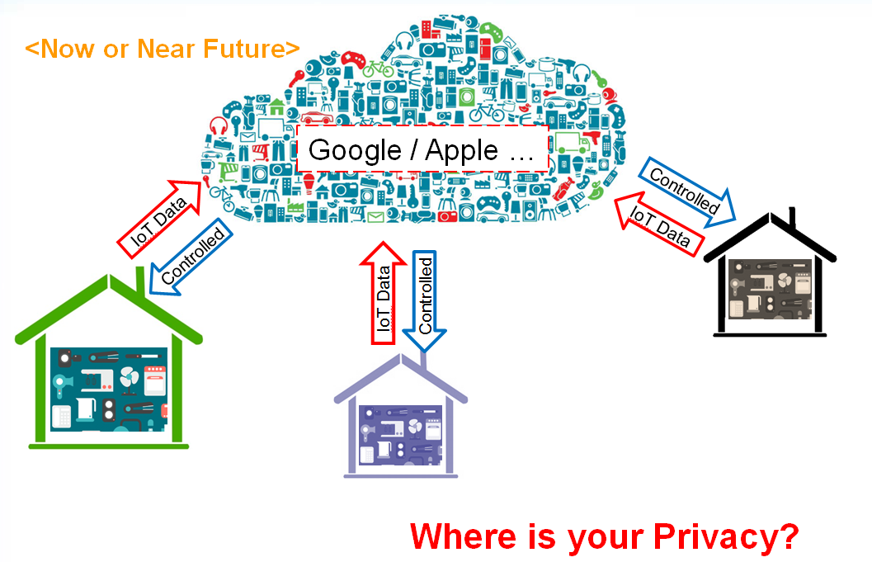
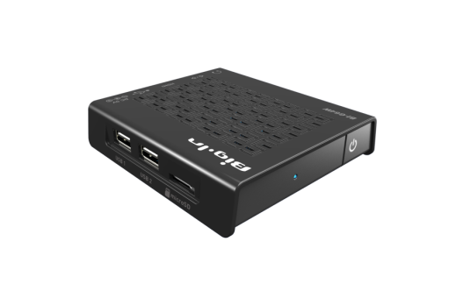

Understanding of IoT Device Events
Prevent hidden dangers in home networks through analyzing IoT Events.
Analyzing the benefits of IoT whilst keeping privacy for the end-users.
Expected Impact:
Big Data, Machine learning able to analyze IoT Events to enable security/privacy for end-users.
Consortium:
See partner ideas in presentation:
https://www.celticplus.eu/project-ideas-from-proposers-days/
Low Energy Small IoT G/W made by SEJONG Creative
Contacts:
YoungBae Seo
Yb.seo@sjcreative.co.kr

Slide 5


Smartly connected world based on low threshold Ge on Si laser
Efficent solution to increasing demand in
bandwidth, distance and energy consumtion
for data centers.
Lowest power Ge laser on SI photonics.
Adopting Si photonics allows much faster digital
signaling than it is currently possible with optical interconnection.
Expected Impact:
Higher optical functionality
Architecture change in data centre
Decrease in current threshold power
1/10 current threshold power @2018 1/50 current threshold power @2019
Partners search
Manufacturers who want to adopt monolithic opto electronic devices in a low cost SI process
https://www.celticplus.eu/project-ideas-from-proposers-days/
Contact:
Wan-Gyu Lee
wangyulee@nnfc.re.kr

Slide 6
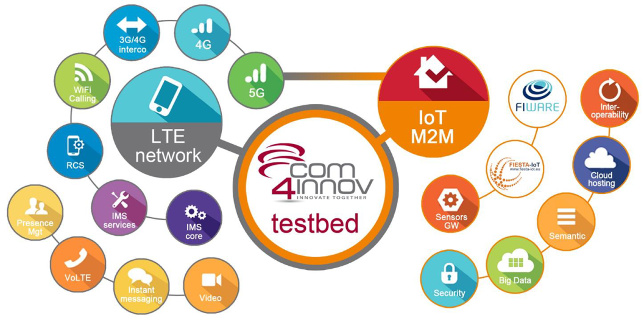

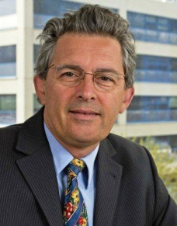
IoT-Square
In a Nutshell
Diversifying radio access connecting objects for massive IoT deployment is mandatory to face Billions of IoT devices
Key challenge: avoid congestion of the network with billions of connections, low cost, extra long battery life, extend coverage.
Provide fully operational 4G network embedded in Datacentres supporting FIWARE
Missing expertise:
System Integrator
Radio Access Network
Configuration Mangement
Gateway provider Users and Experimenters
https://www.celticplus.eu/project-ideas-from-proposers-days/
Expected lab node Impact:
Interoperability tests for internet of things
Semantical standardization of available data
Contact:
Denis ROUSSET, Comm4Innov
denis.rousset@com4innov.com

Slide 7
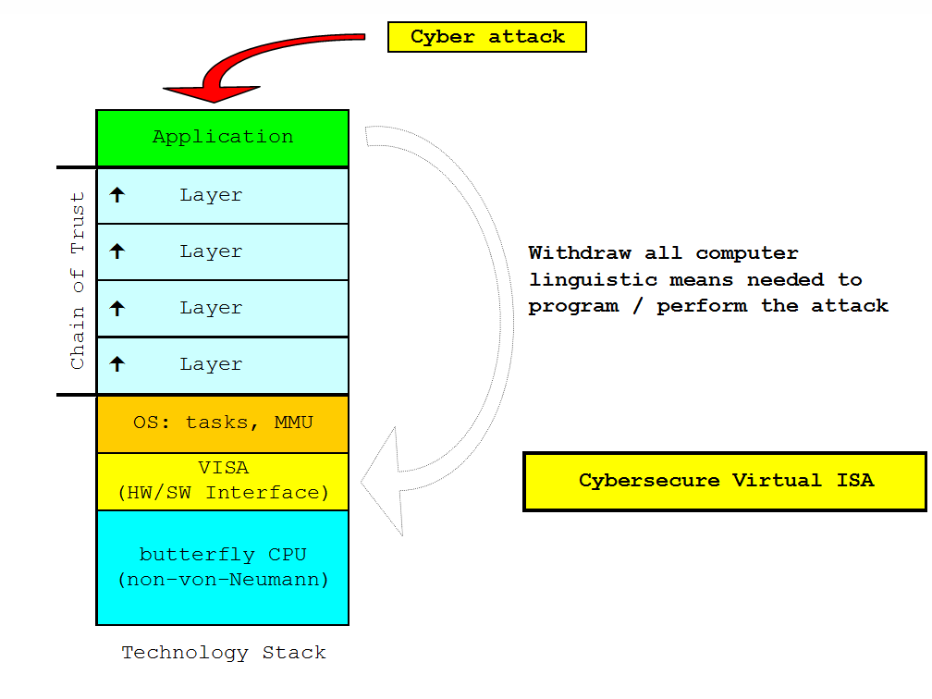
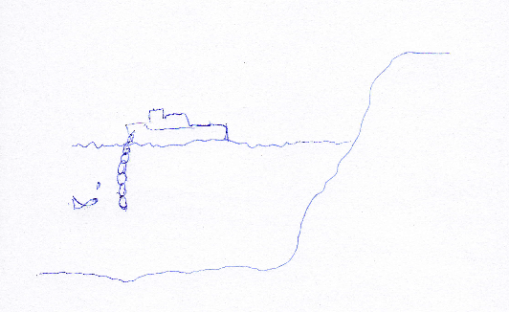
JESI:
Joint European Security Initiative
IT security can not exist without proper hardware anchoring
It never has and never will
Jesi is ready for the prototype phase for further proof of concept – mainly compiler / chip design issues overall fine tuning and improvement, and implementation
Missing partners:
https://www.celticplus.eu/project-ideas-from-proposers-days/
Expected Impact:
Enabler for secure Industry 4.0 and safe and secure V2X communication use-cases.
Consortium:
See partner profiles in presentation:
https://www.celticplus.eu/project-ideas-from-proposers-days/
Contact:
Klaus Kinzinger
kinzinger@kinzinger.de

Slide 8
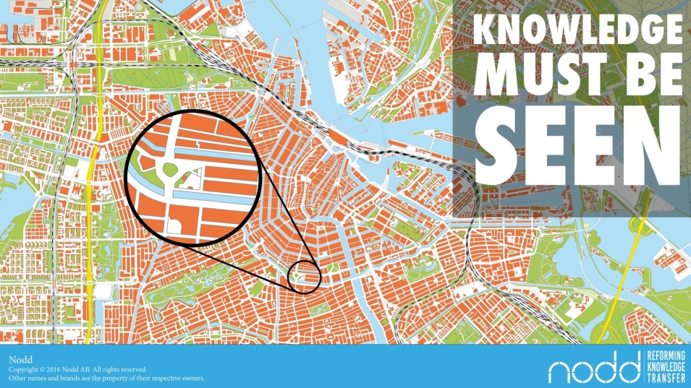

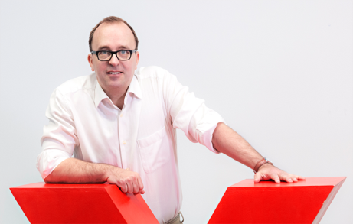
Beyond Words
Vizualising knowledge
Development requires understanding, vizualization is the solution
Nodds turns implicit knowledge to explicit knowledge
Lets you communicate without words and without translations.
Understanding data by carrying it in a better ways.
Missing expertise:
see partner profile online
https://www.celticplus.eu/project-ideas-from-proposers-days/
Contact:
Johan Lundell, NODD
Johan.lundell@nodd.se

Slide 9
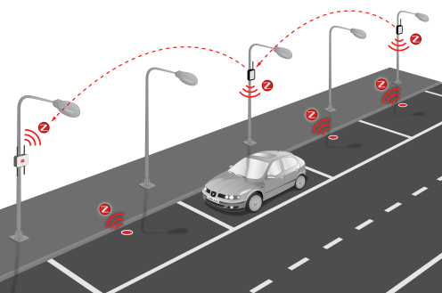
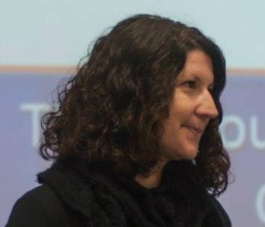

PARKSense
– Provide a robust street parking management solution based on IoT real-time parking occupancy data.
– To reduce hassles and time lost in searching for a free parking space in smart urban environments.
– Enable faster traffic flows & emission reduction.
Looking for partners:
please have a look at the presentation sliedes online:
https://www.celticplus.eu/project-ideas-from-proposers-days/
Expected Impact:
reduced travel times, energy consumption, polution reduction
Contact:
Jerneja Tganec Gros , Alpineon
Jerneja.gros@alpineon.si

