Slide 1


Celtic-Plus Proposers Day 23 November 2016, Leuven
Continuous and Focused Developer Feedback on Software Quality
(CoFoDef)
Dr. Daniel Graziotin, Software Engineering Group, University of Stuttgart
daniel.graziotin@informatik.uni-stuttgart.de

Slide 2
Teaser
Software quality problems often unnoticed
Quality decay
Software and life disasters
CoFoDeF
Detect quality problems before or while they arise
Continuous and focused quality feedback, right context and time
Value, Benefit
Increase quality analysis and awareness
Reduce quality decay and disasters
New market of intelligent tools for development
Domain-independent and customisable for partners (IoT, autonomous driving, ICT, ..)
Daniel Graziotin, daniel.graziotin@informatik.uni-stuttgart.de

Slide 3
Profile
Software
Engineering
Behavioral Science
Requirements
Quality
Safety & Security
Continuous, Agile & Lean
Tools
Daniel Graziotin, daniel.graziotin@informatik.uni-stuttgart.de

Slide 4
Proposal Introduction (1)
Vision Software quality issues and their solution should be detected automagically by tools.
Motivation
Software development needs same rigour as any engineering product
Software intangible
overlooking consequences of development choices + code changes
especially within cycle loops (agile or not)
Content
Conceptualize information quality needs and continuous feedback
Validate effectiveness
Prepare for market solution
Daniel Graziotin, daniel.graziotin@informatik.uni-stuttgart.de

Slide 5
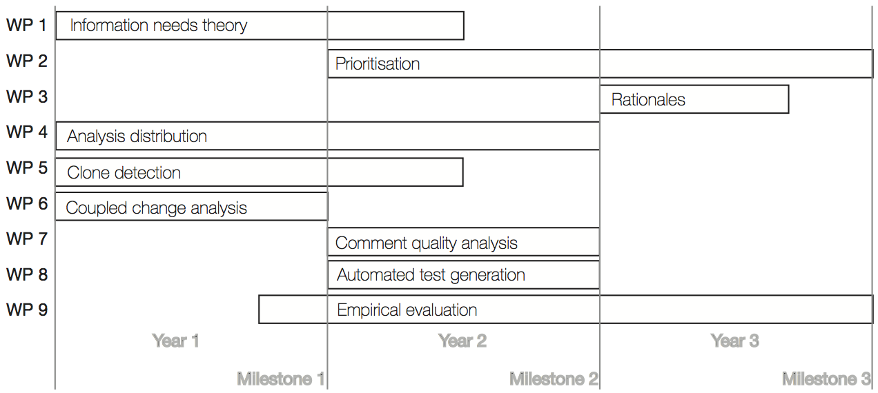
Proposal Introduction (2)
Outcome: validated method for continuous feedback on software quality.
Impact: higher software quality, less incidents, less resources and effort spent.
Daniel Graziotin, daniel.graziotin@informatik.uni-stuttgart.de

Slide 6
Partners
Uni Stuttgart
3rd party, ”case study” partners
Industry
Characteristics:
Practical problems (where we plug-in) Domain area Consultancy
AEB GmbH, DE
CQSE GmbH, DE
Academic / R&D
Characteristics:
Artificial intelligence
👍lead this project
👍join a new project
Daniel Graziotin, daniel.graziotin@informatik.uni-stuttgart.de

Slide 7
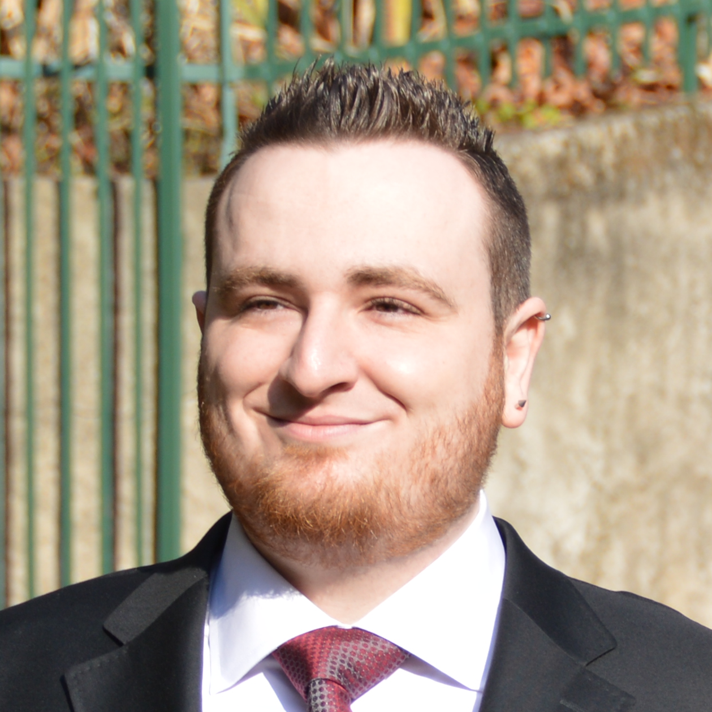
Contact Info
For more information and for interest to participate please contact:
Dr. Daniel Graziotin, Institute of Software Technology,
University of Stuttgart.
daniel.graziotin@informatik.uni-stuttgart.de
+49 711 685-88338
Universitätsstraße 38, D-70569 Stuttgart Deutschland
Easier, find info at ineed.coffee.
Daniel Graziotin, daniel.graziotin@informatik.uni-stuttgart.de

