Slide 1

Pitch Summaries:
Istanbul Celtic-Plus Proposers Day, 22 September 2016
https://www.celticplus.eu/project-ideas-from-proposers-days/
#CelticPropDay

Slide 2
Proposal Ideas Overview
1 | Privacy preserving data mining for telecom operators | Engin Zeydan | Turk Telekom | Turkey
2 | ViSec Lab - Virtual Cyber Security Lab | Uğur Çağal, Hakan Kılınç | Netaş | Turkey
3 | ICT, Telecommunication, Banking, Artificial intelligence Service Management Platform | Burak Barış Bürkan | Turkcell Technology | Turkey
4 | Cost Effective Packet Analyzer for 5G - PAC-MEC Proposal | Basak Gencer Unsalver | Netaş | Turkey
5 | IoT/M2M for smart farming using renewable energy | George Suciu | BEIA Consult | Romania
6 | New Generation Network Security System | Baris Bulut | Enforma | Turkey
7 | 5G Expert Support System | Basak Gencer Unsalver | Netaş | Turkey
8 | Virtual Reality to Overcome Exam Anxiety | Özlem ALBAYRAK | MEBİTECH Bilişim A.Ş | Turkey
9 | IDIMRO: Intelligent Dynamic Integrated Maintenance Repair & Overhaul Planning and Optimization Platform | Nejdet Pamuk | ICRON Technologies | The Netherlands
10 | SAAS Mobile e-Learning Platform | Bilgin Yazar | Etgigrup | Turkey
11 | Virtualisation, Cloud Computing | Özgür Armağan | Netaş | Turkey
12 | IoIST: Data Analytics Platform for IoT Sensor Data | İsmail UZUN | INOSENS | Turkey
13 | VAR2: VR/AR for Physical Rehabilitation | İsmail UZUN | INOSENS | Turkey

Slide 3
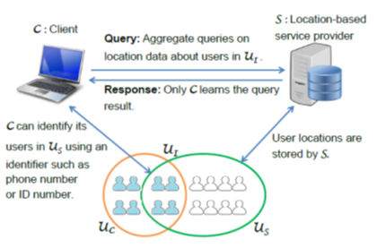

Privacy preserving data mining for telecom operators
Help businesses to better understand their customers via the data they collected through their operations.
Without compromising the privacy and anonymity of the individuals.
Collect, store, process, and share personal data of customers in a privacy-preserving way.
  Solutions for privacy-preserving data publication and sharing.
Expected Impact:
Improvement of technologies for data access, processing and analysis.
Improvements towards creating a secure environment for data access, process and analysis, demonstrated in the use situations that arise in the data experimentation/integration projects.
Consortium:
See partner profiles in presentation:
https://www.celticplus.eu/project-ideas-from-proposers-days/
Contacts:
Engin Zeydan, Türk Telekom Labs
Engin.Zeydan@turktelekom.com.tr

Slide 4
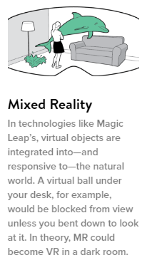

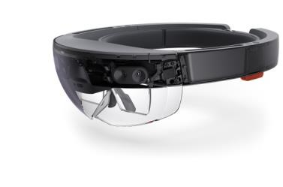

ViSec Lab - Virtual Cyber Security Lab
Leverage technology to create scalable cyber security training and simulation software with increased learning outcomes and motivation
3 trillion USD global education market
E-learning is expected to more than triple within the next 4 years
2012: $91 billion industry
2017: $251 billion industry
Expected Impact:
Combination: Augmented Reality & Virtual Reality
Expensive equipment fully simulated
Enhanced Lab Automation Engine
Removing static flat display monitors
Consortium:
See partner ideas in presentation:
https://www.celticplus.eu/project-ideas-from-proposers-days/
Contacts:
Hakan KILINÇ
hakank@netas.com.tr

Slide 5
Cost Effective Packet Analyzer
for 5G - PAC-MEC Proposal
Vision
The vision is to make a scalable, cost-effective network packet analyzer designed for 5G networks.
Motivation
To improve the 5G network performance.
To improve end-user experience.
Content
5G MEC protocol, RFC compliancy research and implementation.
Parallel programming to get high computing performance from multi core/thread environments
Research on standardized statistical output data and reports
Expected Impact:
Generate statistical data and reports to help ISPs develop new Value Added Services (VAS) and or generate/activate current services quicker.
Income of ISPs will be increased via new VAS.
Better and efficient usage of network infrastructure.
Increase end users’ total Quality of Experience (QoE) in terms of speed, quality, and new services.
Partners Needed
5G research on protocols, RFCs and standardization
SBC and parallel computing experience
VAS infrastructure
https://www.celticplus.eu/project-ideas-from-proposers-days/
Contact:
Mehmet Yoldas SIMSEK
msimsek@netas.com.tr

Slide 6
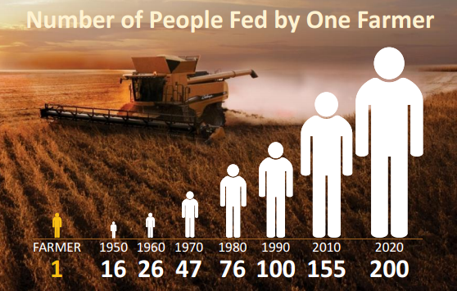

IoT/M2M for smart farming
using renewable energy
In a Nutshell
to develop a tele-monitoring system that can operate in severe condition (radiation, corrosive, humidity, extreme climate, floods, underground, underwater)
to advance the technology for M2M communications in water-environments, especially where no GSM coverage is available
to improve the energy efficiency for telemetry with low-power sensors in remote locations by using only a small size solar panel
Missing partners:
Under-water/ground communication expertise / IND, RES, UNI, SME / ANY country / Design and development of ultra-low power protocols for wireless under-water communication
Sensors expertise / IND, RES, UNI, SME / ANY country / Design and development of micro- and miniaturized sensor systems
https://www.celticplus.eu/project-ideas-from-proposers-days/
Expected Impact:
Telemetry system with secure self-diagnosis and auto-configuration functionalities
Green energy operation in remote locations and harsh environmental conditions (perturbations and corrosion)
Contact:
George Suciu Sr.
george.suciu@beia.ro

Slide 7
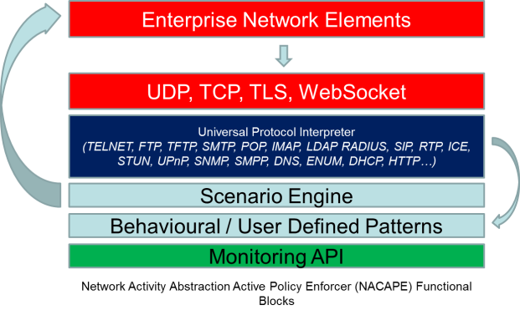

New Generation Network Security System
In a Nutshell
An evolved security system that can address ‘evolved risks’ currently undetectable by the IDS systems
Machine learning ideas incorporated
Kills threats from outside and inside
Detects extended list of network activities such as an abnormally high number of MX lookup local email addresses, or DDOS
Missing expertise:
Analysis of security threats, Development
Testing
Vendors,
Partners with network traffic analysis experience,
Partners with testing capability or a friendly customer status
https://www.celticplus.eu/project-ideas-from-proposers-days/
Expected Impact:
A European security system with zero backdoors
Higher security of systems and personal information
Contact:
Dr. Barış Bulut, Enforma Bilişim A.Ş.
baris@enforma-tr.com

Slide 8


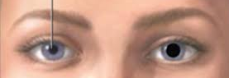

Virtual Reality to Overcome Exam Anxiety
Taking exams is a
nightmare for some
Virtual Reality to Overcome Exam
helps such students to
overcome their exam anxiety
Consortium:
MEBİTECH (Turkey)
Middle East Technical University (Turkey)
Başkent University (Turkey)
https://www.celticplus.eu/project-ideas-from-proposers-days/
Different Bio feed-back monitoring
Expected Impact:
Less failures in Exams
Contact:
Dr. Özlem ALBAYRAK
ozlem.albayrak@mebitech.com

Slide 9


IDIMRO: Intelligent Dynamic Integrated Maintenance Repair & Overhaul
In a Nutshell
It’s an Supply Chain Management Planning, Scheduling and Optimization
project including embedded ERP, Mobile and Execution functions
for
Maintenance Repair and Overhaul companies
(Aviation, Public transportation and Utilities).
Current Consortium of this submitted application:
3 partners from NL and 3 from TR, one from DE
Missing expertise:
Use case partners for airplane, public transportation maintenance
Technology partners for system integration and Human Resources system
https://www.celticplus.eu/project-ideas-from-proposers-days/
Expected Impact:
Direct savings:
Lower maintenance costs
Optimized workforce requirements
7-10% Reduction on the number of spare vehicles required
Reduction on out-of-service durations of vehicles
15-30% reduction in material inventory levels
30-40% improvement in efficiency
Improvement in meeting the SLA requirements
Contact:
Nejdet Pamuk, Managing Director/CEO
nxp@icrontech.com

Slide 10
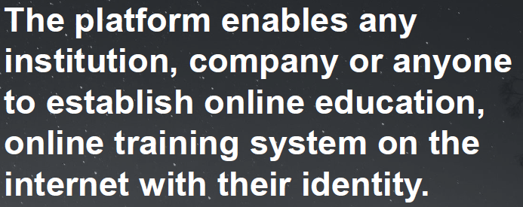
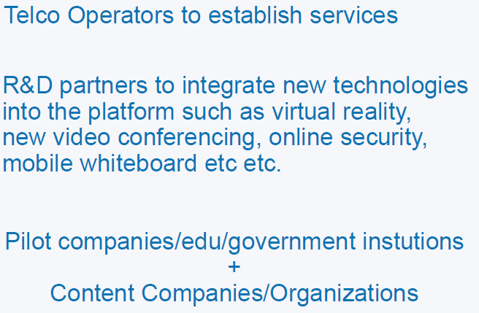
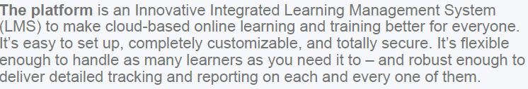

Planning and Optimization Platform
In a Nutshell
Partners needed:
https://www.celticplus.eu/project-ideas-from-proposers-days/
Usage of existing online education platform:
Contact:
Bilgin Yazar
bilginyazar@etgigrup.com

Slide 11
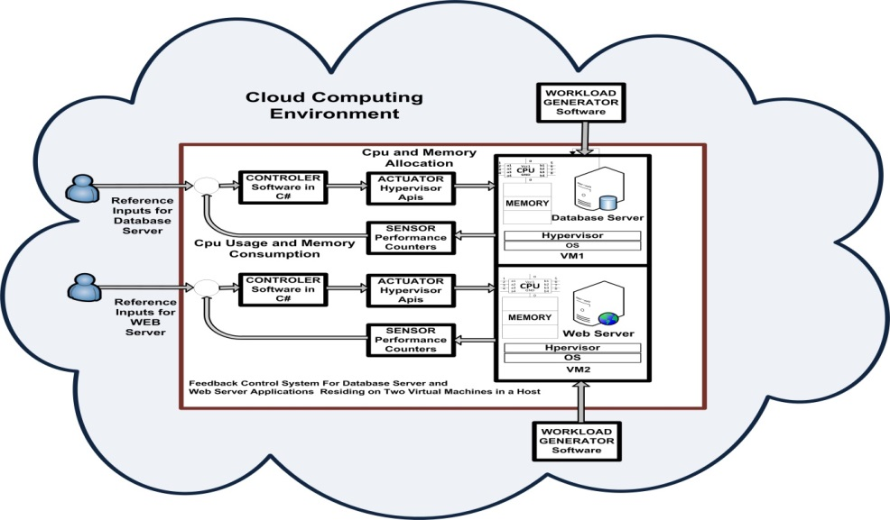
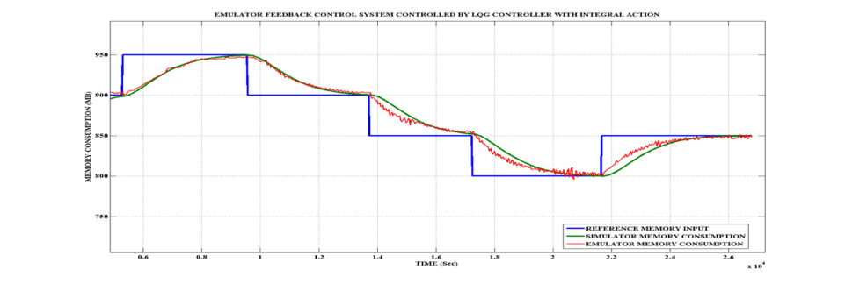

Optimal Control for Resource Usage of Virtualized Server Machines in Data Centers
In a Nutshell
In this project, we address the problem of multiple resource usage among virtual machines in data centers via dynamic allocation of CPU and memory resources among virtual server machines.
Quite Technical Proposal:
Please look at full project Pitch:
Missing partners:
Large Company
University
Research Institution
SME
https://www.celticplus.eu/project-ideas-from-proposers-days/
Contact:
Dr. Özgür Armağan
ozgura@netas.com.tr

Slide 12


IoIST: Data Analytics Platform for IoT Sensor Data
In a Nutshell
What is the main benefit of the proposal?
IoIST allows industries to analyze IoT data for Prediction and Anomaly Detection
What brings the added value?
Cloud-based, generic IoT platform will help industries to start using IoT reliably and securely
Why should you participate in my proposal?
Convergence of IoT ecosystem with Industries
Current Consortium of this submitted application:
INOSENS, SYM
Missing expertise:
IoT vendors (SME/Ind)
Sensor Fusion experience (SME/Uni)
Hardware Development/Prototyping (SME)
System Owners/Operators (Defense, Transportation, Energy, etc.) (Ind/Pub)
https://www.celticplus.eu/project-ideas-from-proposers-days/
Expected Impact:
To enable industries to jump-start IoT and Predictive Maintenance
Expected Outcome:
A Cloud-based Data Analytics Platform for IoT Sensors + New IoT Sensor Data I/F Protocol and Standard will be produced
Contact:
Dr. İsmail UZUN, INOSENS
İsmail.uzun@inosens.com.tr

Slide 13
VAR2:
VR/AR for Physical Rehabilitation
Outcome
VR/AR based active video games (AVG) for physical therapy and rehabilitation will be produced by using motion sensors
Expected Impact:
To enable e-Health to jump-start VR/AR
In a Nutshell
VAR² is a VR/AR based active video games for physical therapy and rehabilitaiton with e-Heatlh capability
VAR² allows Virtual and Augmented Reality based rehabilitation for patients (active video games) (especially for home patients through e-Health platform and motion sensors)
Connecting: Motion Sensors, Active Video Games, e-Health, Healthcare Data Analytics
Missing Partners:
Motion sensor experts (SME/Ind)
e-Health experts (SME/Uni)
Clinics for field applications (SME)
Mobile Operators (Ind/Pub)
https://www.celticplus.eu/project-ideas-from-proposers-days/
Contact:
Dr. İsmail UZUN, INOSENS
İsmail.uzun@inosens.com.tr

Slide 14
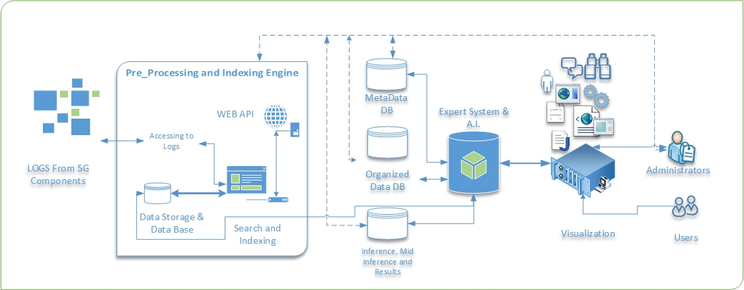
5G Expert Support System
Idea is to support 5G and future networks for each component in an intelligent and cost effective way.
The system will be composed of three main parts:
API’s to access components, databases and logs
Inference engine for expert system
Management and user interface consoles
Expected Impact:
5G and future network support cost can not be maintainable with the current support organizations and techniques
Looking for partners:
with (A.I) expert system and rule based reasoning knowledge.
Which has search engine knowledge
https://www.celticplus.eu/project-ideas-from-proposers-days/
Contact:
Mehmet Yoldas SIMSEK
msimsek@netas.com.tr

Slide 15
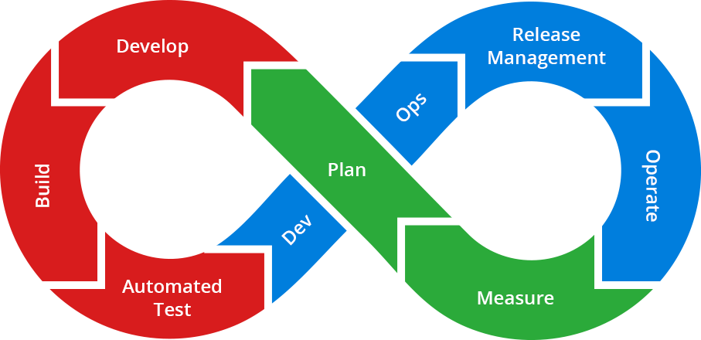



ICT, Telecommunication, Banking, Artificial intelligence Service Management Platform
In a Nutshell
An end-to-end quality assurance (QA) platform for software development houses that design, implement, maintain, and frequently release large numbers of inter-connected, mission-critical Web services.
Consortium:
https://www.celticplus.eu/project-ideas-from-proposers-days/
Expected Impact:
This AI differs from existing approaches in that it is an end-to-end solution that
Continuous integration and DevOps
Improve software quality both development and operational environments
Make development life easier
Control Production system
Contact:
Burak Barış Bürkan
burak.burkan@turkcell.com.tr

