Slide 1

Celtic-Plus Proposers Day
November 2016, Leuven
Cost Effective Packet Analyzer for 5G
PAC-MEC Proposal
Rıza Durucasugil, Mehmet Şimşek
NETAS Telecommunications
  rizad@netas.com.tr, ysimsek@netas.com.tr
<Your Logo>

Slide 2
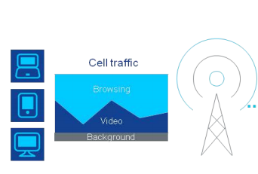
Teaser
MEC Server
4/5 G Internet Traffic
ISP Core Network
HPC Cluster/ Packet Analyzer
A component of Mobile Edge Computing (MEC) Server.
Analyzes 5G traffic through application layer.
Our motivation is to make a 5G Packet Analyzer with highly scalable, low purchasing and operating cost. And provide that as a green solution to ISPs.
Mehmet Şimşek, NETAŞ, ysimsek@netas.com.tr

Slide 3
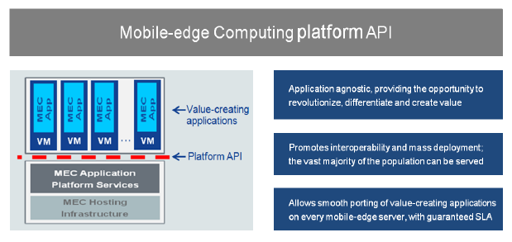
Teaser
MEC Platform API, ETSI Whitepaper
Generate statistical data and reports to help ISPs develop new Value Added Services (VAS) and or generate/activate current services quicker.
Income of ISPs will be increased via new VAS.
Better and efficient usage of network infrastructure.
Increase end users’ total Quality of Experience (QoE) in terms of speed, quality, and new services.
Mehmet Şimşek, Netaş, ysimsek@netas.com.tr

Slide 4
Organisation Profile
Netaş Telecommunications
Netas provides innovative end-to-end value added systems integration and technology services in the fields of information and communications technologies (ICT). Its customers range from telco providers to public and private enterprises in domestic and international markets. Netas’s constant increase in productivity is based on its next generation competencies around technology skillset and expertise. The company holds a track-record of 49 years and continues its foray in the field of information technologies, supported by with its experienced, best of breed research and development department. Netas also plays an important role in the modernization of the Turkish Armed Forces defense communication networks.
Mehmet Şimşek, NETAŞ, ysimsek@netas.com.tr

Slide 5
Proposal Introduction (1)
Vision
The vision is to make a scalable, cost-effective network packet analyzer designed for 5G networks.
Motivation
To improve the 5G network performance.
To improve end-user experience.
Content
5G MEC protocol, RFC compliancy research and implementation.
Parallel programming to get high computing performance from multi core/thread environments
Research on standardized statistical output data and reports to let MEC server generate VAS automatically.
Mehmet Şimşek, NETAŞ, ysimsek@netas.com.tr

Slide 6
Proposal Introduction (2)
Outcome
5G traffic analyzer solution, including cost effective flexible HW + SW
1) 5G Quality of Experience (QoE) of end users will significantly increase 2) New potential high- Value Added Services(VAS) for ISPs
Schedule
The project is planned to be finished in 2.5 years.
Impacts
Mehmet Şimşek, NETAŞ, ysimsek@netas.com.tr

Slide 7
Partners
NETAS
Core competency to coordinate this project and actively embed the researches.
SBC cluster back bone laboratory
Proven relations with mobile operators within the region
Knowledge on high-volume message processing via succession networks
Partners Needed!
With 5G research on protocols, RFCs and standardization (Universities, research institutes)
With SBC and parallel computing experience (SBC HW manufacturers, Universities)
With VAS infrastructure (ISPs, TelCo’s)
Mehmet Şimşek, NETAŞ, ysimsek@netas.com.tr

Slide 8
Contacts Info
For more information and for interest to participate please contact:
Rıza Durucasugil
rizad@netas.com.tr
Mehmet Yoldas SIMSEK
ysimsek@netas.com.tr
Mehmet Şimşek, NETAŞ, ysimsek@netas.com.tr

