Slide 1
Proposers Day 21 February 2017, Berlin
Celtic-Plus Keynote Presentation
Automotive Telecoms
Luc JANSSEUNE EATA
l.Jansseune@mail.ertico.com
EATA
European Automotive Telecom Alliance
Connected and Automated Driving

Slide 2
Agenda
1. EATA : a new alliance
2. EATA objectives
3. EATA roadmap
4. Cross-border challenges & regulatory challenges
5. Conclusions

Slide 3

EATA: a new Alliance
Founded by six associations:
Operational roll-out through companies: 38 members
Telco network operators: Deutsche Telekom, Eurofiber, KPN, Orange, Play, Post Luxembourg, Proximus, Vodafone, Telefonica, Telecom Italia
Telco suppliers: Nokia, Huawei, Ericsson
Automotive OEMs: BMW, DAF, Daimler, Fiat Chrysler, Ford, Hyundai, Iveco, Jaguar Land Rover, Opel, PSA, Renault, Toyota, Volkswagen Group, Volvo Cars, and Volvo Group
Automotive suppliers: Autoliv, Bosch, Continental, Denso, Delphi, Hella, Valeo
Project management: ERTICO

Slide 4
EATA: objectives
Facilitate and accelerate the EU-wide deployment of connected and automated driving:
Remove potential roadblocks and highlight needed technical and regulatory measures
Identify the business models underlying connected and automated driving
Help make Europe a global leader in this field
Provide a platform for knowledge-sharing between the automotive and telecommunications sectors to develop a ‘common language’
Create societal benefits by improving road safety and traffic efficiency
Promote the European digital economy

Slide 5
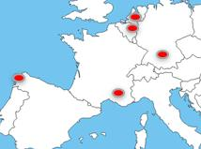
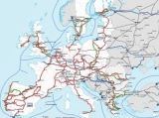
EATA roadmap
Use cases | Communication Technologies | Sites
Enabling services for - Highway chauffeur (L2/3) - High density truck platooning | Pre Deployment: - hybrid communication : LTE, ITS G5 + LTE V, Mobile Edge Computing applications - Network slicing - LTE Broad casting: GNSS offset, hazards and HD-map updates Studies : business models responsibilities, safety concepts, Quality of service, Security and data protection Regulation and standardization | 20..40 km tracks DE, FR,NL, ES, BE
As step 1 + Valet parking | Application above technologies and studies + 5G radio + NB IoT + Evaluation relative localization | Cross border motorways networks
As step 2 Automated driving | Deployment | Commercialisation on AD authorized motorways
STEP1
STEP2
STEP3
Importance of dialogue and partnership
with member states, C-ROADS and regions
STEP 1
STEP 2
STEP 3
2017
2018
2019
2020
2021
2022

Slide 6
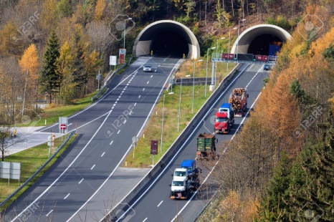
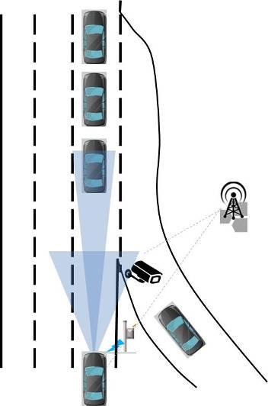
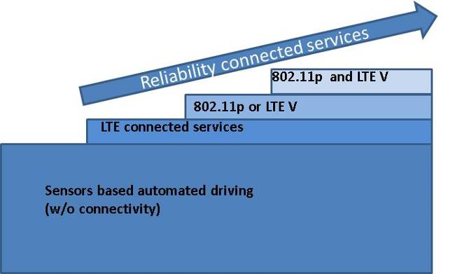
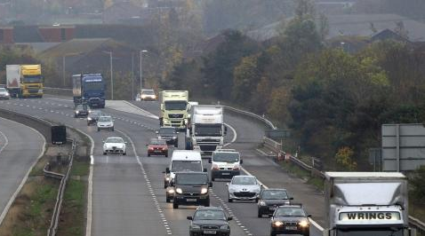

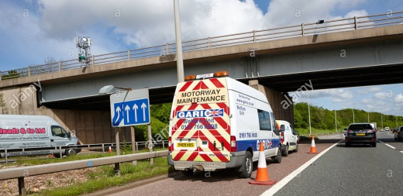
Safety by digital infrastructure

Slide 7
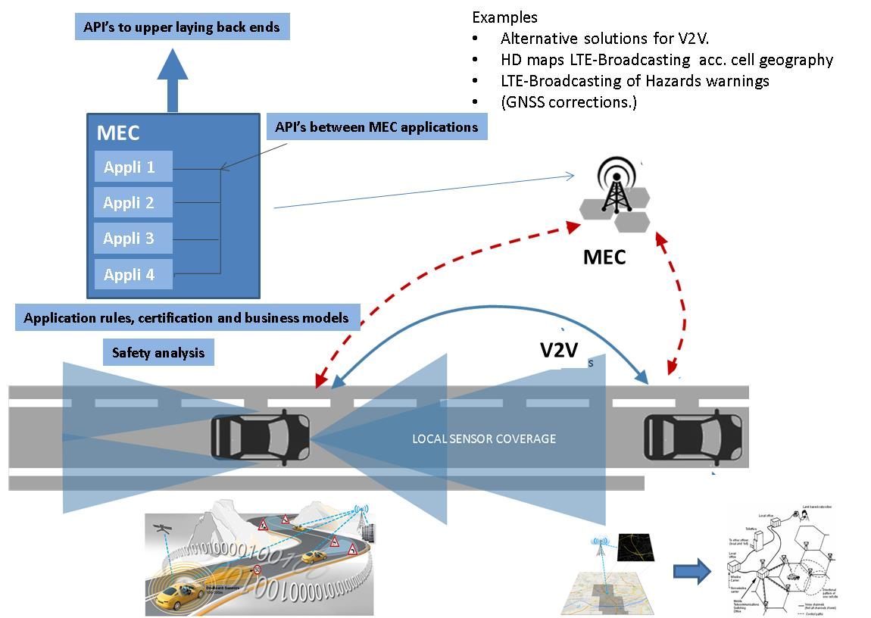
Mobile Edge computing

Slide 8
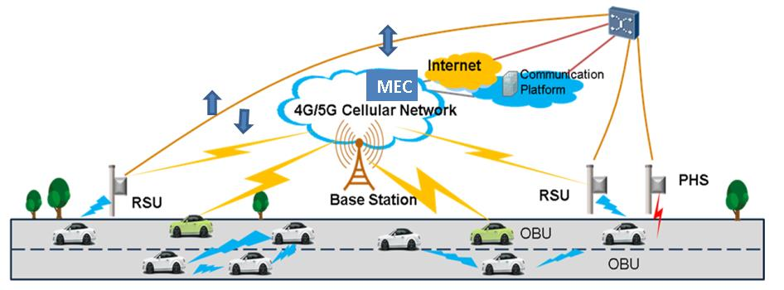

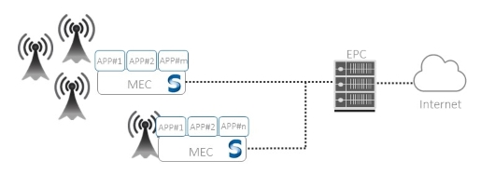

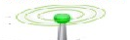
Hybrid communication
Attribution of the right messages using the right communication channels according to the requested performances
The combination of different short- and long-range communication systems, mobile edge computing and cloud applications, should increase the reliability and safety.
LTE – 5G (2)
Path 4
Path 1
(Path 2)
Path 3
MEC
MEC V2V
RSU
Path 4
RSU

Slide 9
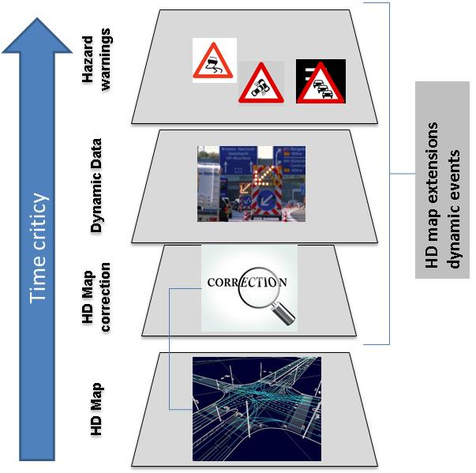
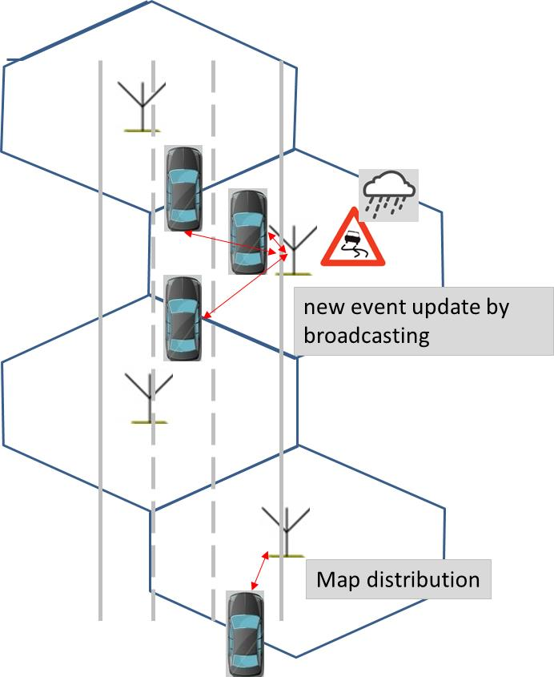
HD map update broad casting

Slide 10
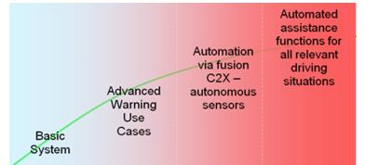
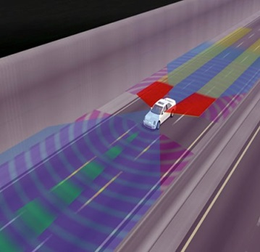
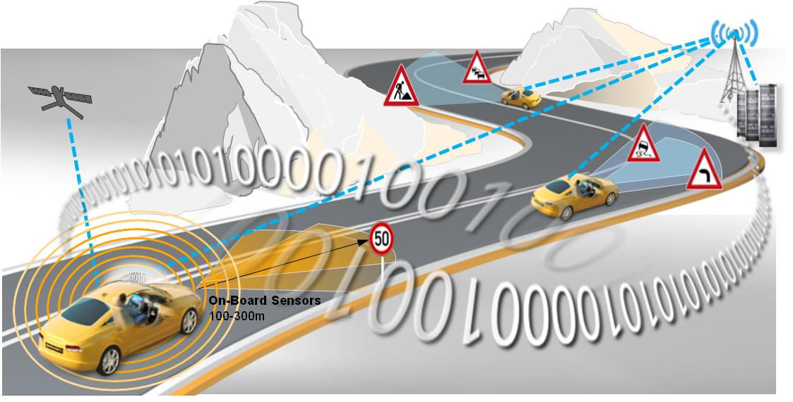



New challenges for automated driving
Car sensors
Connected data
(road sensors and cooperative car data)
The connected data as additional car sensor:
New messages and attributes to messages (e.g. trust , confidence levels)
Safety relevant applications need redundancy via the hybrid communication channels.
Network slicing, priority for AD vital messages
Application of safety rules on digital infrastructure
More accurate and safety relevant localization : GNSS correction and relative fall back solutions.
Sense
Plan
Act

Slide 11
Cross-border challenges (1)
For automated driving (AD)
Need to identify the right cross border test sites :
For C-ITS , we have the TEN-T corridors
For AD, some MS have identified test beds on certain highways but not cross border.
AD cross border test beds need:
Adapted physical infrastructure (Land & road marks, physical road infrastructure, etc) and digital infrastructure
Harmonized architecture for hybrid communications.
Harmonized messaging and associated attributes (e.g. trust-confidence levels)
Definition of common safety requirements + specifications for the digital infrastructure and EU certifications.

Slide 12

Cross-border challenges (2)
In addition for Truck platooning:
EU wide multi brand EU match making
Possible extra spectrum for redundant V2V communication

Slide 13
Envisaged Project
Use cases | Communication Technologies | Sites
Enabling services for - Highway chauffeur (L2/3) - High density truck platooning | Pre Deployment: - hybrid communication : LTE, ITS G5 + LTE V, Mobile Edge Computing applications - Network slicing - LTE Broad casting: GNSS offset, hazards and HD-map updates Studies : business models responsibilities, safety concepts, Quality of service, Security and data protection Regulation and standardization | 20..40 km tracks DE, FR,NL, ES, BE
As step 1 + Valet parking | Application above technologies and studies + 5G radio + NB IoT + Evaluation relative localization | Cross border motorways networks
As step 2 Automated driving | Deployment | Commercialisation on AD authorized motorways
STEP1
What is the main benefit of the idea/proposal?
-> cross border pre-deployment of hybrid communication
What makes the added value?
Test under real traffic circumstances
Envisaged consortium
EATA + other interested partners
Scope of the Celtic plus proposal
STEP2
STEP3
Importance of dialogue and partnership
with member states, C-ROADS and regions
STEP 1
STEP 2
STEP 3
2017
2018
2019
2020
2021
2022

Slide 14

Contact Info
Luc JANSSEUNE Ertico for EATA
l.jansseune@mail.ertico.com
+32 2 400 07 42
Avenue Louise 326 B1050 Brussels
www.ertico.com
Name, affiliation & e-mail of presenter

