Slide 1


CELTIC-NEXT
Innovate UK Summer Briefing
20th August 2019, London
Pitch of the Project Proposal
Adaptive multilink resource management for QoS / QoE in delivery of services to terminals in the home over sliced infrastructure
Les Humphrey, Michael Fitch
ldh@difu5ion.co.uk, fitchmr@gmail.com

Slide 2

Teaser
The main benefit is improved QoE of communications in home / small office
The added value is efficient resource management for mixed wired and wireless communication paths
This work is key to improving in-home QoE along with efficient use of resources
2
www.celticnext.eu Adaptive multilink resource management, Les Humphrey and Michael Fitch, Communications Research Ltd.
Notes:
2

Slide 3
Organisation Profile
Communications Research Ltd is a start-up specialising in modelling and simulations of cross domain resource management (wired / wireless)
Expertise in Cu and wireless broadband transmission systems, signal processing, and network requirements
3
www.celticnext.eu Adaptive multilink resource management, Les Humphrey and Michael Fitch, Communications Research Ltd.

Slide 4
Proposal Introduction (1)
Hybrid Access with 5G reinforcement
Slice session initiation
5G Core Network
5G Mobile Network
Static traffic split
Content
Dynamic Intelligent traffic split
Satellite Network
High level resource crisis management
Slice session instantiation
Low level automatic resource management
Hybrid Access with satellite reinforcement
Fixed Core Network
Fixed Core Network
Fixed Core Network
Fibre Access
Cu Access
e.g. MGFAST
Cu In-home
e.g. HN
Fixed Network
Termination
Wi-Fi Network
UE
Overlapping
spectral-temporal resources
shared between user’s terminals and
with neighbours
Overlapping
spectral-temporal resources
shared between user’s terminals and
with neighbours
The challenge of interest is hybrid access with end-to-end slicing with particular focus on satellite reinforcement for rural areas
4
www.celticnext.eu Adaptive multilink resource management, Les Humphrey and Michael Fitch, Communications Research Ltd.

Slide 5
Proposal Introduction (1)
5G Core Network
Session establishment resource coordination
Content
Dynamic management of end-to-end QoS
Autonomous Real-time Intelligent
Resource management
Autonomous Real-time Intelligent
Resource management
Slice session instantiation
Fixed Network
Termination
Wireless
Network
UE
Fixed Core Network
Fixed Core Network
Content
Fixed Core Network
Fibre Access
Cu Access
e.g. MGFAST
Cu In-home
e.g. HN
Fixed Network
Termination
UE
Overlapping
spectral-temporal resources
Overlapping
Spectral-temporal
resources
Content
Wireless
Network
Cu Access-in-home
e.g. MGFAST
Fixed Network
Termination
UE
Spectral and temporal resources shared between user’s terminals and with neighbours’ terminals
The challenge of interest is centralised / distributed resource management on Xhaul and access portions, to support slicing, in the context of many users who may be constricting each other, and a mix of available technologies.
5
www.celticnext.eu Adaptive multilink resource management, Les Humphrey and Michael Fitch, Communications Research Ltd.

Slide 6

Proposal Introduction (2)
Expected outcome is improved sharing of spectrum and scalable, viable slice management across multiple in home systems.
The major tasks on the project are envisaged to be:
Use-case analysis and architecture design with learning
Modelling of traffic and resource management problem and algorithms
Verification of algorithms on test-beds
Standards participation with contributions
6
www.celticnext.eu Adaptive multilink resource management, Les Humphrey and Michael Fitch, Communications Research Ltd.

Slide 7
Partners
We are seeking to join plans to merge the H-OPTO and FU5ION projects
We are here to seek out partners, and would like to work with systems integrators, in-home terminal vendors and chip designers.
7
www.celticnext.eu Adaptive multilink resource management, Les Humphrey and Michael Fitch, Communications Research Ltd.

Slide 8
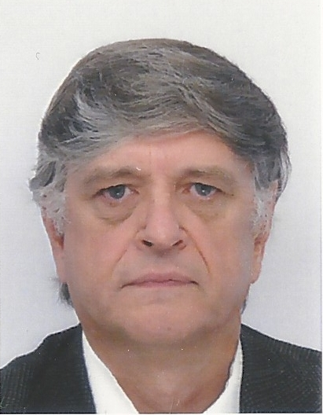
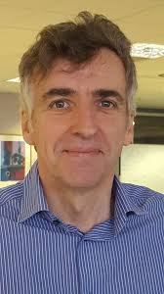

Contact Info
For more information and for interest to participate please contact:
Les Humphrey
ldh@difu5ion.co.uk
01473 855288
Michael Fitch
fitchmr@gmail.com
07469 940285
Presentation available via:
8

