Slide 1


CELTIC-NEXT
Innovate UK Summer Briefing
20th August 2019, London
Secured Autonomous Fog-based Efficient Home/Outdoor Monitoring for Elders
SAFE-HOME
Ayman Radwan
aradwan@av.it.pt

Slide 2


SAFE-HOME
Our generation is getting older
Population of 60 and more years old has doubled in 2017 compared to 1980
[UN report]
Burdens are increasing on healthcare systems
UN 2030 Sustainable goals:
“Ensuring healthy lives and promote well-being for all at all ages”
www.celticnext.eu SAFE-HOME, Ayman Radwan, Instituto de Telecomunicaçoes, aradwan@av.it.pt

Slide 3
Teaser
Socio-economic impact: enabling seniors to live a fully autonomous life, from the comfort of their home, with autonomous monitoring of their health
Economic impact: on healthcare systems, reducing costs through reducing hospital visits, etc..
Optimum Goal
An autonomous monitoring system for elder citizens
at home (and outdoor) to enable them to live a fully independent autonomous life
www.celticnext.eu SAFE-HOME, Ayman Radwan, Instituto de Telecomunicaçoes, aradwan@av.it.pt

Slide 4
Organisation Profile
Instituto de Telecomunicações (IT) is a private, not-for-profit organization, of public interest, a partnership of nine institutions with research and development in the field of Telecommunications.
IT mission is to create and disseminate scientific knowledge in the field of telecommunications.
IT is actively involved in fundamental and applied research both at national and international levels. Simultaneously it is committed to foster higher education and training, by hosting and tutoring graduate and postgraduate students. it also plays its role towards public society with public awareness initiatives, knowledge transfer to industry, and by providing consulting services on a non-competing basis.
www.celticnext.eu SAFE-HOME, Ayman Radwan, Instituto de Telecomunicaçoes, aradwan@av.it.pt

Slide 5

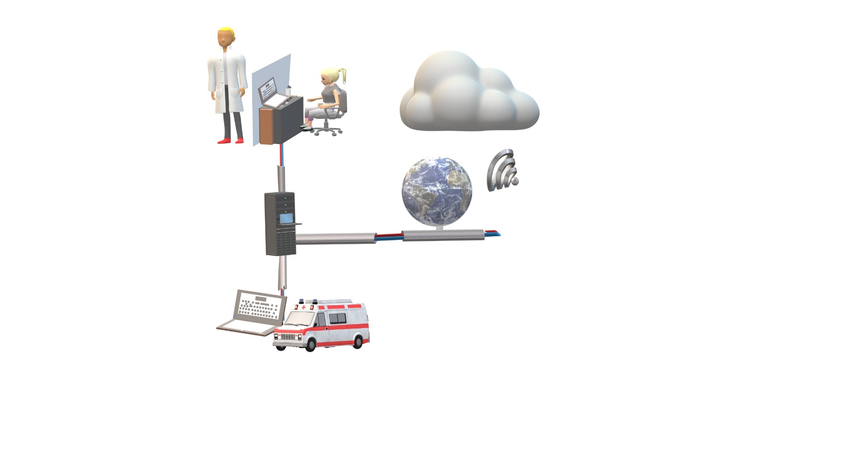

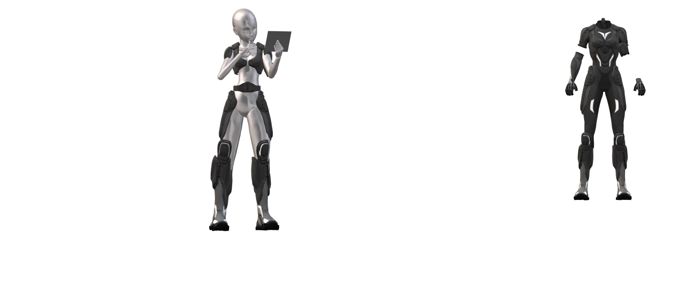

Proposal Introduction
Cloud
Sensor for Cardio-Vascular assessment
Therapist/ Doctor
Acquisition module /
Wireless communication
Network
Collected Data
Soft exoskeleton/ Wearable
state of the art sensors
Feedback/Assistance
Emergency
www.celticnext.eu SAFE-HOME, Ayman Radwan, Instituto de Telecomunicaçoes, aradwan@av.it.pt

Slide 6
Proposal Introduction (2)
Requirements
Sensor Design
Efficient Reliable Networking
{
Fog
Cloud
Data Processing
{
Inferring events
Prediction
Artificial Intelligence
www.celticnext.eu SAFE-HOME, Ayman Radwan, Instituto de Telecomunicaçoes, aradwan@av.it.pt

Slide 7
Being active and physical exercise help maintain the physical and psychological health of elder citizens.
Interaction with others, especially during rehabilitation exercises, helps diminish the effects of treatments both at a psychological and physical level.
www.celticnext.eu SAFE-HOME, Ayman Radwan, Instituto de Telecomunicaçoes, aradwan@av.it.pt

Slide 8
Partners
Sensor Design/
wearable (or non) devices
(IT/UA)
Artificial Intelligence/ Machine Learning
(???)
Efficient wireless connectivity
(IT)
Clinics /
Elder Homes /
Home Care
Provider
(Requirements)
Cloud and Fog
Computing
(????)
www.celticnext.eu SAFE-HOME, Ayman Radwan, Instituto de Telecomunicaçoes, aradwan@av.it.pt

Slide 9
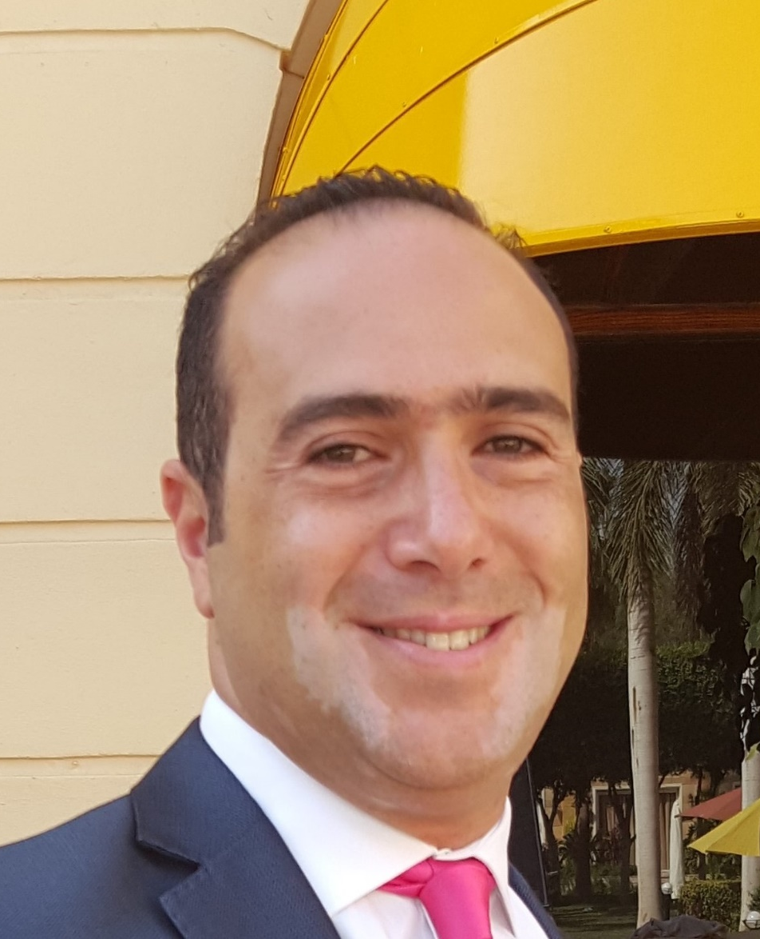
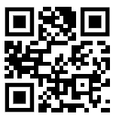
Contact Info
For more information and for interest to participate please contact:
Ayman Radwan
Instituto de Telecomunicações
aradwan@av.it.pt
+351-234-377900
Campus Universitário de Santiago, 3810-193 Aveiro, Portugal
  https://www.it.pt/Members/Index/4014
                Presentation available via:

