Slide 1


Slide 2

Teaser

Slide 3
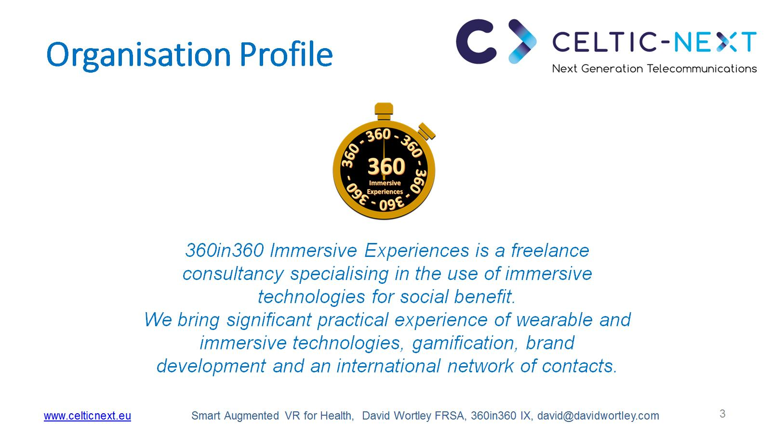
Organisation Profile

Slide 4

Proposal Introduction (1)

Slide 5
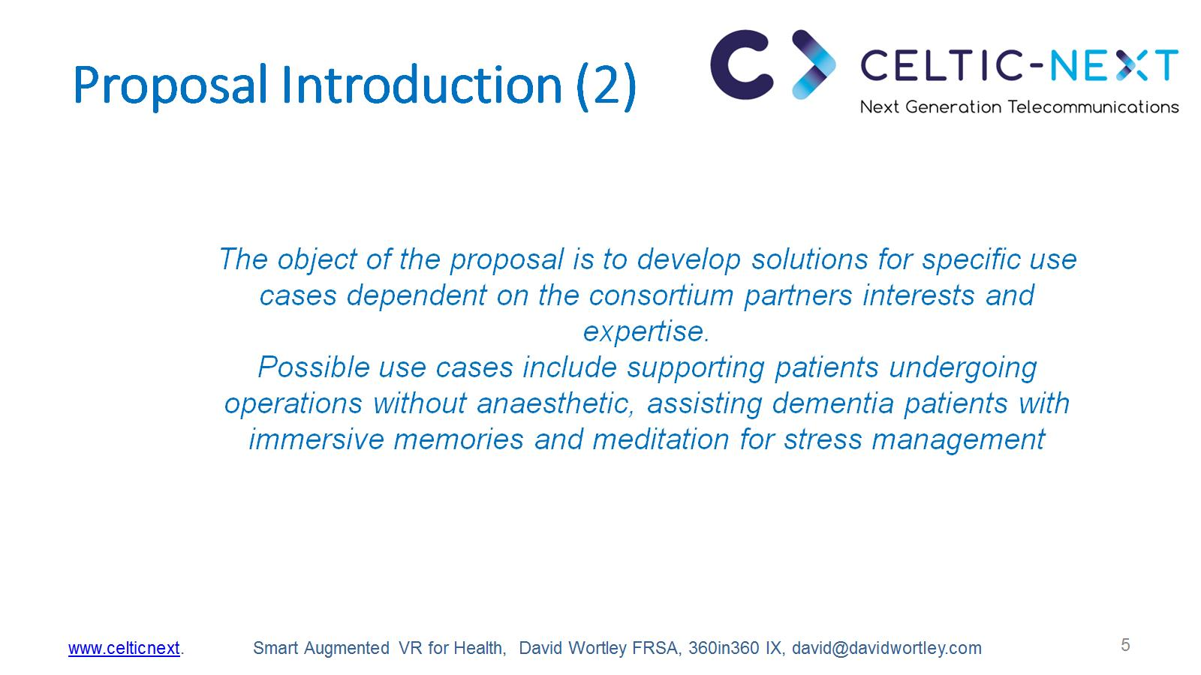
Proposal Introduction (2)

Slide 6

Partners

Slide 7
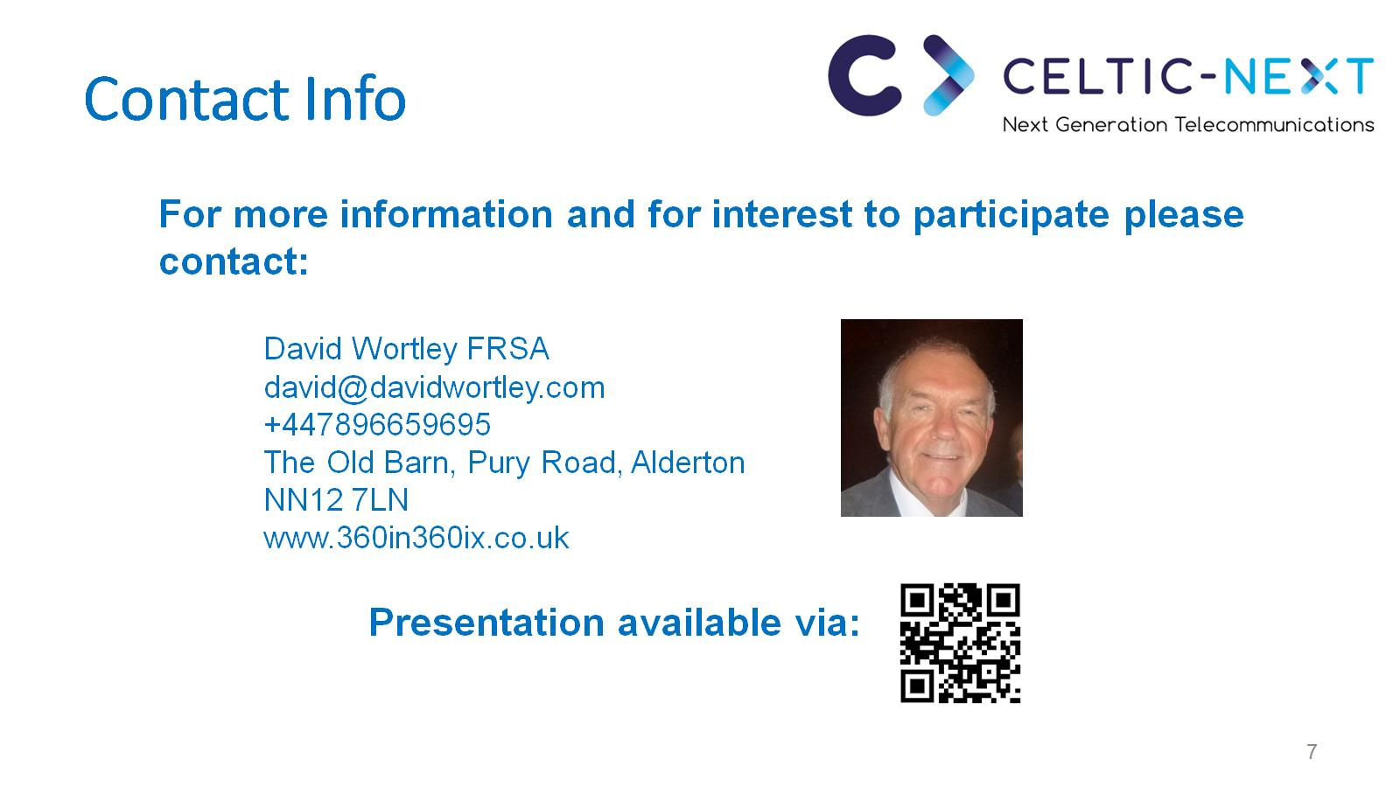
Contact Info

Slide 8

Join the follow-up Telco

