Slide 1



CELTIC-NEXT Innovate UK Summer Briefing
20th August 2019, London
Pitch of the Project Proposal
5G International Music Jam
Nick FablabLondonVR
fablablondonvr@gmail.com

Slide 2


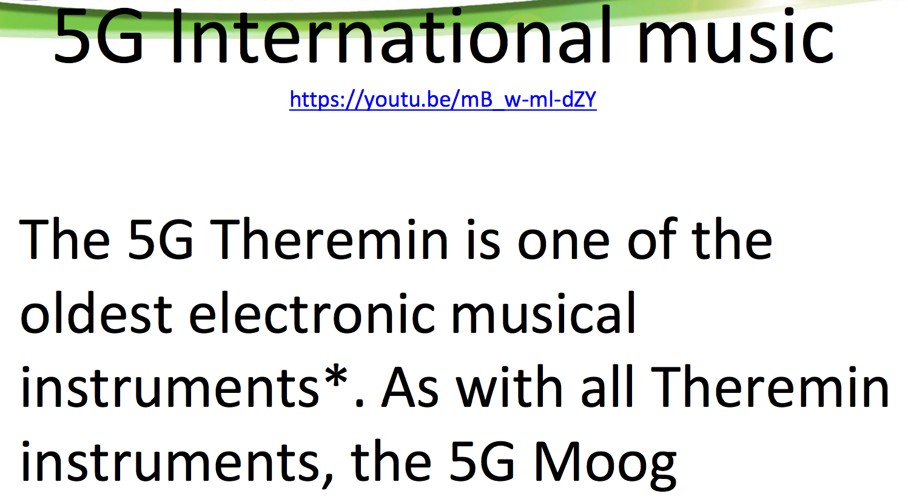
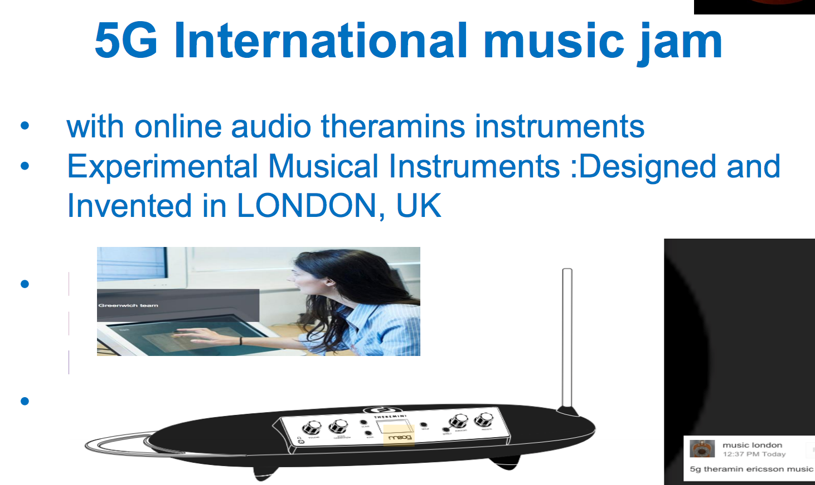
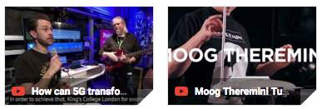
What is the main benefit of the idea/proposal?
What makes the added value?
Why should I participate in the project?
What’s innovative about it?
A Theramin musical instrument using 5g integrated network for low latency real time making music across the world
www.celticnext.eu 5G International Music Jam, Nick, FABLAB LONDON VR fablablondonvr@gmail.com

Slide 3
Profile
Very short info about the profile of your organisation
Fablablondon Vr Is A AI/VR/MR of Fab Lab
Fablab Is A World Wide Fabrication Of Prototypes And Design With 3d Printing And Laser Cutting
We Are A Research And Open Education Organisation Innovating & Inventing With New Technology
www.celticnext.eu 5G International Music Jam, Nick, FABLAB LONDON VR fablablondonvr@gmail.com

Slide 4


Proposal
Short info what the idea/proposal is about vision, motivation, content,
A Theramin musical instrument using 5G integrated network for low latency real time making music across the world possible live
www.celticnext.eu 5G International Music Jam, Nick, FABLAB LONDON VR fablablondonvr@gmail.com

Slide 5
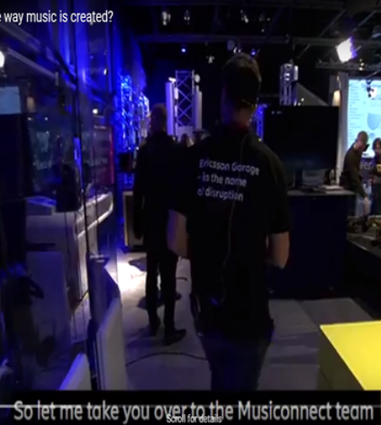
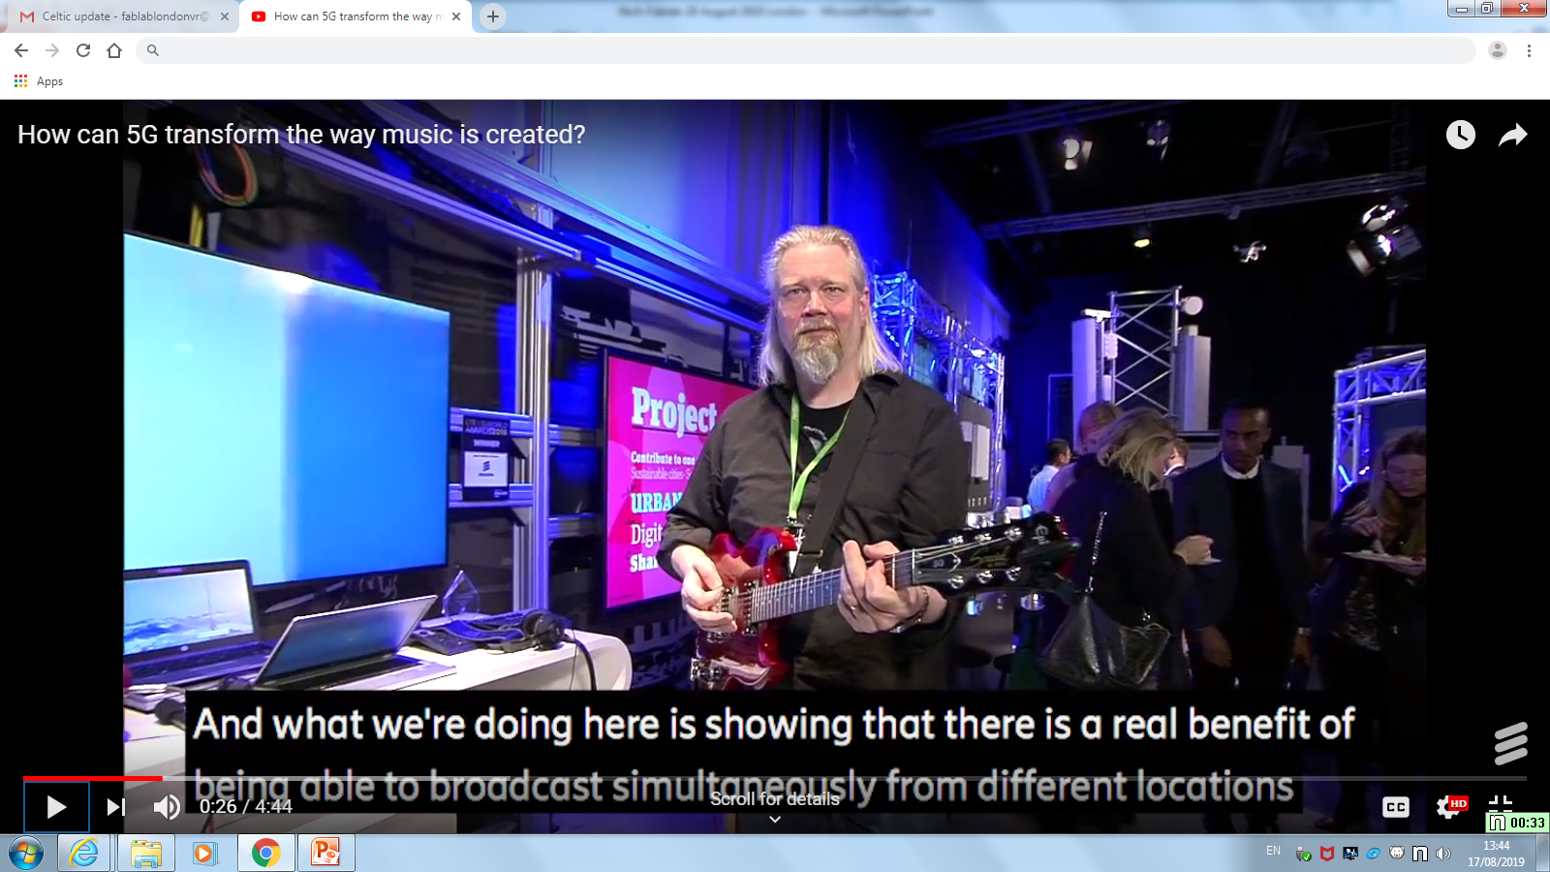
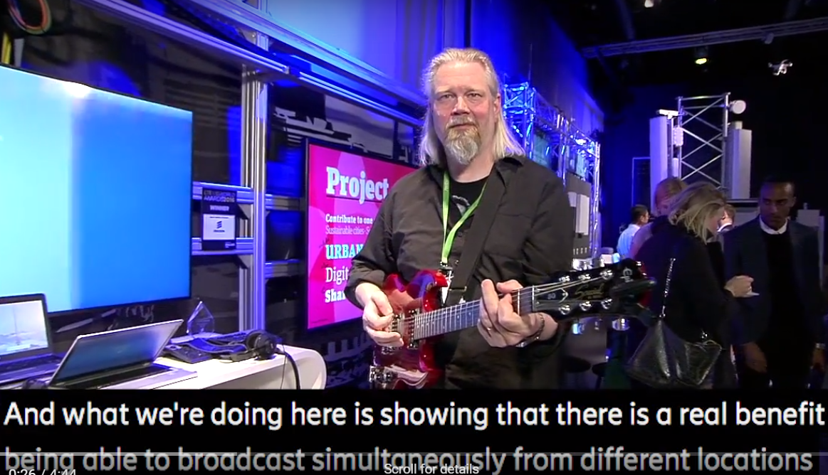
Introduction (2)
Short info on expected outcome, impacts, schedule typical project duration
The services can offer? for the project duration
Ideas generation and artist impression
Product Design and packaging
Exhibition for new product at relevant expos
www.celticnext.eu 5G International Music Jam, Nick, FABLAB LONDON VR fablablondonvr@gmail.com

Slide 6
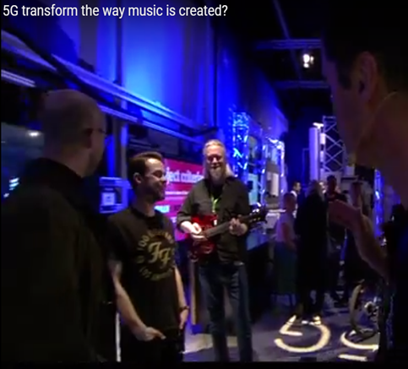
Partners
Existing consortium, involved countries.
Expertise, profiles and types of partners you are looking for.
The partners/services
Fab Lab London vr= SME
Kings College London = University
Ericsson Connect Music Garage= Large Co
www.celticnext.eu 5G International Music Jam, Nick, FABLAB LONDON VR fablablondonvr@gmail.com

Slide 7
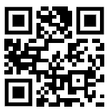
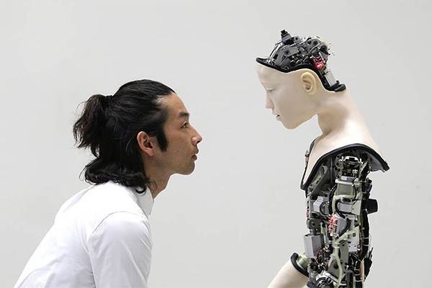

Contact Info
Contact Info
For more information and for interest to participate please contact:
Nick FABLAB LONDON VR
E-Mail: fablablondonvr@gmail.com
Telephone +44 77747806
Sommerset House
The Strand, London ,UK
Presentation available via:
Ref to these video links
https://youtu.be/5WVYbXMnWjs
https://youtu.be/8bakI0ITCqQ
7
For more information and for interest to participate please contact:
Nick FABLAB LONDON VR
E-Mail: fablablondonvr@gmail.com
Telephone +44 77747806
Sommerset House
The Strand, London ,UK
Presentation available via:
Ref to these video links
https://youtu.be/5WVYbXMnWjs
https://youtu.be/8bakI0ITCqQ
https://www.youtube.com/watch?v=5WVYbXMnWjs&feature=youtu.be

Slide 8

Join the follow-up Telco
10 September 11-11.30 CET
Meeting number: 954 830 816
Meeting password: MkX3PN7J
Join the Meeting:
https://eurescom-meetings.webex.com/eurescom-meetings/j.php?MTID=
mabe8521937d3da5cf2abd9042c52aeb8
Join by phone +49-6925511-4400 Germany toll Global call-in numbers Can't join the meeting?
www.celticnext.eu office@celticnext.eu

