Slide 1


CELTIC-NEXT
Innovate UK Summer Briefing
20th August 2019, London
EMPORIUM
Blockchain carbon credits wallet
Renee Wansdronk (architect)
rw@wansdronk.com

Slide 2

Teaser
Buildings account for about 40% of the total energy consumption, and 36% of CO2 emissions, in Europe.
Zero-emission buildings need solar heating and seasonal storage investments, which can be co-financed by carbon credits.
A blockchain carbon credits wallet for individuals is a small scale solution to facilitate this, house by house.
www.celticnext.eu EMPORIUM, Renee Wansdronk,Wansdronk Architektuur, rw@wansdronk.com

Slide 3
Organisation Profile
Wansdronk develops a solar energy, zero-emission and material saving building concept EMPORIUM
EMPORIUM is a low-exergy and zero-emission building concept with an integrated seasonal storage system without energy losses
EMPORIUM is a European Smart Cities and Communities Platform’s Key Innovation, and links with many European research topics
www.celticnext.eu EMPORIUM, Renee Wansdronk,Wansdronk Architektuur, rw@wansdronk.com

Slide 4
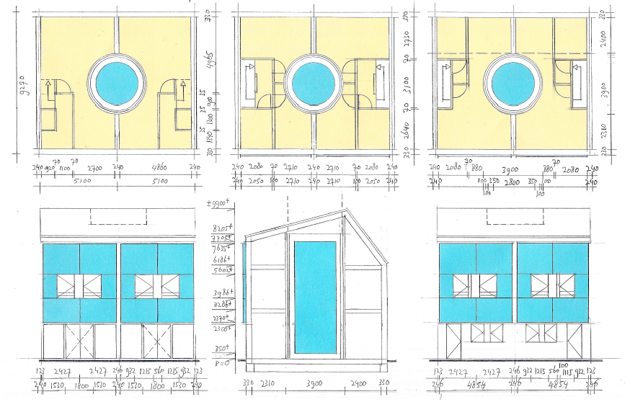
Proposal Introduction
solar heat storage
EMPORIUM BUILDING
solar heat storage &
thermal collector
www.celticnext.eu EMPORIUM, Renee Wansdronk,Wansdronk Architektuur, rw@wansdronk.com

Slide 5

Proposal Introduction (2)
EMPORIUM Blockchain carbon credits wallet topics
• carbon credits calculation methodology and certification
• wallet owned by individual or by building (legal entity status)
• carbon credits liquidation at the EU-ETS or by NGO’s
• social development goal (SDG) values incorporation
• permissioned or unpermissioned (public) blockchain
• energy (emission) footprint per blockchain transaction
www.celticnext.eu EMPORIUM, Renee Wansdronk,Wansdronk Architektuur, rw@wansdronk.com

Slide 6
Partners
Partner involved (European research experience)
• Participation in COST Actions (13) and FP5-FP8 Projects (3):
• 2019-2023 COST CA18136 European Forum for Advanced Practices
• 2016-2020 Horizon 2020 (FP8) CHESS-SETUP Combined Heat Supply
System by using Solar Energy and Heat Pumps (www.chess-setup.net)
Missing consortium (Bockchain wallet development)
• Looking for a consortium in which this development has added value
www.celticnext.eu EMPORIUM, Renee Wansdronk,Wansdronk Architektuur, rw@wansdronk.com

Slide 7

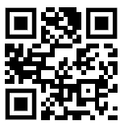
Contact Info
For more information and for interest to participate please contact:
Wansdronk Architektuur BV
Renee Wansdronk (architect)
rw@wansdronk.com
+31 85 878 4298
+31 6 1971 6671 (cell)
W.G. Plein 286, 1054 SE Amsterdam
www.wansdronk.com (Wansdronk)
www.chess-setup.net (CHESS-SETUP)
                Presentation available via:

Slide 8

Join the follow-up Telco
9 September 10-10.30 CET
Meeting number: 959 100 729
Meeting password: 6rXFqMdV
Join the Meeting:
https://eurescom-meetings.webex.com/eurescom-meetings/j.php?MTID=me456e2a83aaf2bd6e77533086d87cc8b
Join by phone
+49-6925511-4400 Germany toll
Global call-in numbers
Can't join the meeting?
www.celticnext.eu office@celticnext.eu

