Slide 1
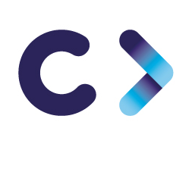
CELTIC-NEXT Innovate UK Summer Briefing
20th August 2019, London
Artificial Intelligent enabling effective directly to customer sales
AI enabling effective directly to customer sales
Markus Sihvonen, LAMK Oy
Markus.Sihvonen@lamk.fi

Slide 2

AI laboratory
Recent results
Micro weather analyser from live video feed: rain, sun, snow, ice
Traffic counter from video feed: pedestrian, bicycle, car, bus and direction of a traffic
CO2 analyser for mobility. Measures in real time users CO2 emissions while mobile. Recognizes walking, bicycling, car, bus, train, tram and metro. https://www.smartlahti.fi/citicap/
Focus on commercial AI applications
www.celticnext.eu Proposal Name, Your Name, affiliation & e-mail of presenter

Slide 3

Proposal Introduction (1)
Goal is to enable producers / manufactures of services and products to market and sell them directly to consumers by utilising AI technologies.
How to define / find potential customers?
On heterogeneous markets?
How to make customer experience pleasant?
How to organise logistics?
What are requirements for business ecosystem?
What are needed tools?
How to do all above cost effective?
www.celticnext.eu Proposal Name, Your Name, affiliation & e-mail of presenter

Slide 4
Partners
Upseller Oy, Finland
- AI chat bot services
GreenPeak Oy, Finland
- Ecosystem analysis
ETM LtD, South Korea
- AI logictic systems
LAMK OY / LAB Oy, Finland
- AI solutions
www.celticnext.eu Proposal Name, Your Name, affiliation & e-mail of presenter

Slide 5
Contact Info
For more information and for interest to participate please contact:
Markus Sihvonen, LAMK Oy
markus.Sihvonen@lamk.fi
+358 44 708 5064

