Slide 1


CELTIC-NEXT Proposers Day
26th September 2018, Madrid
Application of Artificial Intelligence for Fault Management in SDN Networks
Álvaro Carrera – Universidad Politécnica de Madrid
a.carrera@upm.es

Slide 2

Teaser
Project Idea:
Develop a self-healing platform for SDN networks based on Artificial Intelligence techniques
Proposal:
Monitoring SDN networks through the controllers, we can use Big Data platforms to apply Artificial Intelligence techniques to detect, classify, repair and/or prevent different faults in the network reducing operational cost of the network management.
www.celticplus.eu SDN Fault Management, Álvaro Carrera, UPM, a.carrera@upm.es

Slide 3
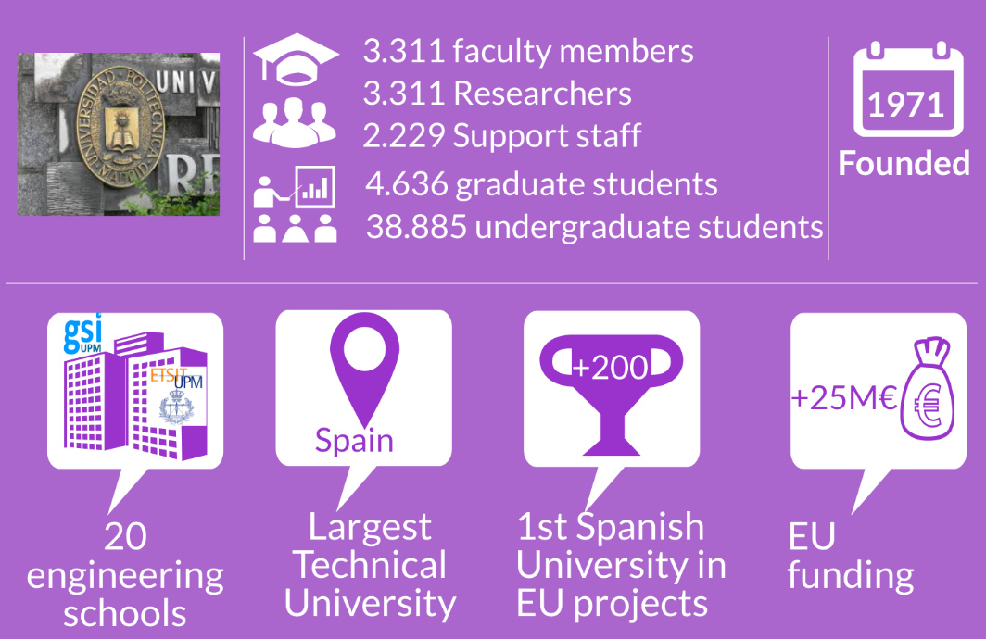
Organisation Profile
www.celticplus.eu SDN Fault Management, Álvaro Carrera, UPM, a.carrera@upm.es

Slide 4

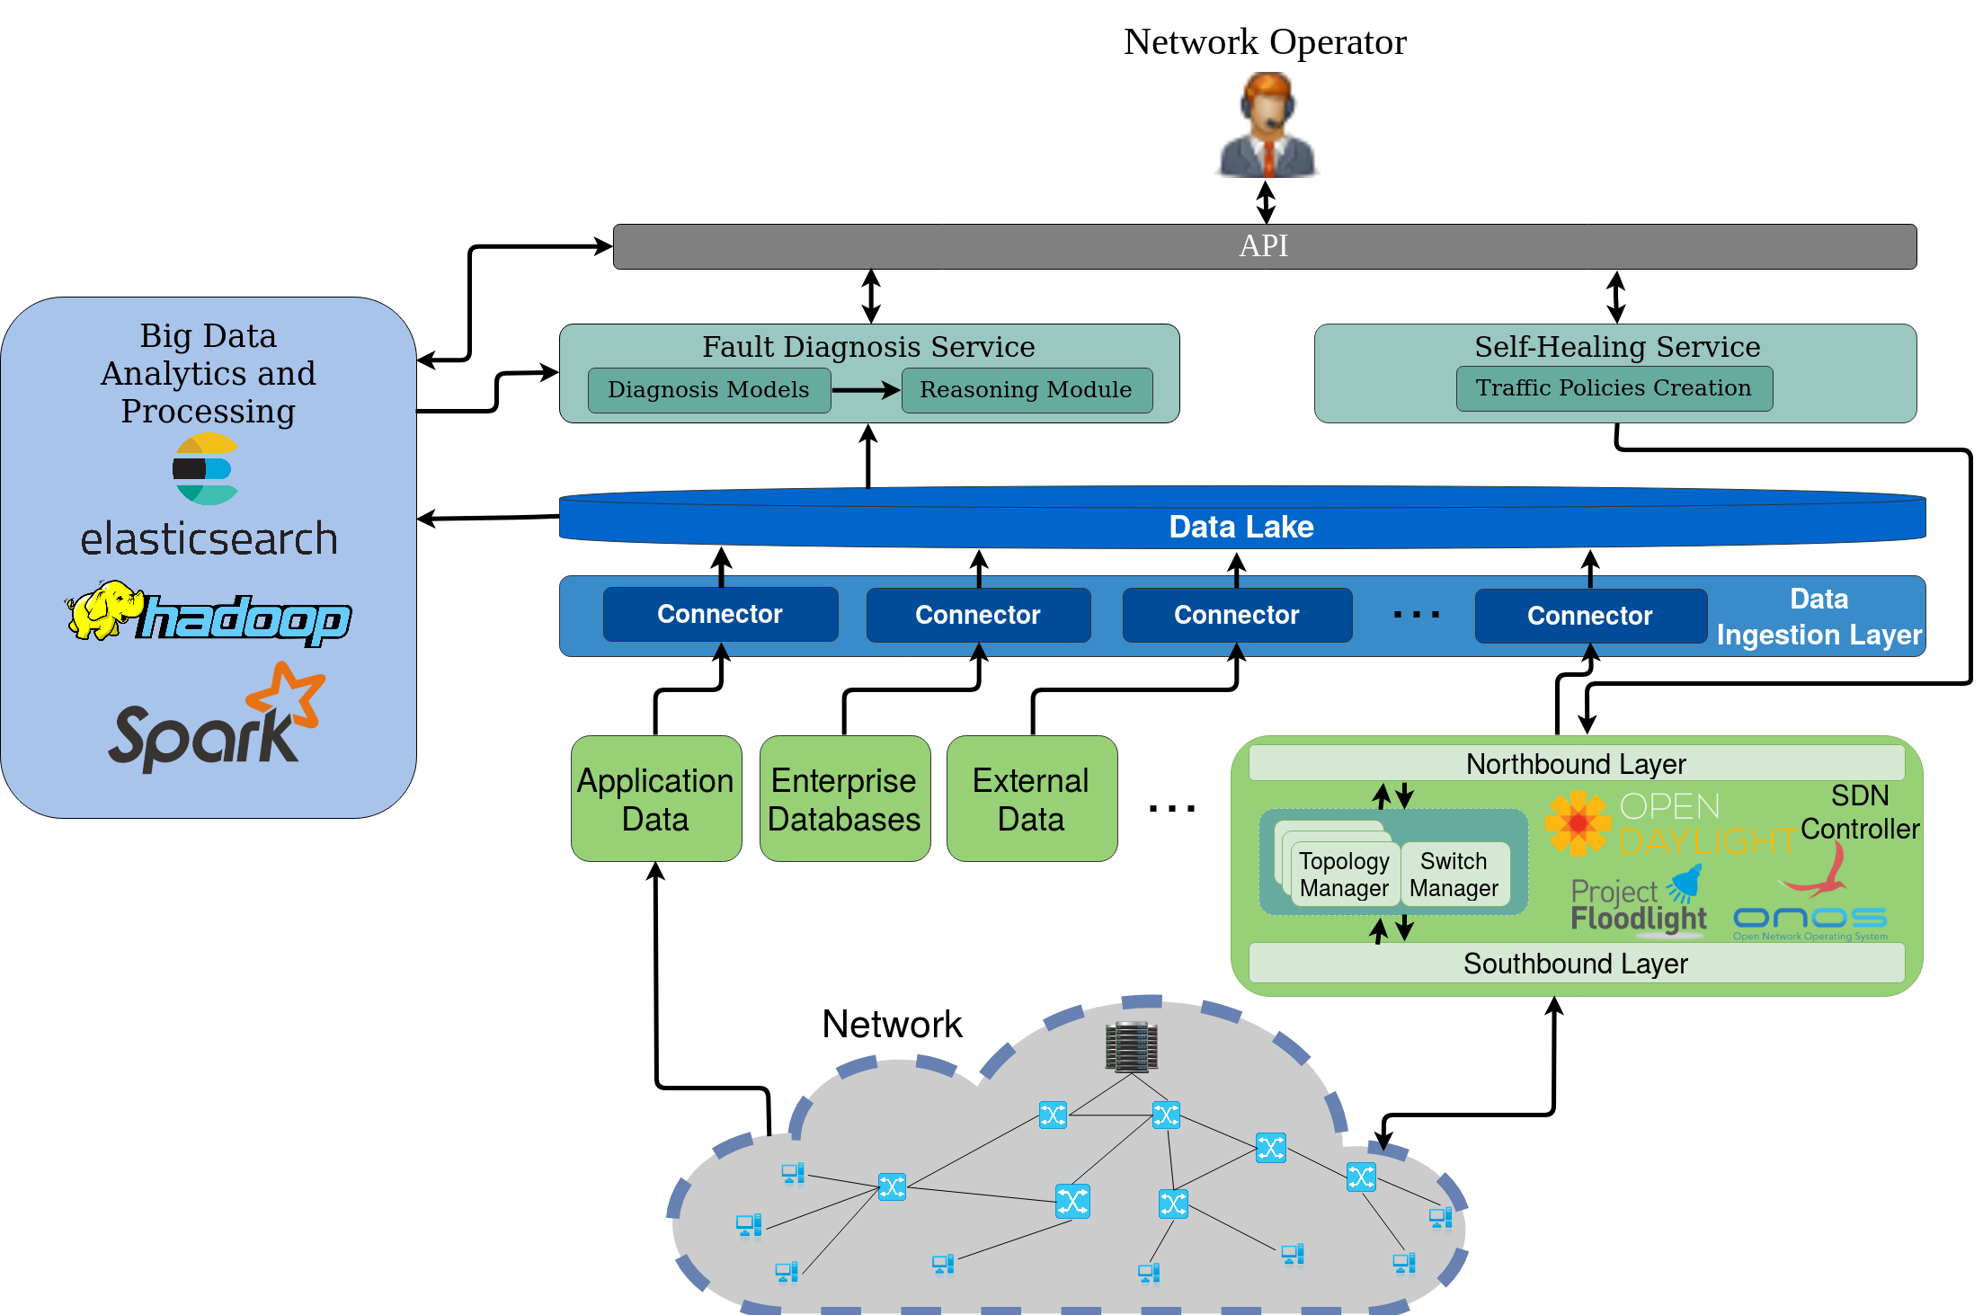
Proposal Introduction (1)
www.celticplus.eu SDN Fault Management, Álvaro Carrera, UPM, a.carrera@upm.es

Slide 5
Partners
Schedule: 36 months, Autumn 2019 call
Existing Spanish consortium conformed by Research Institutions and SMEs.
Looking for partners from different fields and countries:
Network Operators interested in providing data and expertise
Cybersecurity specialists for security use cases
Big Data/Cloud expertises for scalability issues
www.celticplus.eu SDN Fault Management, Álvaro Carrera, UPM, a.carrera@upm.es

Slide 6
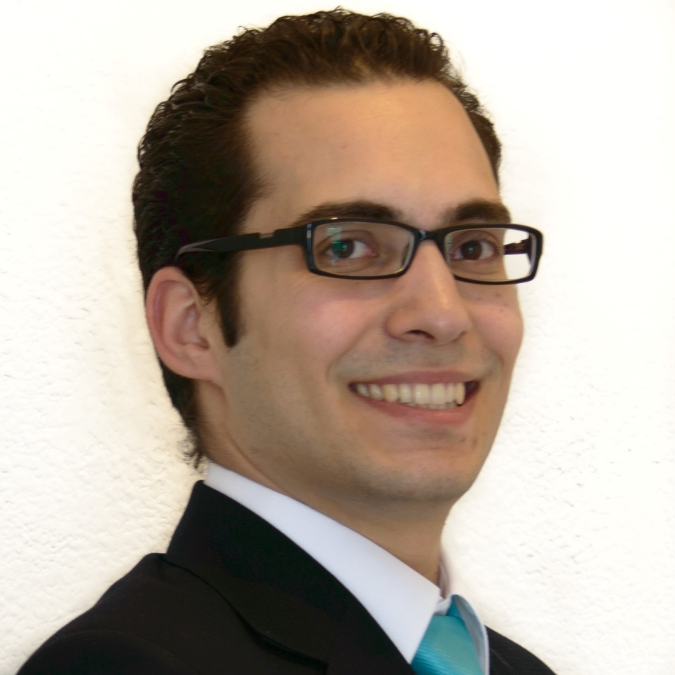
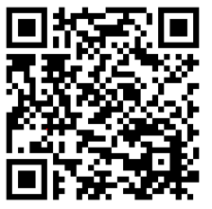
Contact Info
For more information and for interest to participate please contact:
Álvaro Carrera Barroso
a.carrera@upm.es
+34 91 067 21 13
Av. Complutense, 30
28040, Madrid, Spain
www.gsi.dit.upm.es
Presentation available via:
www.tiny.cc/projectidea

Slide 7

Join the follow-up Telco
1st of October 11 CET
For PSTN Access, dial +49-6221-905280
After or during the voice prompt,
dial 5-digit conference ID 37447
(using DTMF or softphone keypad)
For International access numbers http://vc.eurescom.eu/international-info.html
For Voip (SIP) Access, dial ac@eurescom.eu.
For help with Voip (SIP) client setup, http://vc.eurescom.eu/voip-info.html.
www.celticplus.eu office@celticplus.eu

