Slide 1


CELTIC-NEXT Proposers Day
26th September 2018, Madrid
Pitch of the Project Proposal
TeleMove
Dr. Rony Ohayon, LiveU
rony@liveu.tv

Slide 2

Teaser
TeleMove
Develop best practices for holistic remote driving interventions, or teleoperations, of autonomous vehicles
De-facto standard for remote driving
Use cases analysis
Communications method (multilink cellular, 5G, 4G)
Delivery of multi-sensors: video and other sensors
The remote driver control methodology
Interconnecting to the vehicle
Vehicle-environment interactions
Scalability, safety, reliability
www.celticplus.eu TeleMove, Rony Ohayon, LiveU

Slide 3



















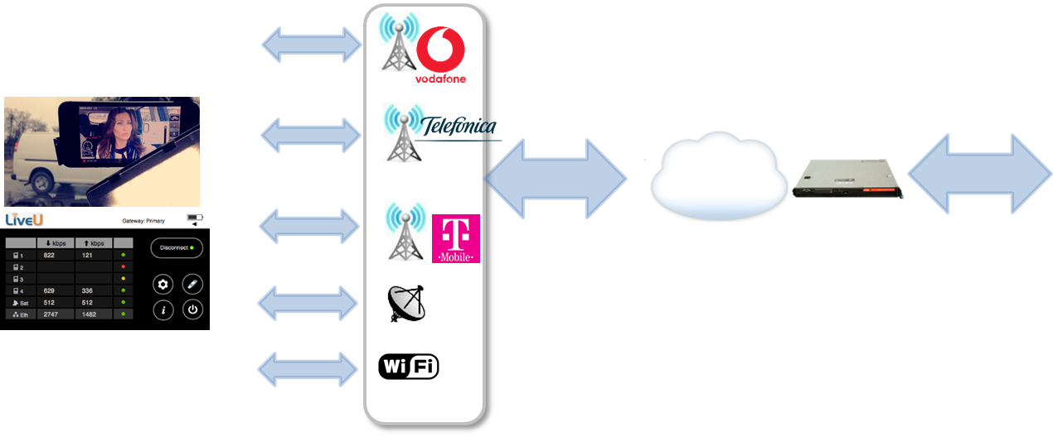
Organisation Profile
LiveU technology enables broadcast quality (4K) live video transmission from the field over multiple cellular and other networks
Installed in the majority of broadcast and media networks worldwide
Advanced IP Cloud-based product portfolio & services
Used for high speed data and security applications
50%+
global market share
~30
Patents
2,000
end customers
LiveU multi-link
bonding software
(from an App to a
Dedicated device)
Physical/Cloud Server
Public Internet
Member in: H2020 5-Xcast, Celtic Health^5G, M2MGrid, PrestoCloud, Nubomedia, FP7 Medieval, …
Multiple 5G/LTE/3G,
Any IP network
www.celticplus.eu TeleMove, Rony Ohayon, LiveU

Slide 4

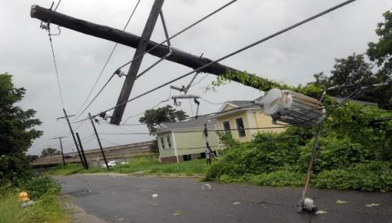
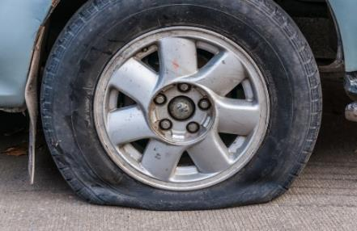
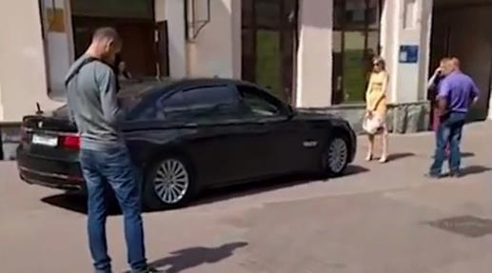

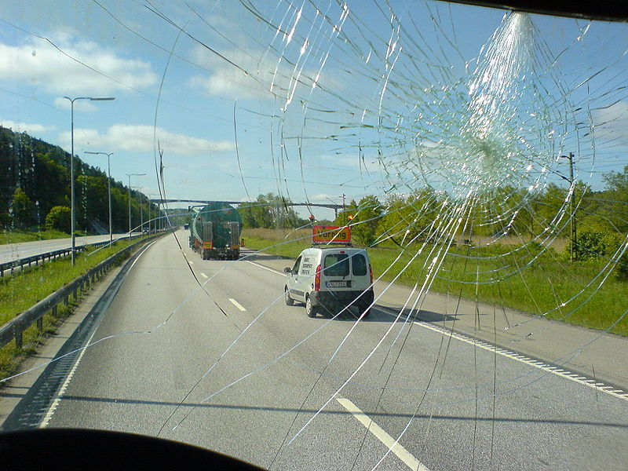
How to Overcome Rare Scenarios?
Proposal Introduction (1)
www.celticplus.eu TeleMove, Rony Ohayon, LiveU

Slide 5

Telemove Introduction (1)
Remote driving of various vehicles (trucks, busses, cars) is needed in order to handle the unexpected and during the long transition period to more autonomous vehicles
Exact use cases, complex environments, multi-parameters scenarios
The “right” way to solve the problem is not identified
How remote driving is done?
Holistic, from the remote driver through the vehicle to other road users
Extremely low latency, high bandwidth, everywhere, all the time, including emergencies
QoE for the remote driver, the passengers and other road users
Goal: Enable scalable, safe and effective remote assitsted driving of any vehicle, anywhere, whenever needed
www.celticplus.eu TeleMove, Rony Ohayon, LiveU

Slide 6
TeleMove Introduction (2)
Expected outcome
Best practices for scalable, safe and effective remote driving service, anywhere, anytime
In Communications, human factor, vehicle integration, interactions with other road users
Impact
Leadership and de-facto standard for remote driving
New business opportunities: globalize remote driving as a service
Accelerate and smooth the acceptance and transition of autonomous vehicles
Relay capabilities and limitations to the regulatory bodies, insurers, vehicular OEMs …
Schedule
3 years project
www.celticplus.eu TeleMove, Rony Ohayon, LiveU

Slide 7


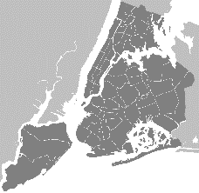



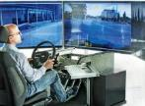


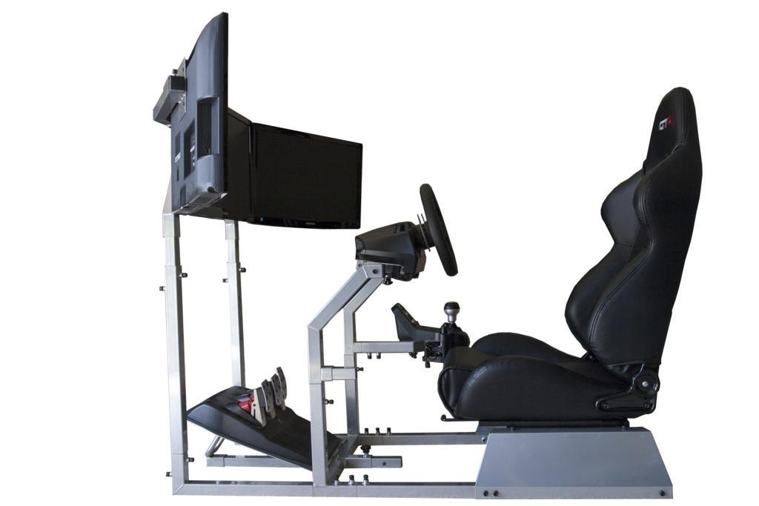


General architecture
Vehicle Telemetry
.
Vehicle Telemetry
Cellular A
.
.
.
.
.
.
.
.
.
Processing module
.
In-vehicle Data backbone
Cellular B
Drive Station Server
Sensors & AD system
Driving Assist Support Center
Sensors & AD system
Modem & Antenna Module
Cellular C
WiFi
In-vehicle
Communications Network
LiveU servers
User Services
Confidential & Proprietary

Slide 8
TeleMove Partners
New consortium
LiveU: multi-link bonded communication, video transmission, remote driving solution
Looking for:
Vehicular OEMs/Tier1s (trucks, busses, cars)
Vehicular drivers psychology researchers
Driving simulators and games developers
5G cellular operators, MEC
Drone/UAVs remote control rooms software vendors
AI researchers for remote assisted driving
www.celticplus.eu TeleMove, Rony Ohayon, LiveU

Slide 9

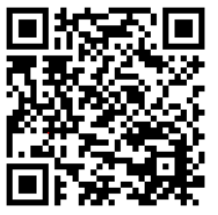
Contact Info
For more information and for interest to participate please contact:
Dr. Rony Ohayon
rony@liveu.tv
www.liveu.tv
Presentation available via:
www.tiny.cc/projectidea

Slide 10

Join the follow-up Telco
2nd of October 10-11 CET
For PSTN Access, dial +49-6221-905280
After or during the voice prompt,
dial 5-digit conference ID 32845
(using DTMF or softphone keypad)
For International access numbers http://vc.eurescom.eu/international-info.html
For Voip (SIP) Access, dial ac@eurescom.eu.
For help with Voip (SIP) client setup, http://vc.eurescom.eu/voip-info.html.
www.celticplus.eu office@celticplus.eu

