Slide 1
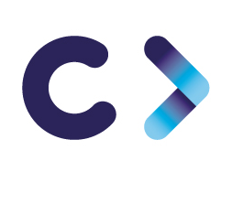

CELTIC-NEXT
Proposers Day
26th September 2018, Madrid
Pitch of the Project Proposal
DISTINGO
DISTributeurs INtelliGents recOnfigurables
(Reconfigurable Smart Lockers)
David Excoffier – Ambient Computing Research Program Manager
david.excoffier@orange.com

Slide 2

Teaser
Create a new generation of lockers providing smart, innovative & dynamic services for users
Extend the B2B/B2C business fields to B2B2C and C2C (collaborative economy)
Extend the locations capabilities of such transactional platforms from dense urban areas only to rural areas too
Offer the capabilities to everyone to share/sale/buy objects and goods of any kind
Extend the services offer and thus, the possible markets differently for each locker
Exploit the capabilities of a safe/secured/auditable marketplace to manage supply&demand in an innovative way.
www.celticplus.eu DISTINGO, David Excoffier, Orange, david.excoffier@orange.com
Notes:
What makes the added value?
Why should I participate in the project?

Slide 3
Organisation Profile
Orange is a telecom operator present in over 30 countries in Europe, Middle East and Africa.
➔ for more information visit www.orange.com
www.celticplus.eu DISTINGO, David Excoffier, Orange, david.excoffier@orange.com
Notes:
1 slide:
Very short info about the profile of your organisation,

Slide 4

Proposal Introduction (1)
Create a disruptive generation of lockers providing smart, innovative & dynamic services :
Each compartment of locker is going to be equipped with a diversity of sensors / actuators and can offer to change dynamically its nature and the services offered according to what it contains / what the applicant wishes / what the sensors / actuators present allow. For example:
Fine-grained detection of objects put in a locker
Passage detection: Counting the number of people in one direction and in the other, hourly, daily, monthly statistics .
Users/ passersby Profiling : direction of passage, sex, age, ... with or without anonymisation
Smarter services related to face/body detection: Welcoming someone who is approaching the locker, proposing a product that could be of interest for him and available in the locker (or in another nearby distributor) according to his usage history/the weather/his way of dressing; knowing if he is in a good mood or not; Use facial recognition as a means of payment ...
Development of these new services will expand & improve currently available solutions on the market, thanks to:
- Fog Computing which will allow services to be deployed across the entire infrastructure and not just in the cloud, limiting data exchanges to the strict minimum, and optimally using all infrastructure equipment for execution, communications and storage of services to be provided.
- Recognition technologies which will notably help to automatically detect and recognise objects dropped off in the lockers, and to offer new high added-value services both for the individual and manufacturers and local authorities.
- Blockchain technology for strong decentralised transaction traceability (commercial and technical) without a trusted third party, and for creating a secured decentralised auditable marketplace to manage users’ supplies & demands.
www.celticplus.eu DISTINGO, David Excoffier, Orange, david.excoffier@orange.com
A new generation of lockers to provide smart, innovative & dynamic services:
Each compartment of locker is going to be equipped with a diversity of sensors / actuators and can offer to change dynamically its nature and the services offered according to what it contains / what the applicant wishes / what the sensors / actuators present allow. For example:
Fine-grained detection of objects put in a locker
Passage detection: Counting the number of people in one direction and in the other, hourly, daily, monthly statistics .
Users/ passersby Profiling : direction of passage, sex, age, ... with or without anonymisation
Smarter services related to face/body detection: Welcoming someone who is approaching the locker, proposing a product that could be of interest for him and available in the locker (or in another nearby distributor) according to his usage history/the weather/his way of dressing; knowing if he is in a good mood or not; Use facial recognition as a means of payment ...
Development of these new services will expand & improve currently available solutions on the market, thanks to:
- Fog Computing which will allow services to be deployed across the entire infrastructure and not just in the cloud, limiting data exchanges to the strict minimum, and optimally using all infrastructure equipment for execution, communications and storage of services to be provided.
- Recognition technologies which will notably help to automatically detect and recognise objects dropped off in the lockers, and to offer new high added-value services both for the individual and manufacturers and local authorities.
- Blockchain technology for strong decentralised transaction traceability (commercial and technical) without a trusted third party, and for creating a secured decentralised auditable marketplace to manage users’ supplies & demands.
Notes:
1 slide:
Short info what the idea/proposal is about
(vision, motivation, content)

Slide 5
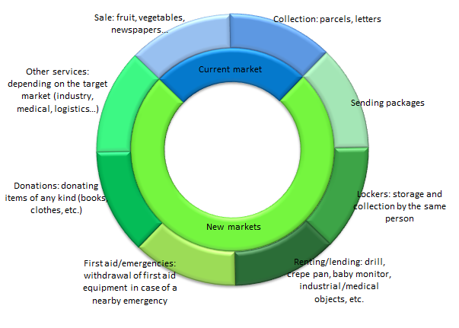
Proposal Introduction (2)
Create new market opportunities & new business models
www.celticplus.eu DISTINGO, David Excoffier, Orange, david.excoffier@orange.com
Notes:
1 slide:
Short info on expected outcome, impacts, schedule

Slide 6
Partners
France: Orange, RENZ, ryax technologies, Université Grenoble-Alpes
Turkey: Building up
Belgium: Building up
Spain: Building up
Looking for partners:
  Objects Recognition/semantics startups/SMEs: AI/Vision/scanning/other tech
  Lockers Manufacturers & Logistics
  Hardware & Mecatronics providers: sensors, Sharing HW
  Software providers: BigData, mobile App, Fog Computing Middleware, Cyber-Physical Security
  Universities and Research Institutes
www.celticplus.eu DISTINGO, David Excoffier, Orange, david.excoffier@orange.com

Slide 7

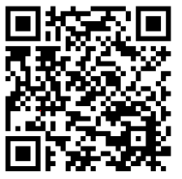
Contact Info
For more information and for interest to participate please contact:
David Excoffier
david.excoffier@orange.com
+33 6 59 38 69 42
28 chemin du Vieux Chêne
38240 Meylan - France
http://www.orange.com
                Presentation available via:
                www.tiny.cc/projectidea

Slide 8

Join the follow-up Telco
1th of October 13-14 CET
For PSTN Access, dial +49-6221-905280
After or during the voice prompt,
dial 5-digit conference ID 32845
(using DTMF or softphone keypad)
For International access numbers http://vc.eurescom.eu/international-info.html
For Voip (SIP) Access, dial ac@eurescom.eu.
  For help with Voip (SIP) client setup, http://vc.eurescom.eu/voip-info.html.
www.celticplus.eu office@celticplus.eu

