Slide 1



CELTIC-NEXT
Proposers Day
26th September 2018, Madrid
Pitch of the Project Proposal
QuickAIDive
David Castells-Rufas
Universitat Autònoma de Barcelona
david.castells@uab.cat

Slide 2

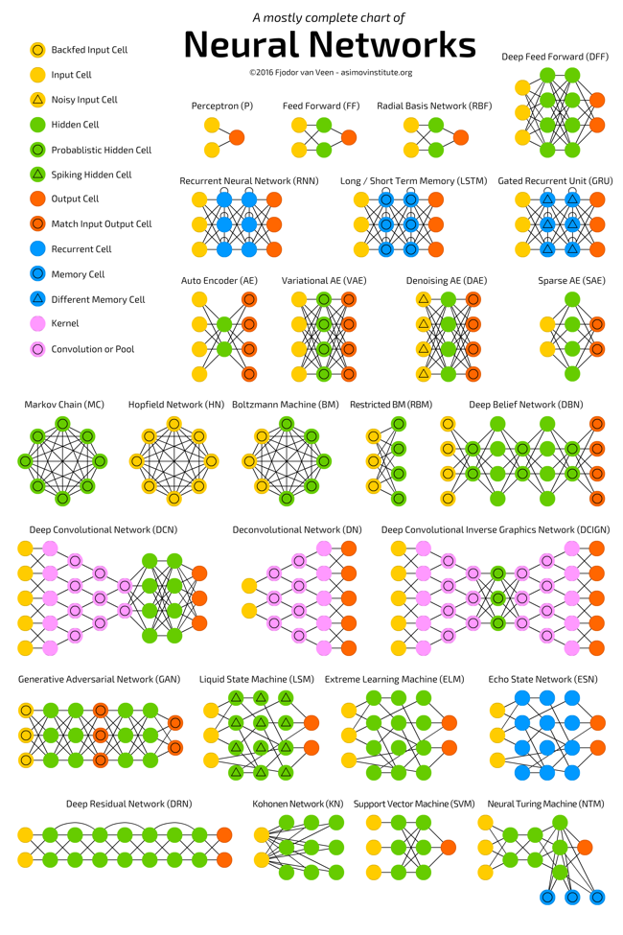
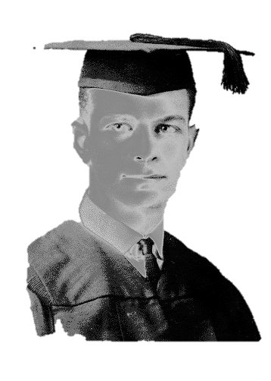
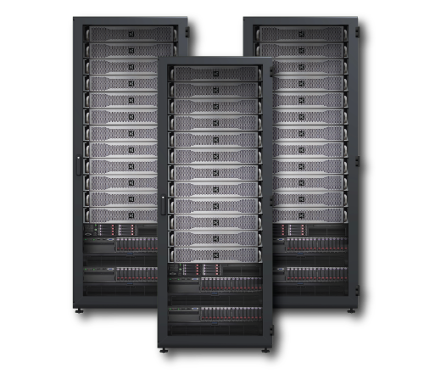
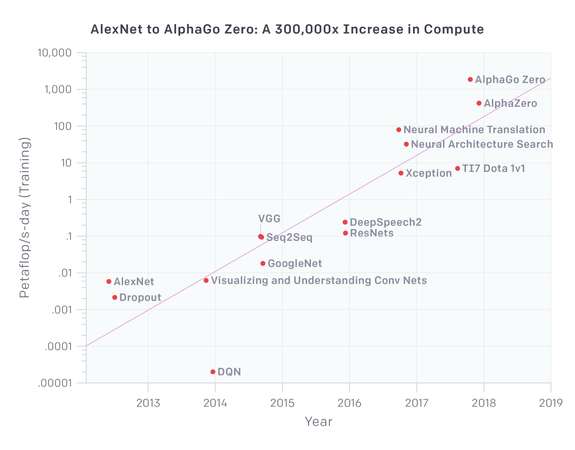
Easy AI entry for industry
Many Industries and SMEs already see the need of Deep-Learning
Roadblocks for adoption
  Lack of experts
  Design Complexity
  Computing Power (CPU years)
Benefits for the final user:
  overcome the roadblocks
Why you should join?
  Academia: Improve the SoA on Deep-Learning
  Industry & SMEs: Benefit from existing knowledge and future developments
HPC
Cloud
AI experts
Current Deep Neural Network architectures
www.celticplus.eu QuickAIDive, David Castells-Rufas, Universitat Autònoma de Barcelona, david.castells@uab.cat

Slide 3




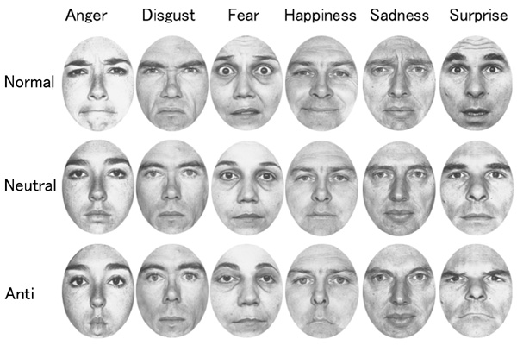
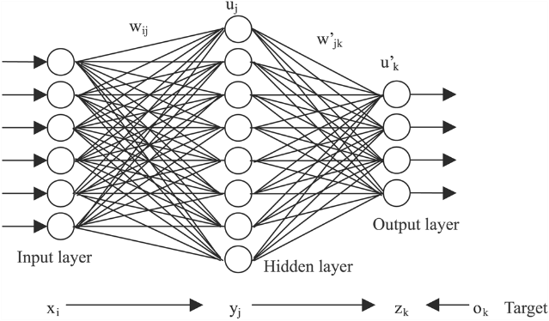
Idea
Do I have to hire a Deep Learning Expert ??
What design should I use??
Cloud
Based
Platform
Should I buy a cluster to train the network?
www.celticplus.eu QuickAIDive, David Castells-Rufas, Universitat Autònoma de Barcelona, david.castells@uab.cat

Slide 4

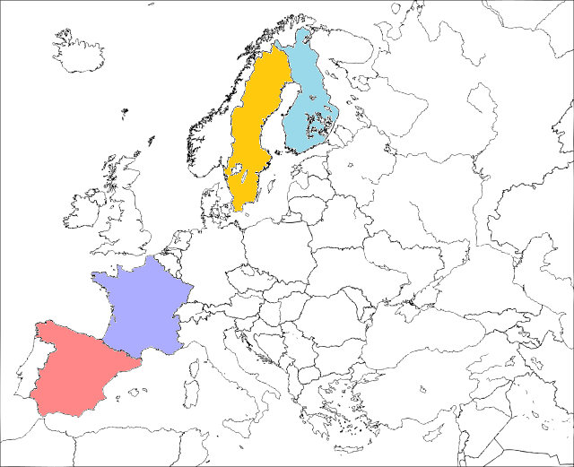



Partners
Spain
  UAB (University)
  KOSTAL (Industry)
  Automotive Components
France
  INRIA / ENS-Lyon (University)
Sweeden
  MDH (University)
Finland
  JYU* (University)
Looking for:
  Cloud providers
  Industrial beneficiaries of the technology
www.celticplus.eu QuickAIDive, David Castells-Rufas, Universitat Autònoma de Barcelona, david.castells@uab.cat

Slide 5
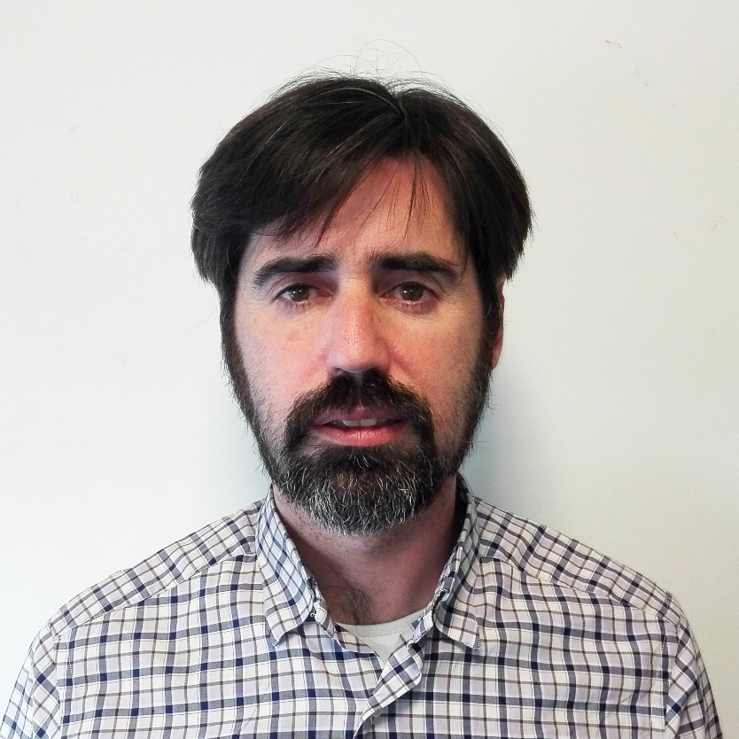
Contact Info
For more information and for interest to participate please contact:
David Castells-Rufas
david.castells@uab.cat
+34 93 581 3358
QC2034, Edifici Enginyeria,
Campus UAB, 08193 Bellaterra, Spain
http://grupsderecerca.uab.cat/cephis/

Slide 6
Extra Slides

Slide 7
The Service
DNN Architecture Selection
Execution
Context Requirements
Stimuli
DNN Design Service
Training
User
Platform Optimized DNN
Optimization
Execution Platform

Slide 8
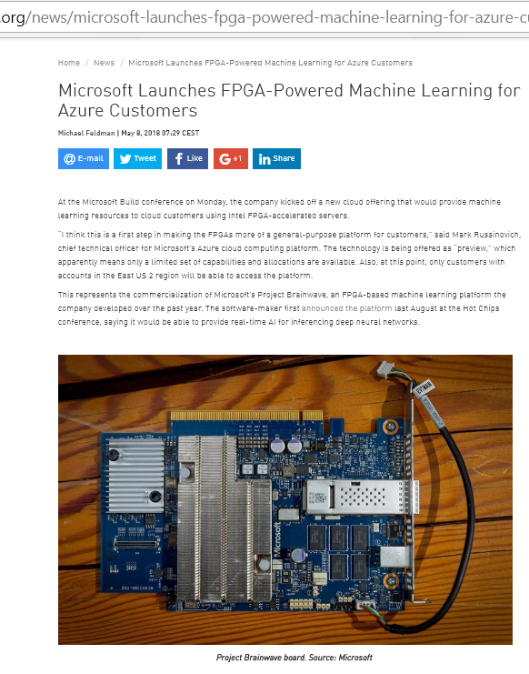
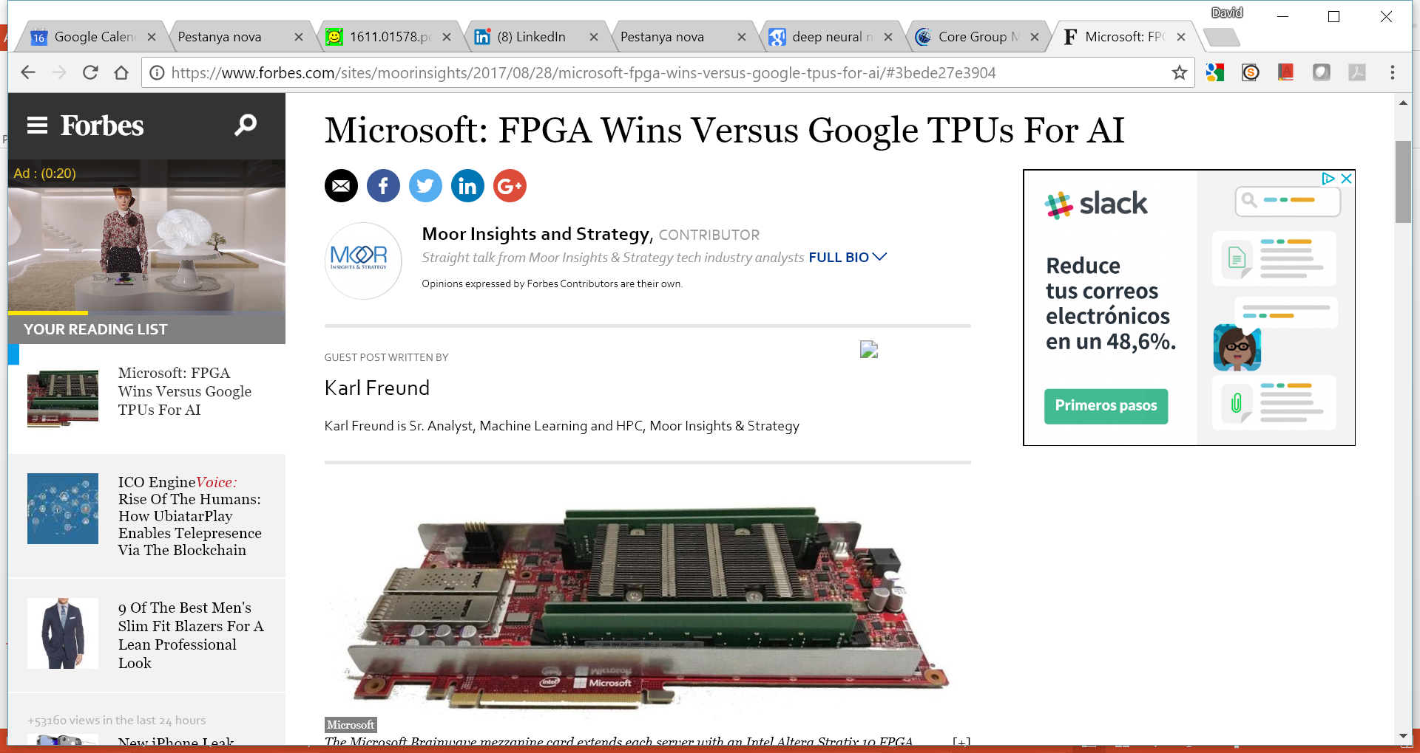
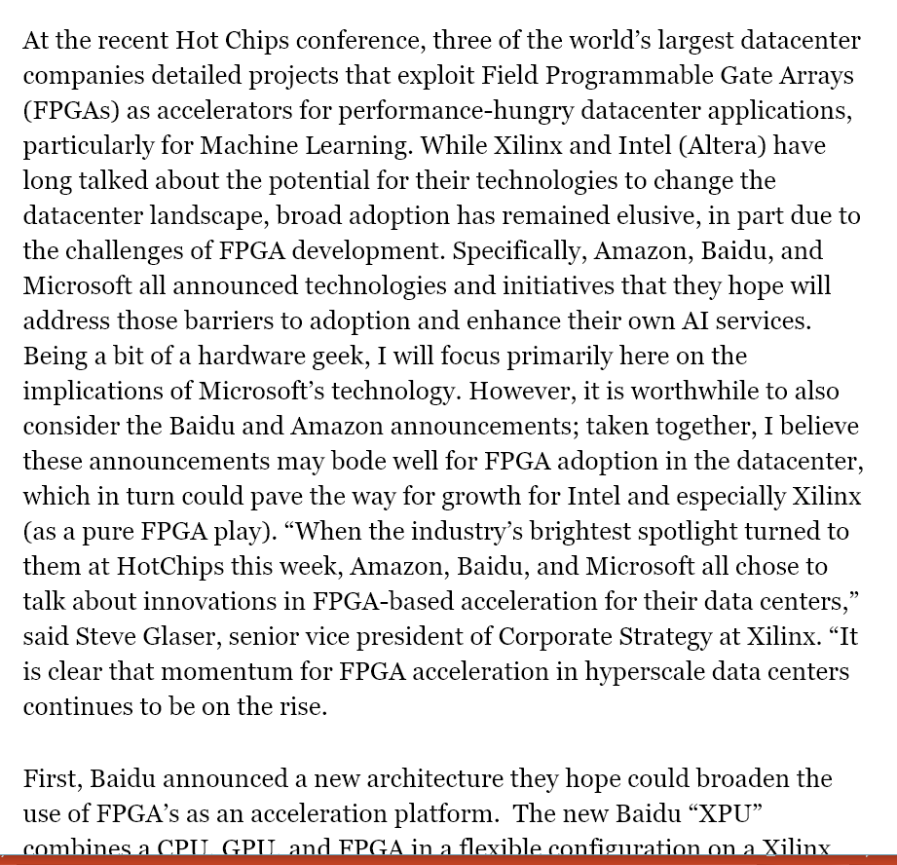
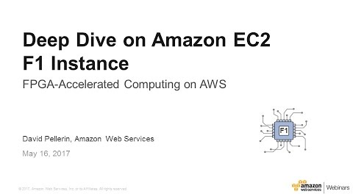
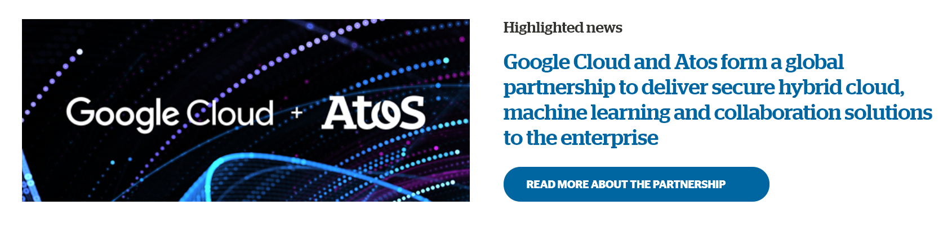
Why Heterogeneous Cloud?
Performance
Energy Efficiency

