Slide 1




CELTIC-NEXT
Proposers Day
26th September 2018, Madrid
Pitch of the Project Proposal
eCoolTour
Joaquín Mª Fernández
joaquin.fernandez@irdetec.com

Slide 2




Organisation Profile
12+ years of experience working for 200+ clients in 400+ projects already developed. Our 250+ engineers are at our clients’ disposal to help them solve complex IT challenges.
Two specialized development centers and two additional project management offices, we serve clients all over Europe and South America.
Education
Govern
Media
Non Profit
Retail
Tech Services
Telecom
Travel
www.celticplus.eu eCoolTour

Slide 3



Teaser
Technology-based Tourism Services: a dysfunctional arena
Tourists lost in a maze of an excess of offering which they can hardly discriminate
DMO heavily investing in data and services that most frequently do not reach general public
ICT developers restlessly providing brand-new solutions and perpetually REINVENTING THE WHEEL.
www.celticplus.eu eCoolTour

Slide 4




Proposal Introduction (1)
In this scenario main strategic objectives of eCoolTour are:
Build a single access point to a broad offering tourism services/data and their corresponding technology-based touristic services (TTS) in a specific geographical area
Open to final users a significant amount of public-owned data resources related to tourism that so far are overwhelmingly unknown by both final users and developers community.
Supply Public Administrations involved in tourism planning and management (DMO) with a BigData-based tool to asses and improve the touristic offering in their area of responsibility.
Coordinate developments made by technology-based tourism services providers, synchronizing individual efforts and avoiding redundancies.
www.celticplus.eu eCoolTour

Slide 5
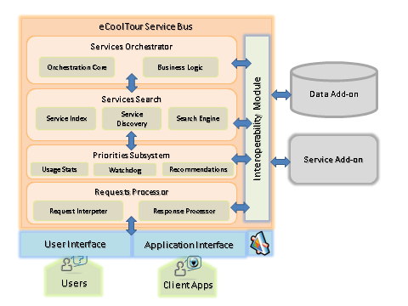
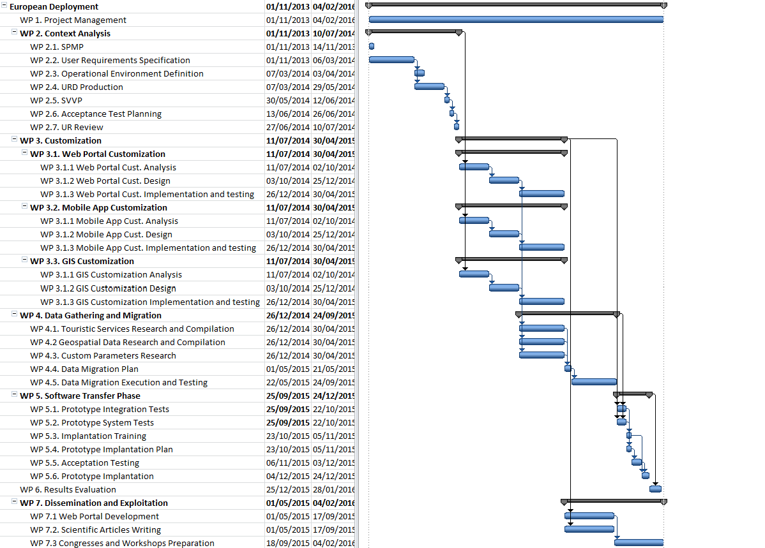
Proposal Introduction (2)
Architecture
Components/WPs
Data Management System
Schedule
Services Interoperability Module
Services Search and Request
Services Orchestrator
Knowledge Management System
Transactions Management System
User Interfaces
www.celticplus.eu eCoolTour

Slide 6
Partners
Partner??
Data Management System
Data storage/Data processing, specifically in:
Aerial imagery gathering & processing,
Remote sensing technologies,
IoT data gathering & processing
Cultural Content,
Unstructured Data Bases
Services Interoperability Module
Data Management System
Services Search and Request
Services Search and Request
Knowledge Management System
Services Orchestrator
Knowledge Management System
Extensive and relevant
experience in Big Data analysis
User Interfaces
Extensive and relevant
experience in Blockchain solutions
Transactions Management System
www.celticplus.eu eCoolTour

Slide 7
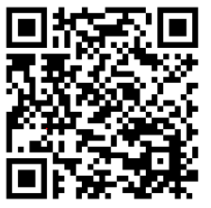
Contact Info
For more information and for interest to participate please contact:
Joaquin M. Fernández
joaquin.fernandez@irdetec.com
Manuel Giménez
mgimenez@emergya.com
34 954 517577
c/Luis de Morales 32
41018-Sevilla
www.emergya.com
                Presentation available via:
                www.tiny.cc/projectidea

Slide 8

Join the follow-up Telco
1st of October 16 CET
For PSTN Access, dial +49-6221-905280
After or during the voice prompt,
dial 5-digit conference ID 30702
(using DTMF or softphone keypad)
For International access numbers http://vc.eurescom.eu/international-info.html
For Voip (SIP) Access, dial ac@eurescom.eu.
  For help with Voip (SIP) client setup, http://vc.eurescom.eu/voip-info.html.
www.celticplus.eu office@celticplus.eu

