Slide 1


Towards a sustainable connected world
Dr Kostas Katsaros
Head of Technology – Future Networks & 5G
18 September 2024 – CelticNext Proposer’s Day

Slide 2
Outline
Introduction
IMT-2030 Scenarios and Capabilities
Sustainable 6G
Key Enablers (Native AI & Multi-Access)
CelticNext Flagship - SUSTAINET

Slide 3


Slide 4

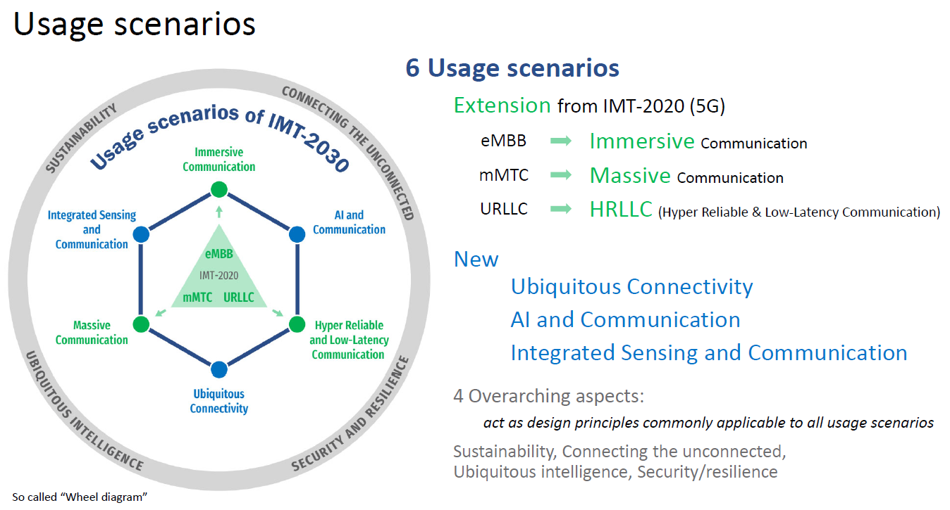

IMT-2030 (aka 6G) Scenarios
Source: ITU

Slide 5
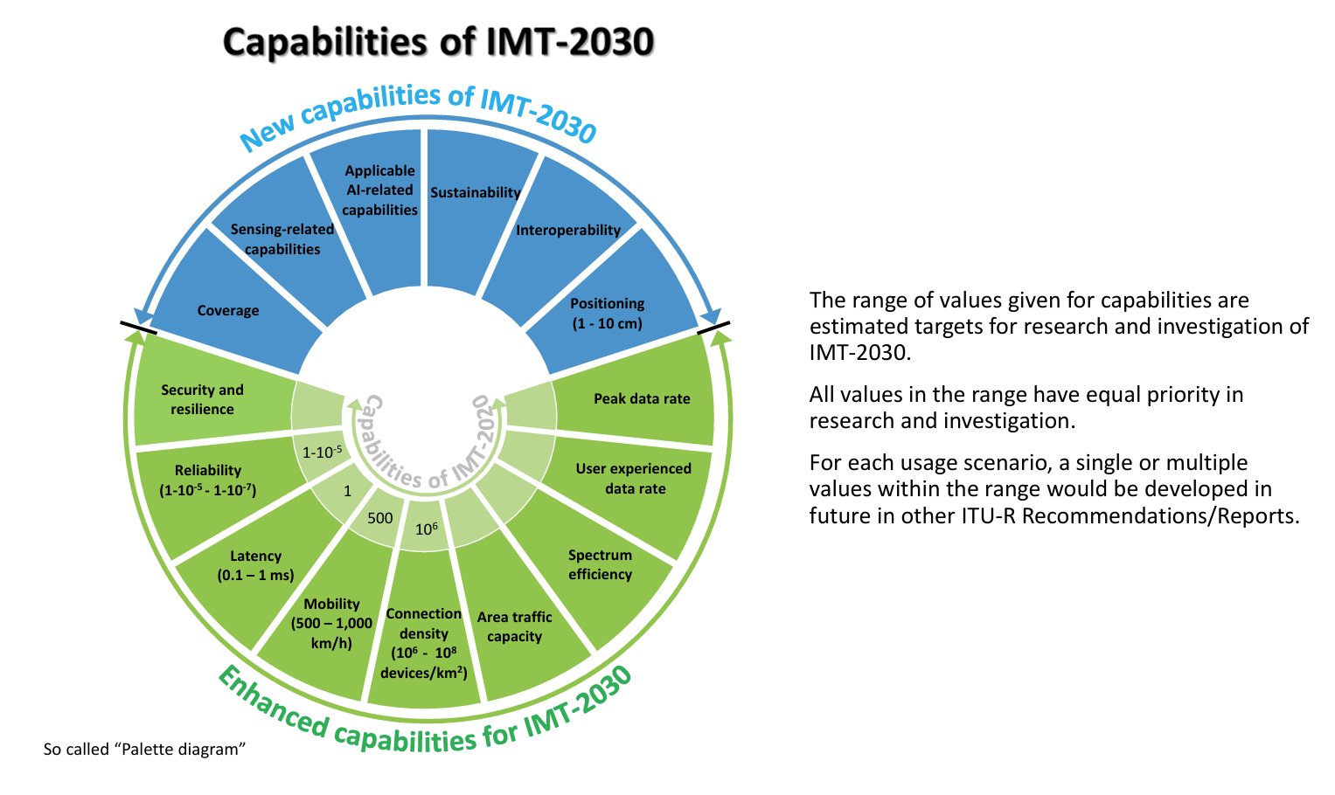
IMT-2030 (aka 6G) Capabilities
Source: ITU

Slide 6
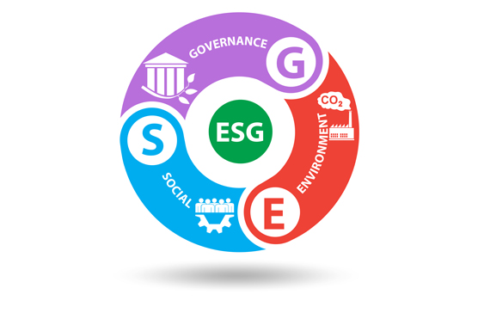

From KPIs to KVIs
KPIs
Latency,
Capacity,
Energy
Intelligence
Primitives
Scalability
KVIs
Sustainability,
Agility
Network Sensing
Inclusion,
Trust, …
User Experience
Performance

Slide 7
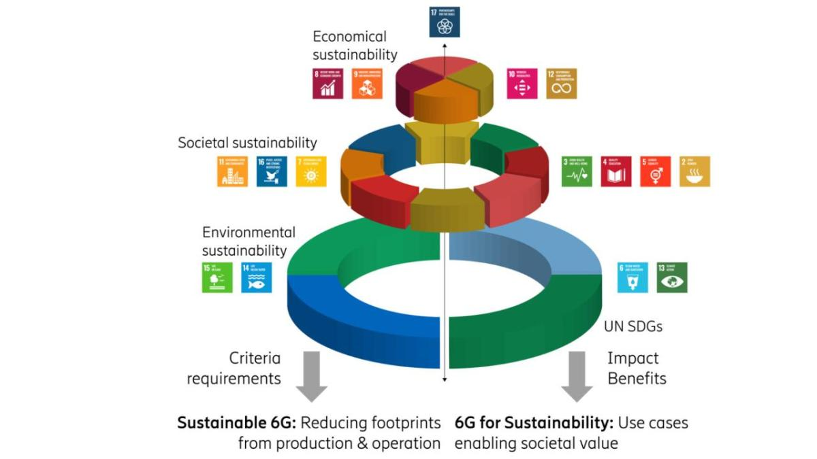
Sustainable 6G
Source: Ericsson
Notes:
Sustainable 6G
6G networks need to minimize any negative impact on sustainability. This objective means that the direct lifecycle impact from building and running networks should be minimized across environmental, social, and economic sustainability domains. Resource consumption is the focus here in terms of energy and material, but also any other impact from production processes and from using the systems and services. It must be clear that this is not just an ambition, but demands a real commitment to optimize networks for reduced negative impact beyond fulfilling regulatory requirements. Moreover, technology must be anchored in society to be socially sustainable, meaning that the use of resources is well motivated and explained.
6G for sustainability
6G networks should contribute to an overall sustainable development in society by enabling the transformation of other sectors than just ICT. This objective means that 6G networks should be designed to support existing or novel activities to enable a positive sustainability impact to produce benefits when scaled across society. Equally important would be to avoid any usage with adverse effects. Here it’s important to consider that there may even be a need to move away from certain use cases if they are identified to have a negative impact on society.

Slide 8
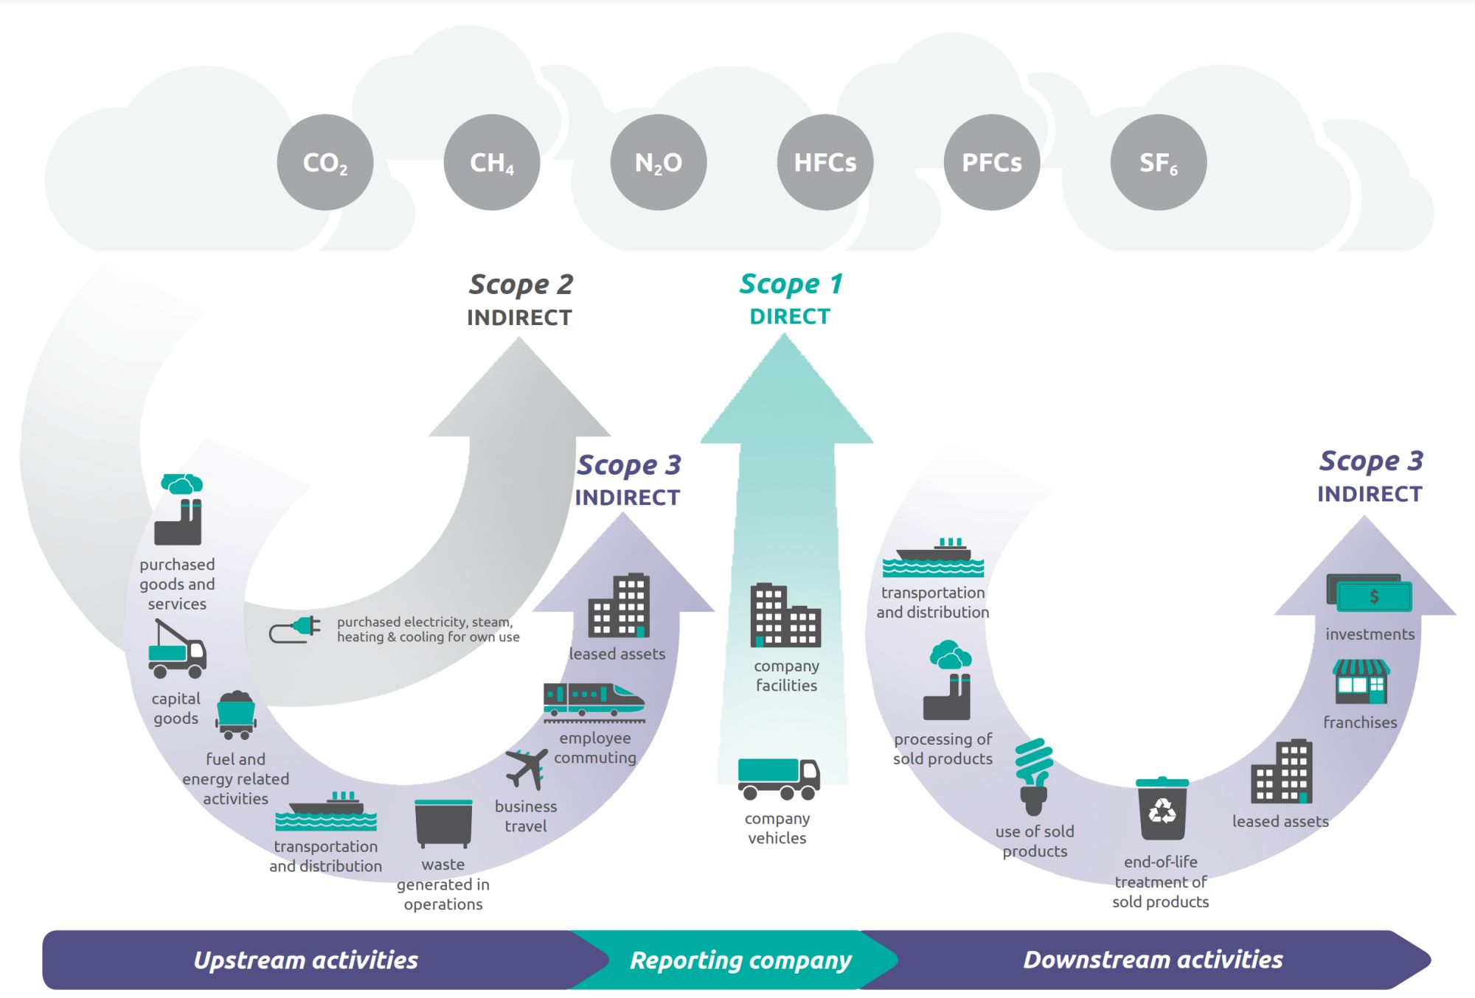
Telco GHG Emissions
Source GHG Protocol
Notes:
Deloitte predicts that telcos worldwide will be able to reduce their carbon footprint by 2%, or 12 million tons of carbon dioxide equivalent (CO2e) in 2024 and do the same again in 2025.¹ The telco industry is not a particularly egregious emitter: It connects over 95% of the planet’s people over wired and wireless networks and yet is directly responsible for only about 1.6% of 2022’s global emissions of 37 billion tons CO2e, or about 600 million tons.²

Slide 9
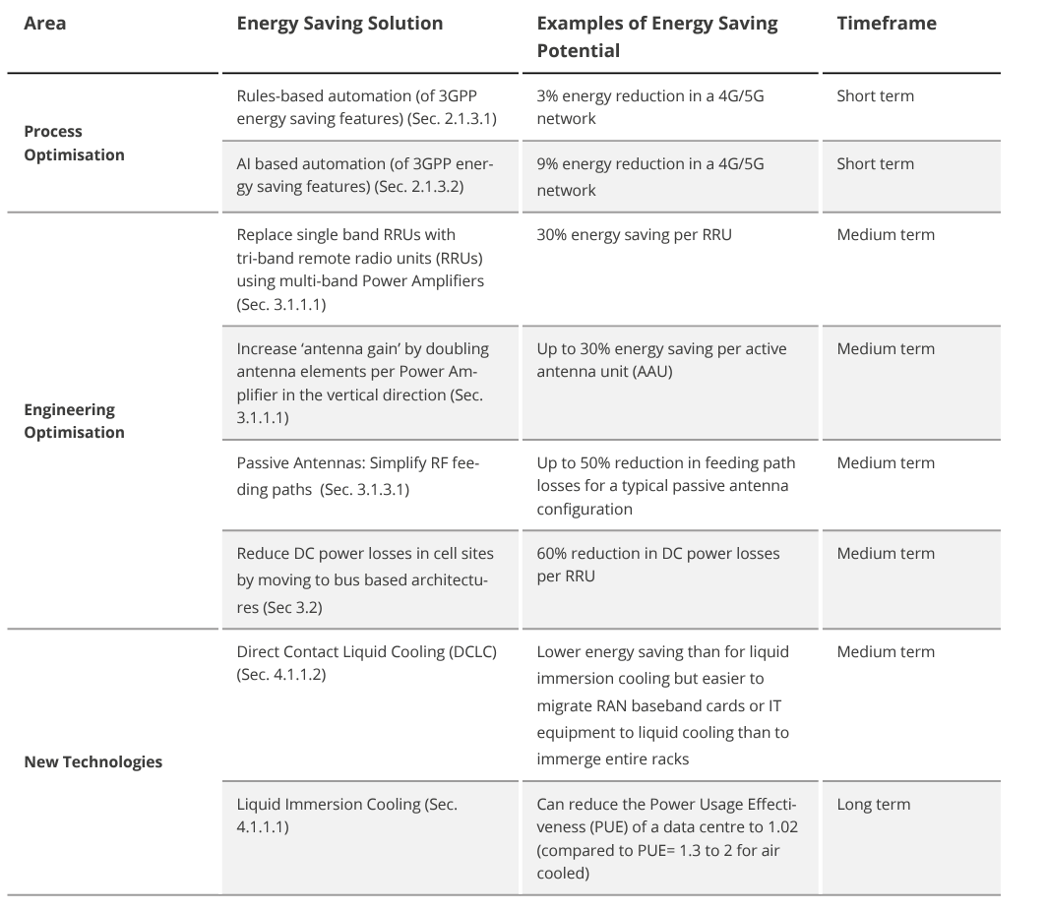
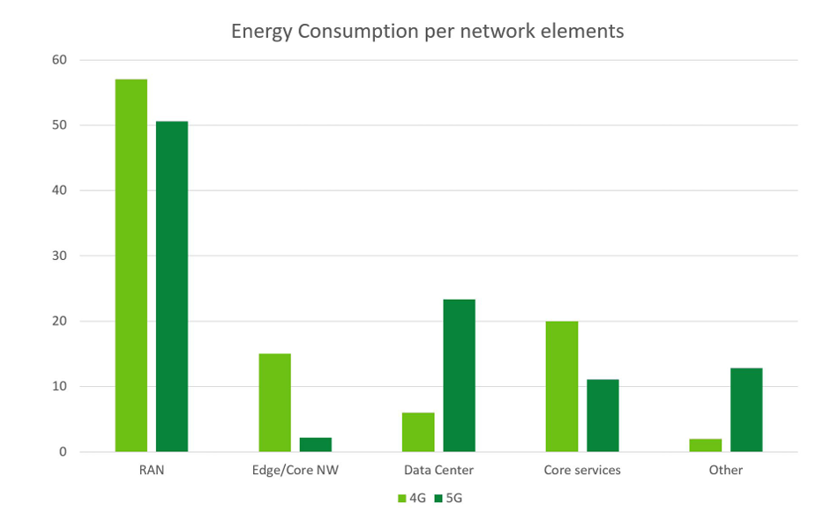
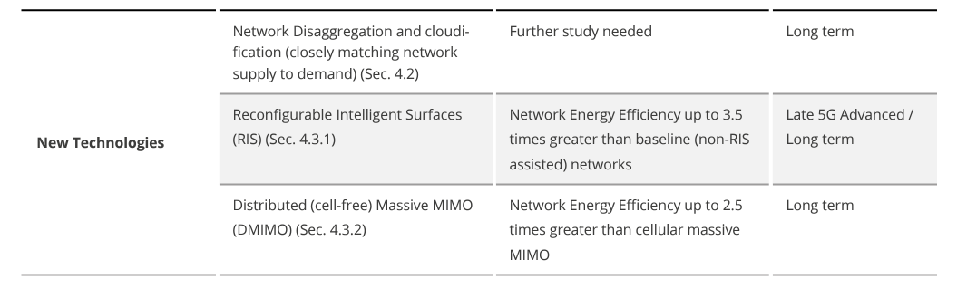
Energy Consumption in Telecoms & roadmap
Source: NextG Alliance
Source NGNM
Notes:
Copper wire and 3G Network switch-off
6G wireless communication systems can be designed to be energy efficient in many ways, including:
Energy-aware traffic management: This method uses data compression and aggregation to reduce the amount of data transmitted, which lowers energy requirements.
Energy-efficient communication protocols: These protocols can help achieve zero energy IoT.
Adaptive power management: This technique can help reduce energy consumption.
Edge computing: This method can help reduce energy consumption by processing data locally.
Sleep and wake-up mechanisms: These mechanisms can help achieve zero energy IoT.
Advanced energy monitoring and optimization algorithms: These algorithms can help improve energy efficiency.
Turning off components: 6G networks can turn off components and scale down capacity when demand is low.

Slide 10




Key Technology Enablers for 6G
AI – Native Networks
Spectrum Technologies
AI-Native Air interface
Split / Federated Learning
Integrated Sensing & Comms
Distributed Intelligence
Cognitive Automation
Security & Trust
Notes:
AI for 6G, using AI technology to improve network performance and 6G for AI, providing AI as a service by the network as a whole.
Recently 6G discussions on vision and enabling technologies have become hot topics in both industry and academia. AI for wireless has attracted even more research in the past few years. By now, it is well understood that AI can be useful to improve wireless network performance especially for tasks such as resource management, network planning and power saving where precise mathematical models are difficult to obtain. Standardization efforts are ongoing to facilitate these applications. Less conclusive is the application of AI in the physical layer design, even though we have seen various scenarios where AI can indeed improve the link level performance. Breakthrough research is needed in this area to warrant a radical new design. One the other hand, there are many usage scenarios being proposed for 6G, ranging from down to the earth 5G evolved use cases to over the moon (literally) space applications. In this talk, we will focus on AI as a service for 6G, in other words, 6G serves as a platform to provide distributed and collaborative AI learning and inference services. This is motivated by the proliferation of AI applications, data privacy concerns and regulations, as well as the need for real-time AI. The existing cloud base centralized AI learning model would not be scalable and sustainable, while on-device AI has limited computing capability and power. Distributed and collaborative AI is thus the key to large scale AI applications. A 6G network integrating sensing, communication, and computing would be a promising platform to support such distributed learning and inference AI services.

Slide 11
Key Technology Enablers for 6G
Multi-Access/Converged Connectivity
Low Band
mmWave
Low/Upper Mid-Band
LiFi
THz
Fixed
NTN
Spectrum Sharing
Optical
Unlicenced
ISAC
Notes:
Optimal selection per use case
Resilience
Capacity
Energy Efficiency
Security

Slide 12
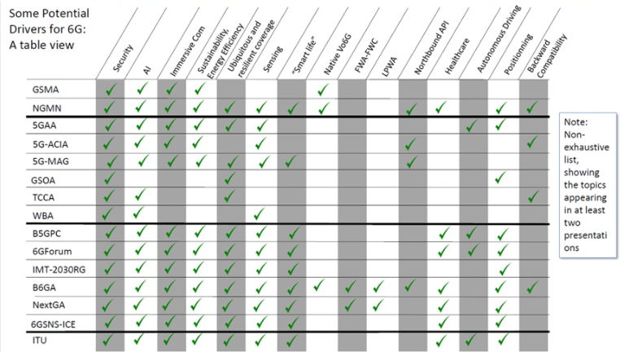
Key Drivers for 6G – findings from ITU Use Case Workshop – May 2024
Source: Free 6G Training

Slide 13
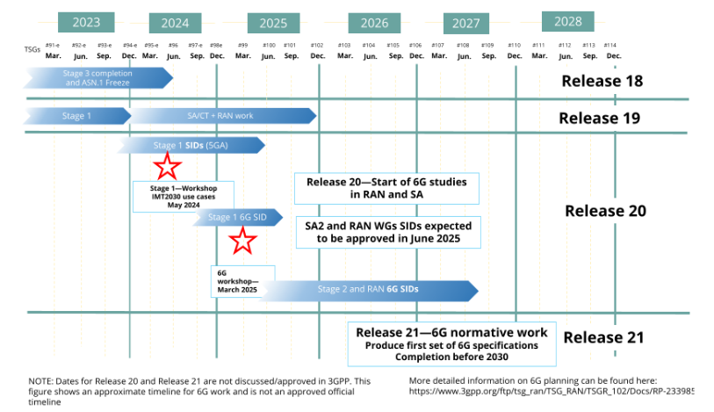
3GPP Rel-18 to Rel-21 timeline
Source: ABI

Slide 14




CelticNext Flagship – SUSTAINET
Sustainable Technologies for Advanced Resilient and Energy-Efficient Networks
SUSTAINET umbrella coordination
SUSTAINET promotes the development of sustainable, resilient, and energy-efficient telecommunication systems, ensuring connectivity of critical infrastructure, enterprise, and communities. It encourages collaboration of key players in the communication business to drive and demonstrate innovative solutions and readiness to contribute to the evolution of telecommunications infrastructure, targeting the integration and operation of future 6G networks.
Sustainable and resilient communication for enterprise, communication and energy networks
Security, AI-assisted network operation, data spaces
Trusted AI, Cyber-Resilience, Cloud, AI Network Automation, SmartGrid, indirect sustainability, multi-vendor interoperability and vendor-neutrality …
Frictionless, secure, and resilient networks for the dynamic digital world
Smart and sustainable Critical infrastructures / cities / grid
Trusted AI, Security
Data sharing, data spaces, labs

Slide 15
SUSTAINET common research topics
Control and monitoring of the telecommunications network
Monitoring and sensing in telecommunications networks
AI-assisted network operation
Dependencies between telecommunications infrastructure and power supply
Smooth digital full interconnection
Sustainable and energy-efficient increase in transmission capacity
Cybersecurity aspects
Increasing the resilience of critical infrastructures
Increasing energy efficiency and sustainability
Convergence of telecommunications networks
Automation, zero-touch

Slide 16
Thank You!
Dr Kostas Katsaros
Kostas.Katsaros@digicatapult.org.uk
CelticNext Brokerage Event – 18 Sept 2024 - London

Slide 17


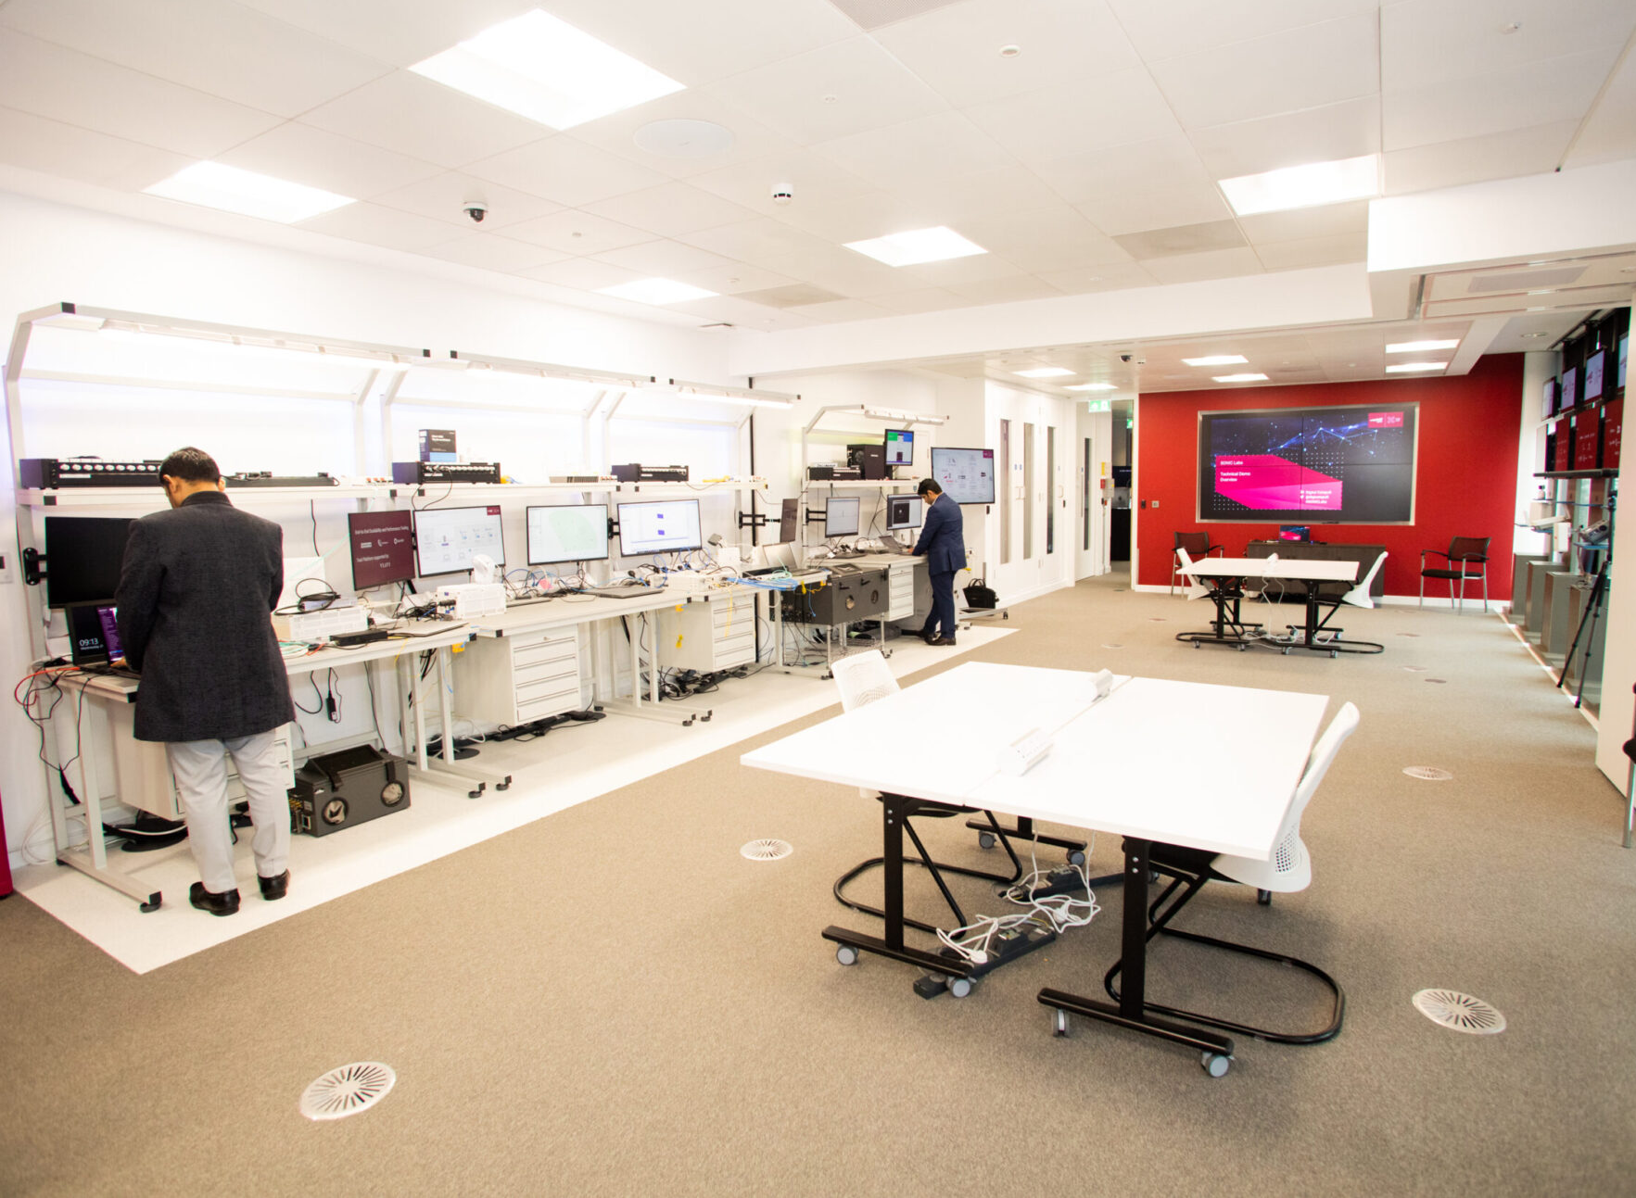
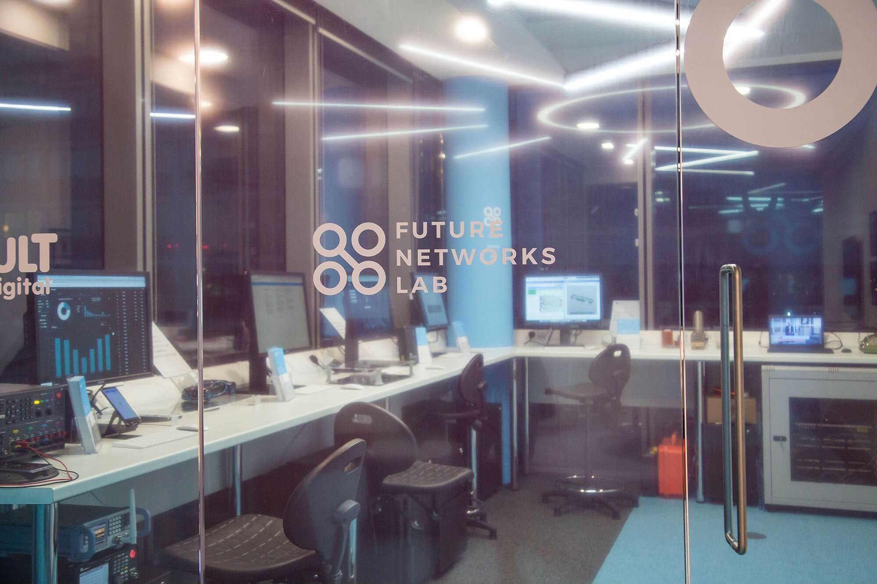
Visit DC Labs

