Slide 1




CELTIC-NEXT
Proposers Brokerage Day
24th February 2025, Barcelona
Pitch of the Project Proposal
EO-CARBON
Martyna Gatkowska, PhD, RadScan
mgatkowska@radscan.com

Slide 2

Teaser
Problem identified: difficulty in monitoring of carbon sequestration and detecting and preventing carbon leakage from agriculture
.
Why is this a problem: OECD’s Report states that combating CC require significant steps towards decreasing carbon footprint in the agricultural sector
State-of-the-art: there is no tool, which in operational way could estimate carbon sequestration on the farm/ region / country level; carbon leakage is not monitored and thus may deepen the problem.
Proposed solution: Smart System for Monitoring and Estimating Carbon Storage and leakage in Agriculture Using Satellite Data – towards Carbon Tax for agriculture sector
www.celticnext.eu Martyna Gatkowska, PhD, RadScan, gatkowskamartyna@gmail.com

Slide 3


RadScan Profile
Since 2023, RadSCAN has been collaborating with Maspex to develop a suite of solutions focused on precision agriculture. This collaboration centers on creating pathogen detection solutions through a sensor fusion approach, integrating IoT sensors, in situ measurements (spectroradiometric), and satellite data. Together with Maspex, a database is being built to support experimental fields, including those cultivating durum wheat. RadSCAN is a spin-off company established by the Space Technology Centre AGH as part of the commercialization of research and industrial use of STC's laboratory and computational infrastructure.
www.celticnext.eu Martyna Gatkowska, PhD, RadScan, gatkowskamartyna@gmail.com

Slide 4

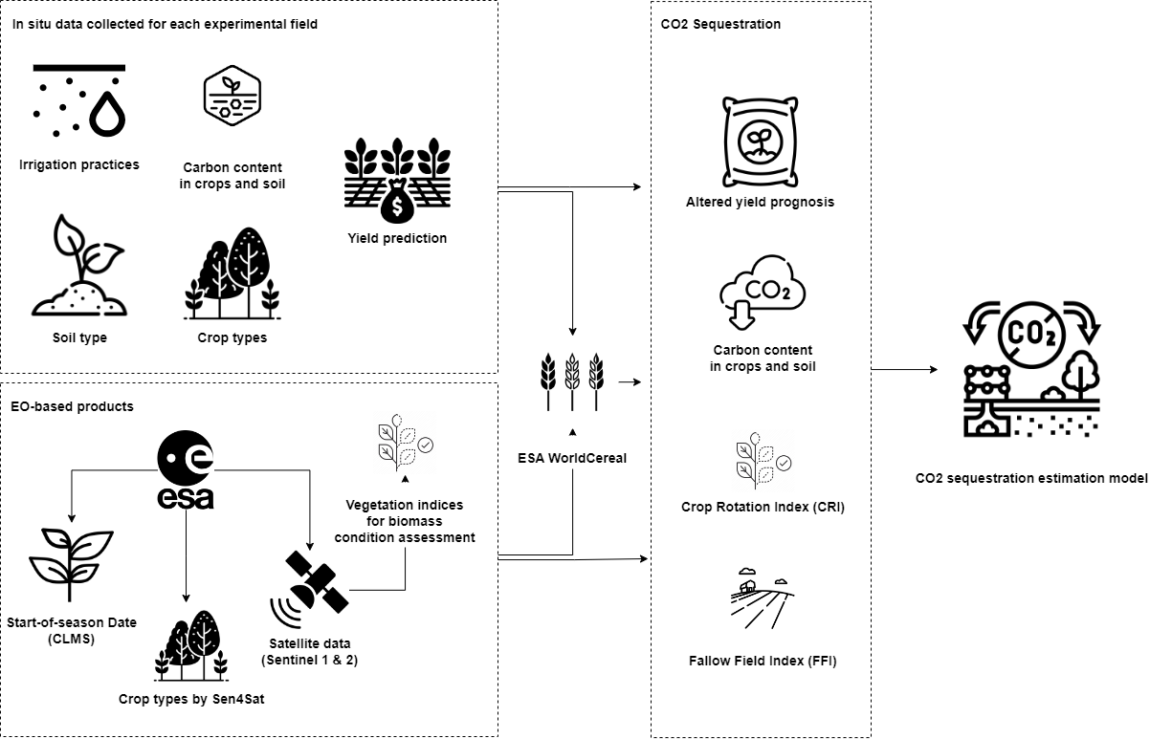
Proposal Introduction (1)
GOAL: deliver and validate the system for dynamic yield forecast of selected crops as well as estimation of carbon sequestration and carbon leakage, which is closely related to the achieved yield and agricultural practices.
KERs: yield estimation and carbon sequestration and leakage
Input data: EO-data and other sources of data (such as: IoT, in-situ, meteorological data, available documents etc.).
www.celticnext.eu Martyna Gatkowska, PhD, RadScan, gatkowskamartyna@gmail.com

Slide 5
Proposal Introduction (2)
The Key Exploitable Results of the proposed project will consist of:
the AI-based model for forecasting of crops yield based on regular observation of parameters impacting the final yield
The AI-based model estimates carbon leakage resulting from agricultural practices, integrating advanced data analytics, machine learning, and environmental modeling.
A model for estimating carbon sequestration relies on data obtained from the two models above, combining insights on field management practices, including factors such as soil tillage frequency and the number of days with exposed soil but also applying the model with the input of soil moisture from the model using Sentinel-1 and biomass and meteorological data from ground meteorological stations.
the System, applying aforementioned methods for forecasting yield of selected crops, on the basis of variable information;
Expected lenght of the project: 24 – 36 months
www.ce lticnext.eu Martyna Gatkowska, PhD, RadScan, gatkowskamartyna@gmail.com

Slide 6
Partners
Leader: RadSCAN/AGH
Partners: Researchturk Space Co. (Turkey)
People in Need (Czech Rep.) to be confirmed
Expertise needed:
Experts on agriculture with the access to experimental fields
Meteorological Offices
Soil experts
www.celticnext.eu Martyna Gatkowska, PhD, RadScan, gatkowskamartyna@gmail.com

Slide 7
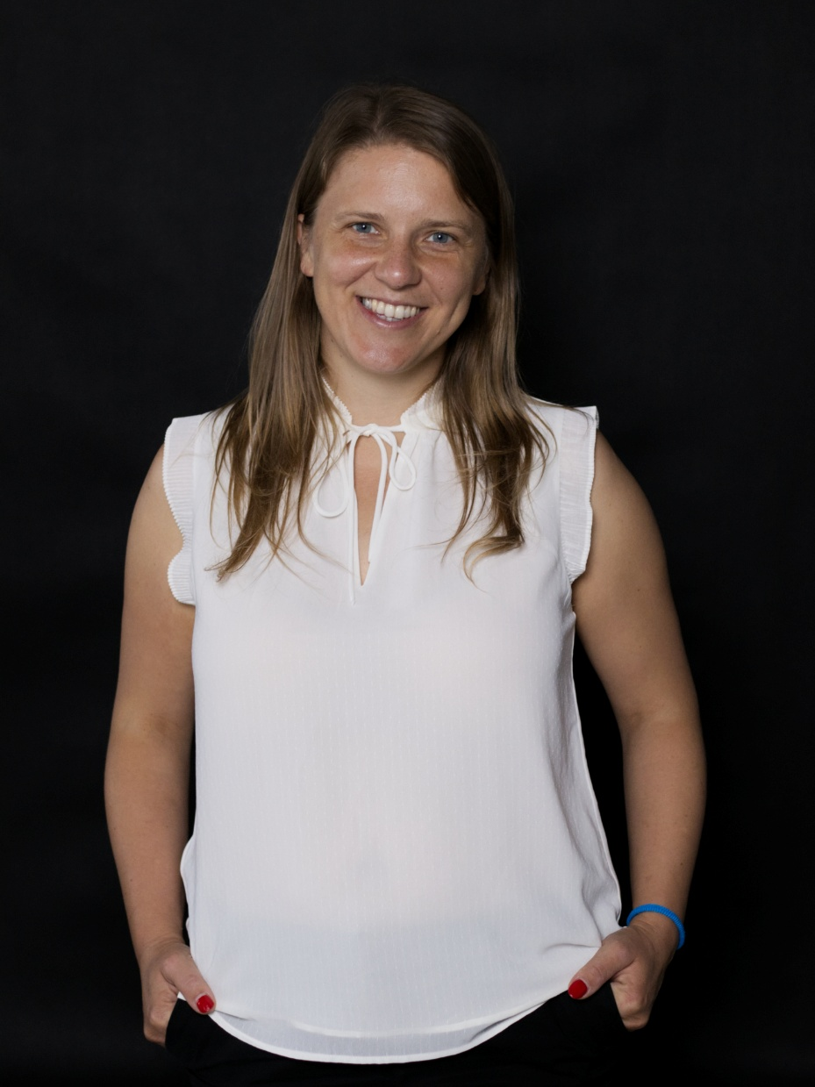

Contact Info
For more information and for interest to participate please contact:
Martyna Gatkowska, PhD, RadScan
gatkowskamartyna@gmail.com
Telephone: +48 516 125 265
Postal Address: Warsaw, Poland
Web (if available)
                Presentation is available via:

